Slide 1
Privacy Preserving Collaborative IDS for Internet of vehicle networks
Faculty Members: Student Members:
Mrs. Durga Hithesh Y
Mrs. Uma Saurabh Krishnan
Mrs. Anusuya
Mr. Praveen

Slide 2
Content:
Threat Model
Threat Matrix and Risk Matrix
Baseline Architecture
Model Architecture
Why FHE in FL
Security and Performance Report
HE Schemes

Slide 3
Baseline Architecture:
PHASE 1: INITIALIZATION:
1. Role : Central Server
2. Action : Init & Broadcast global model
3. Target : N Vehicles
4. Security : SecureChannel (ECDH + AES-256 + Mutual Auth)
PHASE 2: CLIENT SIDE
1. Inputs : CAN (1D-Conv) | V2X (MLP) | GPS/IMU (1D-Conv)
2. Fusion : 10Hz Sync → FiLM Gating → 46-dim Vector
3. Model : KANConvNet
4. Train : SGD + L2 Regularization
5. Adapt : Personalization Blend (Global + Local)
6.Privacy : L2 Clip (C=1.0) + Gaussian Noise (σ=1.2)

Slide 4
Baseline Architecture:
PHASE 3: SERVER AGGREGATION
1. Stage 1 : TOPSIS
Action : Dimensionality Reduction → Rank → Filter Outliers
3. Stage 2 : Multi-Krum
Action : Robust Clustering → Pairwise Distance → Average Top-m
PHASE 4: GA TUNING
1. Goal : Hyperparameter Optimization
2. Genes : {LR, Batch, Epochs, Momentum, Dropout, Optimizer, L2, α}
3. Flow : Init → Eval (F1) → Crossover → Mutate → Deploy

Slide 5
KanConvNet Architecture:
STAGE 1: INPUT
1. Source : Fused Telemetry
2. Shape : 46-dim Vector
3. Preprocess : Normalization / Fourier Transform
STAGE 2: MAPPING
1. Logic : Linear Transform + Fourier Encoding
2. Sequence : Precedes Linear Summation
STAGE 3: ACTIVATION
1. Type : Kolmogorov-Inspired Nonlinearity
2. Placement : Network Edges
3. Benefit : High Interpretability / Safety Audits

Slide 6
KanConvNet Architecture:
STAGE 4: HIDDEN LAYERS
1. Type : Intermediate Layers
2. Activation : ReLU
3. Goal : Spatial-Temporal Pattern Extraction
STAGE 5: OUTPUT
1. Map : Final Kolmogorov Activation
2. Classifier : SGD Prediction

Slide 7
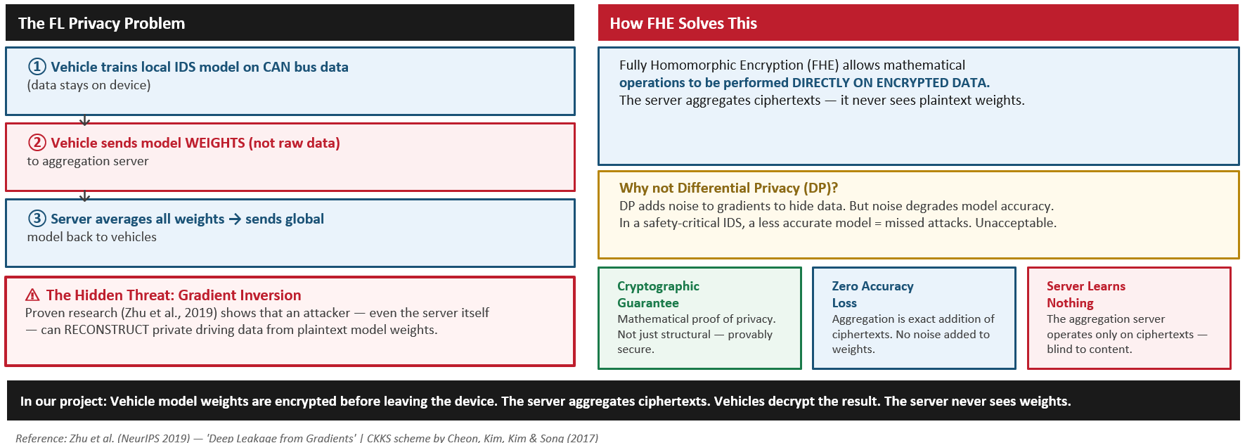
Why FHE in FL:

Slide 8
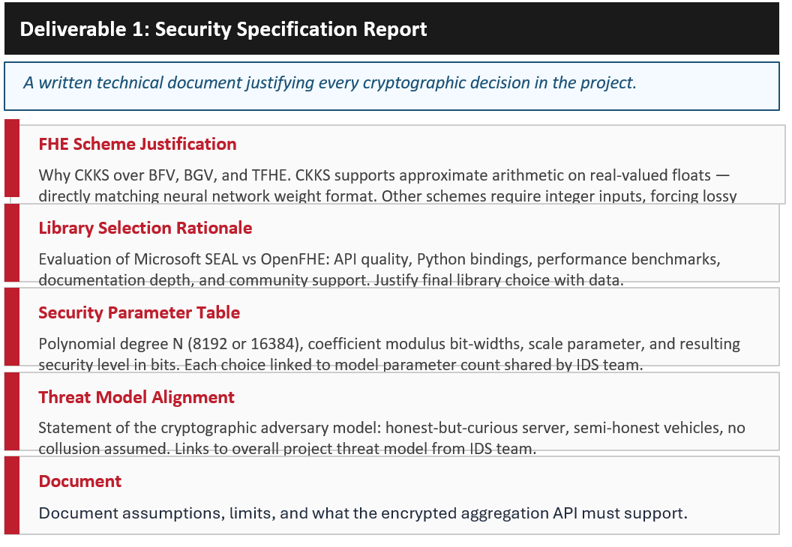
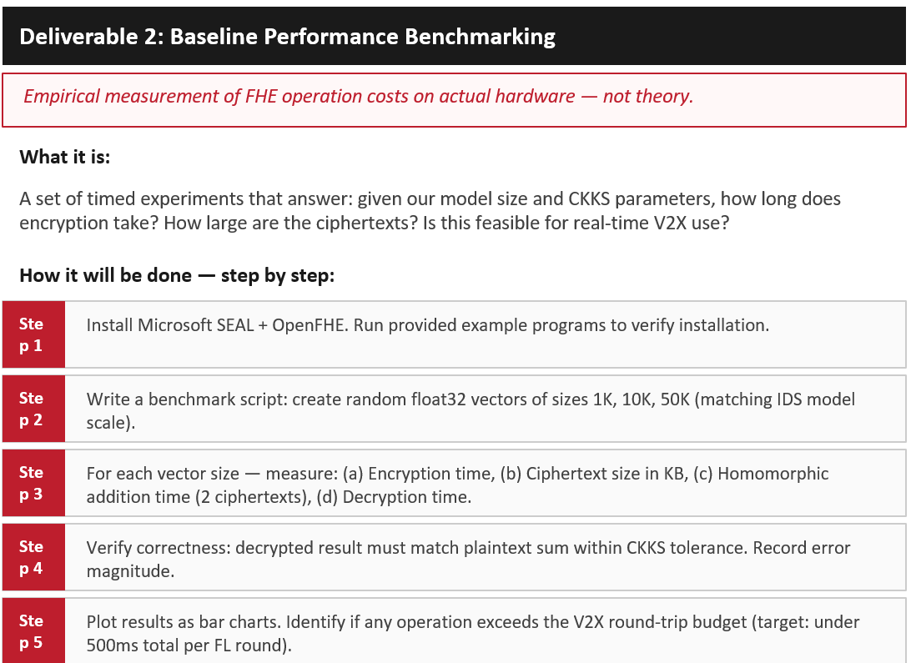
Security and Performance Report:

Slide 9
HE Scheme:
Scheme | Data Type | Top Strength | Main Limitation
BFV | Exact integers | Great for exact arithmetic and databases | Needs complex quantization for floats
BGV | Exact integers | Mature, strong integer support | Poor fit for float-valued model weights
CKKS | Approximate (Floats) | Best for neural networks & weighted sums | Requires careful error & parameter tuning
TFHE / FHEW | Bits / Boolean | Fast bootstrapping for small circuits | Way too slow for large vector aggregation
Hybrid | Mixed | Combines multiple schemes | High scheme-switching overhead
Threshold | Varies | Enables joint multi-party decryption | Unnecessary key-management complexity

