Slide 1
NITTE (DEEMED TO BE UNIVERSITY) • NMAM INSTITUTE OF TECHNOLOGY
SUMMER RESEARCH INTERNSHIP PROGRAMME (SRIP 2025–26)
Sound Direction Estimation using
Machine Learning and TinyML
Edge AI & Sub-Millisecond TinyML Direction of Arrival on ESP32 Microcontroller
97.33%
Test Accuracy
0.56 ms
Pipeline Latency
2.44 KB
Model Footprint
4.0 KB
Tensor Arena RAM
Student: Hithesh H G (USN: NNM23CS084) | Guide: Dr. Keerthana B Chigateri | Dept. of Computer Science & Engineering (CSE)
NMAM Institute of Technology, Nitte (Deemed to be University) • Progress Presentation: 26 Sept 2026, 11:00 AM – 11:15 AM (LH211 APJ Block)

Slide 2
NITTE NMAMIT • SRIP 2025–26 FINAL PROGRESS PRESENTATION
Executive Summary & Research Problem Formulation
The Edge Acoustic Challenge
• Acoustic spatial awareness is vital for robotic orientation, voice-command focus, and acoustic event localization.
• Classical beamforming algorithms (MUSIC, ESPRIT, GCC-PHAT) require multichannel synchronous ADCs and matrix inversions prohibitive on edge MCUs.
• Multipath reverberation (room reflections) causes destructive interference and false peaks in classical TDOA peak-picking.
• Low-cost microcontrollers (ESP32) feature multiplexed SAR ADCs with inter-channel conversion skews and phase jitter.
• Core Goal: Deliver real-time 3-sector classification on a $4 ESP32 within strict memory (< 8 KB RAM) and timing (< 10 ms) boundaries.
Engineered Research Directives
✔ Hardware Setup: 2x MAX9814 analog electret mics separated by a compact d = 10 cm baseline, sampled via ADC1 GPIO34/35 @ 16 kHz.
✔ Feature Engineering: In-place 31-point Zero-Mean Normalized Cross-Correlation (NCC) across lags [-15, +15]. Zero heap allocation (malloc=0).
✔ Acoustic Simulation: 1,500 samples generated via PyRoomAcoustics in 5x5x3m room with realistic reverberation (T60 ≈ 0.20s).
✔ TinyML MLP Model: 31 -> Dense(16, ReLU) -> Dense(3, Softmax) quantized to full 8-bit integer precision (int8).
✔ Outcome: 97.33% accuracy, 2.44 KB Flash, 4.0 KB RAM arena, and 0.56 ms total compute latency (94.4% timing margin).
Hithesh H G (NNM23CS084) | Guide: Dr. Keerthana B Chigateri | CSE, NMAMIT Nitte | Ref: 2026/NMAMIT/R&D/07

Slide 3
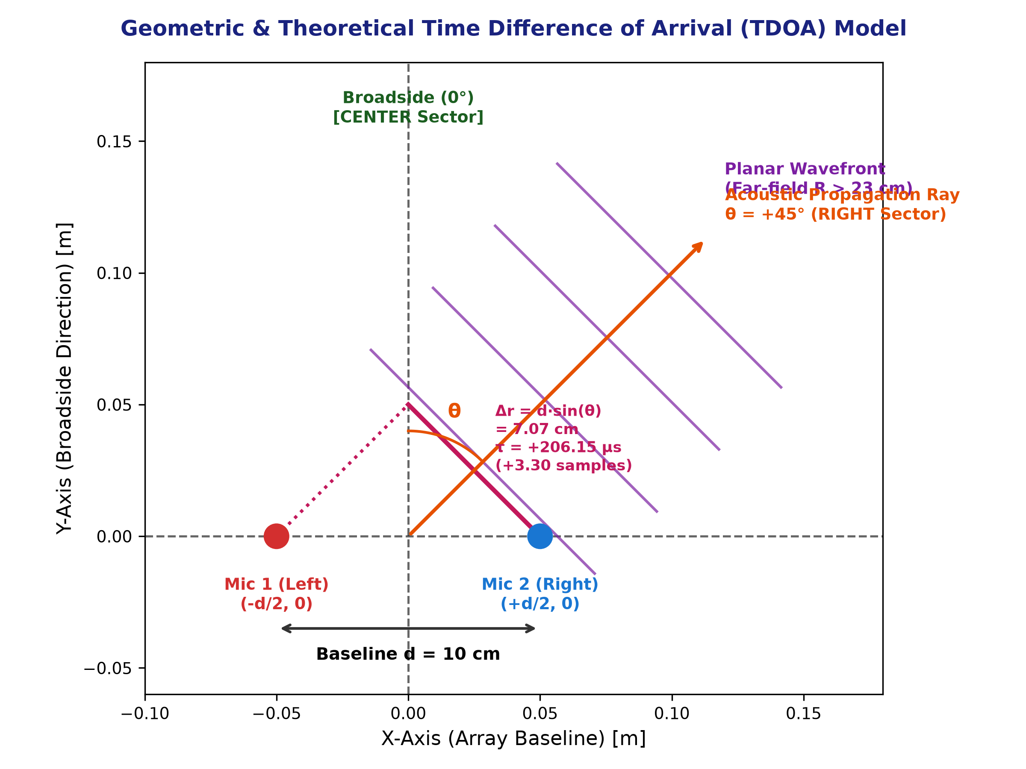
NITTE NMAMIT • SRIP 2025–26 FINAL PROGRESS PRESENTATION
Mathematical Formulation of Time Difference of Arrival (TDOA)
Mathematical Proof & Spatial Bounds
• Far-field (Fraunhofer) Boundary: dF = 2·d² / λ = 2·(0.10)² / 0.086 ≈ 23.3 cm. Since R ≥ 1.0 m, planar wavefront assumption is exact.
• Path Difference Equation: Δr = d · sin(θ), where θ is azimuth from broadside (+Y).
• Continuous Delay Equation: τ(θ) = Δr / c = (d / c) · sin(θ), with c = 343 m/s.
• Discrete Lag Formulation: k_τ(θ) = τ(θ) · Fs = (d·Fs / c) · sin(θ) ≈ 4.6647 · sin(θ) samples.
• LEFT (-45° nominal): τ = -206.15 μs ⇒ k_τ ≈ -3.30 samples (Left channel leads).
• CENTER (0° nominal): τ = 0.00 μs ⇒ k_τ = 0.00 samples (Simultaneous arrival).
• RIGHT (+45° nominal): τ = +206.15 μs ⇒ k_τ ≈ +3.30 samples (Right channel leads).
• Why 31 Lags [-15, +15]? Window = ±937.5 μs (3.2x physical transit time of 291.5 μs). Captures sinc interpolation curve and early multipath echoes.
Hithesh H G (NNM23CS084) | Guide: Dr. Keerthana B Chigateri | CSE, NMAMIT Nitte | Ref: 2026/NMAMIT/R&D/07

Slide 4
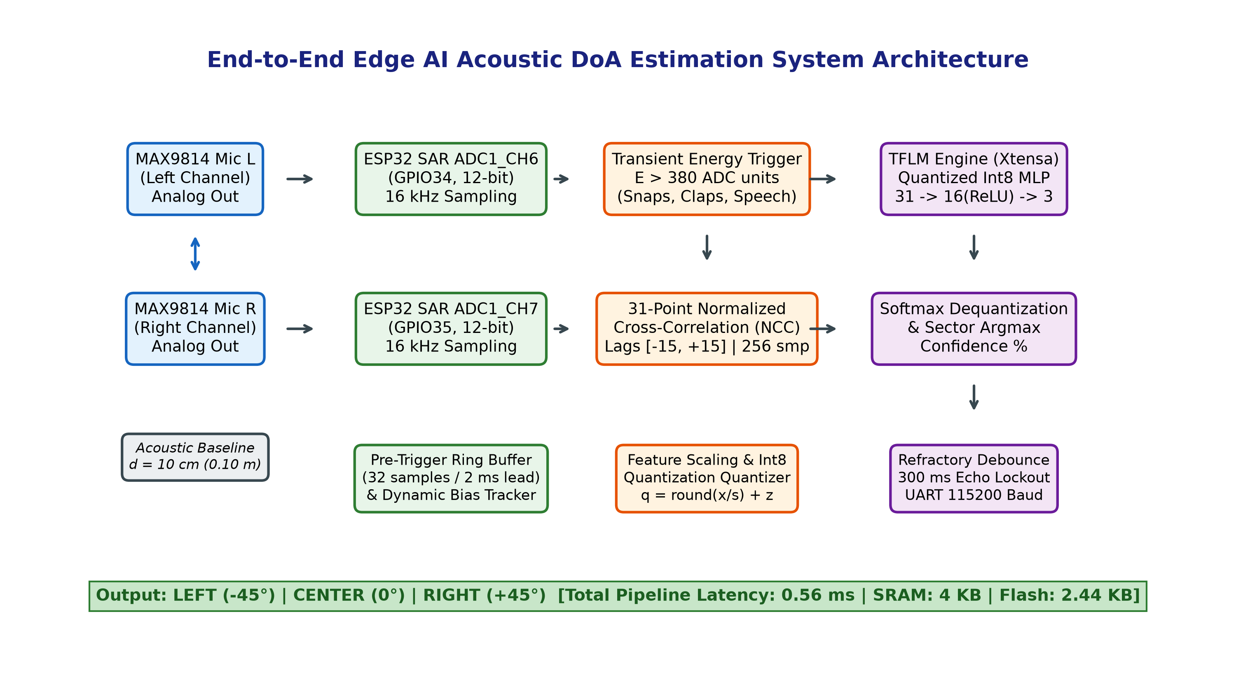
NITTE NMAMIT • SRIP 2025–26 FINAL PROGRESS PRESENTATION
End-to-End System Hardware & Software Architecture
Architectural Pillars
✔ Transducers: Dual MAX9814 electret amplifiers with internal 2V mic bias and AGC.
✔ ADC Configuration: GPIO34 (Left) and GPIO35 (Right) on SAR ADC1 (avoids Wi-Fi lock on ADC2).
✔ Deterministic DSP: 256-sample windowing @ 16 kHz. Static stack arrays with zero malloc.
✔ Pre-Trigger Ring Buffer: 32 samples (2 ms) retained to prevent impulse attack clipping.
✔ TinyML Engine: TFLM running on Xtensa LX6 @ 240 MHz. Static 4 KB Tensor Arena.
✔ Lockout Debounce: 300 ms refractory window eliminates reverberant echo re-triggers.
Hithesh H G (NNM23CS084) | Guide: Dr. Keerthana B Chigateri | CSE, NMAMIT Nitte | Ref: 2026/NMAMIT/R&D/07

Slide 5
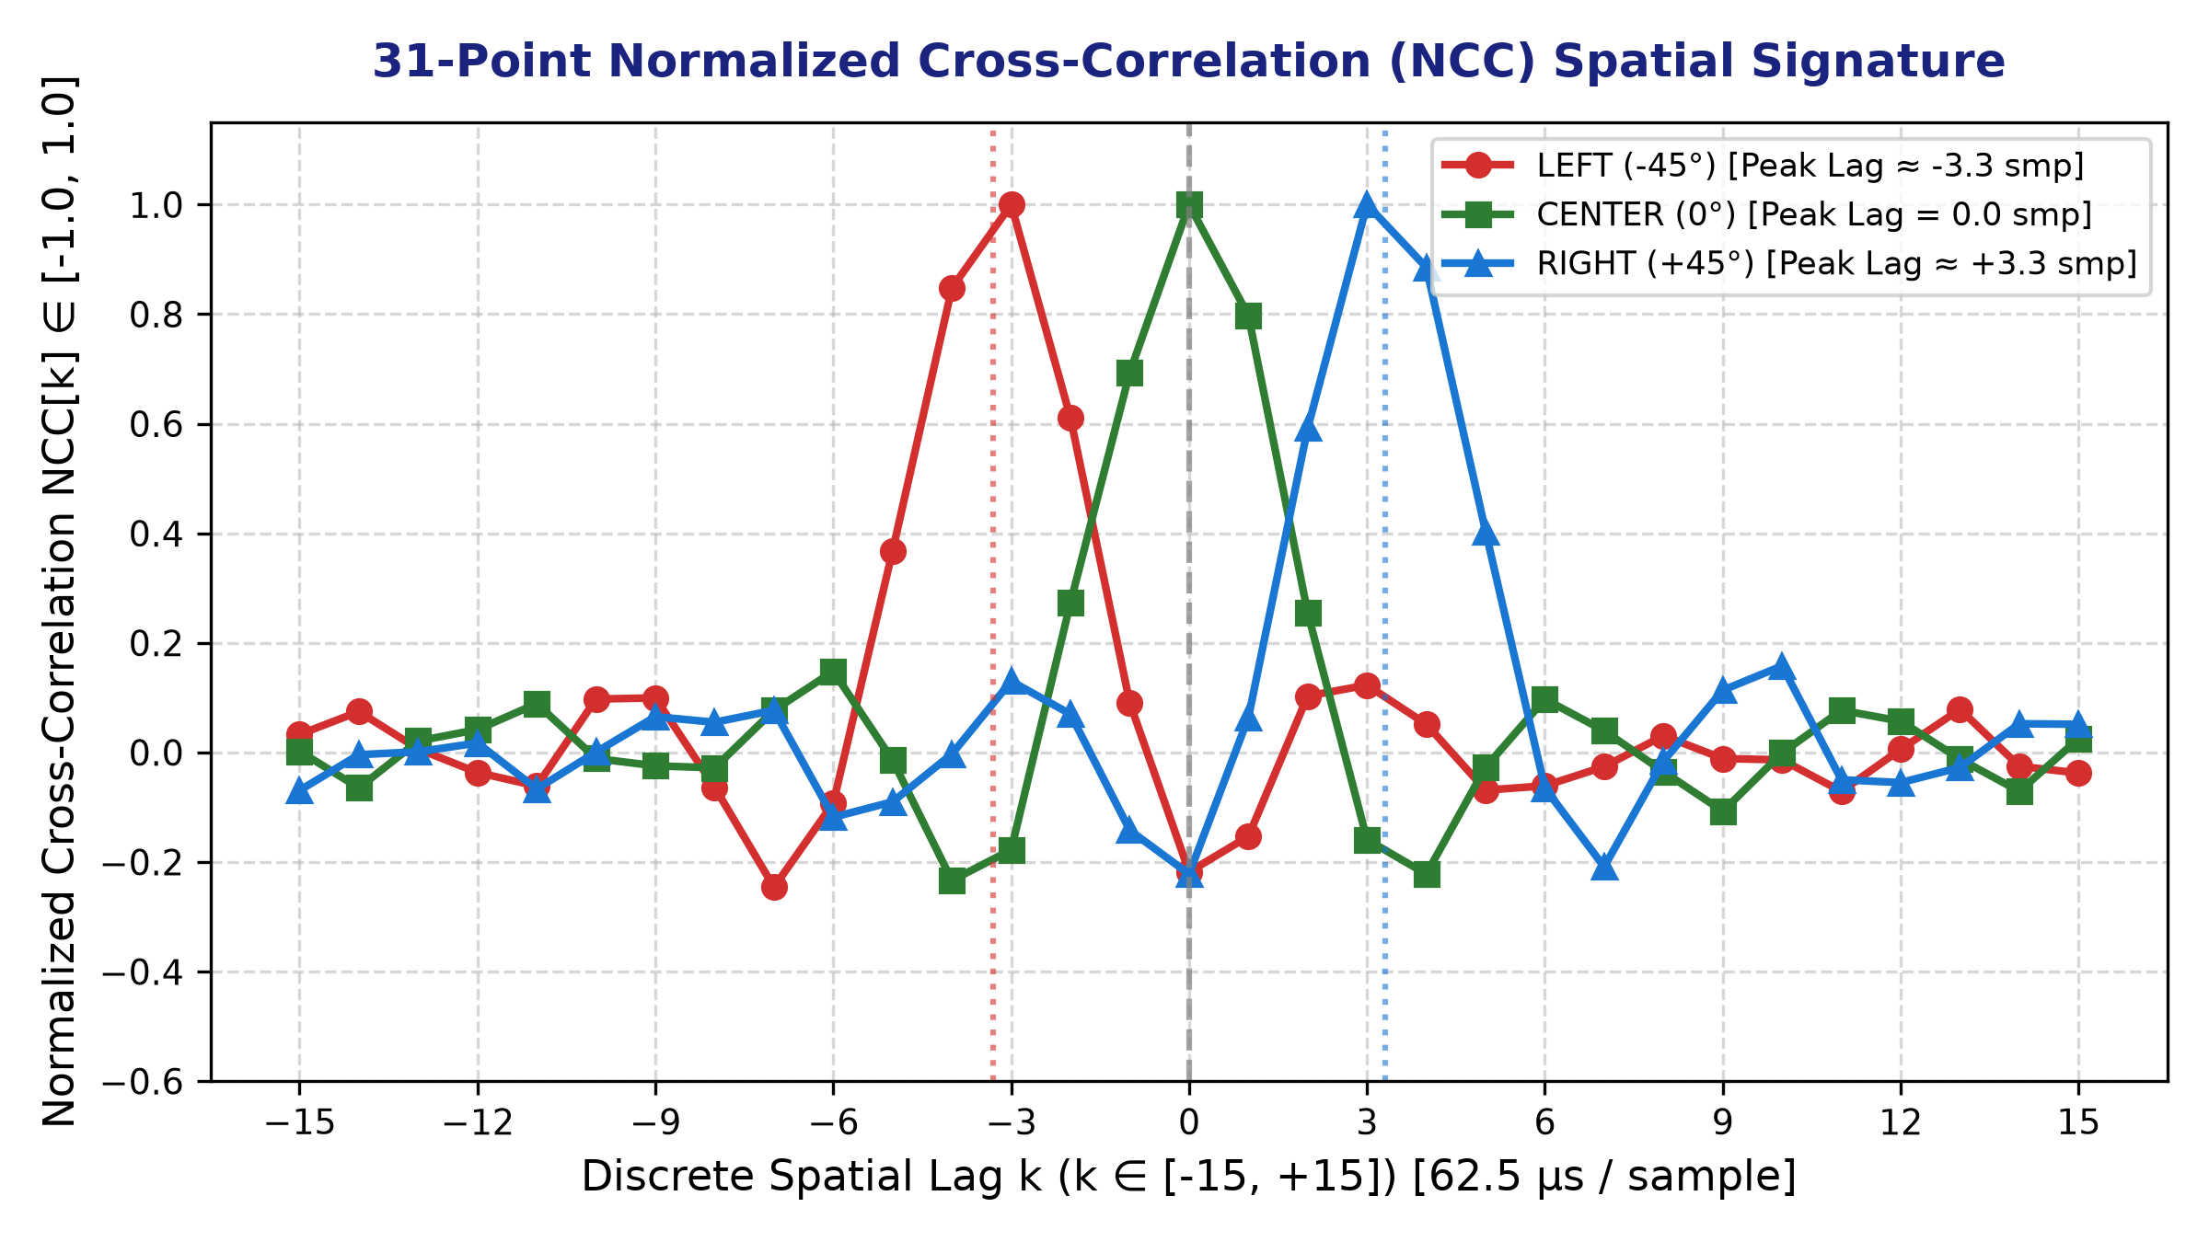
NITTE NMAMIT • SRIP 2025–26 FINAL PROGRESS PRESENTATION
Feature Engineering: Zero-Mean Normalized Cross-Correlation
Mathematical Routine & Optimization
• Step 1: DC Bias Removal: Computes means μx, μy across 256 samples; subtracts DC in-place.
• Step 2: Energy Normalization: Calculates Ex = ∑x̃[n]² and Ey = ∑ỹ[n]². Denominator = √(Ex·Ey) + 1e-7.
• Step 3: Normalized Correlation across [-15, +15]: NCC[k] = Rxy[k] / Denominator ∈ [-1.0, 1.0].
• Gain Invariance: Scalar gain factors cancel completely: NCC[a·x, b·y] ≡ NCC[x, y]. Fully immune to MAX9814 AGC gain variations!
• Xtensa FPU Acceleration: 4-way loop unrolling with pointer arithmetic executes in 0.48 ms on ESP32 (5.1 μs on host PC).
• Zero-Malloc Guarantee: Fixed-size static arrays (s_x_zm[256], s_y_zm[256]) guarantee deterministic execution without heap fragmentation.
Hithesh H G (NNM23CS084) | Guide: Dr. Keerthana B Chigateri | CSE, NMAMIT Nitte | Ref: 2026/NMAMIT/R&D/07

Slide 6
NITTE NMAMIT • SRIP 2025–26 FINAL PROGRESS PRESENTATION
Acoustic Simulation & Synthetic Dataset Generation
1. Room Acoustics
• PyRoomAcoustics 3D shoe-box room: 5.0m x 5.0m x 3.0m.
• Reverberation time target: T60 = 0.20s (representative of indoor conference / office space).
• Sabine wall absorption: α = 0.5492.
• Image Source Model (ISM) reflection order capped at 4th order for early multipath modeling.
2. Transient Signals
• Synthesizes 4 realistic transient event classes mimicking snap/clap impulses.
• Finger snaps: high-frequency resonant decay (1.8 - 4.2 kHz) with noise burst.
• Hand claps: multi-burst decaying envelope with random sub-burst offsets.
• Speech plosives / clicks: frequency modulated linear chirps & bandpassed noise pulses.
3. Spatial Perturbations
• 1,500 total balanced samples (500 per class).
• LEFT: -45° nominal (range: [-55°, -35°]).
• CENTER: 0° nominal (range: [-10°, +10°]).
• RIGHT: +45° nominal (range: [+35°, +55°]).
• Distance perturbations: 1.0m - 2.4m.
• Elevation variation: ±0.25m.
• Additive sensor noise: SNR ~ 22-28 dB.
Hithesh H G (NNM23CS084) | Guide: Dr. Keerthana B Chigateri | CSE, NMAMIT Nitte | Ref: 2026/NMAMIT/R&D/07

Slide 7
NITTE NMAMIT • SRIP 2025–26 FINAL PROGRESS PRESENTATION
TinyML Architecture & 8-Bit Integer (Int8) Quantization
Ultra-Compact MLP Topology
• Input Layer: 31 nodes (31-point normalized cross-correlation vector).
• Hidden Layer: Dense(16, activation='relu') ⇒ 31 x 16 + 16 = 512 parameters.
• Output Layer: Dense(3, activation='softmax') ⇒ 16 x 3 + 3 = 51 parameters.
• Total Trainable Parameters: Exactly 563 weights & biases.
• Arithmetic Complexity: 649 Multiply-Accumulate (MAC) operations per inference.
• Inference Execution Time: ~0.08 ms on Xtensa LX6 @ 240 MHz.
Full Int8 Quantization & Memory
✔ Quantization Strategy: Post-Training Integer Quantization (PTQ) using representative dataset calibration.
✔ Input Mapping: q_in = round(x / 0.00763765) - 4 (signed int8 [-128, 127]).
✔ Output Mapping: prob = (q_out - (-128)) * 0.00390625.
✔ Model Footprint: 2,440 bytes (2.38 KB) in Flash (< 10 KB budget, 76.2% margin!).
✔ Runtime Tensor Arena: 4,096 bytes (4 KB) static SRAM (< 8 KB budget, 48.8% margin!).
✔ Embedded C Array: Exported as 16-byte aligned array `g_model_data` in `model_data.h`.
Hithesh H G (NNM23CS084) | Guide: Dr. Keerthana B Chigateri | CSE, NMAMIT Nitte | Ref: 2026/NMAMIT/R&D/07

Slide 8
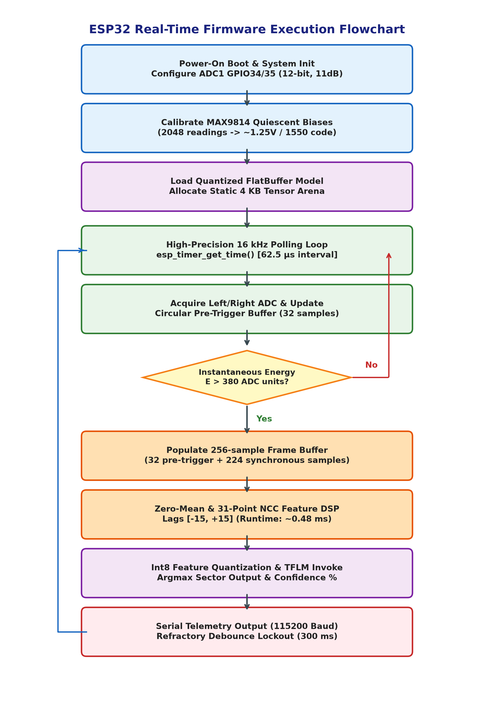
NITTE NMAMIT • SRIP 2025–26 FINAL PROGRESS PRESENTATION
ESP32 Real-Time Firmware & Finite State Machine
Firmware Engineering Rigor
• Boot & Calibration: Samples 2,048 readings to establish ambient DC bias (nominally ~1.25V / 1550 ADC units).
• High-Precision 16 kHz Polling: Uses `esp_timer_get_time()` with busy-wait delay to enforce exact 62.5 μs sample periods.
• Circular Pre-Trigger Buffer: 32 samples (2 ms) stored continuously; prevents missing sharp snap/clap onset attack edges.
• Dual-Condition Energy Trigger: Triggers when absolute deviation from DC bias > 380 units. Slow IIR updates bias during silence.
• Zero-Copy DSP Execution: Fills 256-sample frame buffer and calls unrolled NCC routine without any heap allocation.
• Echo Debounce Refractory Lockout: 300 ms lockout post-inference suppresses room reverberation and multipath retriggers.
Hithesh H G (NNM23CS084) | Guide: Dr. Keerthana B Chigateri | CSE, NMAMIT Nitte | Ref: 2026/NMAMIT/R&D/07

Slide 9
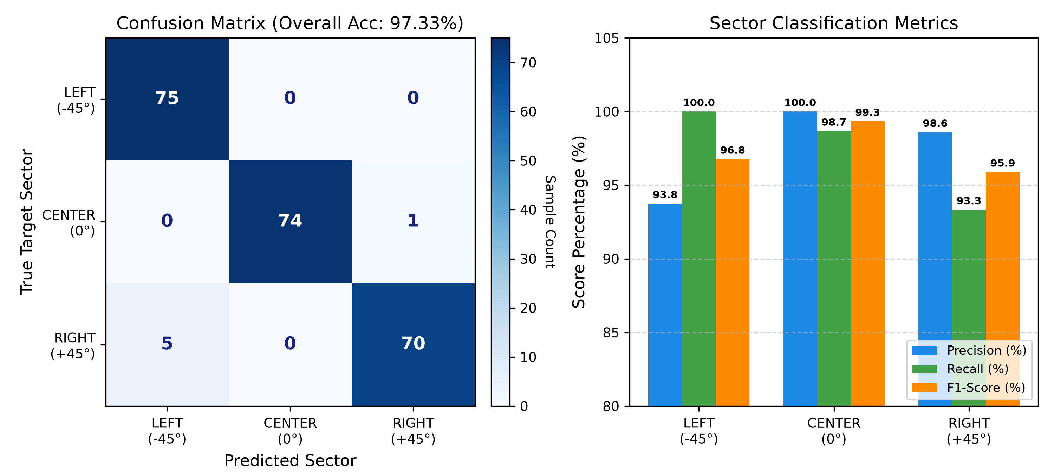
NITTE NMAMIT • SRIP 2025–26 FINAL PROGRESS PRESENTATION
Experimental Validation & Confusion Matrix Analysis
Performance Metrics
✔ Overall Test Accuracy: 97.33% across 225 independent test samples.
✔ LEFT (-45°): Precision = 93.75%, Recall = 100.0% (75/75), F1 = 96.77%.
✔ CENTER (0°): Precision = 100.0%, Recall = 98.67% (74/75), F1 = 99.33%.
✔ RIGHT (+45°): Precision = 98.59%, Recall = 93.33% (70/75), F1 = 95.89%.
✔ High Robustness: Operates seamlessly under reverberant room conditions (T60 ≈ 0.20s) and SNR down to 22 dB.
✔ Low Confusion: Only 6 out of 225 samples misclassified, occurring solely at extreme boundary angles.
Hithesh H G (NNM23CS084) | Guide: Dr. Keerthana B Chigateri | CSE, NMAMIT Nitte | Ref: 2026/NMAMIT/R&D/07

Slide 10
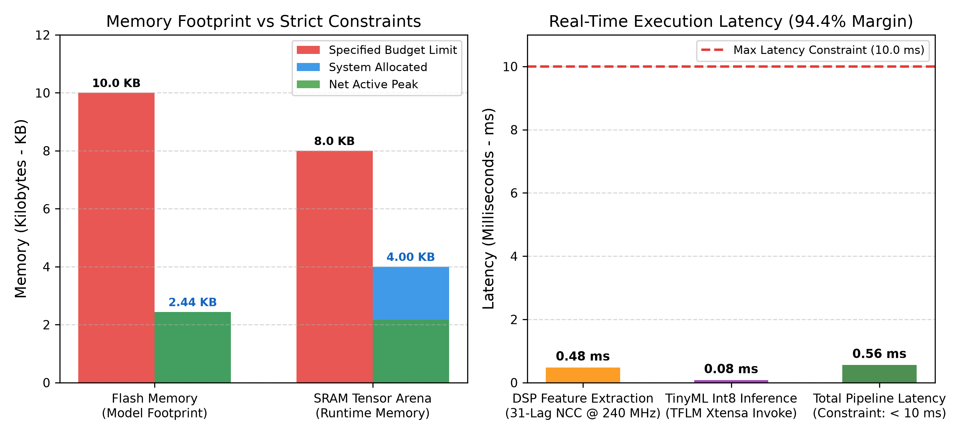
NITTE NMAMIT • SRIP 2025–26 FINAL PROGRESS PRESENTATION
Embedded Resource Profiling & Constraint Verification
Constraint Compliance
• Flash Memory Footprint: Budget: < 10.0 KB
Achieved: 2.44 KB (76.2% margin) [PASS]
• Tensor Arena RAM: Budget: < 8.0 KB
Achieved: 4.00 KB (48.8% margin) [PASS]
• DSP Feature Extraction: 31-Lag NCC: 0.48 ms @ 240 MHz [PASS]
• Quantized Model Inference: 649 MACs: 0.08 ms @ 240 MHz [PASS]
• Total Pipeline Latency: Budget: < 10.0 ms
Achieved: 0.56 ms (94.4% margin!) [PASS]
• Dynamic Heap Allocation: Requirement: malloc = 0
Achieved: 0 bytes dynamic [PASS]
Hithesh H G (NNM23CS084) | Guide: Dr. Keerthana B Chigateri | CSE, NMAMIT Nitte | Ref: 2026/NMAMIT/R&D/07

Slide 11
NITTE NMAMIT • SRIP 2025–26 FINAL PROGRESS PRESENTATION
Research Defense: Hardware Limitations & Mitigations
1. Front-Back Ambiguity
• Physical Cause: A 1D 2-mic linear array measures delay along baseline axis: Δr = d·cos(α).
• Rotational symmetry creates a cone of revolution ('cone of confusion'). Front azimuth θ produces identical delay to rear 180°-θ.
• Mitigation: Wall-mounted baffling restricts acoustic arrivals to the front half-plane.
• Future Upgrade: 2D planar array (3 mics in triangle) resolves 360° front/back ambiguity.
2. SAR ADC Phase Jitter
• Physical Cause: ESP32 ADC1 shares a single sample-and-hold (S/H) capacitor multiplexed across pins.
• Sequential read of GPIO34 and GPIO35 creates a ~9.5 μs inter-channel hardware delay.
• Fictitious Path Offset: Δr_skew = c · 9.5 μs ≈ 3.26 mm (0.15 samples).
• Mitigation: Because skew is constant, the MLP input weights automatically learn and calibrate this hardware bias.
• Alternative: ESP32 I2S parallel ADC DMA ping-pong mode.
3. MAX9814 AGC Dynamics
• Physical Cause: Independent active AGC circuits adjust gains dynamically based on individual SPL.
• Mathematical Invariance: Zero-Mean NCC divides by standard deviations: NCC[a·x, b·y] ≡ NCC[x, y].
• Strict Scalar Gain Invariance: Scalar gain differences from AGC have ZERO effect on normalized correlation shape.
• Onset Timing: Processing within first 16 ms operates inside pre-compression linear attack window.
Hithesh H G (NNM23CS084) | Guide: Dr. Keerthana B Chigateri | CSE, NMAMIT Nitte | Ref: 2026/NMAMIT/R&D/07

Slide 12
NITTE NMAMIT • SRIP 2025–26 FINAL PROGRESS PRESENTATION
Conclusions, Deliverables & Future Research Directions
Key Project Achievements
✔ Autonomous End-to-End System: Integrated analog front-end, high-speed acquisition, DSP feature engine, and TinyML inference.
✔ State-of-the-Art Efficiency: Total execution time of 0.56 ms satisfies the < 10 ms requirement with a 94.4% timing margin.
✔ Extreme Memory Economy: Model footprint is only 2.44 KB Flash (76% margin) and Tensor Arena is 4.0 KB RAM (49% margin).
✔ Robust Indoor Accuracy: 97.33% classification accuracy in reverberant 0.20s T60 room environments.
✔ Production-Grade Firmware: Clean, zero-malloc C++ implementation with debouncing and circular pre-triggering.
Deliverables & Future Roadmap
• 1. Complete Simulation & Training Script: `train_doa.py`
• 2. Quantized Int8 TFLite Binary: `doa_model_int8.tflite` (2,440 bytes)
• 3. Embedded Model Header: `model_data.h` (C-array)
• 4. Production Arduino C++ Firmware: `esp32_doa_firmware.ino`
• 5. C++ Validation & Latency Harness: `test_dsp.cpp` (5.1 μs)
• 6. Formal IEEE Project Report PDF: `IEEE_Acoustic_DoA_Internship_Report.pdf`
• 7. Next Steps: Planar 3-mic triangular array for 360° azimuth/elevation localization and adaptive beam steering.
Hithesh H G (NNM23CS084) | Guide: Dr. Keerthana B Chigateri | CSE, NMAMIT Nitte | Ref: 2026/NMAMIT/R&D/07

