Slide 1
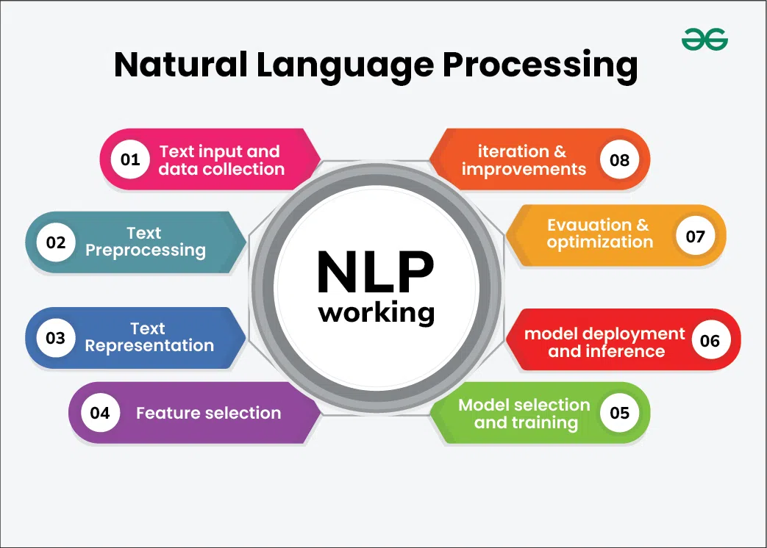
Natural Language Processing

Slide 2
Agenda
NLP
When to use it
Applications
Sentimental analysis
Stop-words,Tokenization,Emotion Algo.
NLP Libraries
NLTK

Slide 3
Natural Language Processing
Text Input and Data Collection
Text Preprocessing
Text Representation
Feature Extraction
Model Selection and Training
Model Deployment and Inference
Evaluation and Optimization
Iteration and Improvement

Slide 4
Text Input and Data Collection
Data Collection: Gathering text data from various sources such as websites, books, social media, or proprietary databases.
Data Storage: Storing the collected text data in a structured format, such as a database or a collection of documents.

Slide 5
Text Preprocessing
Preprocessing is crucial to clean and prepare the raw text data for analysis. Common preprocessing steps include:
Tokenization: Splitting text into smaller units like words or sentences.
Lowercasing: Converting all text to lowercase to ensure uniformity.
Stopword Removal: Removing common words that do not contribute significant meaning, such as “and,” “the,” “is.”
Punctuation Removal: Removing punctuation marks.
Stemming and Lemmatization: Reducing words to their base or root forms. Stemming cuts off suffixes, while lemmatization considers the context and converts words to their meaningful base form.
Text Normalization: Standardizing text format, including correcting spelling errors, expanding contractions, and handling special characters.

Slide 6
Text Representation
Bag of Words (BoW): Representing text as a collection of words, ignoring grammar and word order but keeping track of word frequency.
Term Frequency-Inverse Document Frequency (TF-IDF): A statistic that reflects the importance of a word in a document relative to a collection of documents.
Word Embeddings: Using dense vector representations of words where semantically similar words are closer together in the vector space (e.g., Word2Vec, GloVe).

Slide 7
Feature Extraction
Extracting meaningful features from the text data that can be used for various NLP tasks.
N-grams: Capturing sequences of N words to preserve some context and word order.
Syntactic Features: Using parts of speech tags, syntactic dependencies, and parse trees.
Semantic Features: Leveraging word embeddings and other representations to capture word meaning and context.

Slide 8
Model Selection and Training
Selecting and training a machine learning or deep learning model to perform specific NLP tasks.
Supervised Learning: Using labeled data to train models like Support Vector Machines (SVM), Random Forests, or deep learning models like Convolutional Neural Networks (CNNs) and Recurrent Neural Networks (RNNs).
Unsupervised Learning: Applying techniques like clustering or topic modeling (e.g., Latent Dirichlet Allocation) on unlabeled data.
Pre-trained Models: Utilizing pre-trained language models such as BERT, GPT, or transformer-based models that have been trained on large corpora.

Slide 9
Model Deployment and Inference
Deploying the trained model and using it to make predictions or extract insights from new text data.
Text Classification: Categorizing text into predefined classes (e.g., spam detection, sentiment analysis).
Named Entity Recognition (NER): Identifying and classifying entities in the text.
Machine Translation: Translating text from one language to another.
Question Answering: Providing answers to questions based on the context provided by text data.

Slide 10
Evaluation and Optimization
Evaluating the performance of the NLP algorithm using metrics such as accuracy, precision, recall, F1-score, and others.
Hyperparameter Tuning: Adjusting model parameters to improve performance.
Error Analysis: Analyzing errors to understand model weaknesses and improve robustness.

Slide 11
Iteration and Improvement
Continuously improving the algorithm by incorporating new data, refining preprocessing techniques, experimenting with different models, and optimizing features.

Slide 12
NLP Techniques
Text Processing and Preprocessing In NLP
Syntax and Parsing In NLP
Semantic Analysis
Information Extraction
Text Classification in NLP
Language Generation
Speech Processing
Question Answering
Dialogue Systems
Sentiment and Emotion Analysis in NLP
Dialogue Systems

Slide 13
Text Processing and Preprocessing In NLP
Tokenization: Dividing text into smaller units, such as words or sentences.
Stemming and Lemmatization: Reducing words to their base or root forms.
Stopword Removal: Removing common words (like “and”, “the”, “is”) that may not carry significant meaning.
Text Normalization: Standardizing text, including case normalization, removing punctuation, and correcting spelling errors.

Slide 14
Syntax and Parsing In NLP
Constituency Parsing: Breaking down a sentence into its constituent parts or phrases (e.g., noun phrases, verb phrases).ency Parsing: Breaking down a sentence into its constituent parts or phrases (e.g., noun phrases, verb phrases).
word in a sentence (e.g., noun, verb, adjective).
Dependency Parsing: Analyzing the grammatical structure of a sentence to identify relationships between words.
Constituency Parsing: Breaking down a sentence into its constituent parts or phrases (e.g., noun phrases, verb phrases).

Slide 15
Semantic Analysis
Named Entity Recognition (NER): Identifying and classifying entities in text, such as names of people, organizations, locations, dates, etc.
Word Sense Disambiguation (WSD): Determining which meaning of a word is used in a given context.
Coreference Resolution: Identifying when different words refer to the same entity in a text (e.g., “he” refers to “John”).

Slide 16
Information Extraction
Entity Extraction: Identifying specific entities and their relationships within the text.
Relation Extraction: Identifying and categorizing the relationships between entities in a text.

Slide 17
Text Classification in NLP
Sentiment Analysis: Determining the sentiment or emotional tone expressed in a text (e.g., positive, negative, neutral).
Topic Modeling: Identifying topics or themes within a large collection of documents.
Spam Detection: Classifying text as spam or not spam.

Slide 18
Language Generation
Machine Translation: Translating text from one language to another.
Text Summarization: Producing a concise summary of a larger text.
Text Generation: Automatically generating coherent and contextually relevant text.

Slide 19
Speech Processing
Speech Recognition: Converting spoken language into text.
Text-to-Speech (TTS) Synthesis: Converting written text into spoken language.

Slide 20
Question Answering
Retrieval-Based QA: Finding and returning the most relevant text passage in response to a query.
Generative QA: Generating an answer based on the information available in a text corpus.

Slide 21
Dialogue Systems
Chatbots and Virtual Assistants: Enabling systems to engage in conversations with users, providing responses and performing tasks based on user input.

Slide 22
Sentiment and Emotion Analysis in NLP
Emotion Detection: Identifying and categorizing emotions expressed in text.
Opinion Mining: Analyzing opinions or reviews to understand public sentiment toward products, services, or topics.

Slide 23
Artificial Intelligence Overview
Artificial Intelligence (AI) has become an integral part of our digital world, and its learning techniques are pivotal in its evolution. As AI enthusiasts and professionals, it’s crucial to understand the fundamentals of Zero-Shot, One-Shot, and Few-Shot Learning. These approaches are at the forefront of making AI models more adaptable and efficient, especially when dealing with limited data.

Slide 24
Zero-Shot, One-Shot, and Few-Shot Learning
These learning techniques enable machine learning models to predict new classes with minimal labeled data. Their application varies based on the problem and the availability of labeled data.
Zero-Shot Learning: This technique is used when no labeled data is available for new classes. Models, especially large language models like ChatGPT, rely on their existing knowledge and semantic similarities to make predictions.
Here’s a Zero-Shot example in ChatGPT:

Slide 25
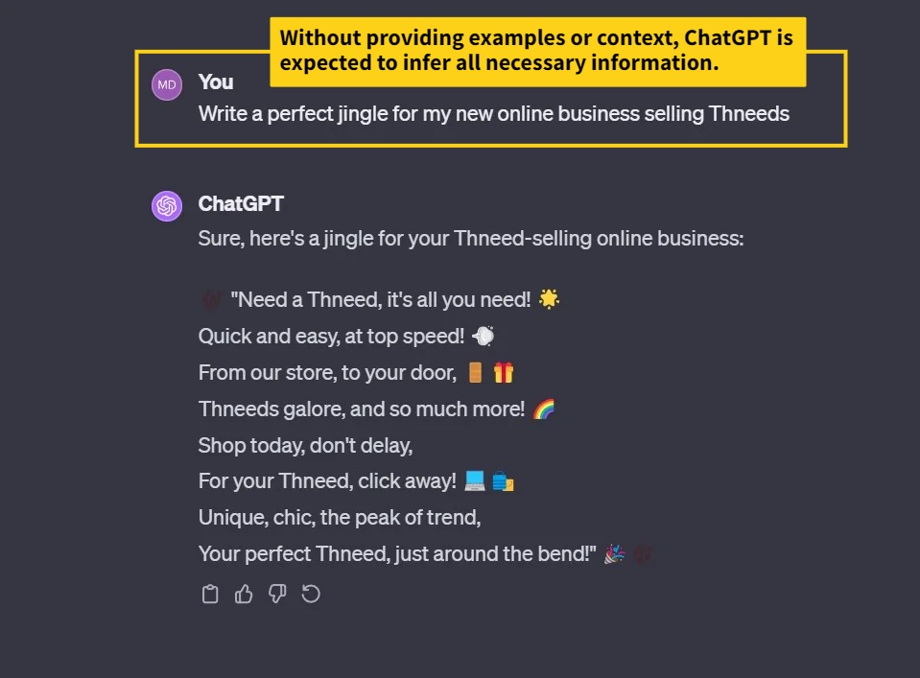

Slide 26
One-Shot Learning
This involves using a single labeled example for each new class. The model learns to make predictions for these classes based on this lone example. In the case below, we provide ChatGPT a “Job Description Template” file as an example (Yes✅ , ChatGPT can read in files!).

Slide 27
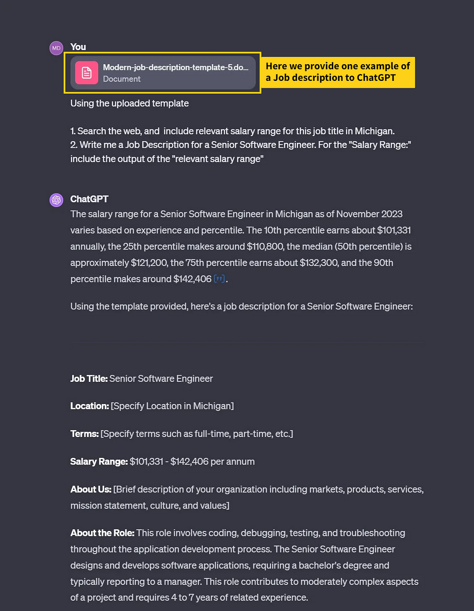

Slide 28
Few-Shot Learning
Here, a handful of labeled examples are available for each new class. The model learns to generalize from these few examples.
Here’s a Few-Shot Example using ChatGPT 4:

Slide 29
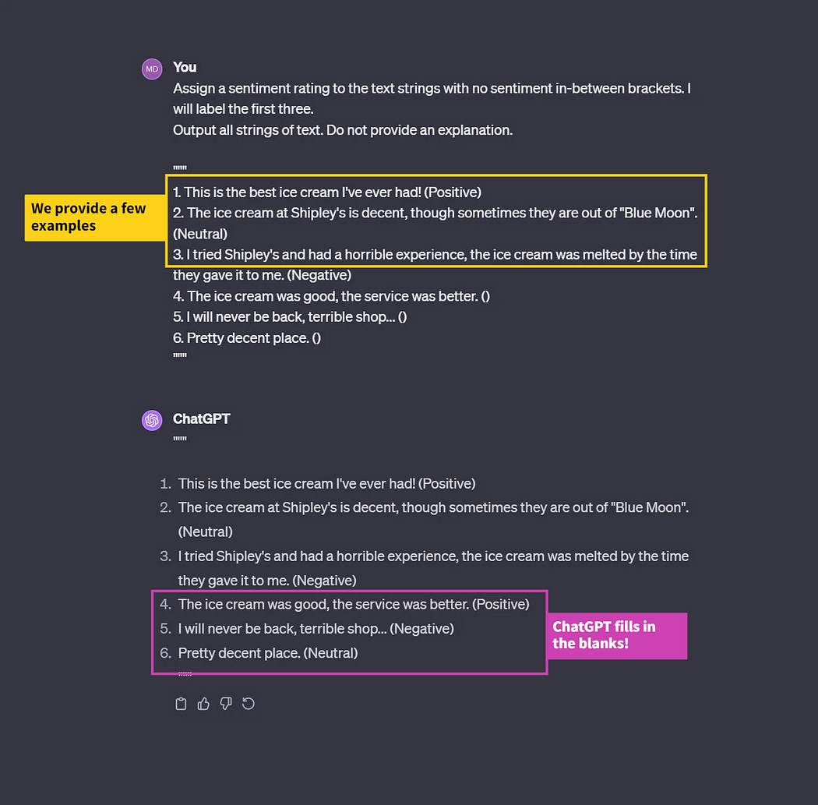

Slide 30
Approaches to Zero-Shot, One-Shot, and Few-Shot Learning
Implementing these techniques involves various methodologies:
Attribute-Based Approaches: Models use attribute relationships to generalize knowledge to new classes. For instance, in wildlife classification, attributes like ‘stripes’ or ‘fins’ help generalize new animal classes.
Embedding-Based Approaches: Models infer information about new classes based on their proximity to known classes in an embedding space. This is common in recommendation systems that suggest products similar to those previously bought.
Generative Approaches: These involve creating synthetic examples for unseen categories, like generating synthetic images of rare animals for species classification.
Metric-Based Models: Develop a similarity metric to predict new classes, such as in medical imaging where rare diseases are identified based on similarities to known conditions.
Neural Network-Based Models: Using CNNs or RNNs, these models correlate input data with class predictions, a technique used in predictive text input.
Transfer Learning-Based Models: Pre-trained on vast data, these models are fine-tuned for specific tasks like using a general language model to perform legal document analysis.

Slide 31
The Importance in Real-World Scenarios
The real world often lacks the luxury of large, labeled datasets for every possible class. Zero-Shot, One-Shot, and Few-Shot Learning enable AI models to adapt to new classes with limited or no additional data. This adaptability is not only efficient but also cost-effective, reducing the need for extensive data labeling.
In conclusion, understanding Zero-Shot, One-Shot, and Few-Shot Learning is essential for anyone venturing into AI. These techniques not only enhance the flexibility and scalability of AI models but also represent a significant step towards more intelligent and adaptable AI systems. As AI continues to evolve, these learning methods will undoubtedly play a pivotal role in shaping its future.

Slide 32
Document Clustering
Grouping Similar Documents
- What is Document Clustering? Clustering involves grouping similar documents together based on their content. It helps us identify related articles, blog posts, or customer reviews.
- K-Means Clustering: K-means is a popular clustering algorithm. It partitions documents into K clusters, where each cluster represents a distinct group of similar content.
- Example: Suppose we have a dataset of customer reviews for a product. K-means clustering might group reviews discussing "performance," "design," and "customer service" into separate clusters.
- Use Cases: Document clustering aids in information retrieval, content recommendation, and identifying trends within large text datasets.

