Slide 1
Team
Photonator
Problem A:
Members:
Hithesh Rai Purushothama
Isaiah Milkey
Zareen Tasnim Rahman

Slide 2
Project Description
Intel has provided a dataset of labeled defects for intel processors.
This challenge requires students to build a model capable of detecting and classifying defects from limited data.
The approach should reflect how a human expert rapidly learns and adapts from a few samples.
Objectives
Enable solution scalability via automation
Improve insights into defect categories
Improve yields and product quality
Scope
Process a gray-scale image approximately 1 second using the hardware recommended as part of the solution.
Handle image sizes up to approximately 1500 x 2500 pixels
Accurately classify images into 8 defect classes, accounting for highly imbalanced data.
Deliverables
Detect and classify defects from gray-scale images.
Provide evaluation plots showing detection and classification accuracy versus defect class occurrence, using randomized samples.
Achieve 85% overall classification accuracy.
Demonstrate how quickly the model learns, evaluated on a randomized sequence of held-out images provided by Intel.
Include documentation summarizing the model approach, assumptions, handling of class imbalance, and hardware used.

Slide 3
Why our Approach?
Our solution:
2-Stage Classification
Having 94.5% of samples being ‘good’ is a clear indicator that the model architecture requires distinction between samples with and without defects.
Stage 1 tries to detect a defect
Stage 2 tries to classify the defect
Code
Defect Segmentation:
Creating a model that segments and annotates the defect is useful but too time consuming by hand
CNN’s:
CNN’s don’t align with rapid learning and needs extensive amounts of training data to not overfit

Slide 4
Model Architecture:
Stage 1 and 2 are both using a DINOv2 backbone that converts every image into a 256-d embedding.
Then this embeddings gets passed into Stage 1 (binary classifier), and possibly Stage 2 (cosine similarity to closest defect class embedding) .
Overfitting is not a concern because the DINOv2 is completely frozen, meaning only the small embedding heads are trained. We then implement generalization techniques for these heads to further ensure the model is learning patterns.
Stage 1: Binary Classifier
“Is this wafer defective?”
Focal Loss + Balanced Sampler
defect_prob < .65
defect_prob ≧ .65
Input (224×224 RGB)
→ DINOv2 ViT-Small/14 [frozen, pretrained on 142M images]
→ Classification token (384-d)
→ FullyConct.(384→256) → BatchNorm → ReLU → Dropout(0.35)
→ FullyConct.(256→256) → BatchNorm → L2-Norm
→ 256-d unit-sphere embedding
├── Stage 1: Binary classifier (good / defect?)
└── Stage 2: Cosine similarity to class prototypes (which defect?)
predict ‘good’
Stage 2: Defect Classifier
“Which of the 8 defect types?”
Cosine similarity to class
defect {...}

Slide 5
Handling Class Imbalance
Baseline (No Techniques)
Cascade Decomposition
Focal Loss
Tau-Normalisation + Logit Adjustment
TTA-Averaged Prototypes
Balanced Accuracy: 0.28
Avg. Defect Recall: ~20%
A majority of the dataset contains images labeled as ‘good’.
A cascade approach means that Stage 2 never interacts with ‘good’ images and is only trained on the other 8 defect classes.
Stage 1 is trained on a subset of all training data.
Focal loss down-weights the majority-class predictions so the model is forced to learn from the rarer classes.
After Stage 1 is trained on the subset of images, normalization is applied to correct any leftover class imbalance.
Logit adjustment shifts the raw output scores of Stage 1 by the log of its know training data, so the model’s outputs better reflect the underlying distribution.
During Stage 2, each class prototype (AKA. avg. embedding ) is built from four flipped variants of every training image.
This embedding is then averaged across all variants, creating a more generalized classifier.
After Techniques
Balanced Accuracy: 0.909
Avg. Defect Recall: 91.25%

Slide 6
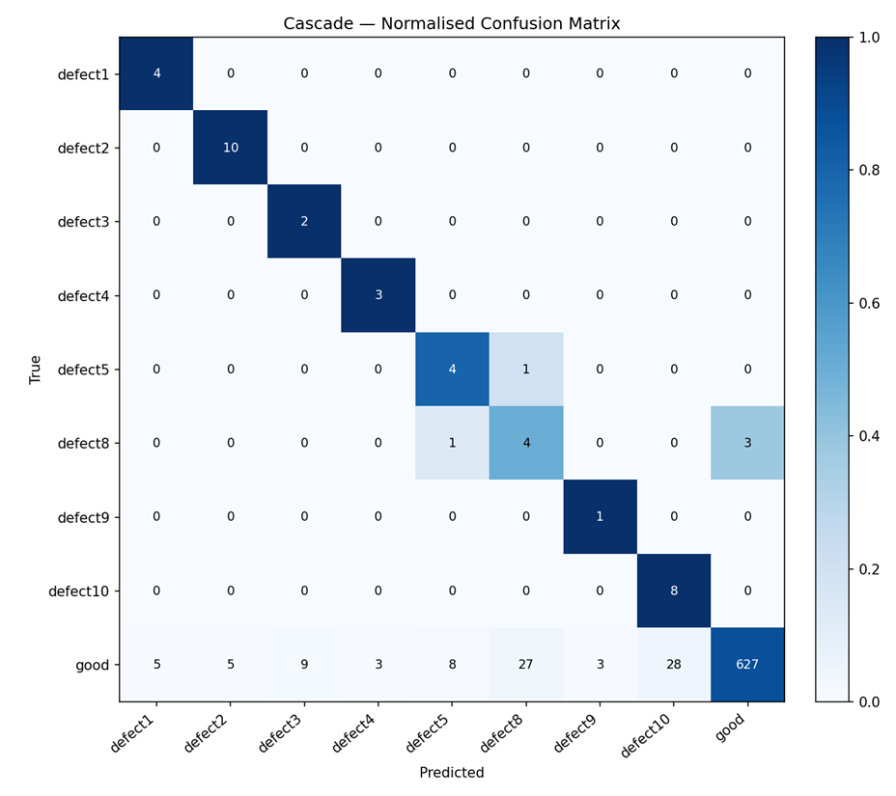
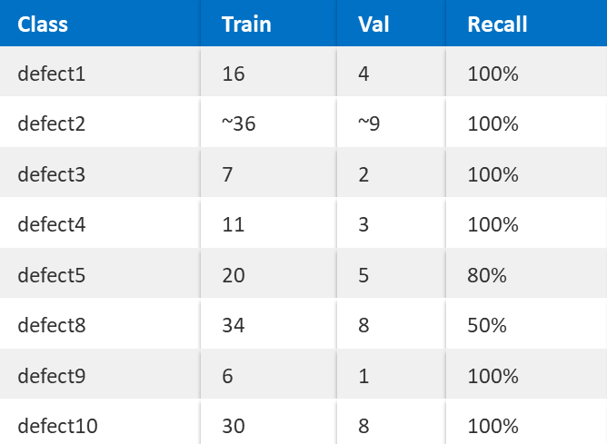
Results:
Overall Accuracy: 87.7%
Balanced Accuracy: 90.9%
Avg. Defect Recall: 91.25%
Our model has 100% recall for 6 out of 8 defect classes.
Inference Speed (Warm GPU): ~46ms / image
Inference Speed (Cold Start): ~600 ms (model loading)
*Problems accessing the dataset resulted in an even more limited dataset

Slide 7

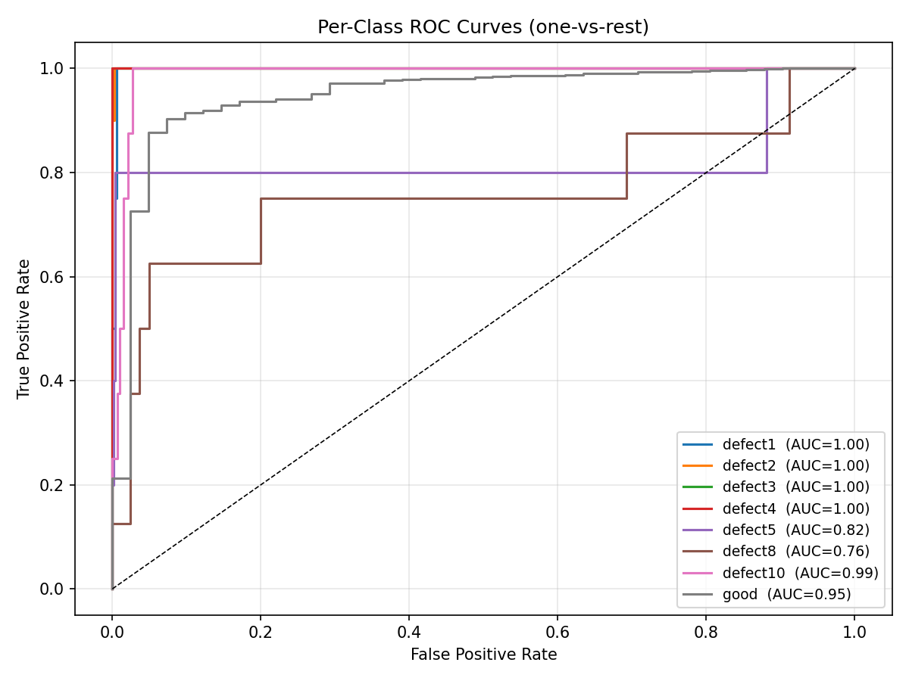
Supporting Analysis: Classification Performance
Cascade Confusion Matrix
Per-Class ROC Curves

Slide 8
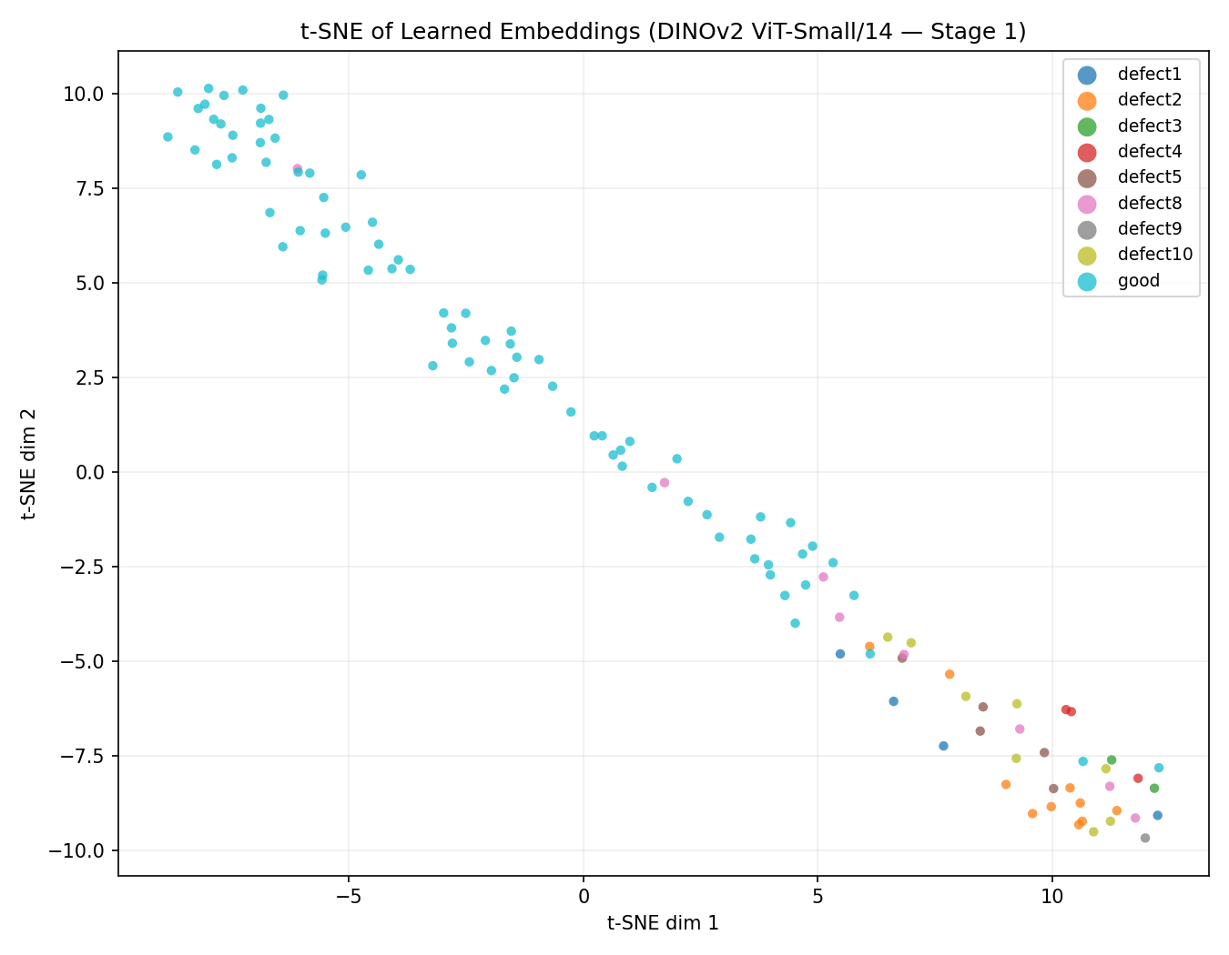
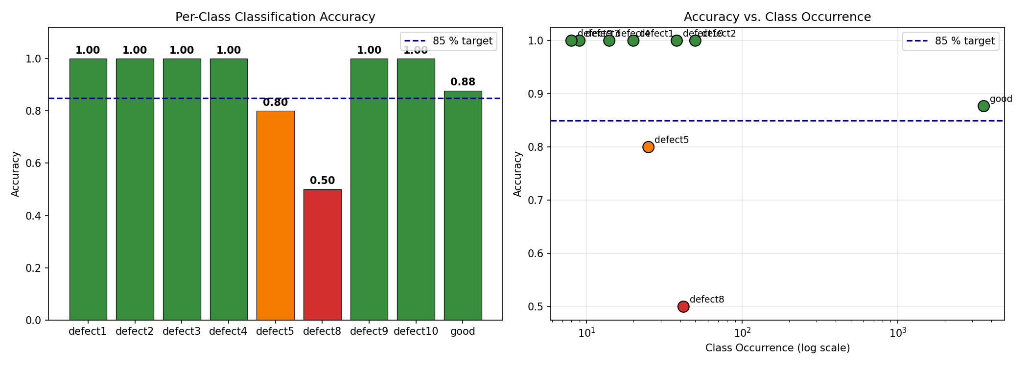
Supporting Analysis: Embedding Quality
t-SNE Embedding Space
Accuracy vs. Training Set Size

Slide 9
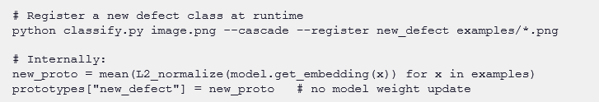
Few-Shot Learning Capability:
Our architecture enables users to add new defects as needed with 80% accuracy after a single labeled sample. No retraining needed.
Just as a human expert learns a new defect type from one reference image – so does our model.
Only takes a few lines to implement:

Slide 10
Assumptions:
→ We convert all images to 224 x 224, as is proven to be sufficient for defect detection.
→ All images are converted from Grayscale to RGB as is required by DINOv2. No pixel information is lost here.
→ We assume images gathered from production will be representative of the given training set.
Future Improvements:
→ Our local version of the dataset was restricted to roughly 1/3 of the full training data available. Thus, training and validation on the full dataset would be ideal to increase accuracy and validation tests.
→ Class embeddings are currently static, but ideally change with new labeled data.

Slide 11
Feasibility & Deployment
• Production-ready: model is 84 MB total — runs on any CUDA GPU or CPU
• Inference: 46 ms/image on GPU (well under the 1-second requirement)
• Cold start with model loading: ~600 ms (one-time cost)
• Scalability: new defect types via few-shot prototype registration — no retraining pipeline needed
• Register a new class from a single labelled image in seconds
• Domain generalization: frozen DINOv2 backbone (pretrained on 142M images) transfers across fabs
• Only class prototypes need updating — not model weights
• Minimal infrastructure: single Python script, no cloud dependency, no MLOps pipeline required

Slide 12
Business Impact
• 91% defect recall: ~9 in 10 defective chips caught before shipping
• Reduces costly field returns and customer-facing failures
• Asymmetric cost advantage: false alarms are cheap; missed defects are not
• Model is tuned to err on the side of flagging — not passing
• Automation: reduces manual inspection burden, frees expert time for edge cases
• Rapid adaptation: new defect types registered in seconds, not days of retraining
• Production lines can respond to novel failure modes immediately
• Consistent quality: eliminates inspector fatigue and subjective variability

Slide 13
Conclusion:
Built a 2-stage DINOv2-based classifier that separates "good" vs. defective wafers first, then identifies which of 8 defect types — bypassing the class imbalance problem entirely
Exceeded the 85% accuracy target → 87.7% overall / 90.9% balanced accuracy, with 100% recall on 6 of 8 defect classes
Achieved true few-shot capability: new defect types registered from a single labeled image, no retraining — matching how a human expert learns
Inference at ~46ms/image on GPU, well within the 1-second requirement
Key insight: cascade decomposition + focal loss + logit adjustment + TTA prototypes together solved what simpler CNNs cannot — learning from as few as 1–2 examples per class
We are grateful to ASU and Intel for providing us with the opportunity to work on this project.

