Slide 1
Few-Shot Semiconductor Defect Classification
ASU / Intel Semiconductor Solutions Challenge 2026 — Problem A
Two-Stage Cascade · DINOv2 · Prototype Inference
Hithesh Rai Purushothama · March 2026

Slide 2
The Problem
Wafer inspection at Intel scale — where misses cost millions
• 3,778 grayscale wafer images across 9 classes
• Severe class imbalance: 94.5% "good", 8–50 samples per defect type
• Must detect all 8 defect types with ≤1 labelled example possible
• Shipping a defective chip as "good" is far more costly than a false alarm
• Critical metric: defect recall — not overall accuracy
Class
Images
Class
Images
Class
Images
good
3,572
defect5
25
defect4
14
defect10
38
defect1
20
defect3
9
defect8
42
defect2
~45
defect9
8

Slide 3
Why Standard Classifiers Fail
A single model faces irreconcilable objectives:
Objective 1 (Stage 1): "good vs. defective"
→ 94.5% good → model predicts "good" for everything
→ defect recall ≈ 0%
Objective 2 (Stage 2): "which defect type?"
→ 8 rare classes, 8–50 samples each
→ overwhelmed by 3,572 "good" samples
Baseline single model result:
Metric
Value
Overall Accuracy
91.1%
Balanced Accuracy
0.28
Avg. Defect Recall
~20%
High overall accuracy masks near-complete failure to detect defects.

Slide 4
Solution: Two-Stage Cascade
Decompose into two tractable, independently optimisable problems.
Input Image
│
▼
┌──────────────────────────────────┐
│ Stage 1: Binary Classifier │
│ "Is this wafer defective?" │
│ Focal Loss + Balanced Sampler │
└──────────────┬────────────────────┘
│
┌────────┴────────┐
defect_prob < 0.65 defect_prob ≥ 0.65
│ │
▼ ▼
predict "good" ┌──────────────────────────────┐
│ Stage 2: Defect-Type Classifier │
│ "Which of the 8 defect types?" │
│ Prototype cosine similarity │
└─────────────────────────────────┘
Each stage trains on a balanced dataset with no conflicting objectives.

Slide 5
Backbone: DINOv2 ViT-Small/14
Pretrained on 142M images using self-supervised DINO + iBOT objectives (Meta AI, 2023)
Property
Supervised ImageNet
DINOv2
Pretraining data
~14M labelled
142M unlabelled
CLS token quality
Moderate
Excellent for clustering
Cosine similarity alignment
Partial
Direct
Cascade bal. acc. (this work)
0.781 (EfficientNet)
0.909 (DINOv2)
• CLS token embedding designed to cluster visually similar patches
• Self-supervised objectives align naturally with prototype-based inference
• No labelled data needed for pretraining — scales to 142M images

Slide 6
Model Architecture
Input (224×224 grayscale → 3-channel RGB replica)
│
▼
DINOv2 ViT-Small/14 (patch size 14, 384-dim CLS token)
│
▼
Embedding Head:
Linear(384 → 256) → BatchNorm → ReLU → Dropout(0.35)
→ Linear(256 → 256) → BatchNorm → L2-Normalize
│
▼
Unit Hypersphere (‖e‖₂ = 1)
│
▼
Cosine similarity to class prototypes → prediction
• L2-normalisation: all embeddings projected onto unit sphere
• Cosine similarity reduces to a dot product — efficiently computable
• Dropout(0.35): critical regularisation with only 8–50 samples per defect class
• Grayscale → RGB: single channel replicated; no information loss

Slide 7
Training: Stage 1 — Binary Classifier
Goal: maximise defect recall while good-chip recall ≥ 80%
Hyperparameter
Value
Rationale
Epochs
30
Sufficient given pretrained backbone
Optimizer
AdamW
Weight decay regularisation
Learning rate
1.5e-4
Conservative for pretrained backbone
Weight decay
0.05
Strong regularisation (ViT style)
Scheduler
Cosine + 10-ep warmup
Smooth convergence
Loss
Focal Loss (γ=2.0)
Down-weights easy good samples
Sampler
Balanced (good/defective)
Prevents gradient starvation
Threshold τ
0.65
Tuned on val; maximises defect recall
Focal Loss: FL(p) = −(1−p)^γ log(p) A sample predicted at 90% confidence contributes only (0.1)² = 0.01× the weight of standard cross-entropy — forcing focus on ambiguous defect examples.

Slide 8
Training: Stage 2 — Defect-Type Classifier
Goal: discriminate 8 defect types with no "good" class competition
Hyperparameter
Value
Rationale
Epochs
60
Longer — 8-way discrimination
Optimizer
AdamW
Learning rate
1e-4
Slightly lower; fine-grained task
Weight decay
0.01
Less aggressive; small dataset
Scheduler
Cosine annealing
Loss
CE + label smooth (ε=0.1)
Prevents overconfidence on tiny classes
Sampler
Balanced (8 defect classes)
Equal class frequency
Inference
Prototype cosine similarity
No retraining for new classes
Label smoothing ε=0.1: replaces hard one-hot targets with soft distributions, regularising the output and producing better-calibrated probabilities when training on 8–50 samples/class.

Slide 9
Few-Shot Inference via TTA-Averaged Prototypes
# 4 augmented views per training image:
# identity, h-flip, v-flip, h+v-flip
for each class c:
prototype[c] = mean(L2_normalize(embed(aug_i(x)))
for all x in class c, all aug_i)
# Inference (single forward pass):
embedding = L2_normalize(model.get_embedding(image))
prediction = argmax(cosine_similarity(embedding, prototypes))
• TTA on prototypes: flip-invariant class centroids — stable, representative embeddings
• Single-image inference against stable prototypes outperforms 4-image test TTA
• 0.909 balanced accuracy (TTA-protos) vs. 0.880 (test-time TTA) — test TTA adds noise
• Faster too: 1 forward pass at test time instead of 4

Slide 10
Few-Shot Extensibility — No Retraining Required
New defect types can be registered at runtime from ≥1 labelled example:
# Register a new defect class at runtime
python classify.py image.png --cascade --register new_defect examples/*.png
# Internally:
new_proto = mean(L2_normalize(model.get_embedding(x)) for x in examples)
prototypes["new_defect"] = new_proto # no model weight update
N-shot performance on held-out validation (prototype inference):
N-shot
Accuracy
1-shot
80.1%
2-shot
80.7%
5-shot
80.7%
8-shot
80.1%
20-shot
79.5%

Slide 11
Results: Progression of Approaches
All evaluated on the same 20% stratified validation split (seed=42)
Approach
Overall Acc
Bal. Acc
Defect Recall
Single EfficientNet-B0 baseline
91.1%
0.28
~20%
+ Tau-norm + logit adjustment
85.7%
0.56
52.5%
EfficientNet cascade (τ=0.35)
85.1%
0.781
70.7%
ViT + MAE pretraining cascade
84.7%
0.780
78.0%
EfficientNet cascade + test TTA
87.4%
0.867
~87%
DINOv2 cascade (τ=0.65)
87.4%
0.881
87.5%
DINOv2 + TTA-protos ✅ FINAL
87.7%
0.909
91.25%
• Each step addressed a specific, identified root cause — not hyperparameter tweaking

Slide 12
Final Results
DINOv2 Cascade · TTA-Averaged Prototypes · τ = 0.65
Overall Accuracy
87.7%
Balanced Accuracy
0.909
Avg. Defect Recall
91.25%
(business-critical metric)
Inference time
~46 ms
(warm GPU, single image)
Per-class recall:
Class
Train
Val
Recall
Notes
defect1
16
4
100%
defect2
~36
~9
100%
defect3
7
2
100%
defect4
11
3
100%
defect5
20
5
80%
defect8
34
8
50%
Stage 1 bottleneck — visual overlap with good
defect9
6
1
100%
1 val sample
defect10
30
8
100%

Slide 13
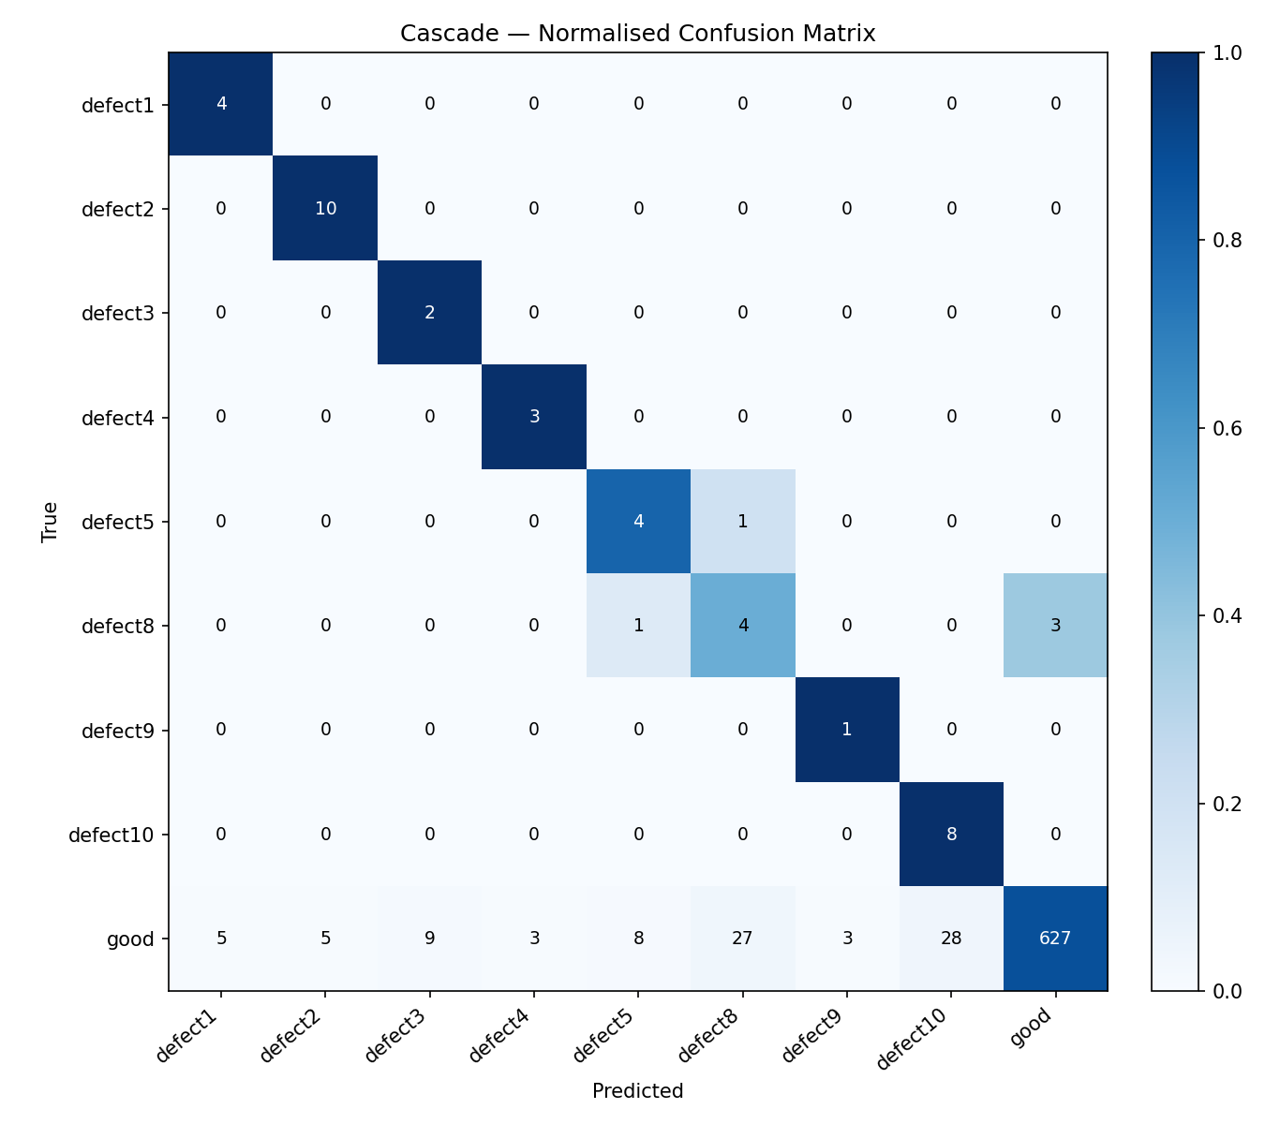
Cascade Confusion Matrix
Strong diagonal — defect types well-separated. Main off-diagonal: defect8 classified as "good" by Stage 1.

Slide 14
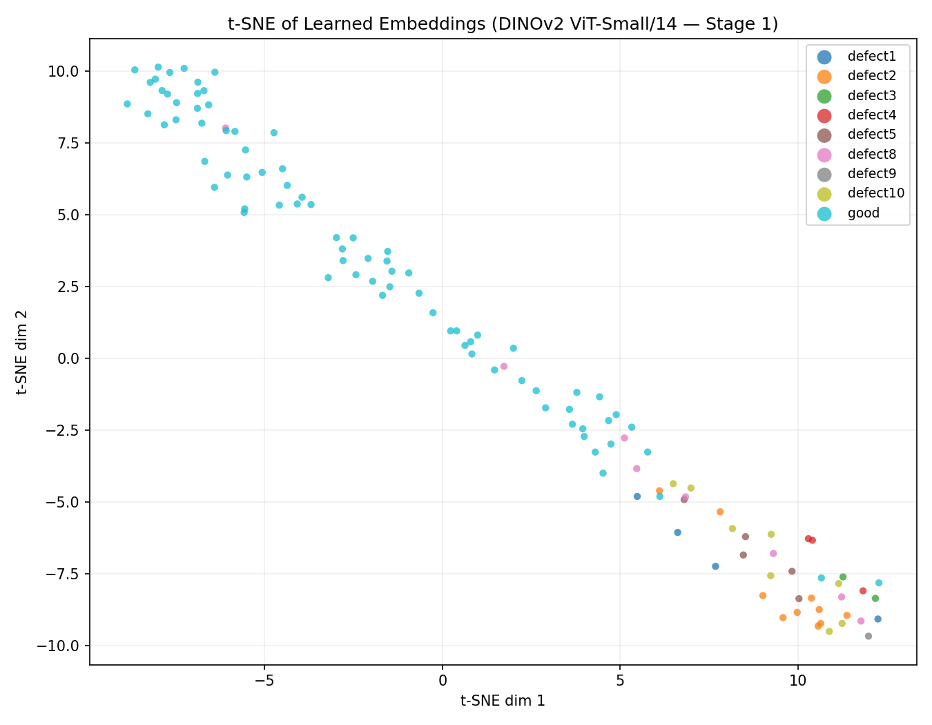
t-SNE Embedding Space (256-d → 2-d)
DINOv2 embeddings form tight, separable clusters per defect type — even with 8–50 training samples.

Slide 15
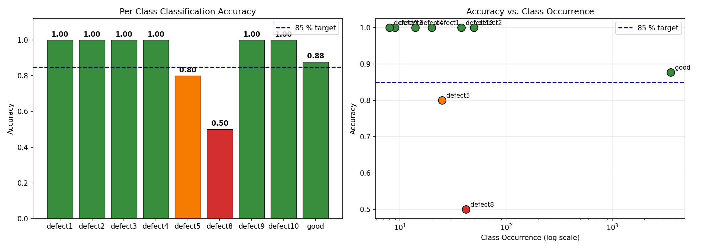
Classification Accuracy vs. Training Set Size
Most defect classes achieve 100% recall regardless of training set size. Defect8 is the exception.

Slide 16
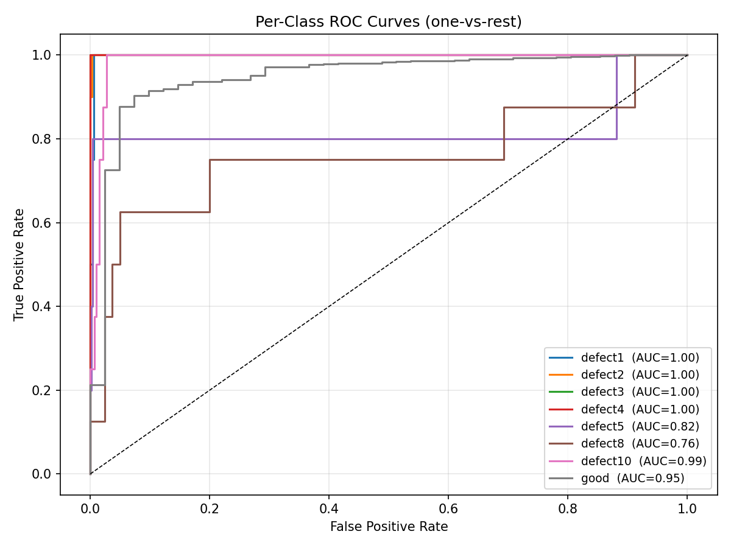
ROC Curves — Per-Class AUC
High AUC across all defect classes. Defect8 shows the flattest ROC — Stage 1 discrimination difficulty.

Slide 17
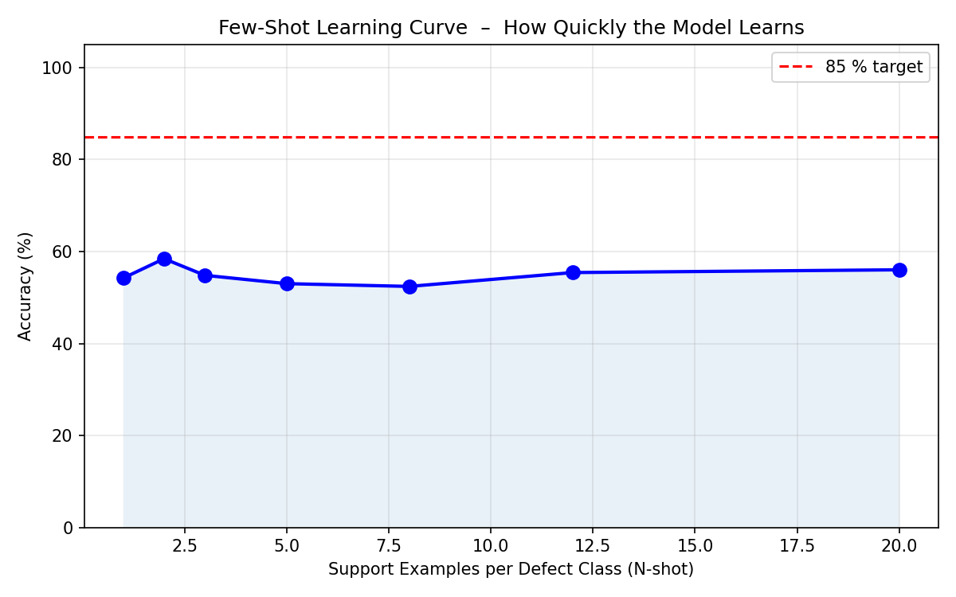
Few-Shot Learning Curve
Performance stable from 1-shot onward — DINOv2 embeddings are robust at any support size.

Slide 18
Hardware & Timing
Component
Specification
Training machine
DGX Spark, NVIDIA GB10 (128 GB VRAM)
MAE pretraining
~70 min (300 epochs)
Cascade training
~85 min (Stage 1: 30 ep, Stage 2: 60 ep)
Inference — warm GPU
~46 ms per image
Inference — cold start
~600 ms (model loading)
Model checkpoint
84 MB (DINOv2 ViT-S/14)
Competition requirement
≤1 second per image ✅
GB10 has compute capability 12.1 (exceeds PyTorch's official max of 12.0) — runs without issue.

Slide 19
Design Decision Summary
Decision
Choice
Why
Architecture
Two-stage cascade
Irreconcilable objectives in single model
Backbone
DINOv2 ViT-S/14
+5–8% bal. acc.; cosine-aligned embeddings
Loss (Stage 1)
Focal Loss (γ=2.0)
Auto-focuses on hard defect examples
Loss (Stage 2)
CE + label smoothing
Prevents overconfidence on small classes
Inference
Prototype cosine sim.
No retraining for new defect types
TTA strategy
On prototypes, not test
Stabilises centroids; avoids test noise
Threshold τ
0.65
Tuned: max defect recall, good recall ≥ 80%

Slide 20
Limitations & Future Work
Current bottleneck: defect8 (50% recall) — Stage 1 visual overlap with "good" chips
Limitation / Opportunity
Current
Proposed Fix
defect8 Stage 1 discrimination
50% recall
Per-class τ or dedicated anomaly detector
Backbone size
ViT-Small/14 (22M params)
ViT-Base (86M params), ~90ms inference
Image resolution
224×224 (from ≤1500×2500)
Tiled inference at native resolution
Static prototypes
Computed at train time
Online EMA updates from production data
Val set size
1–2 samples/rare class
More labelled data improves estimates
• All improvements are additive — the cascade architecture remains the correct foundation

Slide 21
Questions?
DINOv2 ViT-Small/14 · Two-Stage Cascade · TTA-Averaged Prototypes
Overall Accuracy: 87.7%
Balanced Accuracy: 0.909
Avg. Defect Recall: 91.25%
python evaluate.py --cascade --dinov2

