Slide 1
Concentration Inequalities
Shusen Wang
Notes:
When we analyze randomized algorithms, we often use concentration inequalities.
They are also known as tail bounds.
There are many families of concentrations inequalities.
I introduce only one of them and use it to analyze our Monte Carlo algorithms.
分析随机算法理论性质往往要用到 概率不等式。
概率不等式有很多种，我不打算一一介绍。
我只介绍一个常用的，然后用它来分析蒙特卡洛算法。
学会这个，其他概率不等式也不难理解。

Slide 2
Bernstein Inequality
Notes:
The one I am going to introduce is Bernstein inequality.
I will use Bernstein inequality to show the convergence of the Monte Carlo algorithm for estimating Pi.
我要讲的是Bernstein Inequality。
用它可以证明出上节课蒙特卡洛算法的收敛率。

Slide 3

Bernstein Inequality
Let $Z_{1},⋯, Z_{n}$ be independent zero-mean random variables.
They are bounded: $\left|Z_{i}\right|≤b$, for all $i$.
Their variances are bounded: $𝔼\left[Z_{i}^{2}\right]≤v$, for all $i$.
Notes:
Now I explain what Bernstein inequality is.
Let $Z_{1},⋯, Z_{n}$ be independent zero-mean random variables.
We don’t need to know the probability distributions of the variables.
We just need to know that the variable are independent and they have zero mean.
=================
In addition, the random variables must be bounded.
Let b be the upper bound of their absolute values.
=================
Their variance must be bounded, too.
Variance is the expectation of Z square.
Let v be the upper bound of their variance.
下面我解释什么是 Bernstein不等式 。
设 $Z_{1},⋯, Z_{n}$ 为独立的、且期望等于零的随机变量。
不用管他们的概率分布；任何均值为零的概率分布都可以。
=================
这些随机变量 都是有界的； 他们的绝对值都小于 b 。
=================
他们的方差 也是有界的。
方差是随机变量 Z 的平方。
方差全都小于 v。

Slide 4
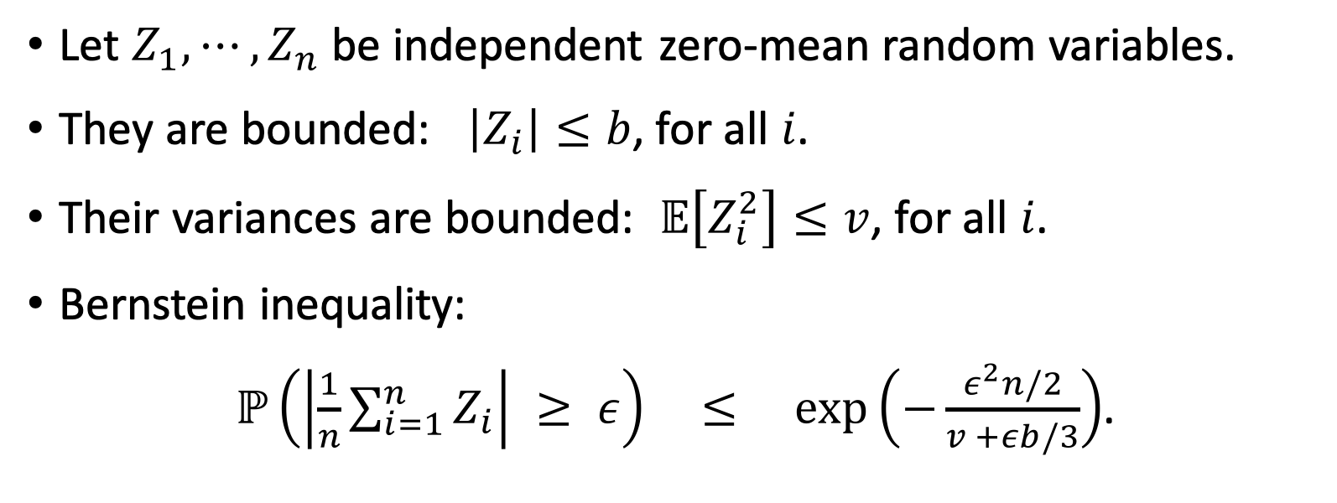
Bernstein Inequality
Let $Z_{1},⋯, Z_{n}$ be independent zero-mean random variables.
They are bounded: $\left|Z_{i}\right|≤b$, for all $i$.
Their variances are bounded: $𝔼\left[Z_{i}^{2}\right]≤v$, for all $i$.
Bernstein inequality:
$ℙ\left(\left|\frac{1}{n}\sum_{i=1}^{n}{Z_{i}}\right| ≥ ε\right) ≤ \exp\left(−\frac{ε^{2}n/2}{v +εb/3}\right)$.
Notes:
Under the aforementioned conditions, this inequality holds.
This inequality is knowns as Bernstein inequality.
Let me explain the meaning of Bernstein inequality.
--------------------
Suppose male’s mean height is 70 inches.
If you randomly choose a man on the street and measure his height, you may get a number quite different from the mean, 70.
He may be short; he may be very tall.
But if you randomly find 10 males, measure their heights, and take the average, then the outcome is not too far from the mean, 70.
If you randomly find 100 men, then their average height is very close to 70.
The more samples you have, the closer the average is to the expectation.
--------------------
That’s basically what Bernstein inequality tells us.
The random variables, $Z_{1},⋯, Z_{n}$, have zero-mean.
If you observe only one Z, then it can be quite different from 0.
However, if you take n sample, $Z_{1},⋯, Z_{n}$, then their average is close to 0.
The bigger n is, the closer the average approaches zero.
只要变量满足上述条件，Bernstein不等式就成立。
这就是Bernstein不等式。
我来解释一下不等式的直观含义。
--------------------
举个例子。
男性平均身高是一米七。
你在路上随便找一个男的，他的身高可能很高，可能很矮，离一米七差的挺远。
如果你随机找10个男性，观测他们的平均身高，那么结果 不会离一米七太远。
假如你随机找 1000 个男性，观测他们的平均身高，你会发现观测值 非常接近 一米七。
样本越多，观测到的均值越接近期望。
--------------------
Bernstein 不等式就是这个意思。
变量 $Z_{1},⋯, Z_{n}$ 的期望都是 0。
如果你只观测一个变量，那么它可能离0 很远。
如果你把n个变量做平均，那么观测到的均值会很接近0。
n 越大，平均值越接近 0。

Slide 5
Bernstein Inequality
Let $Z_{1},⋯, Z_{n}$ be independent zero-mean random variables.
They are bounded: $\left|Z_{i}\right|≤b$, for all $i$.
Their variances are bounded: $𝔼\left[Z_{i}^{2}\right]≤v$, for all $i$.
Bernstein inequality:
$ℙ\left(\left|\frac{1}{n}\sum_{i=1}^{n}{Z_{i}}\right| ≥ ε\right) ≤ \exp\left(−\frac{ε^{2}n/2}{v +εb/3}\right)$.
Mean
Notes:
Look at this part of the inequality.
This is the mean of the n variables.
--------------------
All the variables, $Z_{i}$, are zero-mean.
The average of them should be close to zero.
Let’s consider the absolute value of the average.
The absolute value should be small.
我们来仔细看一下不等式。
先看一下 绝对值里面的部分。
这是n个 变量的均值。
--------------------
每一个变量 Z 的期望都是 0 。
把这些变量取平均，结果会接近 0 。
我们来研究均值的绝对值。
这个绝对值不会太大。

Slide 6
Bernstein Inequality
Let $Z_{1},⋯, Z_{n}$ be independent zero-mean random variables.
They are bounded: $\left|Z_{i}\right|≤b$, for all $i$.
Their variances are bounded: $𝔼\left[Z_{i}^{2}\right]≤v$, for all $i$.
Bernstein inequality:
$ℙ\left(\left|\frac{1}{n}\sum_{i=1}^{n}{Z_{i}}\right| ≥ ε\right) ≤ \exp\left(−\frac{ε^{2}n/2}{v +εb/3}\right)$.
a rare even
Notes:
We consider the event that the absolute value is greater than epsilon.
This event should not often happen because the mean is close to zero.
We don’t want the event to happen.
绝对值超过 epsilon 是一个小概率事件。
我们不希望这个小概率事件发生。

Slide 7
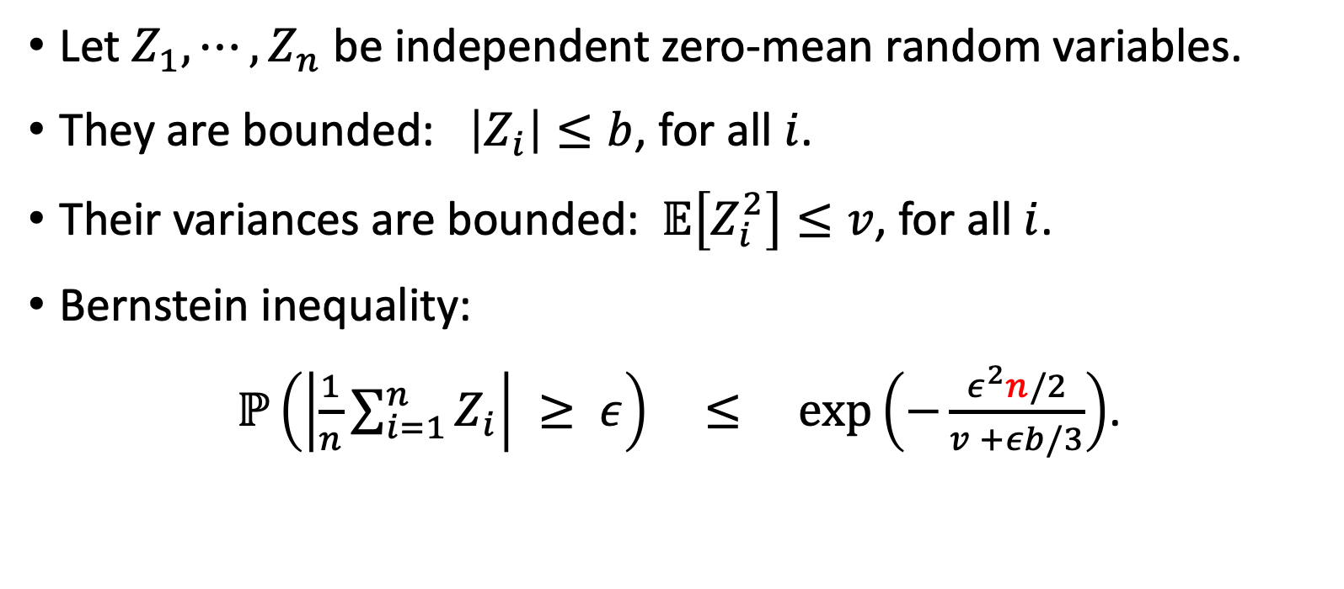
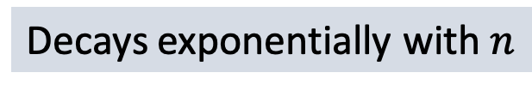
Bernstein Inequality
Let $Z_{1},⋯, Z_{n}$ be independent zero-mean random variables.
They are bounded: $\left|Z_{i}\right|≤b$, for all $i$.
Their variances are bounded: $𝔼\left[Z_{i}^{2}\right]≤v$, for all $i$.
Bernstein inequality:
$ℙ\left(\left|\frac{1}{n}\sum_{i=1}^{n}{Z_{i}}\right| ≥ ε\right) ≤ \exp\left(−\frac{ε^{2}n/2}{v +εb/3}\right)$.
Failure Probability
Decays exponentially with $n$
Notes:
The lefthand side is the probability of the event.
We call it the failure probability.
----------------
We hope the average of Z’s is close to zero.
The event means the average is away from zero by a margin of epsilon.
That is why we think of the probability as the failure probability.
Bernstein inequality guarantees that the event happens with low probability.
=========================
The righthand side is an exponential function.
=========================
Here is a negative sign.
So the exponential function decays to zero very rapidly as n grows.
If n is big, then the failure probability must be very small.
左边这一项 是小概率事件 的概率，也就是失败的概率。
这种事件会发生，但是发生的概率不大。
Bernstein 不等式 保证了这个概率会小于 右边的值。
=========================
右边是一个指数函数。
它会随着 n 的增大而减小，而且是指数衰减。
所以当n很大的时候，左边的概率一定会非常小。

Slide 8
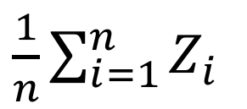
Probability density
$\frac{1}{n}\sum_{i=1}^{n}{Z_{i}}$
Notes:
I’d like to explain Bernstein inequality once again.
The x-axis is the mean of the n random variables.
The mean is also a random variable; its expectation is 0.
---------
The red curve is its probability density.
The probability density is big around 0.
Away from 0, the probability density is small.
我再解释一下 Bernstein不等式的含义。
横轴是n个随机变量的均值。
这个均值本身也是个随机变量，它的期望等于0 。
---------
红色的曲线是它的概率密度。
在0附近的概率很大，远离0的概率较小。

Slide 9


Probability density
$\frac{1}{n}\sum_{i=1}^{n}{Z_{i}}$
$$−ε$$
$$ε$$
Failure Probability
Notes:
I marked epsilon and negative epsilon on the x-axis.
Epsilon is arbitrary.
It’s up to you.
====================
The grey regions represent the failure probability.
That is, the probability that the mean is at least epsilon away from 0.
------------------
The failure probability dependents on epsilon.
If you set epsilon small, then the failure probability is big.
That is to say, if you require the mean be very close to zero, then failure can often happen.
Otherwise, if you set epsilon big, then the failure probability is small.
It means if you are willing to tolerate a big mean, then failure can hardly happen.
------------------
Bernstein inequality guarantees that the failure probability cannot be too big.
Furthermore, if the number of random variables, n, is big, then the failure probability is small.
在横轴上标出 epsilon 和 负epsilon。
====================
阴影部分是 绝对值大于 epsilon的概率，也就是失败的概率。
------------------
失败的概率取决于 epsilon 的大小。
如果你把 epsilon 设置得很小，那么失败概率就会很大。
也就是说，如果你要求均值非常接近零，那么失败的概率就会比较大。
如果你把 epsilon 设置得比较大，那么失败概率就会很小。
换句话说，如果你能容忍均值离 0 比较远，那么就不太可能会失败。
------------------
Bernstein不等式 保证了这个概率不会很大。
n 是随机变量 Z 的数量。
n 越大，失败的概率越小。

Slide 10
Approximating Pi Using Monte Carlo
Notes:
In the previous lecture, we used Monte Carlo to approximate Pi.
Let’s briefly review the Monte Carlo algorithm and then use Bernstein inequality to prove the convergence.
上节课我们用蒙特卡洛来近似pi值。
先回顾一下上节课的内容。
然后我要用 Bernstein 不等式来证明蒙特卡洛算法的收敛率。

Slide 11






Monte Carlo Approximation to Pi
$$y$$
Let $f\left(x,y\right)=\left\{\begin{aligned}4, if x^{2}+y^{2}≤1; \\ 0, otherwise. \end{aligned}\right.$
$$1$$
$$−1$$
$$x$$
$$1$$
$$−1$$
Notes:
Define f by the bivariate function.
It has two variables: x and y.
If the variable (x, y) is in the green circle, then the function value is 4.
Otherwise, the function value is zero.
定义二元函数f，它有两个变量：x和y。
如果点(x, y)在这个圆里，那么函数值f就是4.
如果点在圆外面，那么函数值就是0。

Slide 12
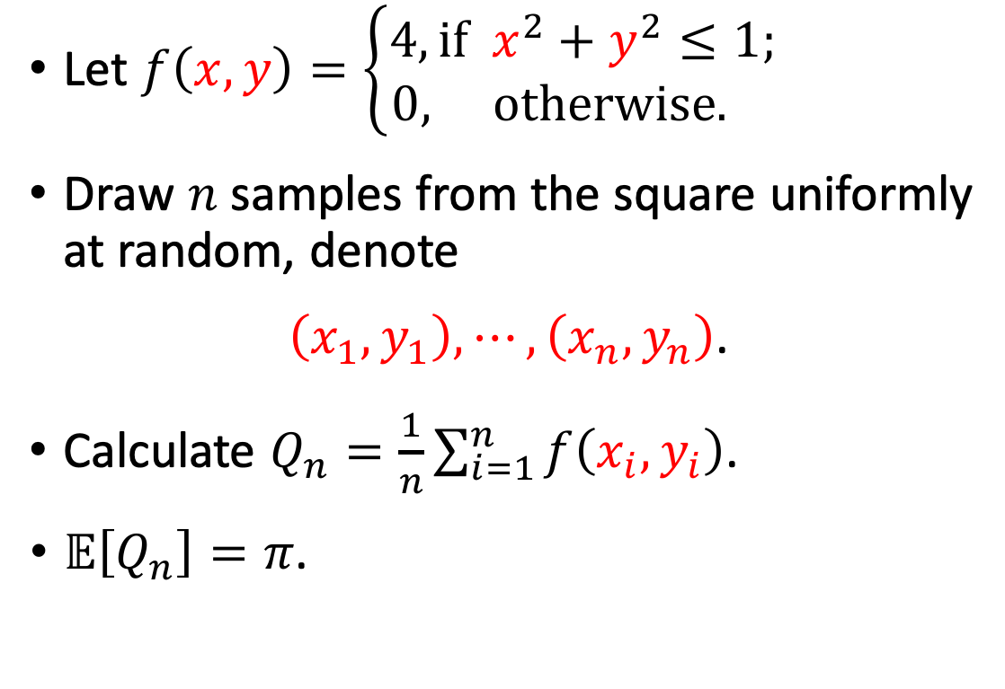
Monte Carlo Approximation to Pi
$$y$$
Let $f\left(x,y\right)=\left\{\begin{aligned}4, if x^{2}+y^{2}≤1; \\ 0, otherwise. \end{aligned}\right.$
Draw $n$ samples from the square uniformly at random, denote
$\left(x_{1},y_{1}\right), ⋯,\left(x_{n}, y_{n}\right)$.
Calculate $Q_{n}=\frac{1}{n}\sum_{i=1}^{n}{f\left(x_{i},y_{i}\right)}$.
$𝔼\left[Q_{n}\right]=π$.
$$1$$
$$−1$$
$$x$$
$$1$$
$$−1$$
Notes:
Draw n samples from the square uniformly at random.
Denote the random samples by $\left(x_{1},y_{1}\right), ⋯,\left(x_{n}, y_{n}\right)$.
===============
For each random sample, we evaluate the function f, and then take the average of f.
Denote the average by $Q_{n}$.
===============
In the previous lecture, we proved that the expectation of $Q_{n}$ is equal to pi.
That’s why we can use $Q_{n}$ for approximating pi.
在正方形中做随机抽样，把样本记做 $\left(x_{1},y_{1}\right), ⋯,\left(x_{n}, y_{n}\right)$.
===============
对每一个样本，计算函数 f 的值，然后把n个函数值做平均。
把均值记做 $Q_{n}$。
===============
上节课我们证明过 $Q_{n}$ 的期望等于 pi。
所以可以拿 $Q_{n}$ 来近似 pi 值。

Slide 13
Analyzing Convergence Rate
Notes:
Let’s use Bernstein inequality for analyzing the convergence rate.
下面我们用Bernstein不等式来分析算法收敛率。

Slide 14

Applying Bernstein Inequality
Define random variable $Z=f\left(X,Y\right)−π$.
Notes:
Define the random variable, Z, as f(X, Y) minus Pi.
The pair, (X, Y), is a random variable.
It is uniformly distributed in the blue square.
The value of function f is either 0 or 4.
If (X, Y) is in the green circle, then f(X, Y) is equal to 4; other, f(X, Y) is 0.
定义随机变量Z 等于 f(X, Y) - pi。
(X, Y) 是个随机变量，它在刚才蓝色正方形中均匀分布。
f 的函数值要么是0，要么是4 。
如果(X, Y) 在圆中，那么 f(X, Y) 就是4；否则 f 就是0。

Slide 15



Applying Bernstein Inequality
Define random variable $Z=f\left(X,Y\right)−π$.
$Z$ has zero mean: $𝔼\left[Z\right]=0$. (Because $𝔼\left[f\left(X,Y\right)\right]=π$.)
$$z$$
$$0$$
Notes:
The expectation of Z is zero.
It is because the expectation of f(X, Y) is equal to Pi.
=================
I plot this axis to illustrate variable Z.
The mean of Z is 0.
随机变量 Z 的期望等于 0 。
这是因为 函数 f 的期望等于 pi。
上节课我们分析过。
=================
我画一根数轴来表示 Z。
Z的期望等于 0。

Slide 16



Applying Bernstein Inequality
Define random variable $Z=f\left(X,Y\right)−π$.
$Z$ has zero mean: $𝔼\left[Z\right]=0$. (Because $𝔼\left[f\left(X,Y\right)\right]=π$.)
$Z∈\left\{−π, 4−π\right\}$. (Because $f\left(X,Y\right)$ is either 0 or 4.)
$$z$$
$$−π$$
$$0$$
$$4−π$$
Notes:
The variable Z is either negative Pi or 4 minus pi.
It is because f(X, Y) is either 0 or 4.
随机变量 Z要么是 $−π$，要么是 $4−π$。
这是因为 f的函数值 要么是 0，要么是4。

Slide 17
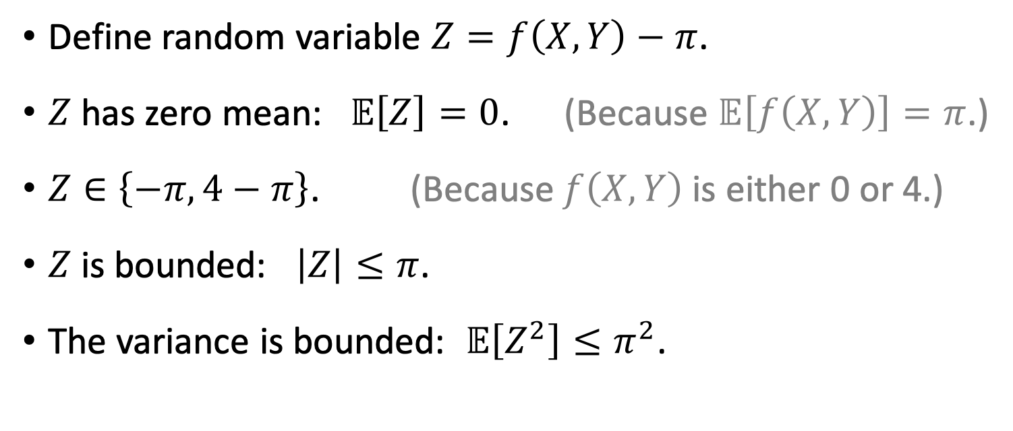
Applying Bernstein Inequality
Define random variable $Z=f\left(X,Y\right)−π$.
$Z$ has zero mean: $𝔼\left[Z\right]=0$. (Because $𝔼\left[f\left(X,Y\right)\right]=π$.)
$Z∈\left\{−π, 4−π\right\}$. (Because $f\left(X,Y\right)$ is either 0 or 4.)
$Z$is bounded: $\left|Z\right|≤π$.
The variance is bounded: $𝔼\left[Z^{2}\right]≤π^{2}$.
$$z$$
$$−π$$
$$0$$
$$4−π$$
Notes:
The absolute value of Z is either pi or 4-pi.
Thus the absolute value of Z is at most pi.
==================
Similarly, Z square is at most pi square.
Thus the variance is less than or equal to pi square.
-----------------------------
In sum, Z is a random variable.
Its expectation is 0.
It absolute value is at most pi.
Its variance is at most pi square.
-----------------------------
To apply Bernstein inequality, the random variables must be zero-mean and have bounded absolute value and variance.
Z satisfies all the requirements.
So we can apply Bernstein inequality.
Z 的绝对值要么是 pi，要么是 4-pi。
所以 Z的绝对值 肯定不超过 pi 。
==================
同样的 道理，Z的平方 不超过 pi平方，所以方差不超过 pi平方。
-----------------------------
总结一下。
Z是个随机变量，它的均值等于0，绝对值不超过 pi，方差不超过 pi 平方。
想要用 Bernstein 不等式的话，变了必须均值为零，而且绝对值和方差都有界。
变量 Z 满足了使用 Bernstein不等式 的条件。

Slide 18
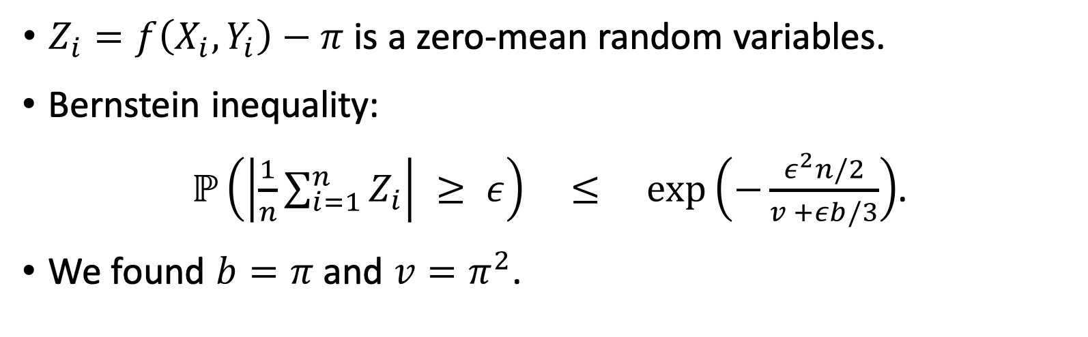
Applying Bernstein Inequality
$Z_{i}=f\left(X_{i},Y_{i}\right)−π$ is a zero-mean random variables.
Bernstein inequality:
$ℙ\left(\left|\frac{1}{n}\sum_{i=1}^{n}{Z_{i}}\right| ≥ ε\right) ≤ \exp\left(−\frac{ε^{2}n/2}{v +εb/3}\right)$.
We found $b=π$ and $v=π^{2}$.
Notes:
Now let’s apply Bernstein inequality.
Let $Z_{i}$ be $f\left(X_{i},Y_{i}\right)−π$.
It is a random variable.
If we repeat random sampling n times, then we will have n such random variables.
=====================
This is Bernstein inequality.
I have explained its meaning.
=====================
The righthand side contains b and v.
b is the bound of the absolute value of Z.
v is the bound of the variance of Z.
=====================
I have shown that b is pi and v is pi square.
我们现在来用Bernstein 不等式。
设 $Z_{i}=f\left(X_{i},Y_{i}\right)−π$ 为一个随机变量。
如果我们做n次随机抽样，那么就有n个这样的随机样本。
=====================
这是Bernstein不等式，我之前解释过。
不等式右边的指数里有 b 和 v。
b是变量绝对值的上界，v是方差的上界。
=====================
刚才我推导出 b 等于 pi，方差v 最多是pi平方。

Slide 19
Applying Bernstein Inequality
$Z_{i}=f\left(X_{i},Y_{i}\right)−π$ is a zero-mean random variables.
Bernstein inequality:
$ℙ\left(\left|\frac{1}{n}\sum_{i=1}^{n}{Z_{i}}\right| ≥ ε\right) ≤ \exp\left(−\frac{ε^{2}n/2}{v +εb/3}\right)$.
We found $b=π$ and $v=π^{2}$.
Lemma 1: $ℙ\left(\left|\frac{1}{n}\sum_{i=1}^{n}{Z_{i}}\right| ≥ ε\right) ≤ \exp\left(−\frac{ε^{2}n/2}{π^{2} +επ/3}\right)$.
Notes:
With b substituted by pi and v substituted by pi squared, Bernstein inequality becomes Lemma 1 in below.
The lemma guarantees that the average of Z is close to zero.
===============
We use Lemma 1 to show the convergence rate of Monte Carlo algorithm.
把 b 和 v 的值都带入 Bernstein 不等式，就有了下面的 引理一。
引理保证变量 Z 的均值 不会很大。
===============
现在我们 用 引理一 推导 蒙特卡洛算法的收敛率。

Slide 20

Establishing Convergence Rate
Lemma 1: $ℙ\left(\left|\frac{1}{n}\sum_{i=1}^{n}{Z_{i}}\right| ≥ ε\right) ≤ \exp\left(−\frac{ε^{2}n/2}{π^{2} +επ/3}\right)$.
$$≜ δ$$
Notes:
In the lemma, the righthand side is an exponential function.
It is the upper bound of the failure probability.
====================
Denote this exponential function by delta.
delta is the failure probability.
引理一 中等式右边 是一个指数函数。
它是失败概率的上界。
====================
我用 符号 delta 表示这个指数函数。
我把等式给变换一下，把指数函数中的 epsilon提取出来。

Slide 21
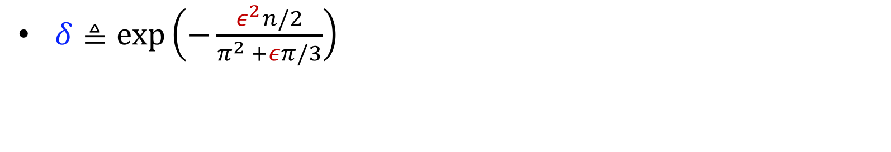
Establishing Convergence Rate
Lemma 1: $ℙ\left(\left|\frac{1}{n}\sum_{i=1}^{n}{Z_{i}}\right| ≥ ε\right) ≤ \exp\left(−\frac{ε^{2}n/2}{π^{2} +επ/3}\right)$.
$$≜ δ$$
$δ≜\exp\left(−\frac{ε^{2}n/2}{π^{2} +επ/3}\right)$ ➔ $ε= \frac{4.7}{\sqrt{n}}⋅\ln^{\frac{1}{2}}\left(\frac{1}{δ}\right)$.
Notes:
Here is what we defined: delta is this exponential function.
It is the righthand side of the inequality in above.
-----------------
The exponent contains epsilon.
I can transform this equation to move epsilon to the left side.

Slide 22
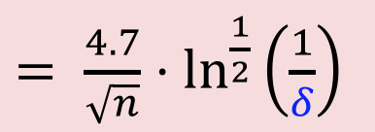
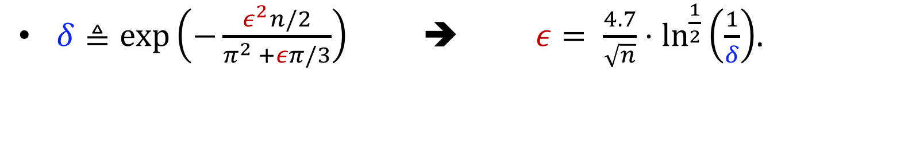
Establishing Convergence Rate
Lemma 1: $ℙ\left(\left|\frac{1}{n}\sum_{i=1}^{n}{Z_{i}}\right| ≥ ε\right) ≤ \exp\left(−\frac{ε^{2}n/2}{π^{2} +επ/3}\right)$.
$= \frac{4.7}{\sqrt{n}}⋅\ln^{\frac{1}{2}}\left(\frac{1}{δ}\right)$
$$≜ δ$$
$δ≜\exp\left(−\frac{ε^{2}n/2}{π^{2} +επ/3}\right)$ ➔ $ε= \frac{4.7}{\sqrt{n}}⋅\ln^{\frac{1}{2}}\left(\frac{1}{δ}\right)$.
Notes:
We get this equation.
epsilon is written as a function of n and delta.
Using this equation,
====================
we replace epsilon in Lemma 1 by the function of n and delta.

Slide 23
Establishing Convergence Rate
Lemma 1: $ℙ\left(\left|\frac{1}{n}\sum_{i=1}^{n}{Z_{i}}\right| ≥ ε\right) ≤ \exp\left(−\frac{ε^{2}n/2}{π^{2} +επ/3}\right)$.
$= \frac{4.7}{\sqrt{n}}⋅\ln^{\frac{1}{2}}\left(\frac{1}{δ}\right)$
$$≜ δ$$
Lemma 2: $ℙ\left(\left|\frac{1}{n}\sum_{i=1}^{n}{Z_{i}}\right| ≥\frac{4.7}{\sqrt{n}}⋅\ln^{\frac{1}{2}}\left(\frac{1}{δ}\right)\right) ≤δ$.
Notes:
In this way, Lemma 1 is equivalently transformed to Lemma 2.
Lemma 2 contains only n and delta; it does not contain epsilon.
=========================
Lemma 2 looks complicated.
It is not easy to understand.
Let's write it in an equivalent way.

Slide 24
Establishing Convergence Rate
Lemma 2: $ℙ\left(\left|\frac{1}{n}\sum_{i=1}^{n}{Z_{i}}\right| ≥\frac{4.7}{\sqrt{n}}⋅\ln^{\frac{1}{2}}\left(\frac{1}{δ}\right)\right) ≤δ$.
Lemma 2’: $\left|\frac{1}{n}\sum_{i=1}^{n}{Z_{i}}\right|≤\frac{4.7}{\sqrt{n}}⋅\ln^{\frac{1}{2}}\left(\frac{1}{δ}\right)$ holds w.p. at least $1−δ$.
Notes:
I write Lemma 2 in this way to make it easier to understand.
==========================
This inequality means that the average of the random variables is close to zero.
==========================
The absolute value of the average is bounded by this term.
----------------------------------------------
Because of the randomness in Z, this inequality can sometimes fail.
==========================
The failure probability is delta.
The inequality holds with probability at least 1 minus delta.
----------------------------------------------
Next, let’s use Lemma 2 to show the convergence rate of the Monte Carlo algorithm.
最后我要拿 引理二 来推导出蒙特卡洛算法的收敛率。

Slide 25
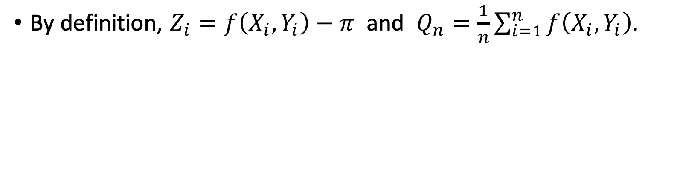
Establishing Convergence Rate
Lemma 2: $ℙ\left(\left|\frac{1}{n}\sum_{i=1}^{n}{Z_{i}}\right| ≥\frac{4.7}{\sqrt{n}}⋅\ln^{\frac{1}{2}}\left(\frac{1}{δ}\right)\right) ≤δ$.
Lemma 2’: $\left|\frac{1}{n}\sum_{i=1}^{n}{Z_{i}}\right|≤\frac{4.7}{\sqrt{n}}⋅\ln^{\frac{1}{2}}\left(\frac{1}{δ}\right)$ holds w.p. at least $1−δ$.
By definition, $Z_{i}=f\left(X_{i},Y_{i}\right)−π$ and $Q_{n}=\frac{1}{n}\sum_{i=1}^{n}{f\left(X_{i},Y_{i}\right)}$.
Notes:
We have defined the variables, $Z_{i}$ and $Q_{n}$.
==========================
$Z_{i}$ is defined as $f\left(X_{i},Y_{i}\right)−π$.
Recall that $f\left(X_{i},Y_{i}\right)$ is the estimate of $π$ based on only one random sample.
${\text{Z}}_{i}=f\left(X_{i},Y_{i}\right)−π$ is the error of the approximation to $π$.
==========================
$Q_{n}$ is the average of $f\left(X_{i},Y_{i}\right)$.
$Q_{n}$ is the outcome of Monte Carlo estimation.
If n is big, then $Q_{n}$ should be very close to $π$.

Slide 26
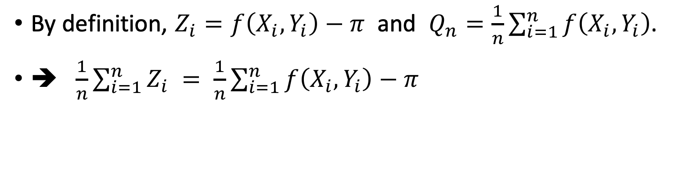
Establishing Convergence Rate
Lemma 2: $ℙ\left(\left|\frac{1}{n}\sum_{i=1}^{n}{Z_{i}}\right| ≥\frac{4.7}{\sqrt{n}}⋅\ln^{\frac{1}{2}}\left(\frac{1}{δ}\right)\right) ≤δ$.
Lemma 2’: $\left|\frac{1}{n}\sum_{i=1}^{n}{Z_{i}}\right|≤\frac{4.7}{\sqrt{n}}⋅\ln^{\frac{1}{2}}\left(\frac{1}{δ}\right)$ holds w.p. at least $1−δ$.
By definition, $Z_{i}=f\left(X_{i},Y_{i}\right)−π$ and $Q_{n}=\frac{1}{n}\sum_{i=1}^{n}{f\left(X_{i},Y_{i}\right)}$.
➔ $\frac{1}{n}\sum_{i=1}^{n}{Z_{i}} = \frac{1}{n}\sum_{i=1}^{n}{f\left(X_{i},Y_{i}\right)−π} = Q_{n}−π$.
Notes:
Using the definition of $Z_{i}$, we obtain this equation.
The average of $Z_{i}$ is equal to the average of $f\left(X_{i},Y_{i}\right)$ minus $π$.

Slide 27

Establishing Convergence Rate
Lemma 2: $ℙ\left(\left|\frac{1}{n}\sum_{i=1}^{n}{Z_{i}}\right| ≥\frac{4.7}{\sqrt{n}}⋅\ln^{\frac{1}{2}}\left(\frac{1}{δ}\right)\right) ≤δ$.
Lemma 2’: $\left|\frac{1}{n}\sum_{i=1}^{n}{Z_{i}}\right|≤\frac{4.7}{\sqrt{n}}⋅\ln^{\frac{1}{2}}\left(\frac{1}{δ}\right)$ holds w.p. at least $1−δ$.
By definition, $Z_{i}=f\left(X_{i},Y_{i}\right)−π$ and $Q_{n}=\frac{1}{n}\sum_{i=1}^{n}{f\left(X_{i},Y_{i}\right)}$.
➔ $\frac{1}{n}\sum_{i=1}^{n}{Z_{i}} = \frac{1}{n}\sum_{i=1}^{n}{f\left(X_{i},Y_{i}\right)−π} = Q_{n}−π$.
$$≜Q_{n}$$
Notes:
By definition, the average of $f\left(X_{i},Y_{i}\right)$ is equal to $Q_{n}$.

Slide 28
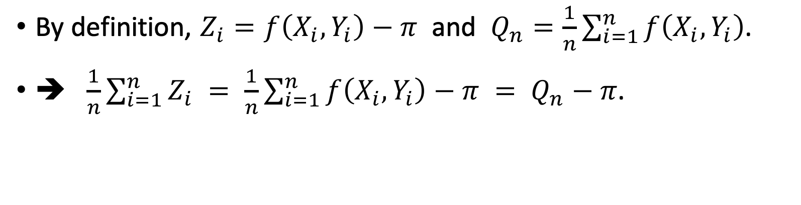
Establishing Convergence Rate
Lemma 2: $ℙ\left(\left|\frac{1}{n}\sum_{i=1}^{n}{Z_{i}}\right| ≥\frac{4.7}{\sqrt{n}}⋅\ln^{\frac{1}{2}}\left(\frac{1}{δ}\right)\right) ≤δ$.
Lemma 2’: $\left|\frac{1}{n}\sum_{i=1}^{n}{Z_{i}}\right|≤\frac{4.7}{\sqrt{n}}⋅\ln^{\frac{1}{2}}\left(\frac{1}{δ}\right)$ holds w.p. at least $1−δ$.
By definition, $Z_{i}=f\left(X_{i},Y_{i}\right)−π$ and $Q_{n}=\frac{1}{n}\sum_{i=1}^{n}{f\left(X_{i},Y_{i}\right)}$.
➔ $\frac{1}{n}\sum_{i=1}^{n}{Z_{i}} = \frac{1}{n}\sum_{i=1}^{n}{f\left(X_{i},Y_{i}\right)−π} = Q_{n}−π$.
Notes:
We therefore obtain the righthand side, $Q_{n}−π$.
We conclude that the average of Z is equal to $Q_{n}−π$.

Slide 29

Establishing Convergence Rate
Lemma 2: $ℙ\left(\left|\frac{1}{n}\sum_{i=1}^{n}{Z_{i}}\right| ≥\frac{4.7}{\sqrt{n}}⋅\ln^{\frac{1}{2}}\left(\frac{1}{δ}\right)\right) ≤δ$.
Lemma 2’: $\left|\frac{1}{n}\sum_{i=1}^{n}{Z_{i}}\right|≤\frac{4.7}{\sqrt{n}}⋅\ln^{\frac{1}{2}}\left(\frac{1}{δ}\right)$ holds w.p. at least $1−δ$.
$$≜\left|Q_{n}−π\right|$$
Notes:
We proved that the absolute value of the average is equal to the absolute value of $Q_{n}−π$.

Slide 30
Establishing Convergence Rate
Lemma 2: $ℙ\left(\left|\frac{1}{n}\sum_{i=1}^{n}{Z_{i}}\right| ≥\frac{4.7}{\sqrt{n}}⋅\ln^{\frac{1}{2}}\left(\frac{1}{δ}\right)\right) ≤δ$.
Lemma 2’: $\left|\frac{1}{n}\sum_{i=1}^{n}{Z_{i}}\right|≤\frac{4.7}{\sqrt{n}}⋅\ln^{\frac{1}{2}}\left(\frac{1}{δ}\right)$ holds w.p. at least $1−δ$.
$$≜\left|Q_{n}−π\right|$$
Theorem: $\left|Q_{n}−π\right|≤\frac{4.7}{\sqrt{n}}⋅\ln^{\frac{1}{2}}\left(\frac{1}{δ}\right)$ holds w.p. at least $1−δ$.
Notes:
Finally, we obtain our main theorem.
======================
The lefthand side is the absolute value of $Q_{n}−π$.
Recall that $Q_{n}$ is the outcome of the Monte Carlo approximation based on n random samples.
We use $Q_{n}$ to approximate $π$.
So the absolute value of $Q_{n}−π$ is the error of Monte Carlo approximation.
We wish the error is as small as possible.
======================
The theorem shows that the error is bounded.
Look at the underlined term.
The error decays as n grows.
The convergence rate is one over square root n.
It means if we grow n by 100 times, the error will be 10 times smaller.
If we grow n by a million times, the error will get 1000 times smaller.

Slide 31
Thank you!
Notes:
这节课就讲到这里，感谢大家观看。

