Slide 1
Memory Vault
A.Bhargavi
A.Hyma Hithyshini
M. Naga Bhavya Sree
M.Praneetha

Slide 2
Project Proposal: Vision and Goals
Vision:
To provide a structured, secure, and interactive platform for users to document, store, and revisit their life memories in an engaging digital format.
Goals:
Enable user authentication and profile management.
Support story creation with images and travel dates.
Implement search, filtering, and pinning functionalities.
Implement a seamless user experience with intuitive UI/UX.

Slide 3
Problem Statement and Solution Approach
Problem Statement
Many people struggle to maintain a structured, organized, and private archive of their life experiences. Traditional journaling methods lack the ability to securely store media and categorize memories effectively.
Existing platforms mix varied content, making it hard to find authentic experiences.
Solution Approach
We propose a Site where users can:
Create, edit, and share travel stories with images and dates.
Search and filter stories by location, date, and category.
Pin favorite stories for quick access.

Slide 4
Technology Stack and Architecture Plan
Technology Stack:
Frontend: React.js
Backend: Node.js & Express.js
Database: MongoDB & Firebase
Architecture Plan:
User interacts with the frontend UI.
Data is stored and retrieved from MongoDB.
Media files are uploaded to Firebase.

Slide 5

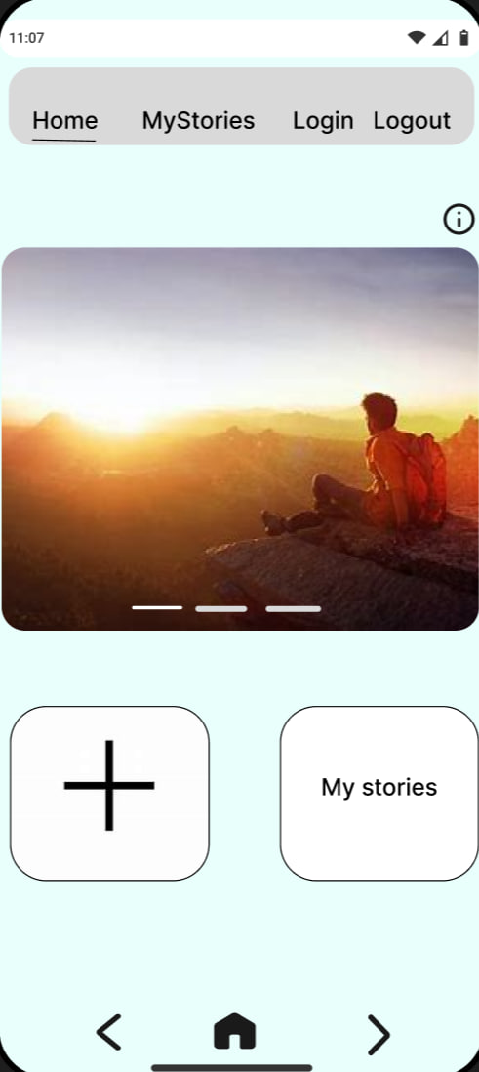
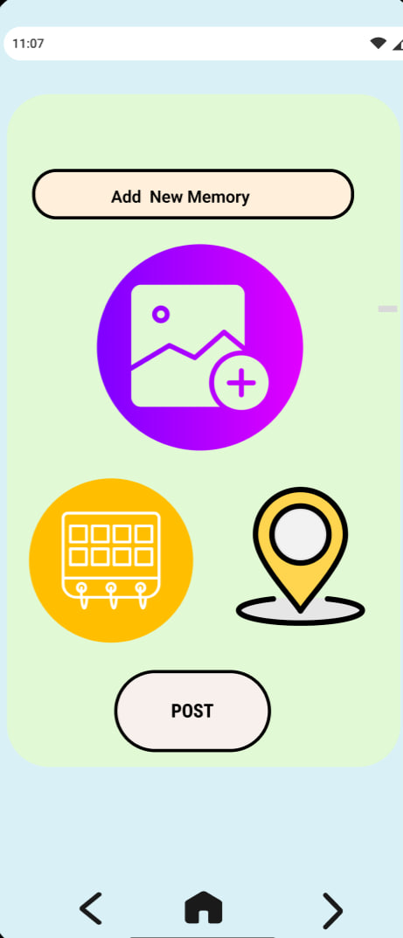
Wireframes

Slide 6
Database Flow
Database Schema:
Users Collection: Stores user details and authentication info.
Stories Collection: Stores travel stories with images and timestamps
Data Flow:
The user interacts with frontend.
Requests are sent to backend APIs.
Data is fetched/stored in MongoDB

Slide 7
Development Strategy
Phase 1: Develop CRUD functionalities for story management.
Phase 2: Implement authentication and media storage .
Phase 3: Enhance UI/UX for smooth navigation .
Phase 4: Optimize search and filtering features.

Slide 8
Challenges & Next Steps
Challenges:
Ensuring secure authentication.
Managing image uploads efficiently.
Optimizing database queries for performance.
Next Steps :
Optimize UI for better engagement.
Plan deployment strategy.

