Slide 1
HWSE Tomcat and Docker Overview Jon Gunnip 1/16/2018
Bob Zitelli
1/7/2013

Slide 2
Tomcat and Docker Overview
What is Tomcat?
What is Docker?
Docker Terminology
Testing in Tomcat/Docker
Developing in Tomcat/Docker
Resources

Slide 3

What is Tomcat?
Application container for deploying Java web applications
Open source
The industry standard
http://tomcat.apache.org
Lighter-weight alternative to WebSphere (if not using EJB)

Slide 4
What is Tomcat?
Simpler to install, configure, deploy to, and manage
Installing is unzipping an 9.5 MB zip file
WebSphere zip is 1600 MB
Configuring is changing some text files
Deploying is copying a war to a folder
Managing is start/stop
In development, full deploy takes 2 minutes in Tomcat, about 1 hour 20 minutes in WebSphere

Slide 5
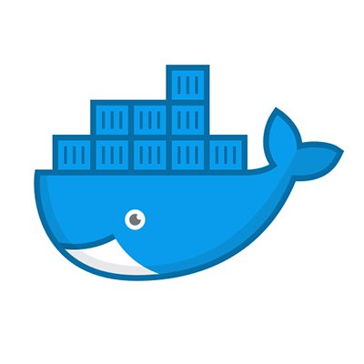
What is Docker?
A technology and a company
Built around concept of a container – a lightweight VM that includes all aspects of application (OS, Java, wars, Wily, configuration) that can run alongside other containers in a VM
Easier to scale up and down
To change Docker container, deploy a new image (immutable)

Slide 6
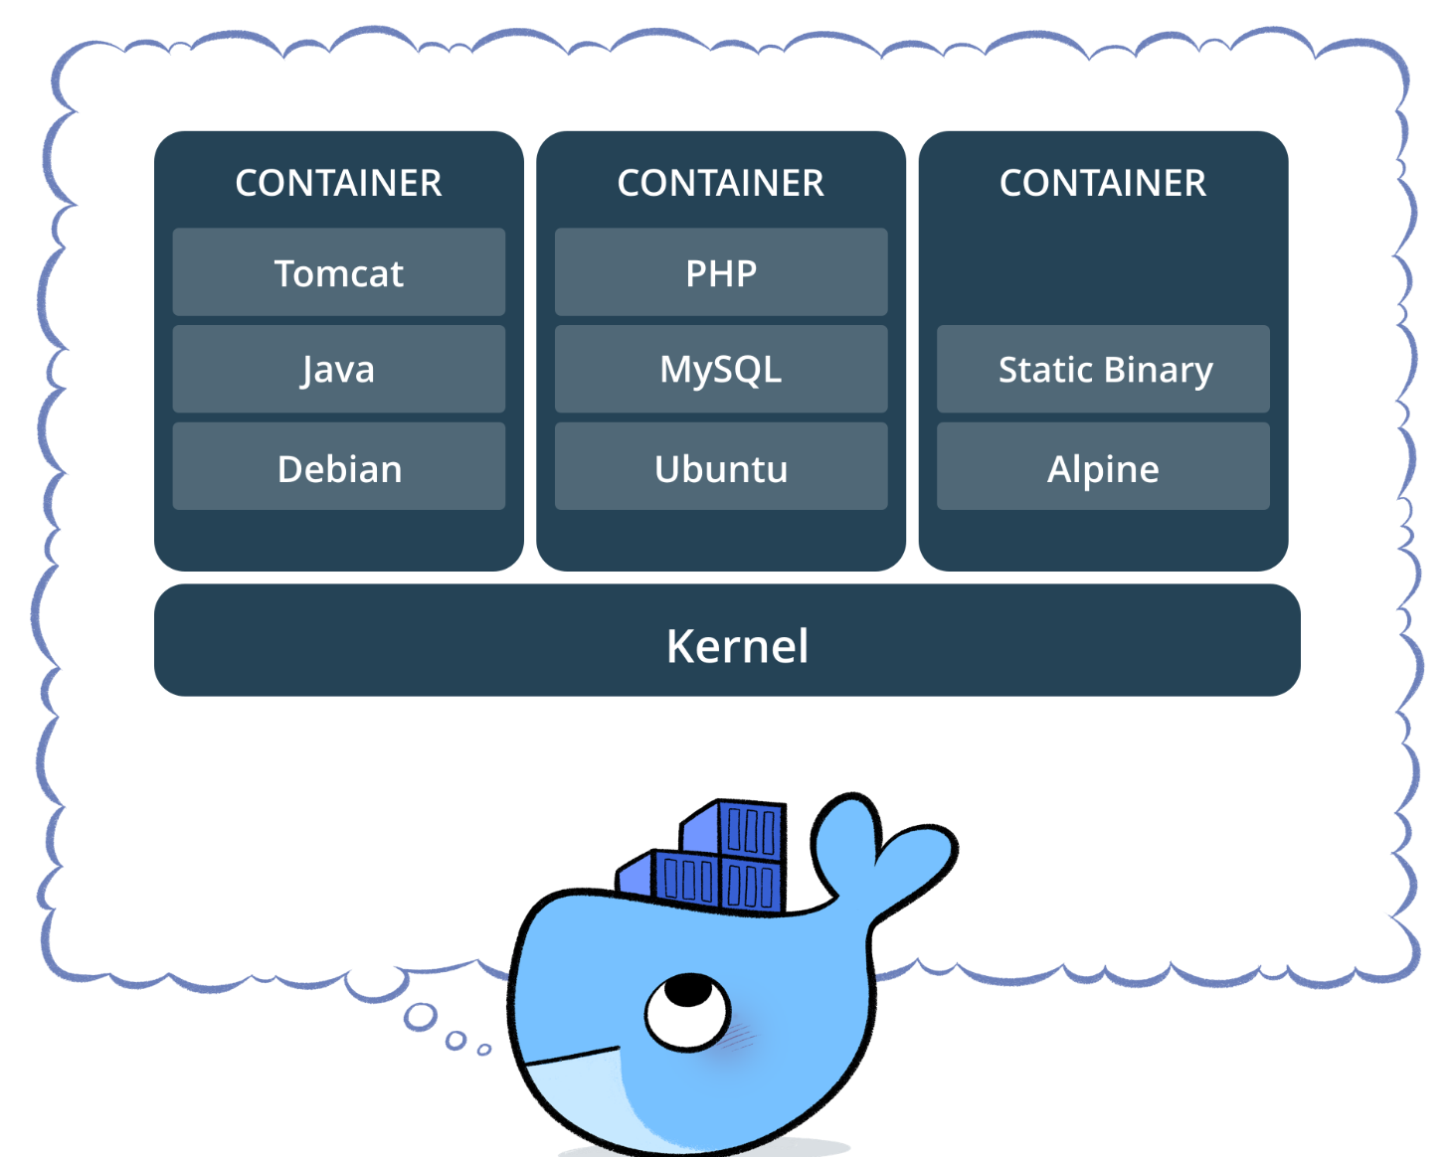
What is Docker?

Slide 7
Docker Terminology
Image – deployable binary containing the OS variant, application, supporting binaries and configuration
Container – an executing image
Swarm – orchestration engine that deploys containers to one or more nodes (servers)
Docker Compose – tool for deploying containers to the swarm
UCP – Universal Control Panel - administration UI for the swarm

Slide 8
Testing in Tomcat/Docker
Docker env will have new URL’s
WebSphere going away for Standalone
UCP – lets you see what is running and for how long
Logs are written directly to Splunk – there are no logfiles
Deployments – eventually more ownership
Testing on feature branches
Automation as part of the build

Slide 9
Developing in Tomcat/Docker
All development done in Tomcat
Build and Publish process is similar using Ant commands
Overview of Tomcat layout and configuration
Use of Logback for logging

Slide 10
Developing in Tomcat/Docker
Docker requires Windows 10 (with particular setup) or Mac
Running Docker is useful in general but often not needed for most people
Docker image is controlled by Dockerfile
Docker variation by environment is provided by docker-compose-<env>.yml
Docker images are deployed to Docker Trusted Registry as part of build

Slide 11
Developing in Tomcat/Docker
Docker deployments are done as part of image build process (DIT) or deployment dashboard (all other environments)
Docker apps should not use local storage in container
Docker apps should be stateless (e.g. Redis)
Docker means more responsibility for development for deployment, monitoring, and troubleshooting
Docker infrastructure and tools are still a work in progress

Slide 12
Resources
https://confluence.es.ad.adp.com/display/HWSE/Migration+to+Tomcat
https://confluence.es.ad.adp.com/display/HWSE/Migration+to+Docker

