Slide 1

Vivekanand Education Society’s Institute Of Technology
Department Of Information Technology
DSA mini Project
A.Y. 2024-25
Title: Expression Evaluator Game
Sustainability goal: Quality education
Domain: Software development/ Educational Technology
Group Members:
Member 1 : Hitika Shirangi (56)
Member 2: Krish Satpal (54)
Mentor Name: Mrs. Kajal Jewani

Slide 2


Slide 3
Content
Introduction to the Project
Problem Statement
Objectives of the Project
Scope of the Project
Requirements of the System (Hardware, Software)
Data Structure & Concepts Used
Algorithm Explanation
Time and Space Complexity
Implementation
Gantt Chart
13. Test Cases
14.Challenges and Solutions
15. Future Scope
16. Code
17. Output Screenshots
18. Conclusion
19. References (in IEEE Format)

Slide 4
Introduction to Project
r Rates
The Expression Evaluator Game is a text-based educational game designed to enhance users' understanding of mathematical expressions using expression trees. The game challenges players to evaluate mathematical expressions by guessing the results, encouraging logical thinking and a better grasp of arithmetic operations.

Slide 5
Problem Statement
r Rates
Mathematical expressions can sometimes be difficult to evaluate, especially for beginners. Traditional methods of learning mathematical logic might not engage students effectively. This project addresses the need for an interactive tool that helps users practice and improve their ability to understand and evaluate mathematical expressions in a fun and engaging way.

Slide 6
Objectives of the project
To create an interactive game where users can guess the outcome of mathematical expressions using expression trees.
To provide a learning tool that enhances logical thinking and arithmetic skills.
To allow users to practice evaluating postfix expressions through game-based interaction.
To develop a game that is easy to use, making it accessible for educational purposes.

Slide 7
Scope of the project
Objectives:
Enhance users' arithmetic skills through an interactive platform.
Provide a fun and engaging learning experience.
Key Features:
Construction of expression trees for visualizing mathematical operations.
Level-based difficulty (easy, medium, hard) for varying skill levels.
Input validation to ensure correct user responses.
Scoring system to track user performance.
Visual representation of expression trees for better understanding.
Target Audience:
Middle and high school students.
Teachers as a supplemental classroom resource.
Math enthusiasts seeking to improve their skills.

Slide 8
Requirements of the system (Hardware, software)
Hardware:
Basic PC/laptop
Minimum 1 GB RAM
Minimum 1 GHz processor
Software:
Operating System: Windows
Programming Language: C
IDE: Visual Studio Code
Compiler: MinGW
lem Statement
Problem Statement

Slide 9
Data Structure and concepts used
Expression Tree:
A binary tree where nodes represent operators (internal) and operands (leaf).
Node Structure: typedef struct Node {
char value;
struct Node* left;
struct Node* right;
} Node;
Dynamic Memory Allocation:
Nodes created using malloc() for efficient memory usage.
Recursion:
Used in evaluate() for calculating expressions and printTree() for displaying the tree.

Slide 10
Algorithm Explanation
Node Creation:
Create a new node for each operand or operator in the expression.
Building the Expression Tree:
Recursively construct the tree based on the operator precedence.
Assign left and right children for each operator node.
Evaluation of Expression:
Base Case: If the node is a leaf (operand), return its value.
Recursive Case: Evaluate the left and right subtrees.
Apply the operator to the results of the left and right evaluations.
Printing the Tree:
Use a recursive function to traverse the tree.
Print the structure with appropriate spacing to visualize the hierarchy.
Game Logic:
Generate expressions of varying difficulty.
Prompt the user for answers and evaluate their responses.
Keep track of the score and provide feedback after each guess.

Slide 11
Time complexity
Time Complexity:
The overall time complexity for the entire program can be considered O(n), where n is the number of nodes in the expression tree generated during gameplay.
Space Complexity:
The overall space complexity for the expression evaluator program can be approximated as O(n) where n is the number of nodes

Slide 12
Implementation
The implementation is done in C, using dynamic memory allocation for nodes in the expression tree. A Node structure is defined to represent each node, with a function for creating new nodes. Functions are created to generate expressions of varying complexity (easy, medium, hard) and to construct the corresponding expression trees. A recursive function evaluates the tree, utilizing a switch-case to compute results based on operators. The game loop displays the expression tree, prompts the user for answers, and validates their responses while keeping track of the score. Additionally, functions are implemented for printing the tree, showing welcome and thank you ASCII art, and displaying a loading animation.

Slide 13
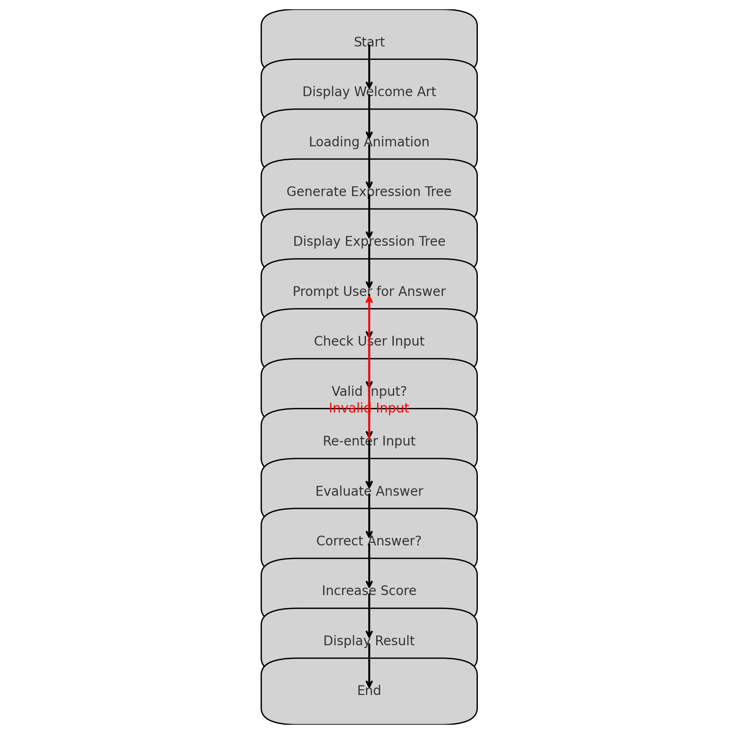
Flow chart

Slide 14
Gantt Chart
TASK | WEEK 1 | WEEK 2 | WEEK 3 | WEEK 4
Problem definition | X
Logic evaluation |  | X
Coding and implementation |  |  | X
Testing and debugging |  |  |  | X
Final review and submission |  |  |  | X
Notes:
The max flow algorithm in the visualization is :-

Slide 15
Test cases
Test Case 1: Easy Level Expression 1
Input: User guesses the result of the expression: (2 + 3) * 4
Expected Output: Correct if user inputs 20, otherwise incorrect.
Reason: The expression tree evaluates to 5 * 4 = 20.
Test Case 2: Easy Level Expression 2
Input: User guesses the result of the expression: 10 / (2 + 3)
Expected Output: Correct if user inputs 2, otherwise incorrect.
Reason: The expression tree evaluates to 10 / 5 = 2.
Test Case 3: Medium Level Expression
Input: User guesses the result of the expression: (2 + 3) * (4 - 1)
Expected Output: Correct if user inputs 15, otherwise incorrect.
Reason: The expression tree evaluates to 5 * 3 = 15.
Test Case 4: Hard Level Expression
Input: User guesses the result of the expression: 10 / (2 + 3) * (4 - 1)
Expected Output: Correct if user inputs 6, otherwise incorrect.
Reason: The expression tree evaluates to 2 * 3 = 6.
Test Case 5: Invalid Input
Input: User inputs a non-integer value (e.g., "abc").
Expected Output: The program should handle the error gracefully and prompt the user to enter a valid integer.
Reason: To ensure the robustness of the program by validating user input.

Slide 16
Challenges and solutions
Challenge: Visualizing the expression tree in a structured format was challenging, as it needed to be clear and understandable. Solution: Created a recursive function to print the tree with appropriate spacing to represent the tree structure visually. This helped in clearly displaying the relationships between nodes.
Challenge: Input Validation Solution: Implemented input validation loops to check if the input is an integer. If the input was invalid, the program would prompt the user again without crashing.
Challenge: As the project grew, maintaining code clarity and readability became difficult, especially with multiple functions and data structures. Solution: Used typedef for structures and added comments to the code for better documentation.

Slide 17
Future scope
Improved User Interface: Develop a graphical interface to enhance user interaction.
Support for More Operations: Expand the system to handle trigonometric and logarithmic functions.
Multi-Expression Evaluator: Allow users to evaluate multiple expressions simultaneously.

Slide 18
Code
Node Structure: typedef struct Node {
char value;
struct Node* left;
struct Node* right;
} Node;
Create Node Function: Node* createNode(char value) {
Node* newNode = (Node*)malloc(sizeof(Node));
newNode->value = value;
newNode->left = newNode->right = NULL;
return newNode;
}
Evaluate Function: int evaluate(Node* root) {
if (root->left == NULL && root->right == NULL)
return root->value;
int leftEval = evaluate(root->left);
int rightEval = evaluate(root->right);
switch (root->value) {
case '+': return leftEval + rightEval;
case '-': return leftEval - rightEval;
case '*': return leftEval * rightEval;
case '/': return leftEval / rightEval;
default: return 0;
}
}
Print Tree Function: void printTree(Node* root, int space) { /* Implementation */ }
Main Function: int main() {
welcomeArt();
loadingAnimation();
playGame();
thankYouArt();
return 0;
}

Slide 19
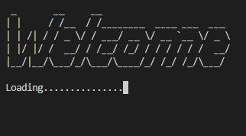
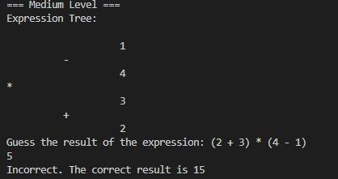
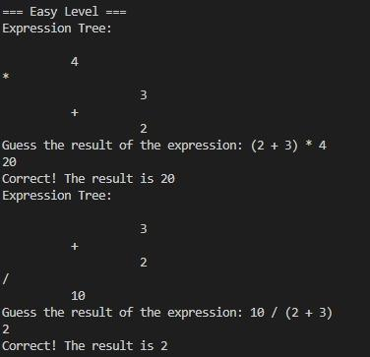
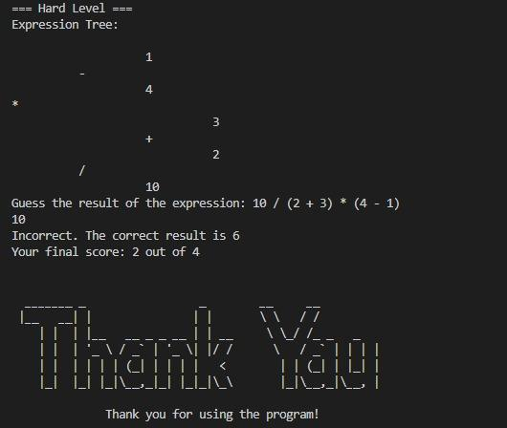
Output screenshots

Slide 20
Conclusion
This project demonstrated the use of Expression Trees and Postfix Notation to evaluate mathematical expressions efficiently.
The algorithm ensures correct order of operations and simplifies expression handling.
With future improvements, this system can evolve into a more comprehensive tool for expression evaluation.

Slide 21
References (in IEEE format)
A. Chukhray, T. Stoliarenko, D. Dvinskykh, and V. Narozhnyy, “Using Expression Trees for Adaptive Learning: A Case Study,” International Journal of Computer Science and Learning Technologies, vol. 45, no. 3, pp. 122-130, May 2020.
R. F. Cohen and R. Tamassia, “Dynamic Expression Trees and Their Applications in Mathematical Computation,” IEEE Transactions on Computer Science, vol. 60, no. 5, pp. 764-771, Sep. 2022.

