Slide 1
DAA Assignment
By – Hitika Rajesh Kumar IIB2019021
Gaurav Yadav IIB2019022
Aditya Raj IIB2019023

Slide 2
Question
Given two integers m & n, find the number of possible sequences of length n such that each of the next element is greater than or equal to twice of the previous element but less than or equal to m.

Slide 3
Initial Approach
According to the question, at most any element in the sequence can have a value of m. Also the sequence is an increasing sequence, so the last element will have the largest value. So, we encounter the following cases:
n-th element is m, so n-1th can have a value of at most m/2.
n-th element isn't m, then it can have a value which is at most m-1.
The above conditions can be used by us to write an algorithm which count the number of such subsequences.

Slide 4
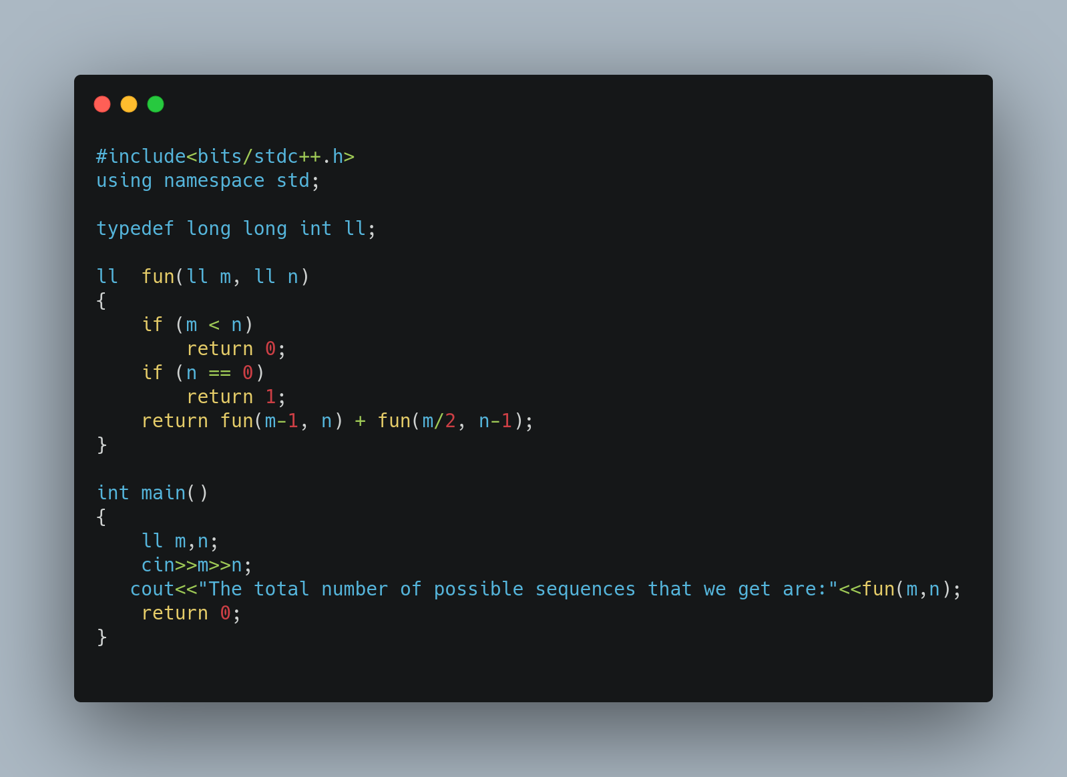

Slide 5
Further improvements
The algorithm implemented in the previous code in simple recursions with multiple-branching (2 to be exact) and therefore we can consider using Dynamic Programming to optimize our solution. The perquisites for DP are:
Overlapping Subproblems – Yes.
Optimal Substructure – Yes.
Therefore, we now add the process of tabulation to our code which can optimize our solution to a great extent.

Slide 6
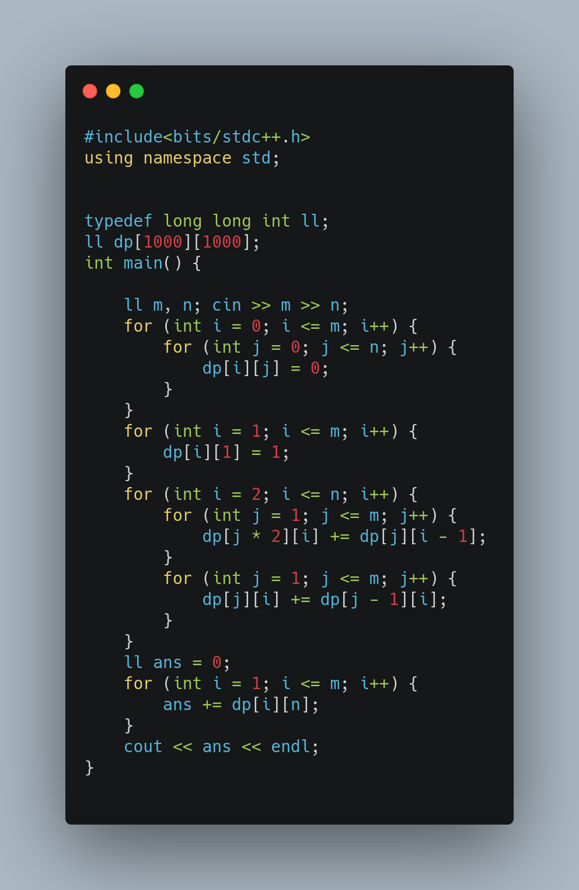

Slide 7
Sample Tabulation taking N as 5, M as 10
Here n=5 and m=10 | m=1 | m=2 | m=3 | m=4 | m=5 | m=6 | m=7 | m=8 | m=9 | m=10 | Ans
n=1 | 1 | 1 | 1 | 1 | 1 | 1 | 1 | 1 | 1 | 1 | 10
n=2 | 0 | 1 | 1 | 2 | 2 | 3 | 3 | 4 | 4 | 5 | 25
n=3 | 0 | 0 | 0 | 1 | 1 | 2 | 2 | 4 | 4 | 6 | 20
n=4 | 0 | 0 | 0 | 0 | 0 | 0 | 0 | 1 | 1 | 2 | 4
n=5 | 0 | 0 | 0 | 0 | 0 | 0 | 0 | 0 | 0 | 0 | 0

Slide 8
Thank You!

