Slide 1
ML Exercise 1
Classification
Group 8:
Alexander Leitner, 01525882
Mario Hiti, 01327428
Peter Holzner, 01426733

Slide 2
Datasets
Classifiers
Heart disease
Amazon
Congressional voting
Polish company bankruptcy
K-Nearest Neighbors (KNN)
Random Forest (RF or RFC)
Multilayer Perceptron (MLP)
Dataset | samples | dimensions | Nominal/ordinal | # of classes | missing values
Heart Disease | 303 | 14 | mixed | 5 | very few
Amazon | 750 | 10000 | ordinal | 40 | no
Companies | 6k | 64 | ordinal | binary | ~1,5%
Congress | 218 | 17 | nominal/binary | binary

Slide 3
Heart Disease

Slide 4
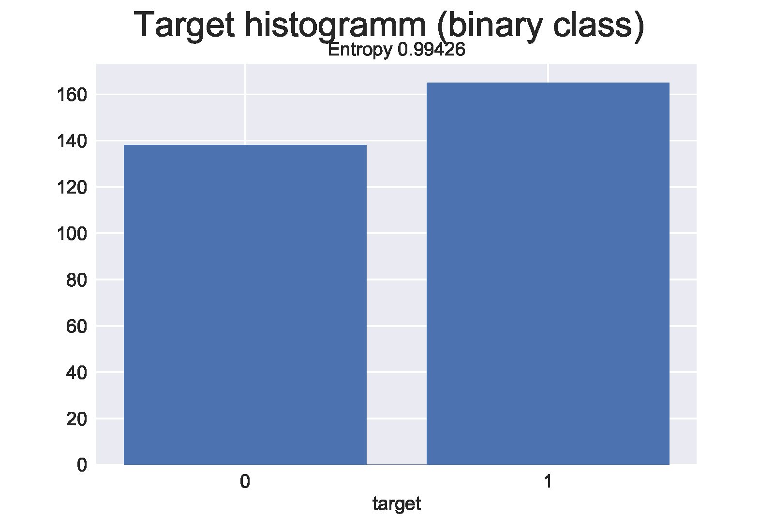
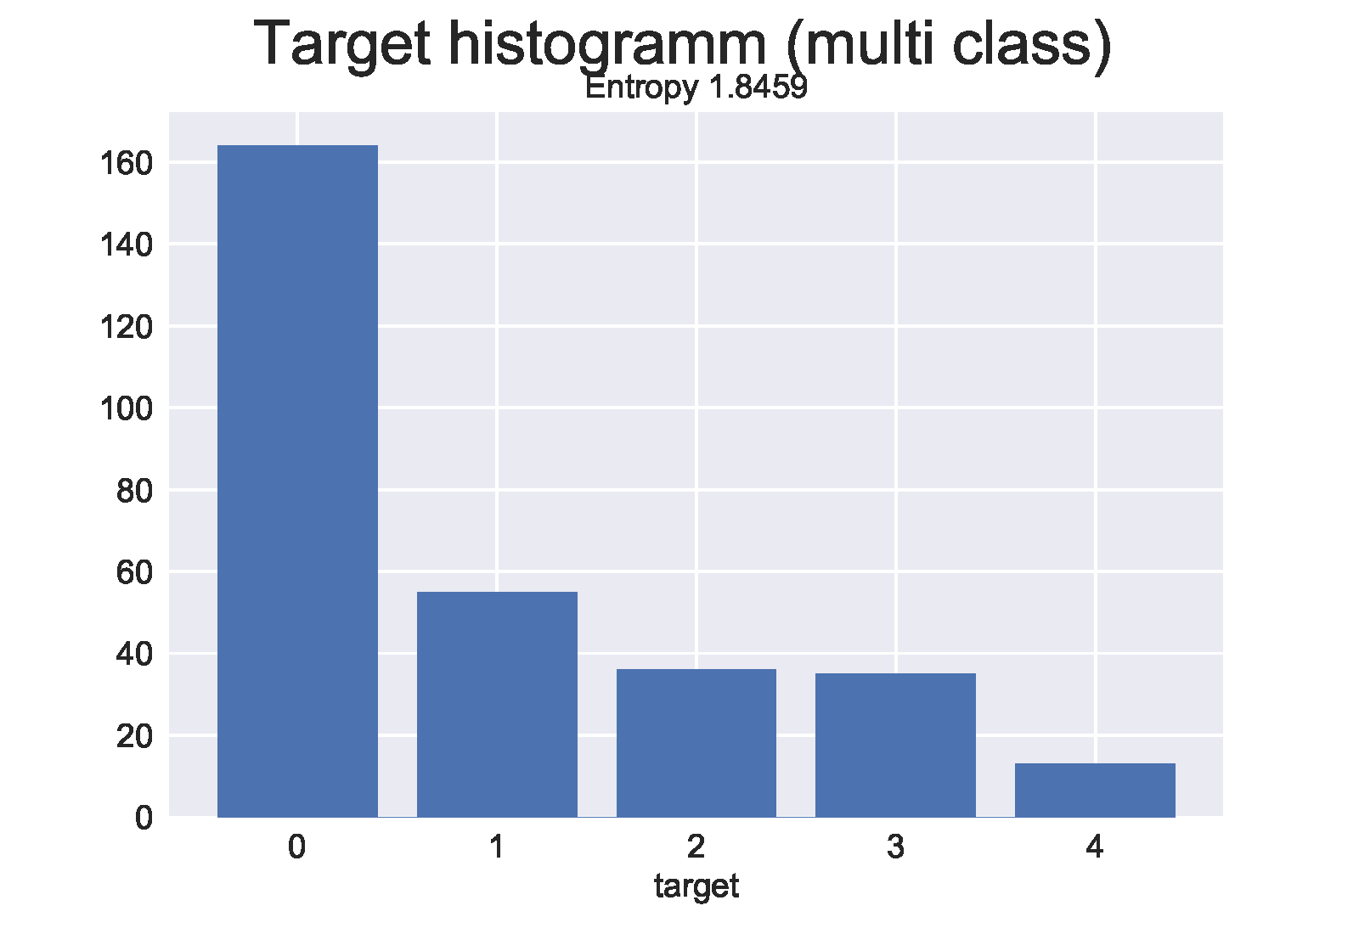
Heart Disease
Small + low dimensional:
Samples: 303
Features: 13 + 1 target
Target (5 classes):
0… no disease
1,2,3,4… different diseases
Uneven target distribution
Evaluation: Accuracy + F1-score (balanced model)
Custom cost matrix: domain expert needed
45.8%
54.2%

Slide 5
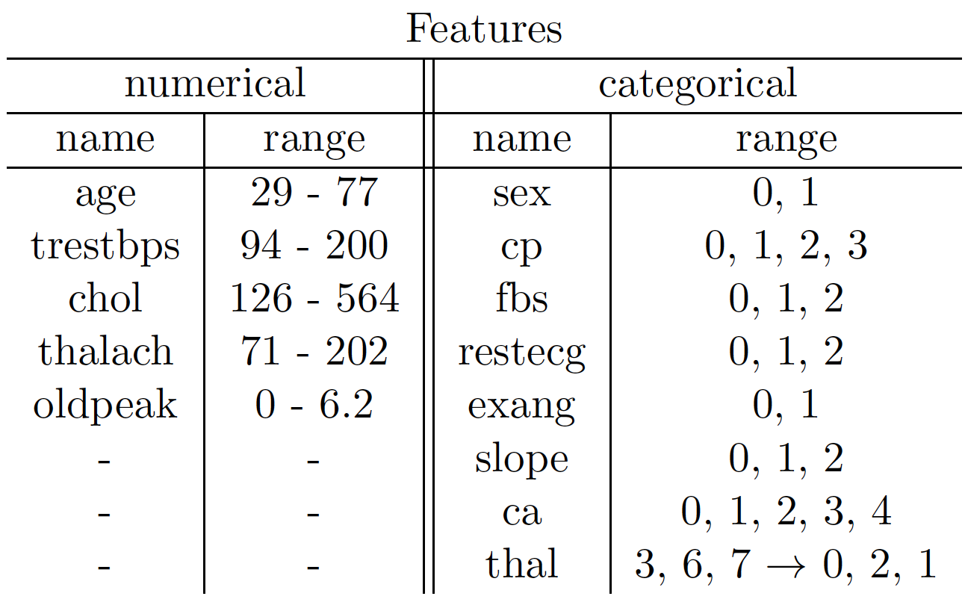
Data preparation
Features:
5 numerical
different ranges → scale
8 categorical
2 - 5 encoded categories per feature
5 samples with missing values in “ca” or “thal” (entry “?” in csv → hard to spot)
1.5% of samples: no gain if imputed → simply drop samples

Slide 6
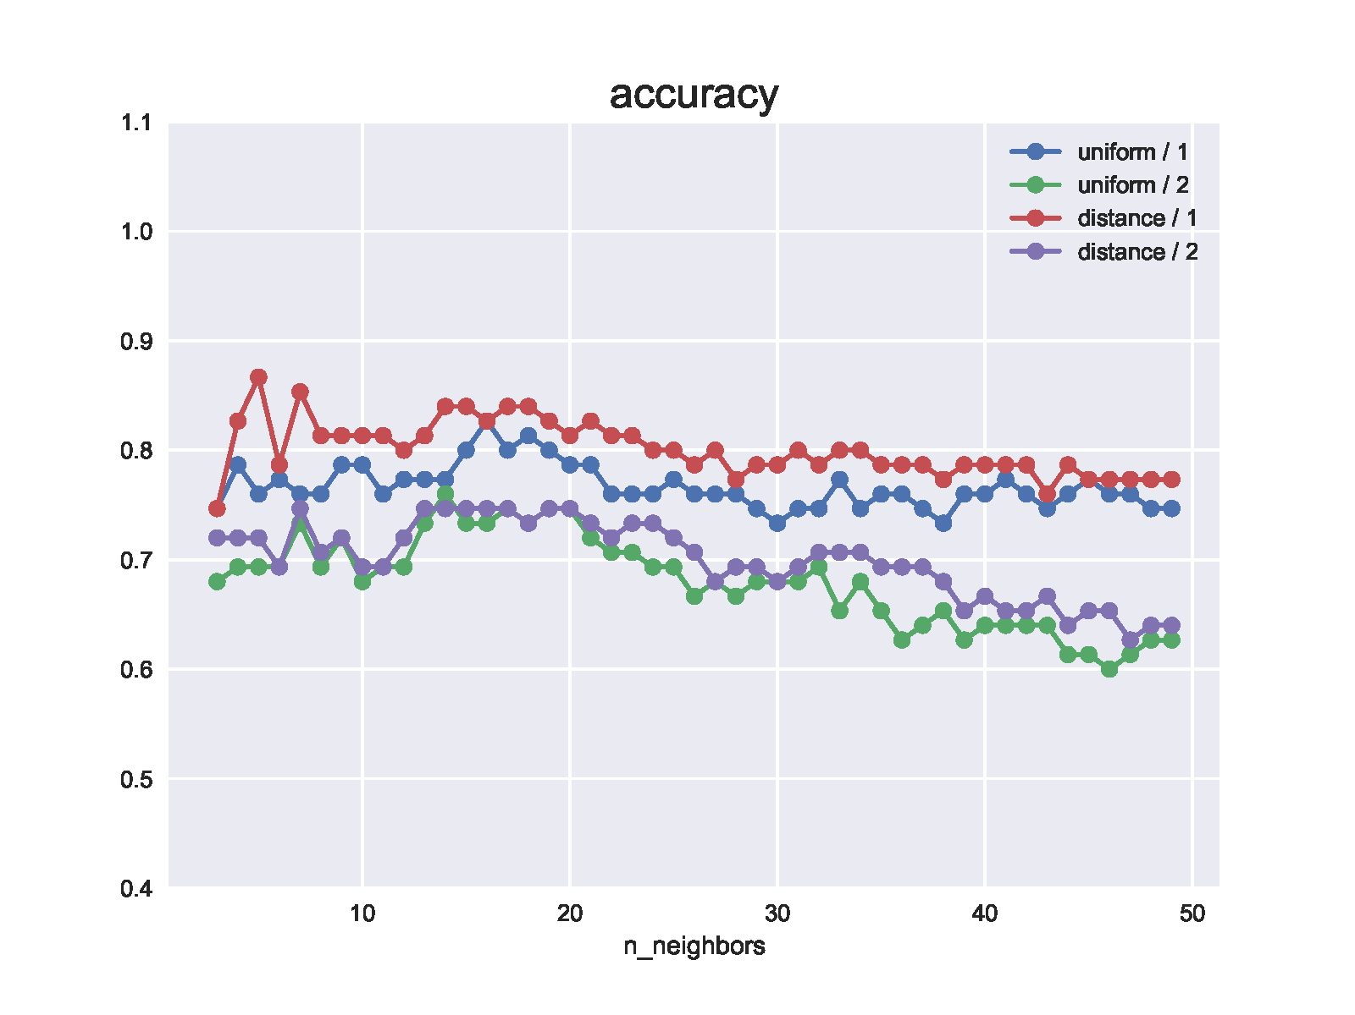
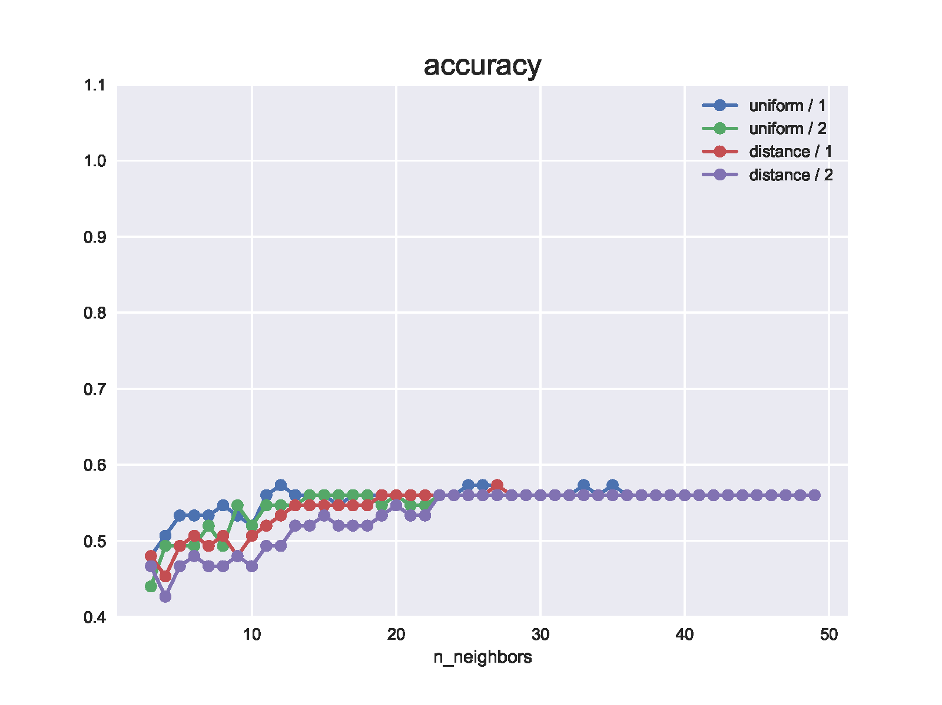
KNN Classifier
k=5
Results:
Unscaled: BAD
CM: only guesses 0
Scaled: OKAY
norm: Manhattan (p=1) > Euclidean (p=2)
weights: distance > uniform
With scaling
Without scaling

Slide 7
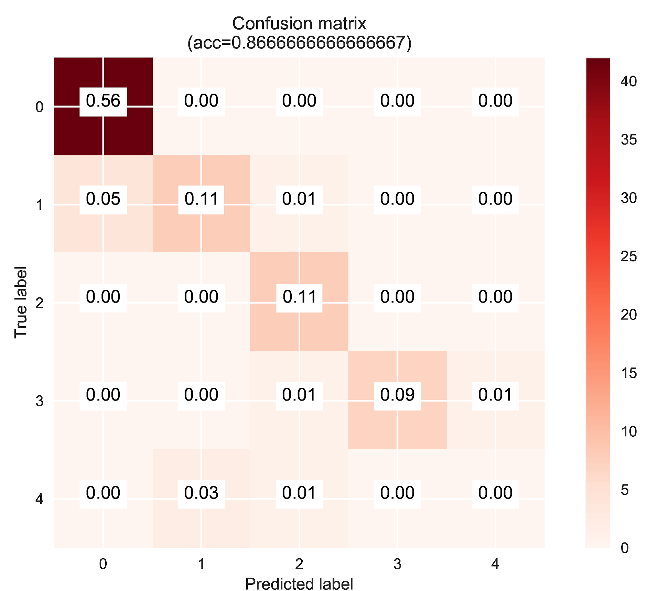
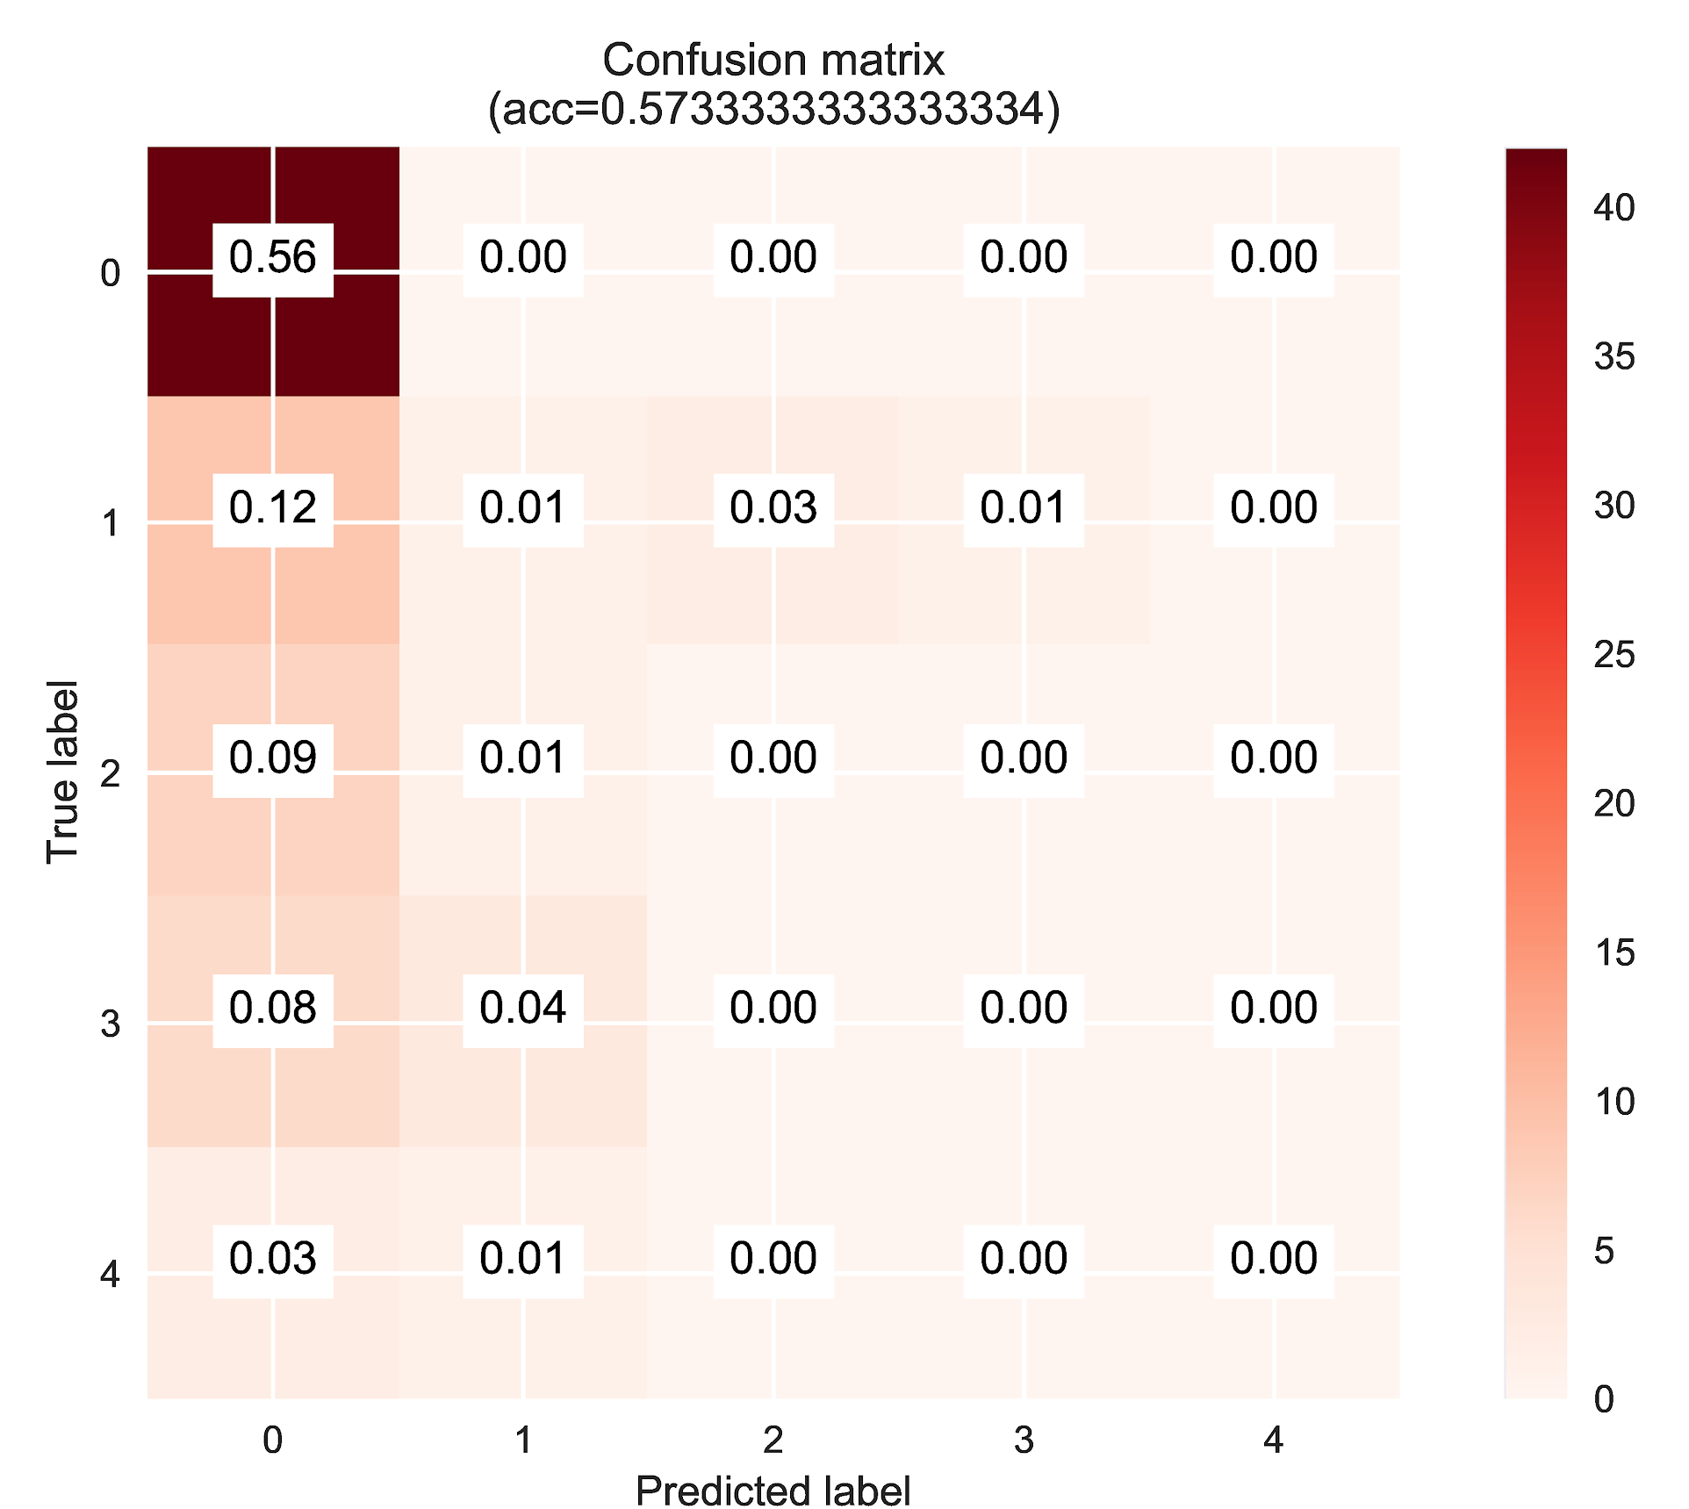
KNN Classifier - Confusion Matrices (BONUS)
Scaled vs. unscaled

Slide 8
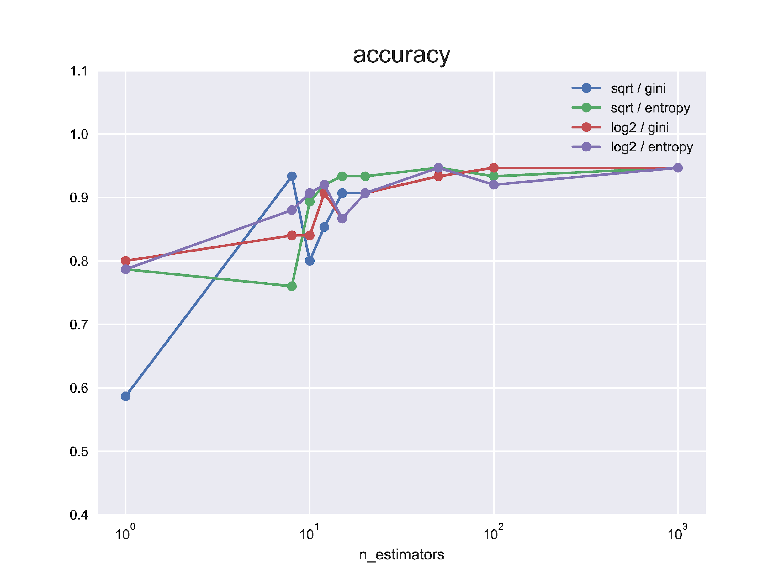
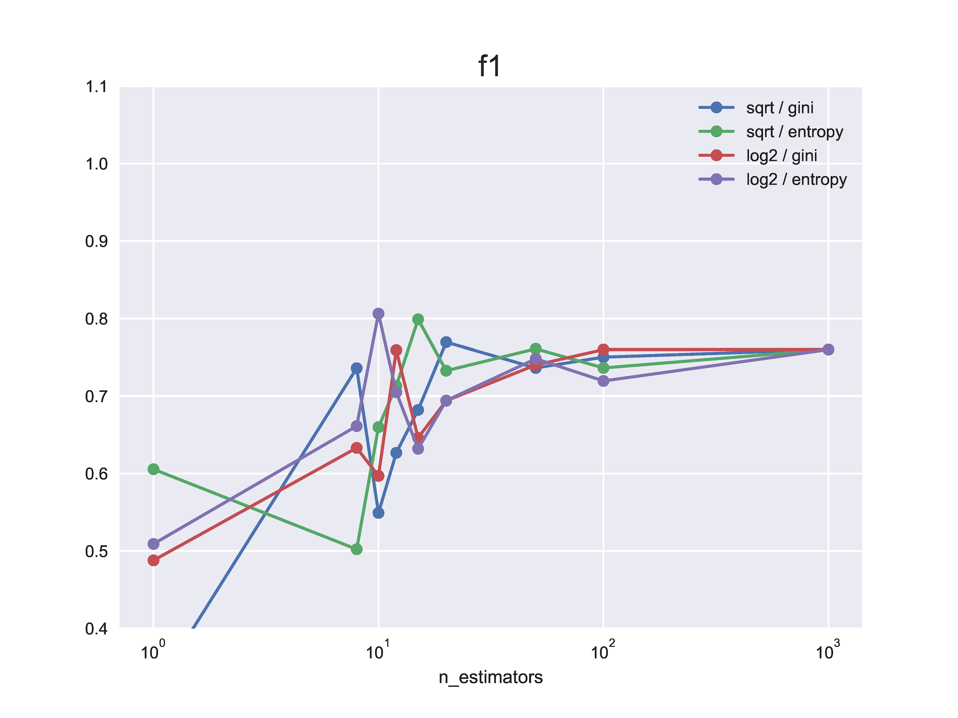
RF Classifier (BONUS)
Results:
scaled, unscaled: no difference
n_estimators:
10 - 20 best
criterion:
entropy > gini
max features (per split):
no difference

Slide 9
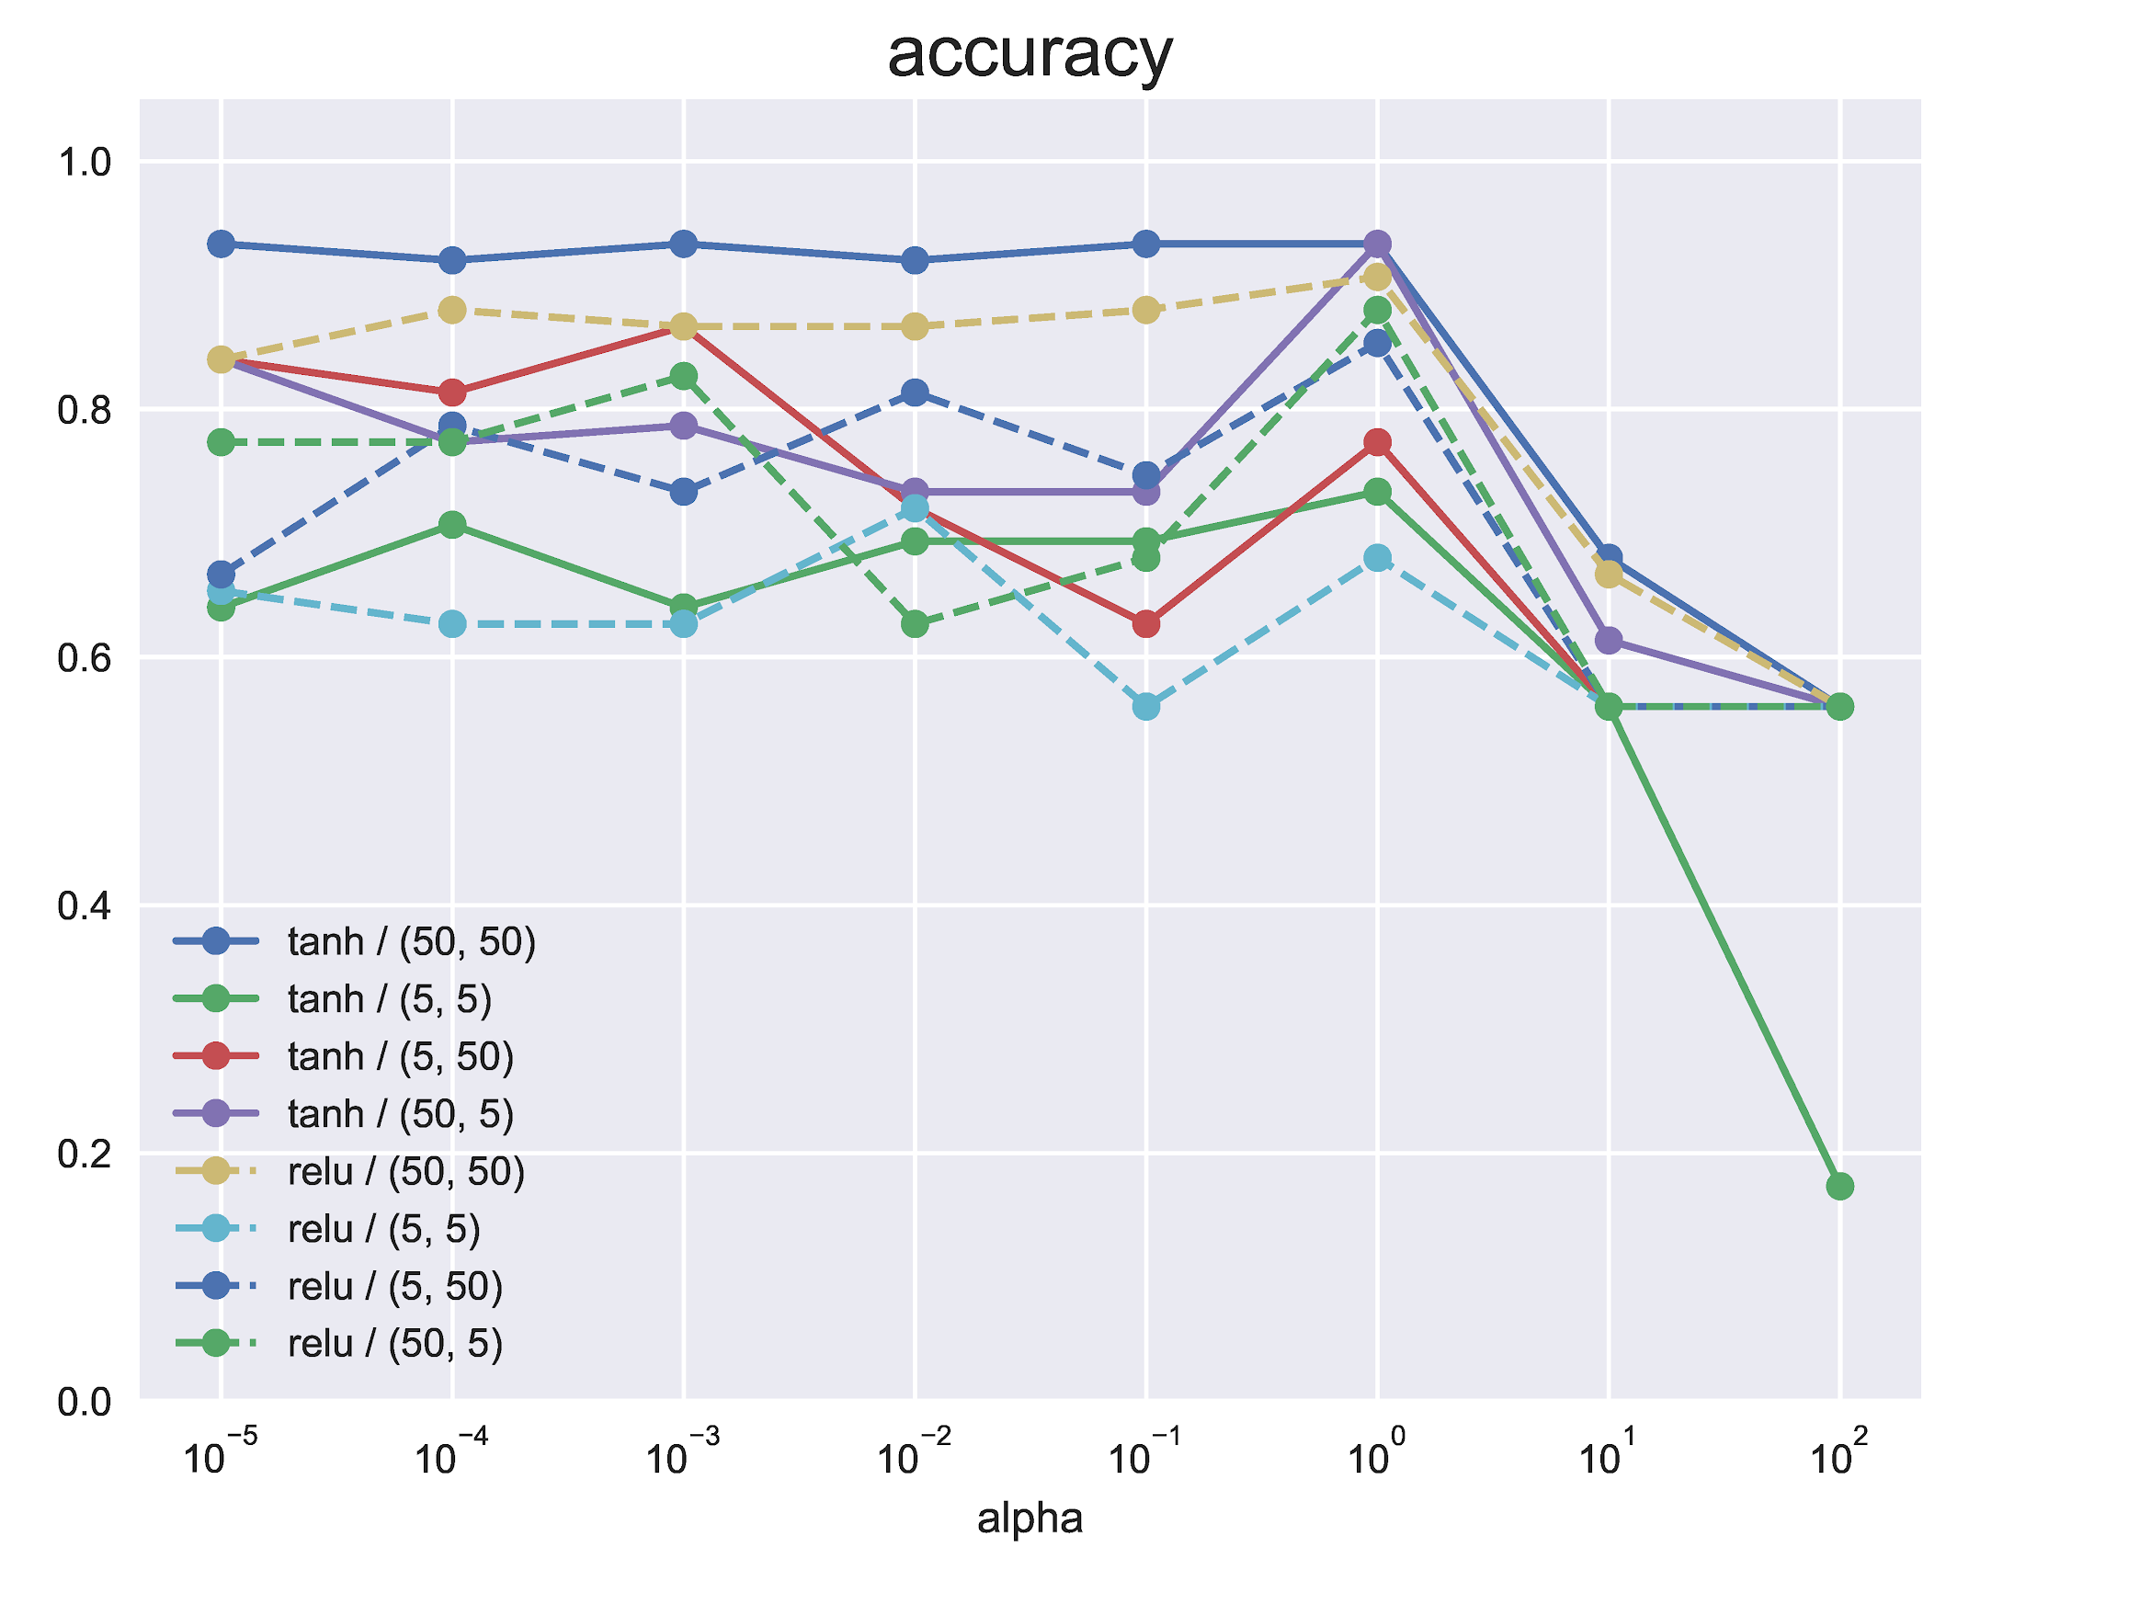
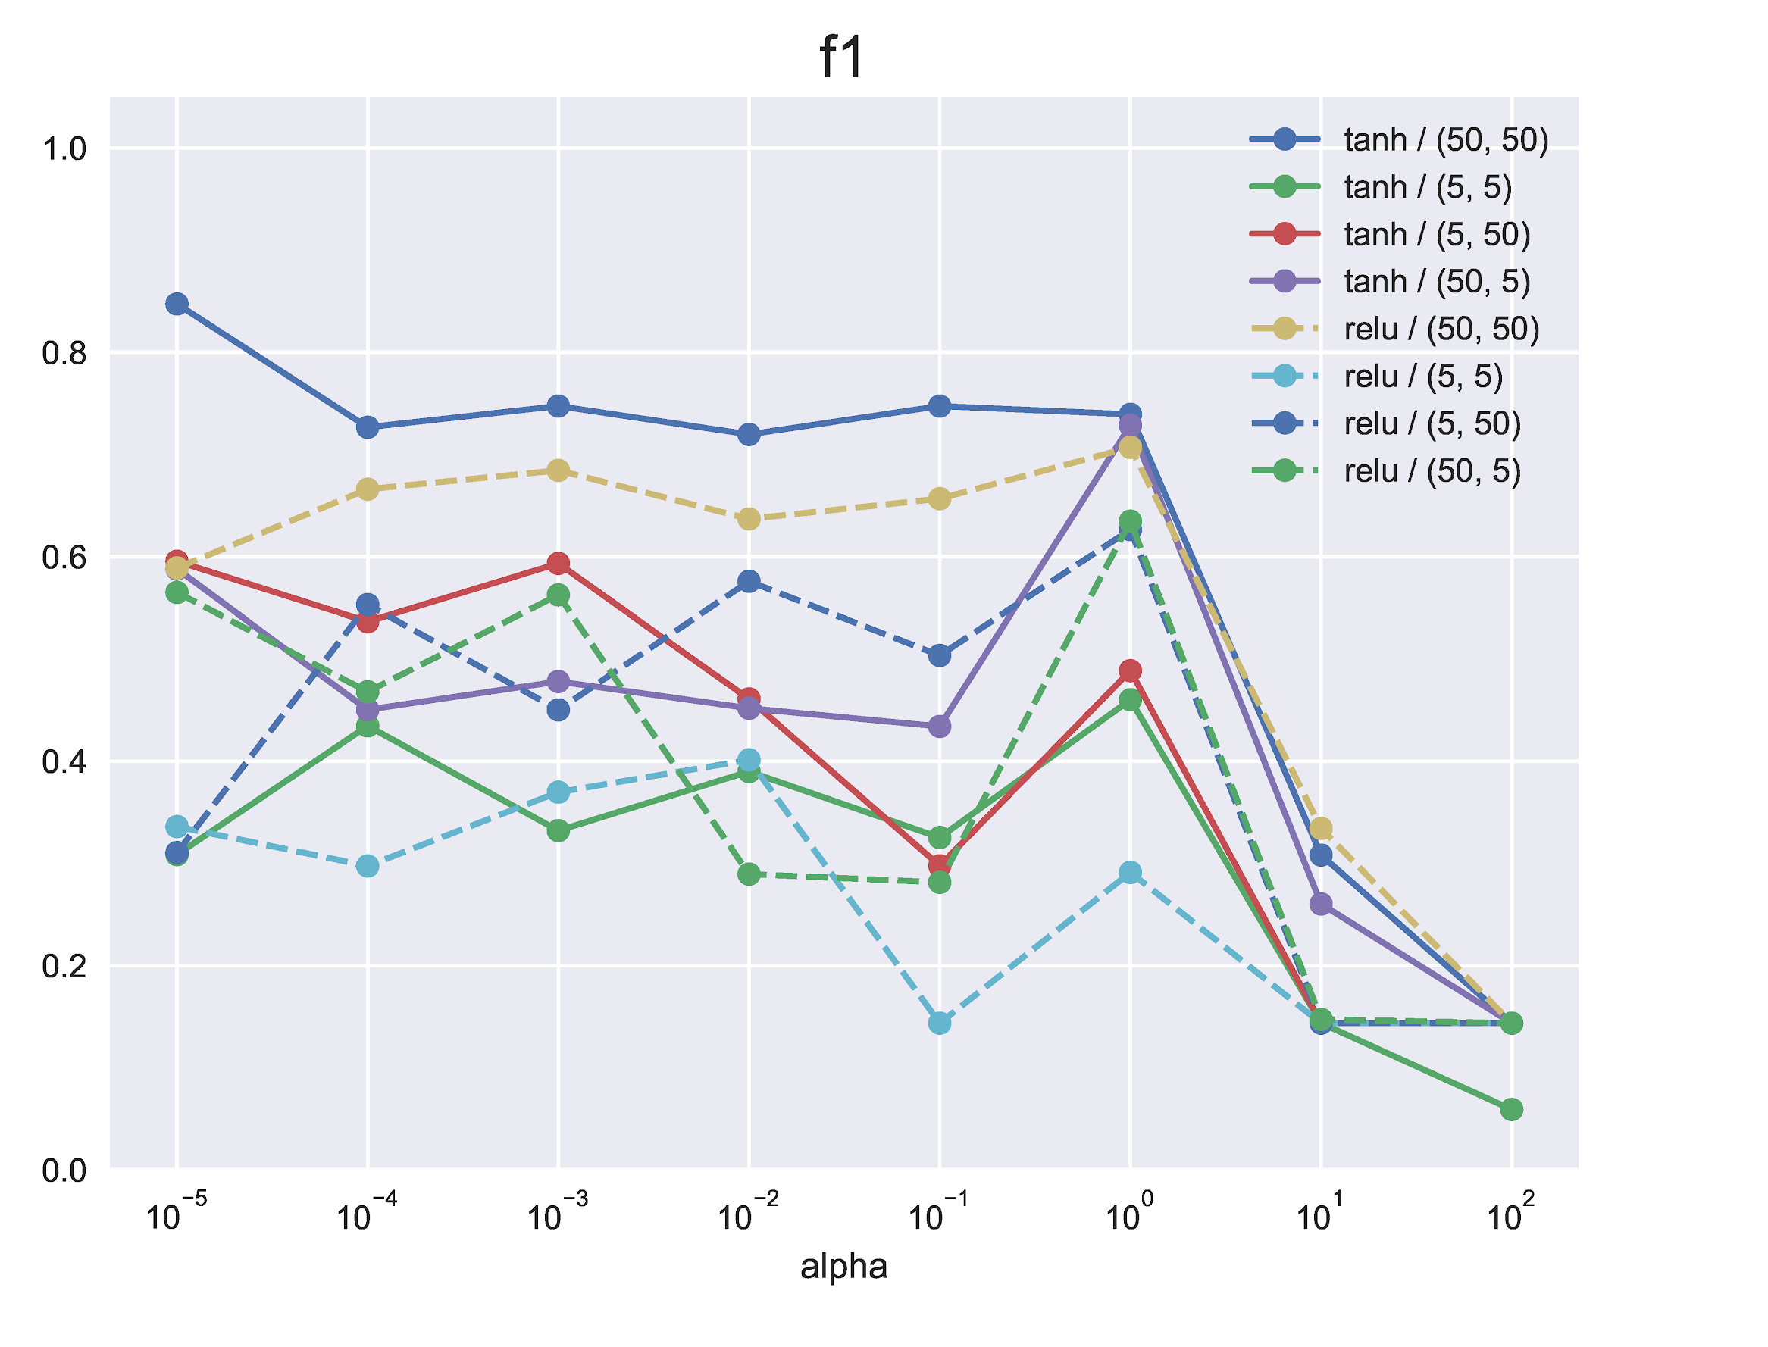
MLP Classifier
Results:
scaled > unscaled data
right side: scaled
Regularization alpha:
1e-5 best (even smaller?)
activation:
mostly relu > tanh
BUT: tanh has best
hidden layers:
bigger = better

Slide 10
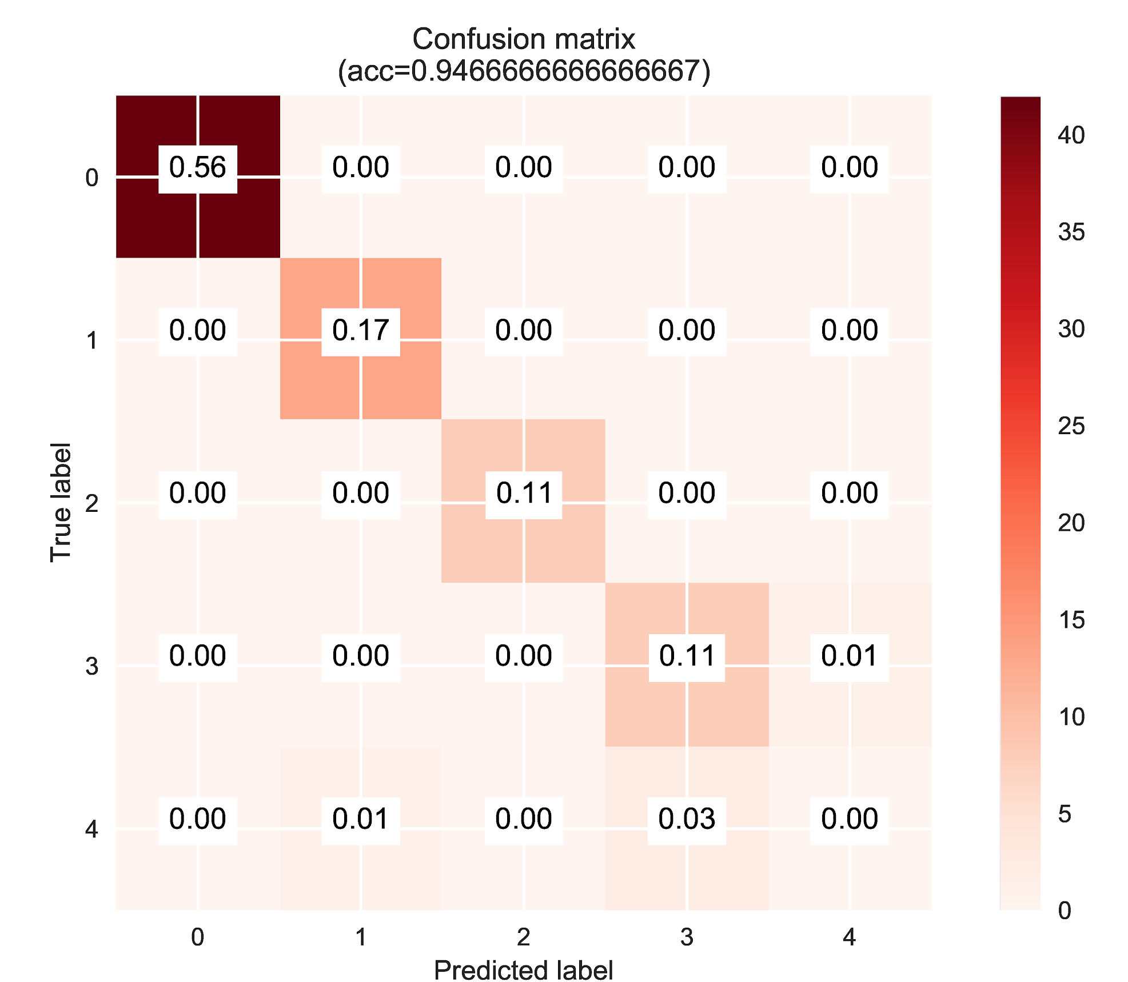
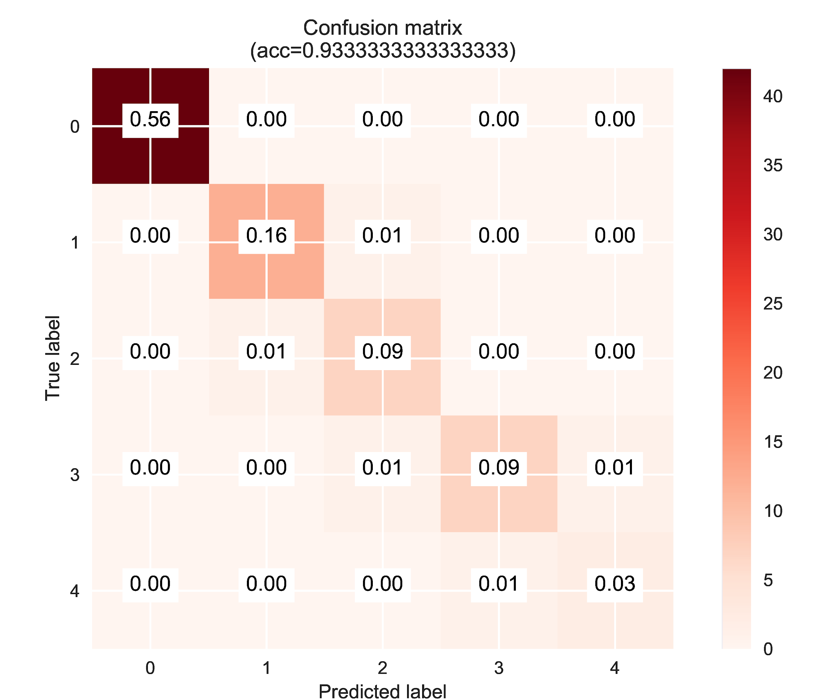
Final decision
WINNER
RF
F1=0.801
MLP
F1=0.847
vs

Slide 11
Amazon

Slide 12
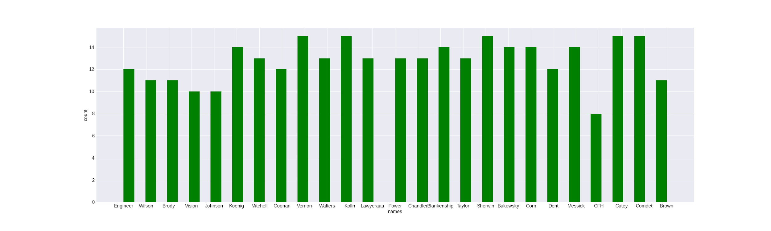
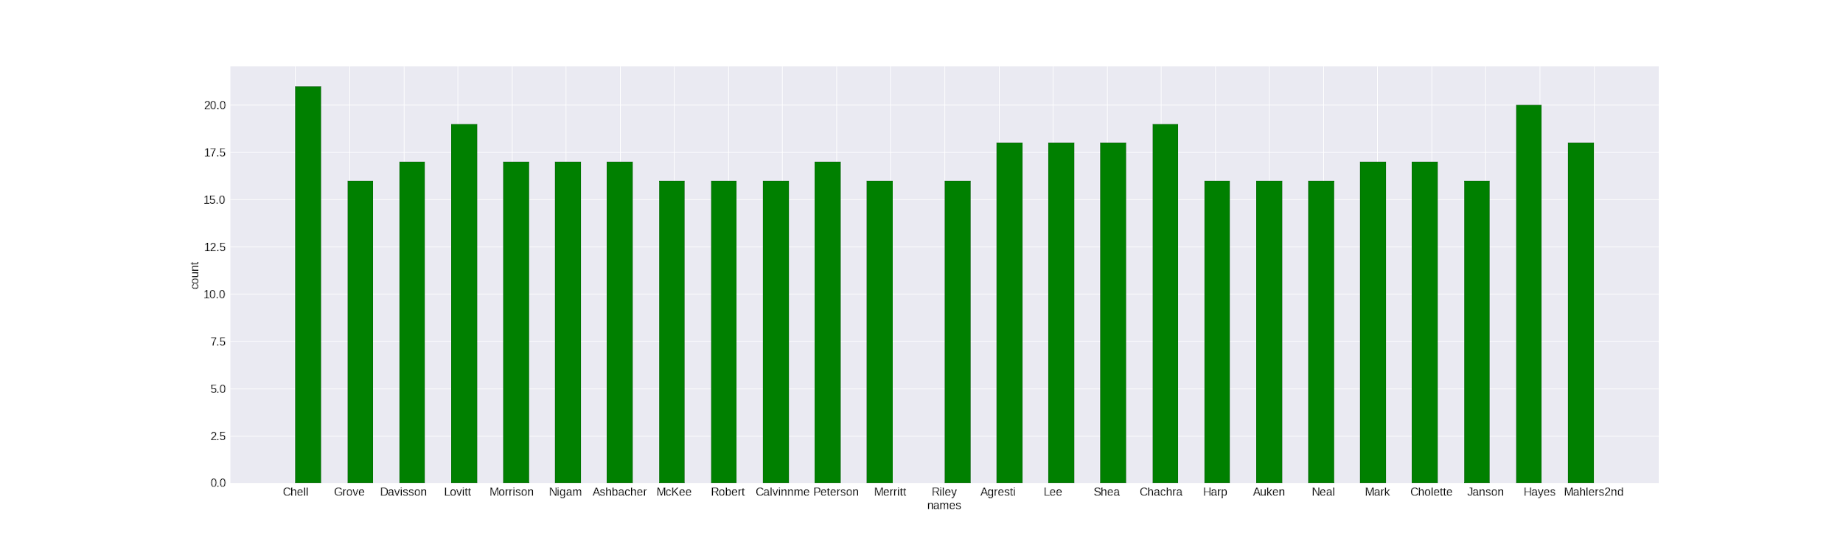
Amazon
Description:
Class: 50 different names
features: numeric values
Preparation:
feature selection: kBest or PCA

Slide 13
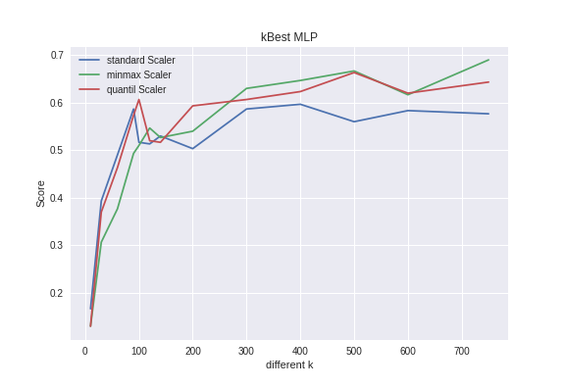
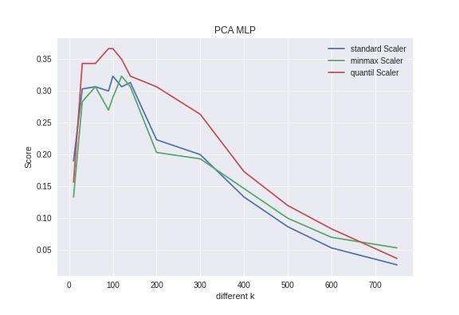
Feature Selection
Classifier | k-value | scaler
Knn | 500 | quantil
RFC | 300 | quantil
MLP | 750 | MinMax

Slide 14
Results
parameter:
KNN n_neighbors = 8; weights = distance; algorithm = auto
RFC n_estimators = 1000; max_features = sqart; criterion = gini
MLP alpha = 0.01; layers = (100,100); solver = lbfgs; activation = tanh
Classifier | score | F1 score | recall | precision | train-time
Knn | 0.477 | 0.453 | 0.489 | 0.537 | 0.059s
RFC | 0.593 | 0.572 | 0.612 | 0.627 | 6.558s
MLP | 0.616 | 0.608 | 0.636 | 0.622 | 10.969s

Slide 15
Congressional Voting

Slide 16
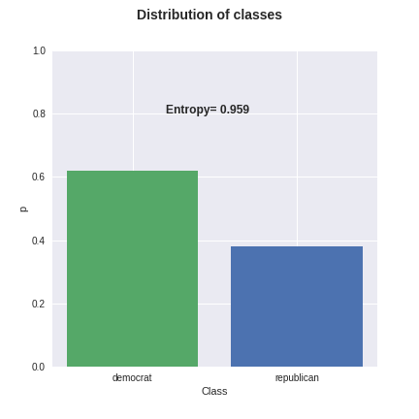
Congressional Voting
Description:
Class: Republicans or Democrats
features: nominal values “y”, “n” and “unknown”
Preparation:
write “n” -> -1; “y” -> 1; “unknown” -> 0
even distributed -> prevent scaling

Slide 17
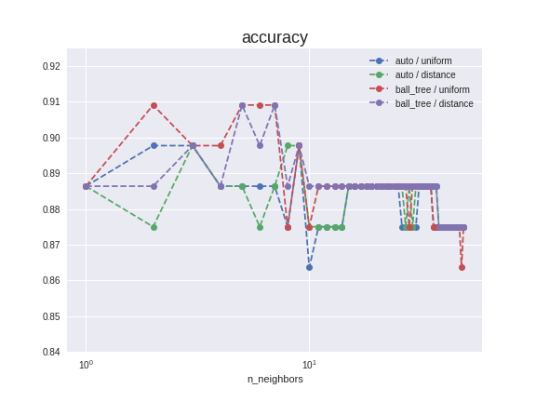
Results KNN
parameter:
auto/ball_free or uniform/distance
results:
very short time
a good score
score | F1 score | precision | recall | runtime
0.915909 | 0.915368 | 0.916842 | 0.914155 | 2.082ms

Slide 18
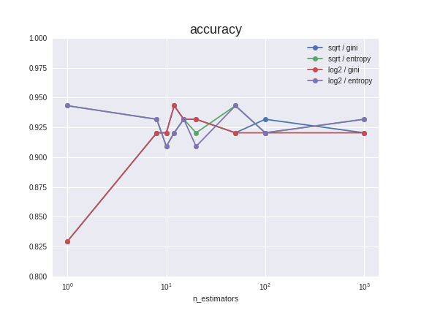
Results RM
parameter:
sqrt/log2 or gini/entropy
results:
better score than the KNN
score | F1 score | precision | recall | runtime
0.9476 | 0.9296 | 0.9276 | 0.92445 | 4.402ms

Slide 19
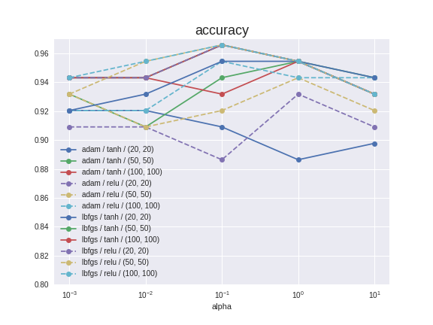
Results MLP
parameter:
sqrt/log2 or gini/entropy
results:
best score
200 times more intensive
score | F1 score | precision | recall | runtime
0.965 | 0.9653 | 0.9641 | 0.9668 | 487.08ms

Slide 20
Polish Company Bankruptcy

Slide 21
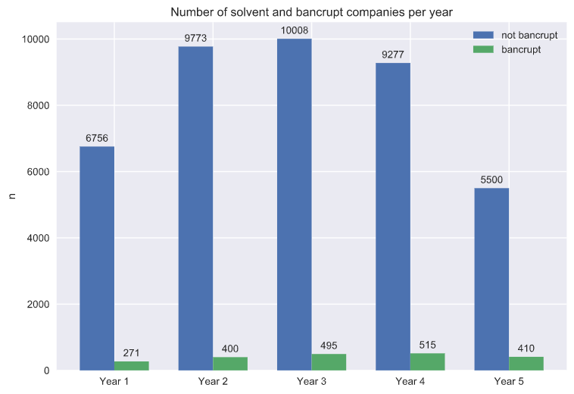
Polish company bankruptcy
5 data sets
5k-10k samples / year
64 dimensions
2 different classes
high imbalance of class distribution ~15:1

Slide 22
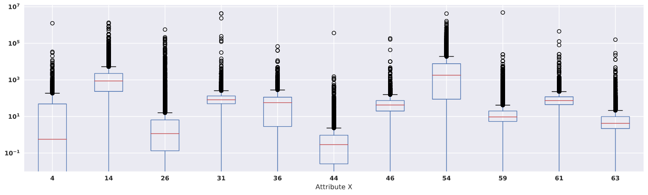
Preprocessing
extreme outliers
mean value
-> Normalization expected to have a positive impact

Slide 23
Rating classifiers / Cost Matrix
FP is much worse than FN
Rating based on normalized cost
1: perfect prediction
0 -1: good model
< 0: bad model
Cost Matrix |  | actual
 |  | solvent | bankrupt
pred. | solvent | -1 (TP) | 100 (FP)
 | bankrupt | 1 (FN) | 0 (TN)

Slide 24
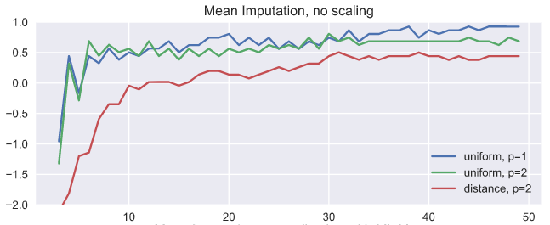
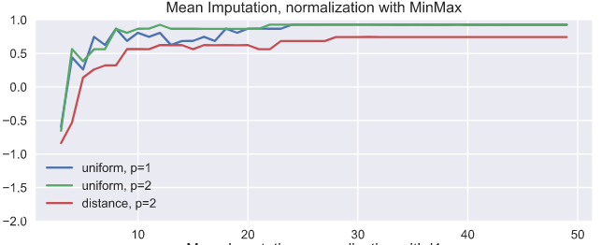
Findings - KNN
n_neighbous

Slide 25
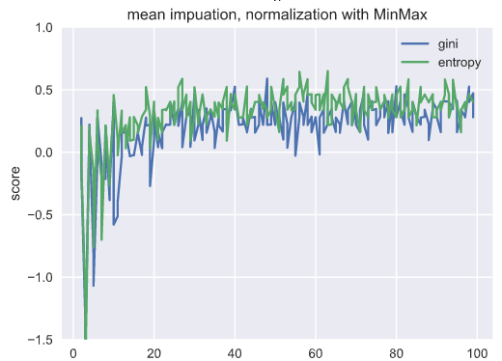
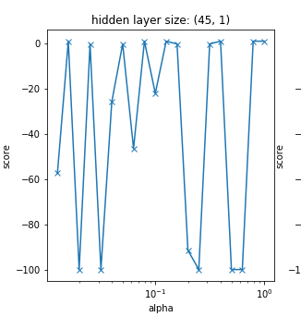
Findings - RFC and MLP
n_estimators

Slide 26

Findings - Conclusion
Cost Matrix |  | actual
 |  | solvent | bankrupt
pred. | solvent | -1 (TP) | 100 (FP)
 | bankrupt | 1 (FN) | 0 (TN)
KNN reached the highest score consistently
Classifiers with few FP are favored due to cost matrix
No model with high recall AND precision was found
=> best models have low recall / high precision

Slide 27
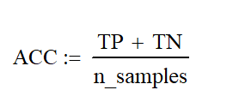

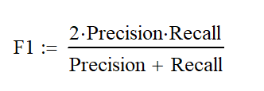

Scores
punishes false negatives ability to find all positive samples
punishes false positives ability to not mislable negative samples

