Slide 1
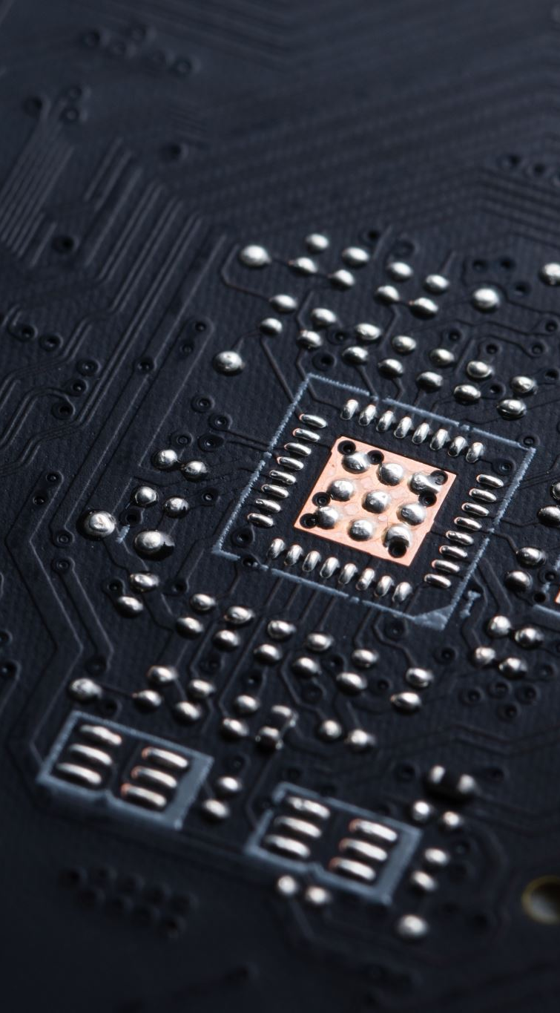
Evaluation of Direct Level-Set Ray Tracing Performance on GPUs for Process Simulation Applications 360.245 Selected Topics - Computational Electronics Mario Hiti

Slide 2
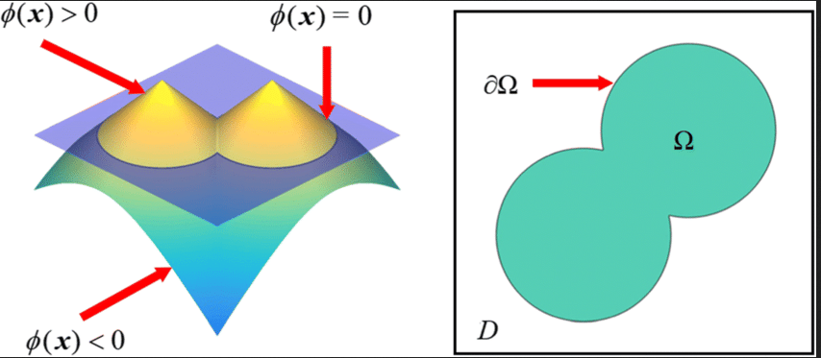
Signed distance function Φ
Φ(x) returns the shortest distance between x and the surface ∂Ω
Sign determines if point is on the inside or outside
Very easy to simulate surface advection
Notes:
Shortest distance
Sign
Advection
Don’t store formula but values of phi in a volumetric grid

Slide 3
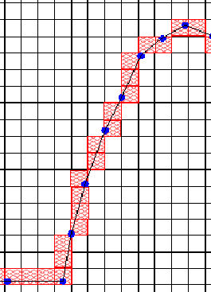
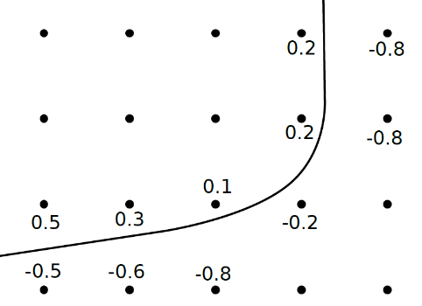
Narrow Band Level-Sets
Store values of Φ(x) in a discrete grid
Φ(|x| >> 0) irrelevant
only store values near the surface boundary
all other voxels are inactive
Very well suited for raytracing

Slide 4
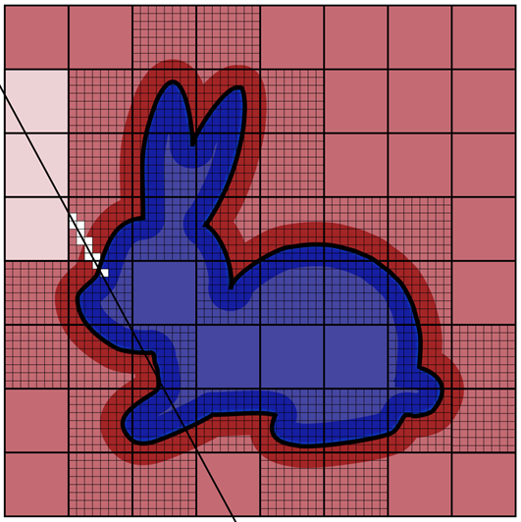
Raytracing
Inactive Voxels
Ray origin
active Voxels
Narrow band
Intersection:
The sign of Φ(x) changes
Notes:
Start somewhere and step to next voxel
Fast in coarse grid
Then slow
Interseciton
Sign change

Slide 5
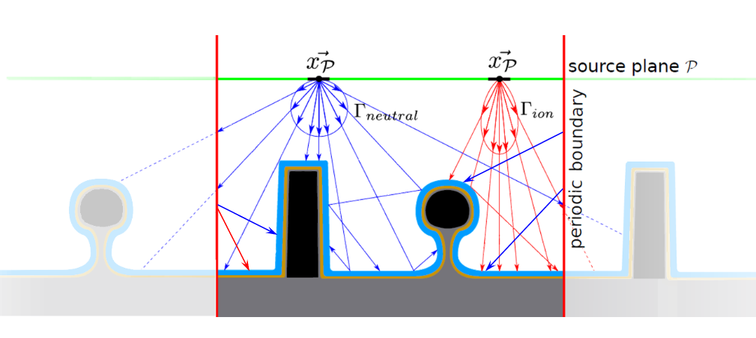
Applications
Notes:
Multiple sources
Reflections, absorptions
Boundary conditions

Slide 6
Frameworks
OpenVDB
NanoVDB
Released in 2012
Mature and rich in features
CPU only
Allows changes to the narrow band
Complex build process
Several dependencies
Released in 2021
Many features missing or incomplete
CPU and/or GPU (CUDA)
Recompute everything when narrow band changes
Header only
No dependencies

Slide 7
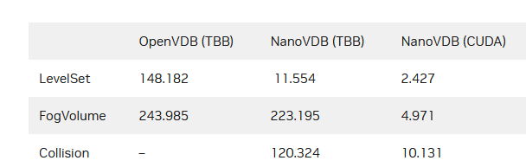
Goal
NVIDIA released a benchmark promising a 60x increase in performance
Can we expect the same performance for our simulations?
https://developer.nvidia.com/blog/accelerating-openvdb-on-gpus-with-nanovdb
60x faster!
Notes:
NVIDAI promises 60x increase in perf
Question: can we expect the same
Details are vague at best, and they usually try to sell a best-case scenario
We aimed to design a worst-case benchmark

Slide 8
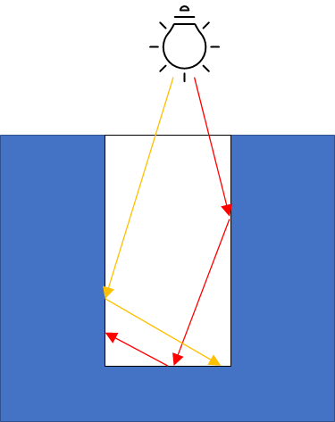
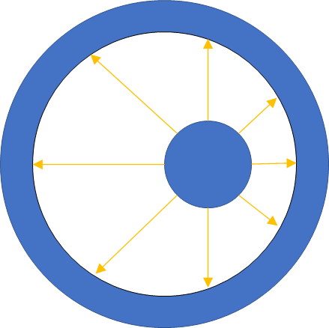
The worst-case Scenario
Typical Application
Modified Setup
Workflow
Pre-comupte n rays
Calculate intersections
Verify results
Increase n and goto 1.
Notes:
Rays being cast down a trench
already quite difficult
2 spheres within each other
Rays exit inner narrow band, traverse ccoarse grid, reenter narrow band
All rays intersect
Offset
Some other measures: Rays are shuffled

Slide 9
Hardware
Benchmark performed on a TCAD Cluster provided by IuE
Hardware | Price | Power Consumption | Cores
Intel Xeon 6248 | 3.300 € | 105W | 20 Cores, 40 Threads
NVIDIA Tesla T4 | 3.000 € | 70W | 2.560 CUDA-Cores
Notes:
CPU and GPU are different
Comparing apples to oranges
Similar price and power consumption

Slide 10
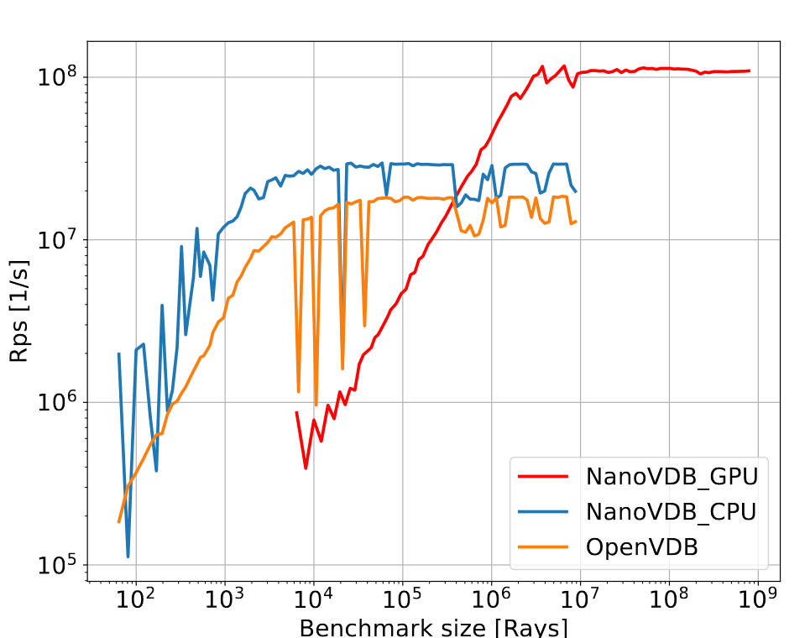
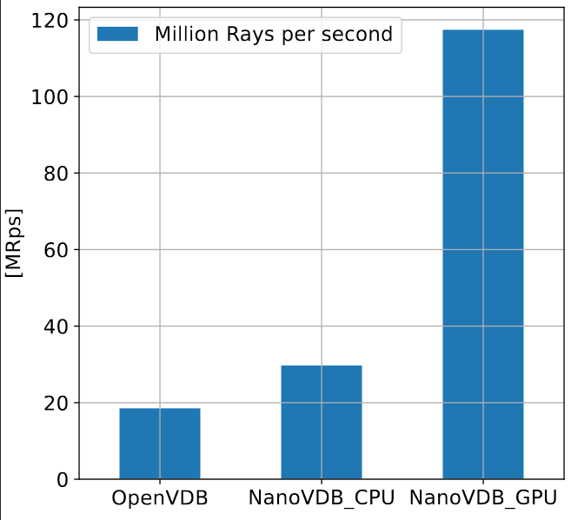
Benchmark Results
Rays per Second (parameter-sweep)
Rays per second for n ≈ 5mio
6.2x faster
Notes:
X axis
Y axis
Small size
Big size
6.2x faster

Slide 11
NanoVdb: The Good
Performance is great
Very good code quality, no bugs encountered
Target platform is determined at compile time
Same code for CPU and GPU
Develop on PC (no GPU necessary), deploy on cluster
Calculation can run on CPU and GPU in parallel → add performance of both

Slide 12
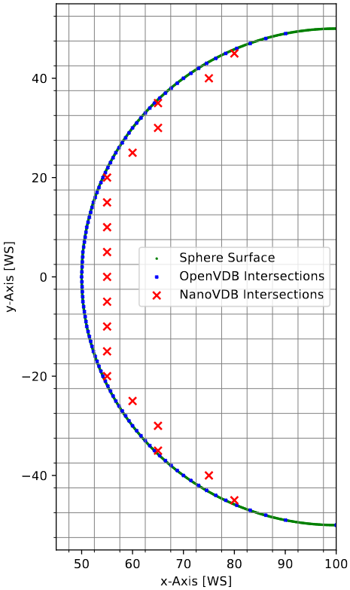
Nanovdb: The bad
Raytracing accuracy
No boundary conditions (periodic or reflective)
Can be implemented
Raytracing is inaccurate (see image)
Can be improved
Realistically OpenVDB is still needed → difficult to compile on cluster
Can be automated

Slide 13
Nanovdb: The ugly
Difficult to learn
poor documentation (especially for NanoVDB)
Limited compatibility between OpenVDB and NanoVDB
Lots of template meta-programming and boiler-plate code

Slide 14
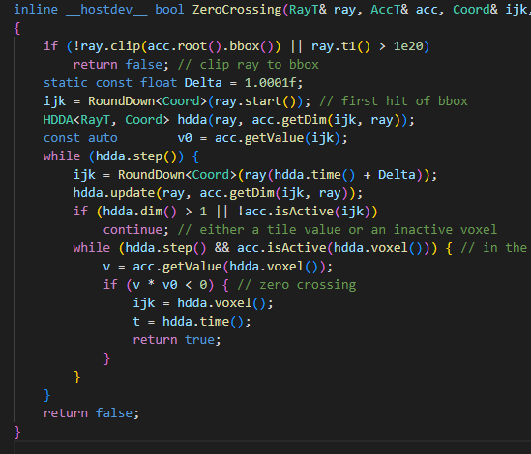
Outlook and further topics
Expand NanoVDB for process simulations
Implement reflections
Implement boundary conditions
Increase accuracy of raytracing
Moving ray sources
…
Further improve performance
branchless programming
Use more GPU features such as CUDA streams
Multiple GPUs
Combine CPU + (multiple) GPU
RTX?
…

Slide 15
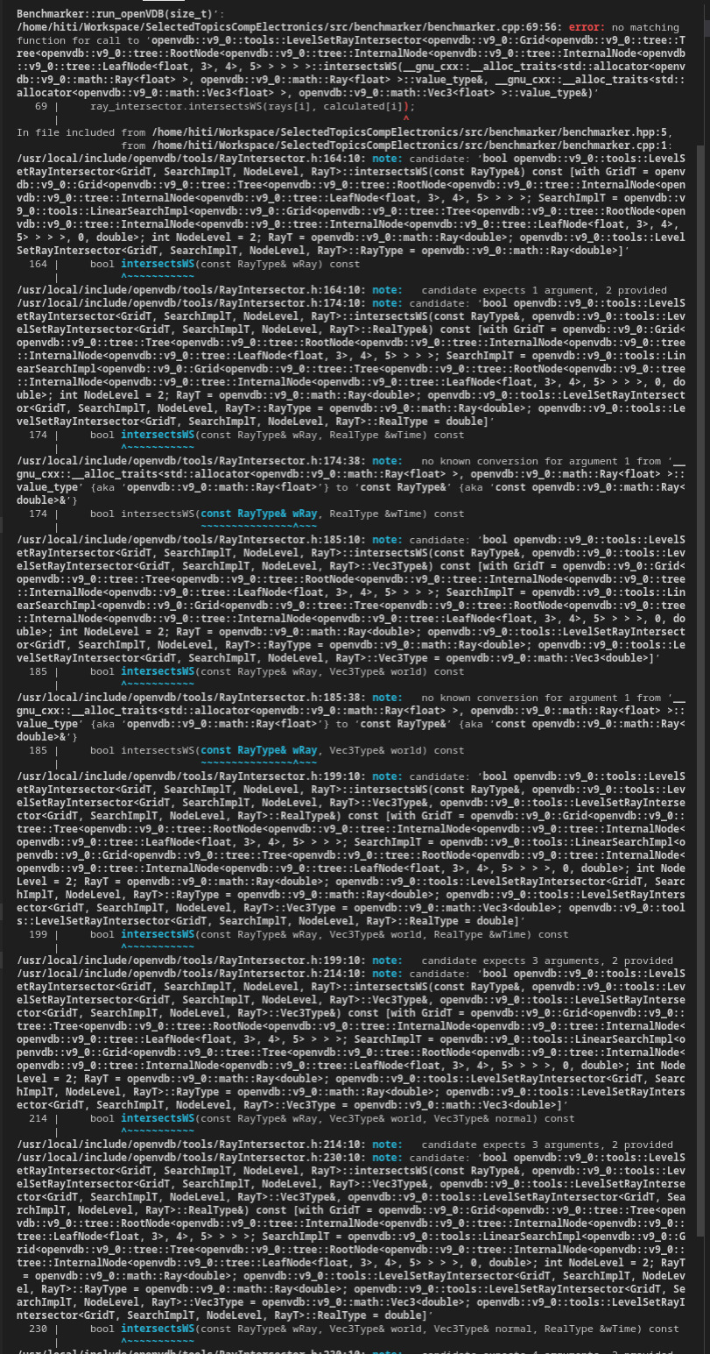
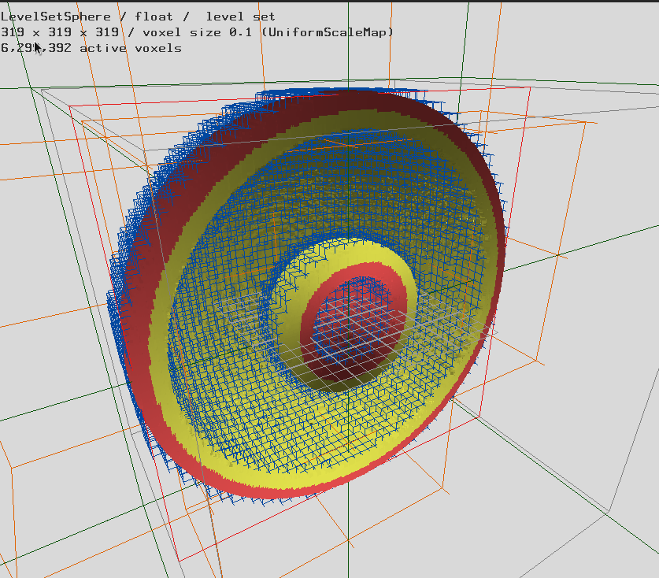
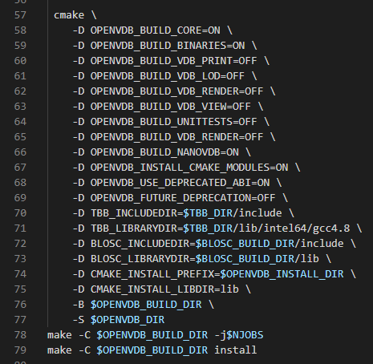
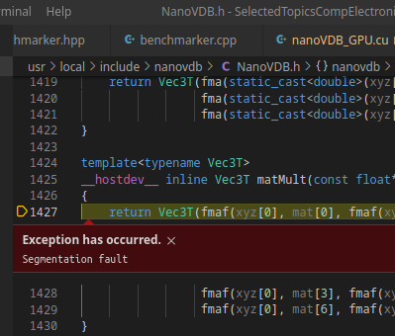
Questions

Slide 16
Appendix: Simulation setup
3D spheres
Rays are shuffled in memory
No reflections
Volumetric ray source
Offset sphere for distribution of ray lengths
No ray leaves bounding box
All rays leave narrow band, traverse inactive cells and reenter narrow band
Time for ray generation not included
Rays are reused if (V)RAM is full
All calculations are verified
No repetitions
Only single precision
Notes:
Rays are shuffled
no reflections
all rays intersect
leave narrow band
Leave narrow band
traverse inactive voxels and reenter the narrow band

Slide 17
Appendix: accuracy
NanoVDB stops when a voxel containing the intersection point is found
Realistically only useful to determine IF the ray intersects
OpenVDB uses neighboring voxels to approximate real intersection point
Most likely (part of) the reason why NanoVDB is faster on CPU

Slide 18
Appendix: BRANCHLESS programming
GPUs use SIMT architecture (single instruction multiple thread)
Threads are grouped in “warps” (usually 32 threads = 1 warp)
Problem: branches
Threads execute both branches sequentially and a mask determines which branch has an effect
Branchless programming:
x = (a > b) ? C : D; // branches
x = (a > b) * C + (a <= b) * D; // no branches

