Slide 1
CS4104
Applied Machine Learning
Lecture No 15
Simple Linear and Multiple Linear Regression
(Reference Lecture)
Spring 2025
1

Slide 2

Regression Analysis
X3
X1
X2

Slide 3
STATITICAL DATA ANALYSIS
COMMON TYPES OF ANALYSIS?
  Compare Groups
    Compare Proportions (e.g., Chi Square Test—χ²)
      H₀: P₁ = P₂ = P₃ = … = P_{k}
    Compare Means (e.g., Analysis of Variance)
      H₀: µ₁ = µ₂ = µ₃ = …= µ_{k}
  Examine Strength and Direction of Relationships
    Bivariate (e.g., Pearson Correlation—r)
      Between one variable and another: Y = a + b₁ x₁
    Multivariate (e.g., Multiple Regression Analysis)
      Between one dep. var. and each of several indep. variables, while holding all other indep. variables constant:
      Y = a + b₁ x₁ + b₂ x₂ + b₃ x₃ + … + b_{k} x_{k}

Slide 4

Simple and Multiple Regression Analysis
What does regression analysis do?
Examines whether changes/differences in values of one variable (dependent variable Y) are linked to changes/differences in values of one or more other variables (independent variables X₁, X₂, etc.), while controlling for the changes in values of all other Xs.
  E.g., Relationship between salary and gender for people who have the same levels of education, work experience, position level, seniority, etc.
The DV (Y) must be metric.
The IVs (Xs) must be either metric or dummy var.
Central Question Addressed:
  Is Y a function of X₁, X₂, etc.? How ?
  Is there a relationship between Y and X₁, X₂ , etc., (in each case, after controlling for the effects of all other Xs)? In what way?
  What is the relative impact of each X on Y, holding all other Xs constant (that is, all other Xs being equal)?

Slide 5
Simple and Multiple Regression Analysis
More specifically,
Do values of Y tend to increase/decrease as
values of X₁, X₂, etc. increase/decrease?
If so,
  By how much?
  And
  How strong is the connection/relationship
  between Xs and Y?
    what % of differences/variations
    in Y values (e.g., income) among
    study subjects can be explained by
    (or attributed to) differences in
    X values (e.g. years of education,
    years of experience, etc.)?
X3
X1
X2

Slide 6
Simple and Multiple Regression Analysis
NOTE: Once we can determine how values of Y change as a function of values of X₁, X₂, etc., we will also be able to predict/estimate the value of Y from specific values of X₁, X₂, etc.
Y = a + b₁ x₁ + b₂ x₂ + b₃ x₃ + … + b_{k} x_{k}+є
Therefore, regression analysis, in a sense, is about ESTIMATING values of Y, using information about
values of Xs:
The objective?
  To minimize error in estimation.
  Or, to compute estimates that are
  as close to the true/actual values as possible.
∧

Slide 7
Simple and Multiple Regression Analysis
QUESTION: What is the simplest way to obtain an estimate for some population characteristic
(e.g., number of credit cards per U.S. household)?
ANSWER:
Select a representative sample from the population and
Compute the mean for that sample (e.g., compute the
average number of CCs for the sample households).
Regression analysis can be viewed as a technique that often significantly improves the accuracy of estimation results relative to using the mean value.
So, suppose we were to estimate the number of credit cards for U.S. households, based on information from a random sample of, say, n = 8 families.
X

Slide 8
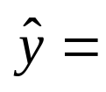
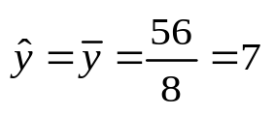
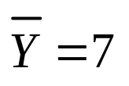

Simple and Multiple Regression Analysis
Estimating Number of Credit Cards*
i Family Number | y_{i} Actual # of Credit Cards
1 | 4
2 | 6
3 | 6
4 | 7
5 | 8
6 | 7
7 | 8
8 | 10
Estimate?
QUESTION: Can we determine how much error in estimation we are committing by using as our estimate, for each of these households?
* This example was adopted from Hair, Black, Babin, Anderson, & Tatham, (2006). Multivariate Data Analysis, 6th ed., Prentice Hall.

Slide 9


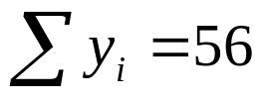
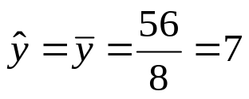
Simple and Multiple Regression Analysis
Estimating Number of Credit Cards
i Family Number | Actual # of Credit Cards | Estimate for # of Credit Cards | Error in Estimation
1 | 4 | 7 | ?
2 | 6 | 7 | ?
3 | 6 | 7 | ?
4 | 7 | 7 | ?
5 | 8 | 7 | ?
6 | 7 | 7 | ?
7 | 8 | 7 | ?
8 | 10 | 7 | ?

Slide 10

Simple and Multiple Regression Analysis
Estimating Number of Credit Cards
i Family Number | Actual # of Credit Cards | Estimate for # of Credit Cards | Error in Estimation
1 | 4 | 7 | -3
2 | 6 | 7 | -1
3 | 6 | 7 | -1
4 | 7 | 7 | 0
5 | 8 | 7 | +1
6 | 7 | 7 | 0
7 | 8 | 7 | +1
8 | 10 | 7 | +3
Lets now see all this graphically

Slide 11
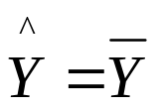
Simple and Multiple Regression Analysis
10
9
8
7
6
5
4
3
2
1
0
F8
F5
F7
F6
Estimate
Actual # of credit cards
F4
F2, F3
F1
Let’s spread the dots away from each other to see things more clearly!

Slide 12
Simple and Multiple Regression Analysis
10
9
8
7
6
5
4
3
2
1
0
Graphic Representation
F8
Actual
Estimate
F5
F7
Estimate
Actual # of credit cards
F4
F6
F3
F2
F1
Estimation Error
Can we determine the total estimation error for all 8 families?

Slide 13



Simple and Multiple Regression Analysis
i Family Number | Actual # of Credit Cards | Estimate for # of Credit Cards | Error in Estimation
1 | 4 | 7 | -3
2 | 6 | 7 | -1
3 | 6 | 7 | -1
4 | 7 | 7 | 0
5 | 8 | 7 | +1
6 | 7 | 7 | 0
7 | 8 | 7 | +1
8 | 10 | 7 | +3
What would be the total estimation error for all 8 families combined?
= 0
Solution?

Slide 14
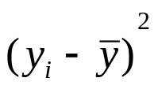


Simple and Multiple Regression Analysis
Estimating Number of Credit Cards
i Family Number | Actual # of Credit Cards | Estimate for # of Credit Cards | Error in Estimation | Errors Squared
1 | 4 | 7 | -3 | 9
2 | 6 | 7 | -1 | 1
3 | 6 | 7 | -1 | 1
4 | 7 | 7 | 0 | 0
5 | 8 | 7 | +1 | 1
6 | 7 | 7 | 0 | 0
7 | 8 | 7 | +1 | 1
8 | 10 | 7 | +3 | 9
SST = Sum of Squares Total

Slide 15
Simple and Multiple Regression Analysis
22 = SST = Index for total (combined) amount of estimation error
for all families (observations) in the sample when using the mean
as the estimate.
  SST is also the sum of squared deviations from the mean.
    Remember the formula for computing Variance?
Objective in Estimation?
  Minimize error, maximize precision.
Can we cut down the amount of estimation error (SST)? How?
  Yes, we can, by using information about other variables suspected to be strong predictors (strongly related to) # of credit cards possessed by families (e.g., family size, family income, etc.)..

Slide 16


Simple and Multiple Regression Analysis
i Family Number | Actual # of Credit Cards | Family Size
1 | 4 | 2
2 | 6 | 2
3 | 6 | 4
4 | 7 | 4
5 | 8 | 5
6 | 7 | 5
7 | 8 | 6
8 | 10 | 6
We now can attempt to estimate # of credit cards from the information on family size, rather than
from its own mean.
Let’s first see this graphically!

Slide 17
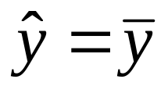


Simple and Multiple Regression Analysis
Y
Plot actual numbers of CCs against family Size.
F8
10
9
8
7
6
5
4
3
2
1
0
F5
F7
F2
F4
F6
# Of Credit Cards
Original (Baseline) Estimate
F3
F1
QUESTION: Does the mean appear to represent the closest estimate of the actual c.c. numbers for our sample families ?
That is, is the green line the best line to represent the location of estimates of # of CC for these families?
X
1 2 3 4 5 6 7
Family Size

Slide 18



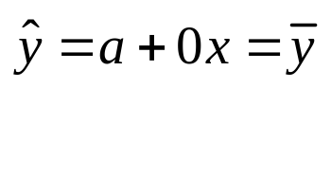
Simple and Multiple Regression Analysis
Y
Generic Equation for any straight line: Y= a + bx
F8
10
9
8
7
6
5
4
3
2
1
0
Regression Line
F4
F5
F7
F2
# Of Credit Cards
F6
Original (Baseline) Estimate
F3
Regression Line (Line of Best Fit)--new improved location for CC estimates (see next slide)
F1
X
1 2 3 4 5 6 7
Family Size

Slide 19



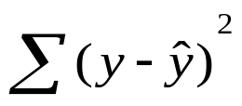
Simple and Multiple Regression Analysis
Y
F8
10
9
8
7
6
5
4
3
2
1
0
Reg. Line (Line of Best Fit)--new improved location for CC estimates
F5
F7
F2
F4
# Of Credit Cards
Original (Baseline) Estimate
F6
F3
Estimation ERROR
F1
Regression Line will
Minimize = total estimation error.
But, how do we know the values a and b in (the reg. line)?
X
1 2 3 4 5 6 7
Family Size

Slide 20
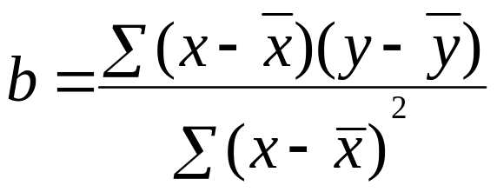
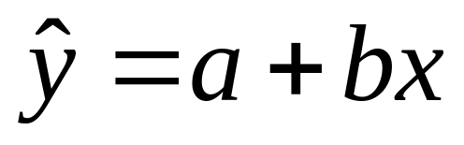
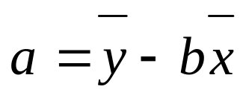
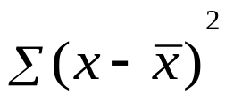



Actual # of credit cards
EQUATION FOR REGRESSION LINE (LINE OF BEST FIT)--
Values of a and b for the regression line:
Let’s use above formulas to compute the values of “a” and “b” for the regression line in our example.
We will need: and

Slide 21
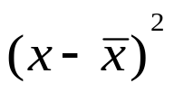



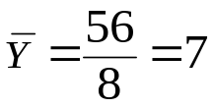
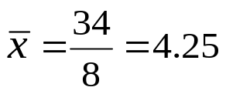


Simple and Multiple Regression Analysis
We need:
and
i Family Number | Actual # of Credit Cards | Family Size
1 | 4 | 2 | ? | ? | ? | ?
2 | 6 | 2 | ? | ? | ? | ?
3 | 6 | 4 | ? | ? | ? | ?
4 | 7 | 4 | ? | ? | ? | ?
5 | 8 | 5 | ? | ? | ? | ?
6 | 7 | 5 | ? | ? | ? | ?
7 | 8 | 6 | ? | ? | ? | ?
8 | 10 | 6 | ? | ? | ? | ?

Slide 22
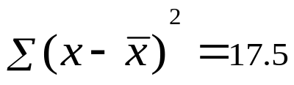

Simple and Multiple Regression Analysis
We need:
and
i Family Number | Actual # of Credit Cards | Family Size
1 | 4 | 2 | -2.25 | -3 | 6.75 | 5.0625
2 | 6 | 2 | -2.25 | -1 | 2.25 | 5.0625
3 | 6 | 4 | -.25 | -1 | .25 | .0625
4 | 7 | 4 | -.25 | 0 | 0 | .0625
5 | 8 | 5 | .75 | 1 | .75 | .5625
6 | 7 | 5 | .75 | 0 | 0 | .5625
7 | 8 | 6 | 1.75 | 1 | 1.75 | 3.0625
8 | 10 | 6 | 1.75 | 3 | 5.25 | 3.0625

Slide 23
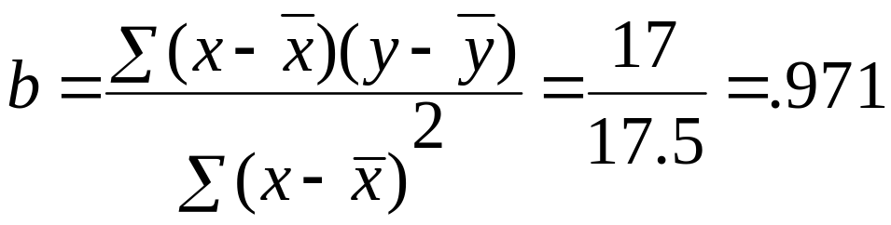
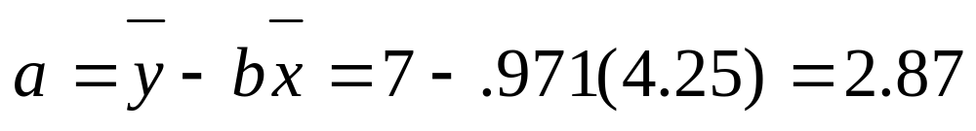
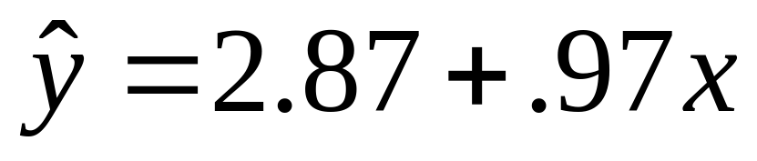
Simple and Multiple Regression Analysis
REGRESSION LINE (LINE OF BEST FIT):
a =2.87 b = .97
?
?
Y-Intercept
Regression Coefficient

Slide 24

Simple and Multiple Regression Analysis
Y
F8
10
9
8
7
6
5
4
3
2
1
0
New Improved Estimates
F5
F7
F2
F4
# Of Credit Cards
Original (Baseline) Estimate
F6
F3
F1
Can we tell how much estimation error we have committed by using the new regression line?
Yes, examine differences between our household’s actual # of CCs and their new/regression estimates.
X
1 2 3 4 5 6 7
Family Size

Slide 25




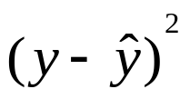

Simple and Multiple Regression Analysis
i Family Number | Actual # of Credit Cards | Family Size | Regression Estimate | Error (Residual) | Errors Squared
1 | 4 | 2 | ? | ? | ?
2 | 6 | 2 | ? | ? | ?
3 | 6 | 4 | ? | ? | ?
4 | 7 | 4 | ? | ? | ?
5 | 8 | 5 | ? | ? | ?
6 | 7 | 5 | ? | ? | ?
7 | 8 | 6 | ? | ? | ?
8 | 10 | 6 | ? | ? | ?

Slide 26


Simple and Multiple Regression Analysis
i Family Number | Actual # of Credit Cards | Family Size | Regression Estimate | Error (Residual) | Errors Squared
1 | 4 | 2 | 4.81 | -.81 | .66
2 | 6 | 2 | 4.81 | 1.19 | 1.42
3 | 6 | 4 | 6.76 | -.76 | .58
4 | 7 | 4 | 6.76 | .24 | .06
5 | 8 | 5 | 7.73 | .27 | .07
6 | 7 | 5 | 7.73 | -.73 | .53
7 | 8 | 6 | 8.7 | -.7 | .49
8 | 10 | 6 | 8.7 | 1.3 | 1.69
SSE = Sum of Squares Error (SS Residual)

Slide 27
Simple and Multiple Regression Analysis
Total Baseline Error using the mean (SS Total) 22.0
New or Remaining Error (SS Error or SS Residual) 5.486 ~ 5.5
QUESTION: How much of the original estimation error have we explained
away (eliminated) by using the regression model (instead of the mean)?
Total Var. in Y = 22
5.5
16.5
22 – 5.486 = 16.514 (SS Regression or SS Explained)
QUESTION: What % of estimation error have we explained (eliminated by using the regression model?
X₁
Y
R² =
16.514 / 22 = .751 or 75% What is this called?
% of differences in # of CCs among households that is explained by differences in their family size.
What does the remaining 25% represent?
Percent of variation (differences) in number of credit cards owned by families that can be accounted for by: (a) all other potential predictors not included in the model, beyond family size, and (b) unexplainable random/chance variations.

Slide 28
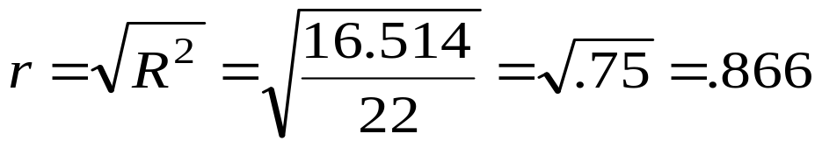
Simple and Multiple Regression Analysis
R² = SS Regression / SS Total = 16.5/22 = 75%
R² is a measure of our success regarding accuracy of our estimation effort.
  R² = % of estimation error that we have been able to explain away by
  using the regression model, instead of using the mean.
  R² indicates how much better we can predict Y from information about
  Xs, rather than from using its own mean.
  R² = % of differences (variations) in Y values that is explained by
  (attributable to) differences in X values.
Note: When dealing with only two variables (a single X and Y):
Let’s now examine all this graphically!
Pearson Correlation
of Y with X₁
(NOT controlling for any other var.)

Slide 29



Simple and Multiple Regression Analysis
Y
Regression Line (New Improved Estimates):
F8
10
9
8
7
6
5
4
3
2
1
0
F5
F7
F2
F4
F6
# Of Credit Cards
Original (Baseline) Estimate
?
Explained by REGRESSION Model
F3
Original Baseline ERROR for F1
?
F1
New ERROR (Unexplained/ RESIDUAL)
X
1 2 3 4 5 6 7
Family Size

Slide 30
Simple and Multiple Regression Analysis
5.5 = SSE = The amount of estimation error for the 8 sample families when using simple regression (i.e., a regression model that includes only information about family size).
Can we reduce the amount of estimation
error (SSE) to an even lower level and,
thus, improving the estimation process? How?
  Yes, by adding information on a second variables suspected to be strongly related to # of credit cards (e.g., family income--X₂).
.

Slide 31


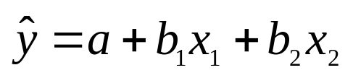
Simple and Multiple Regression Analysis
i Family Number | y_{i} Actual # of Credit Cards | Family Size | Family Income
1 | 4 | 2 | 14
2 | 6 | 2 | 16
3 | 6 | 4 | 14
4 | 7 | 4 | 17
5 | 8 | 5 | 18
6 | 7 | 5 | 21
7 | 8 | 6 | 17
8 | 10 | 6 | 25
We now can attempt to estimate # of CCs from our information on family size and family income!
Our regression model will now be a linear plane, rather than a straight line!
Generic Equation for a linear plane:
Let’s examine the regression plane for our example graphically.

Slide 32

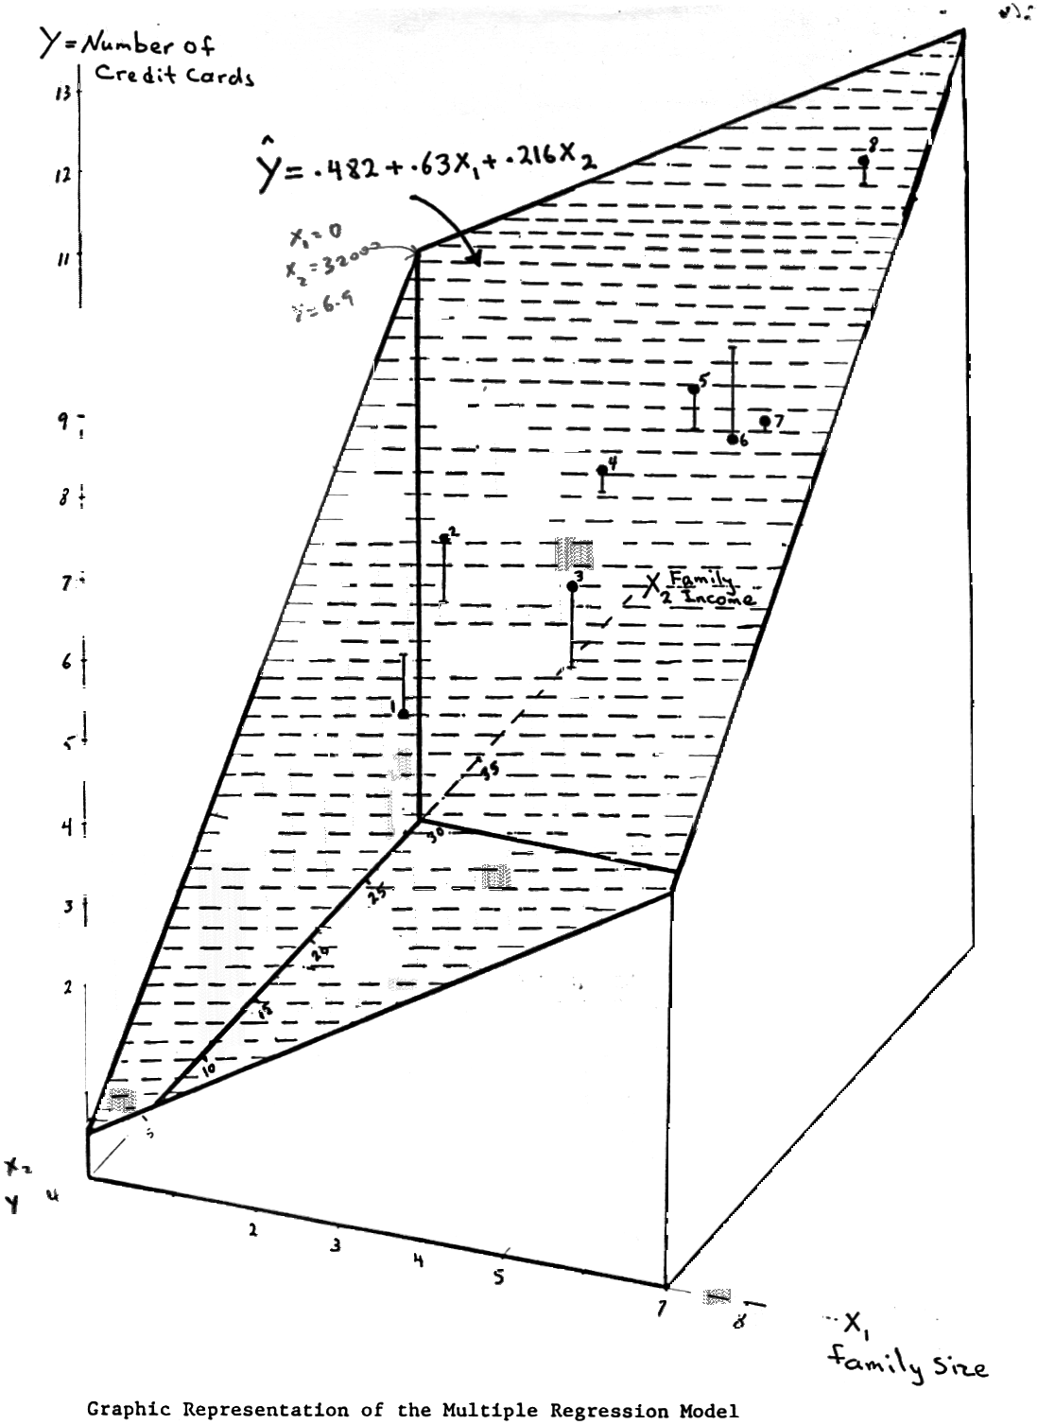
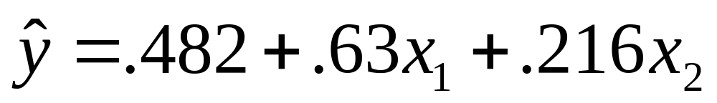
Y = # of Credit Cards
12
11
10
9
8
7
6
5
4
3
2
1
0
Formulas are available for computing values of
a, b₁ and b₂
MULTIPLE REGRESSION
MODEL FOR OUR EXAMPLE:
Family Income
Let’s now see how much error in estimation we are committing by using this multiple regression model.
Actual
Regression Estimate
0 1 2 3 4 5 6 7 8
X1 = Family Size

Slide 33


Simple and Multiple Regression Analysis
i Family Number | Actual # of Credit Cards | Family Size | Family Income ($000) | Regression Estimate | Error (Residual) | Errors Squared
1 | 4 | 2 | 14 | ? | ? | ?
2 | 6 | 2 | 16 | ? | ? | ?
3 | 6 | 4 | 14 | ? | ? | ?
4 | 7 | 4 | 17 | ? | ? | ?
5 | 8 | 5 | 18 | ? | ? | ?
6 | 7 | 5 | 21 | ? | ? | ?
7 | 8 | 6 | 17 | ? | ? | ?
8 | 10 | 6 | 25 | ? | ? | ?

Slide 34
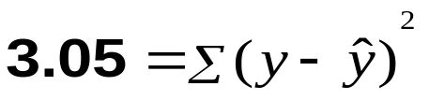
Simple and Multiple Regression Analysis
i Family Number | Actual # of Credit Cards | Family Size | Family Income ($000) | Regression Estimate | Error (Residual) | Errors Squared
1 | 4 | 2 | 14 | 4.77 | -.77 | .59
2 | 6 | 2 | 16 | 5.20 | .80 | .64
3 | 6 | 4 | 14 | 6.03 | -.03 | .00
4 | 7 | 4 | 17 | 6.68 | .32 | .10
5 | 8 | 5 | 18 | 7.53 | .47 | .22
6 | 7 | 5 | 21 | 8.18 | -1.18 | 1.39
7 | 8 | 6 | 17 | 7.95 | .05 | .00
8 | 10 | 6 | 25 | 9.67 | .33 | .11
SSE = Sum of Squares Error (Residual)
Unique (additional) contribution of X₂ (family income) beyond X₁ = ?
5.5 – 3.05 = 2.45

Slide 35
Simple and Multiple Regression Analysis
The MULTIPLE REGRESSION MODEL FOR OUR EXAMPLE:
?
?
Y-Intercept, “a”
(NOTE: Only when all Xs can meaningfully take on value of zero, the intercept will have a meaningful/direct/ practical interpretation. Otherwise, it is simply an aid in increasing accuracy of estimation.
b₁ and b₂ = Regression Coefficients
0.63: Among families of the same income, an increase in family size by one person would, on average, result in .63 more credit cards.
0.21: Among families of the same size, an income increase of $1,000, results in an average increase of 0.2 credit cards .
“b”s represent effect of each X on Y when all other Xs are controlled for/held constant/taken into account
  i.e., after impacts of all other variables are accounted for (remember the high blood pressure-hearing problem connection?)

Slide 36
Simple and Multiple Regression Analysis
The MULTIPLE REGRESSION MODEL FOR OUR EXAMPLE:
SST = 22 SSE = 3.05
What is our new R²?
SS Regression = 22 – 3.05 = 18.95
R² = 18.95 / 22 = .861 or 86%
Percent of differences in households’ number of CCs that is explained by differences in family size and family income.
The Remaining 14%?
(3.05 / 22 = .14)
Percent of variation in number of credit cards that can be accounted for by (a) all other relevant factors not included in the model, beyond family size and income, and (b) unexplainable random/chance variations.

Slide 37


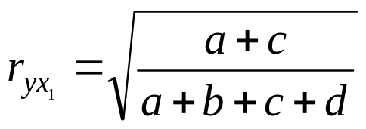

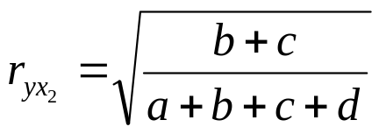
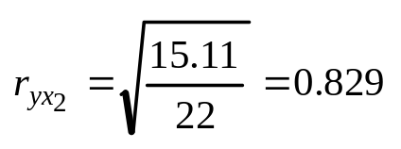
d
Y= # of CC
a
Total Variation/Error in Y = SS Total = a + b + c + d = 22
c
b
r² = ?
R² = (a+c) / (a+b+c+d)
X₁=Family
Size
Y
R² = 16.5 / 22 = 0.75
X₂ = Family
Income
What do we call the square root of this?
SSR =
a + c
= 16.5
Pearson/simple
Correlation
of Y with X₁ (not controlling for X₂)
X₁=Family
size
Y
r² = (b+c) / (a+b+c+d) = 15.12 / 22 = 0.687
SSR =
c + b
= 15.12
Pearson/simple Correlation of Y with X₂ (not controlling for X₁) ?
X₂ = Family
Income

Slide 38

d
a
c
b
R² Graphically = ?
X₁=Family
Size
NOTE: c is explained by
both X₁ and X₂
X₂ = Family
Income
SSR = a + b +c = 18.95
SST = a + b + c + d = 22
R² = SSR / SST = (a + b + c) / (a + b + c + d) = 18.95 / 22 = 86%
SSE = ?
SSE = d = 22 – 18.95 = 3.05

Slide 39
Simple and Multiple Regression Analysis
i Family Number | Actual # of Credit Cards | Family Size | Family Income ($000) | Regression Estimate | Error (Residual) | Errors Squared
1 | 4 | 2 | 14 | 4.77 | -.77 | .59
2 | 6 | 2 | 16 | 5.20 | .80 | .64
3 | 6 | 4 | 14 | 6.03 | -.03 | .00
4 | 7 | 4 | 17 | 6.68 | .32 | .10
5 | 8 | 5 | 18 | 7.53 | .47 | .22
6 | 7 | 5 | 21 | 8.18 | -1.18 | 1.39
7 | 8 | 6 | 17 | 7.95 | .05 | .00
8 | 10 | 6 | 25 | 9.67 | .33 | .11
SSE = Sum of Squares Error (Residual)
Remember:
Unique (additional) contribution of X₂ = 5.5 – 3.05 = 2.45

Slide 40

Exercise 1: Redo the credit card analysis in Python.
  First, Correlations and Simple Regression
  Next, Multiple Regression

Slide 41
Interpreting Regression Results
H_{o}: R² = 0. That is, There is NO RELATIONSHIP between the DV and ANY OF the IVs included in the regression model.
No
1. Is overall F significant?
(i.e., α < 0.05)
Yes
Don’t reject Ho; No indep. Variable has a sig. relationship with dep. Variable. Stop.
Reject Ho; One or more independent variables are significantly related to the dep. Variable.
2. Which independent variable(s) have significant relationships with the dep. Var.? In the “Coefficients” table, look up the result of the t-test for each indep. variable’s regression coefficient (b). H_{o} for t-test of a given variable hypothesizes that the coefficient b = 0. That is, there is no relationship between the corresponding independent variable and the dep. Variable. If a t-test’s α < 0.05, reject the null and conclude that the corresponding variable has a significant relationship with the dep. Variable.
3. Look up the sign of the regression coefficient (b) ONLY FOR
those indep. variables that are found to have a significant
relationship with the dependent variable (i.e., those
with α < 0.05), and state your conclusions accordingly.

Slide 42
Simple and Multiple Regression Analysis
Regression Analysis Using Categorical Variables:
General Rule: Categorical variables should NOT be used in multiple regression since interpretation of the variable’s regression coefficient becomes nonsensical.
EXAMPLE: Income = 24000 + 1400 Political Party
Exception to the above Rule: “Dummy variables” (i.e., categorical variables representing only two groups--such as gender, when coded as 0 and 1) can be used as independent variables in regression analysis. The reason is that a dummy variable’s values (0, 1) can go up or down by only 1 unit, signifying a change from one group to another.
EXAMPLE: Income = 24000 + 1400 gender
.
Coded: Democrat = 1
Republican = 2
Independent = 3
Other = 4
Coded: Female = 0, Male = 1
Meaning?
Note: A dummy variable’s regression coefficient represents the average difference in the value of the dependent variable between the two groups represented by the dummy variable.

Slide 43
Simple and Multiple Regression Analysis
Coded: Female = 0, Male = 1
EXAMPLE 1: Income = 24000 + 1400 gender.
Average income of females is $24,000.
Males on average make $1400 more than females
Coded: Female = 0, Male = 1
MULTIPLE REGRESSION EXAMPLE 2:
Income = 12000 + 1000 Education Years + 800 Gender
Meaning?
Meaning?
Among people of the same gender, every additional year of education results in an average additional income of $1,000.
Males make, on average, $800 more in comparison with females who have the same number of years of education.
Average income of females with no education is $12000.

