Slide 1
Computational Complexity

Slide 2
Guideline 1
The running time of a comments, declarative and function statements count to zero
template <class Type>
class List ;
int age;
//a variable to store age
void Print();
Declarative Statements
comments
Function statements
Total time = zero
‹#›

Slide 3
Guideline 2
Expressions, memory management & assignment statements for primitive data types have constant running time i.e. one.
int a = 4+5;
char b =‘a’;
int * a = new int;
delete a;
Expressions and assignment statements
Memory Management statements
Total time = constant
‹#›

Slide 4
Guideline 3
Memory management & assignment statements for objects have constant running time i.e. size of object.
Student a,b;
Student * a = new Student;
delete a;
a = b;
Memory Management statement of object
Assignment statement of object
Total time = constant
‹#›

Slide 5
Guideline 4
Function invocations count as 1 step
Total time = constant
‹#›

Slide 6
Guideline 5: Loops
The running time of a loop is, at most, the running time of the statements inside the loop (including tests) multiplied by the number of iterations.
for (i=1; i<=n; i++)
{
m = m + 2;
}
executed
n times
constant time
Total time = (constant) c * n = cn
‹#›

Slide 7
Guideline 6: Nested loops
Analyse inside out. Total running time is the product of the sizes of all the loops.
for (i=1; i<=n; i++) {
for (j=1; j<=n; j++) {
k = k+1;
}
}
outer loop
executed
n times
inner loop
executed
n times
constant time
Total time = c * n * n * = cn²
‹#›

Slide 8
Guideline 7: Consecutive statements
Add the time complexities of each statement.
constant time c₀
x = x +1;
for (i=1; i<=n; i++) {
m = m + 2;
}
for (i=1; i<=n; i++) {
for (j=1; j<=n; j++) {
k = k+1;
}
}
executed
n times
constant time c₁
outer loop
executed
n times
inner loop
executed
n times
constant time c₂
Total time = c₀ + c₁n + c₂n²
‹#›

Slide 9
Guideline 8: If-then-else statements
if( exp)
statements1;
else
statements2;
Cost is the number of steps corresponding to exp, statements1 and statements2.
If exp:
Constant c₀
if (depth( ) != otherStack.depth( ) ) {
return false;
}
else {
for (int n = 0; n < depth( ); n++) {
if (!list[n].equals(otherStack.list[n]))
return false;
}
}
Statements1:
Constant c₁
else part:
(constant c₂ +
Constant c₃) * n
another if :
constant + constant
(no else part)
Total time = c₀ + c₁ + (c₂ + c₃) * n
‹#›

Slide 10
Problems with T(n)
T(n) is difficult to calculate
T(n) is also not very meaningful as step size is not exactly defined
T(n) is usually very complicated so we need an approximation of T(n)….close to T(n).
This measure of efficiency or approximation of T(n) is called ASYMPTOTIC COMPLEXITY or ASYMPTOTIC ALGORITHM ANALYSIS
Asymptotic complexity studies the efficiency of an algorithm as the input size becomes large
‹#›

Slide 11
Example
If T(n) = 7n+100
What is T(n) for different values of n???
n | T(n) | Comment
1 | 107 | Contributing factor is 100
5 | 135 | Contributing factor is 7n and 100
10 | 170 | Contributing factor is 7n and 100
100 | 800 | Contribution of 100 is small
1000 | 7100 | Contributing factor is 7n
10000 | 70100 | Contributing factor is 7n
10⁶ | 7000100 | What is the contributing factor????
When approximating T(n) we can IGNORE the 100 term for very large value of n and say that T(n) can be approximated by 7(n)

Slide 12
Example 2
T(n) = n² + 100n + log₁₀n +1000
n | T(n) | n² |  | 100n |  | log₁₀n |  | 1000
 |  | Val | % | Val | % | Val | % | Val | %
1 | 1101 | 1 | 0.1% | 100 | 9.1% | 0 | 0% | 1000 | 90.8%
10 | 2101 | 100 | 5.8% | 1000 | 47.6% | 1 | 0.05% | 1000 | 47.6%
100 | 21002 | 10000 | 47.6% | 10000 | 47.6% | 2 | 0.99% | 1000 | 4.76%
10⁵ | 10,010,001,005 | 10¹⁰ | 99.9% | 10⁷ | .099% | 5 | 0.0% | 1000 | 0.00%
When approximating T(n) we can IGNORE the last 3 terms and say say that T(n) can be approximated by n²

Slide 13
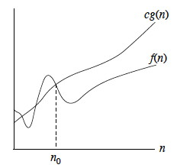
Big-Oh
Definition:
f(n) is O(g(n)) if there exist positive numbers c & N such that f(n)<=cg(n) for all n>=N
g(n) is called the upper bound on f(n) OR
f(n) grows at the most as large as g(n)
Example:
T(n) = n² + 3n + 4
n² + 3n + 4 <= 2 n² for all n>10
so we can say that T(n) is O(n²) OR
T(n) is in the order of n^{2.}
T(n) is bounded above by a + real multiple of n²

Slide 14
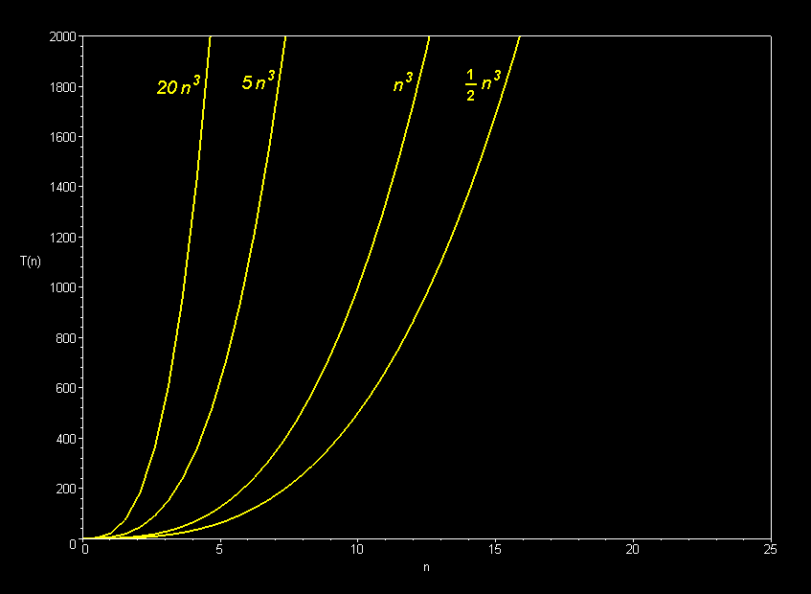

Slide 15
Properties of Big-Oh
If f(n) is O(g(n)) and g(n) is O(h(n)) then f(n) is O(h(n))
If f(n) is O(h(n)) and g(n) is O(h(n)) then f(n) + g(n) is O(h(n))
an^{k} is O(n^{k}) where a is a constant
n^{k} is O(n^{k+j} ) for any positive j
If f(n)=cg(n) then f(n) is O(g(n))

Slide 16
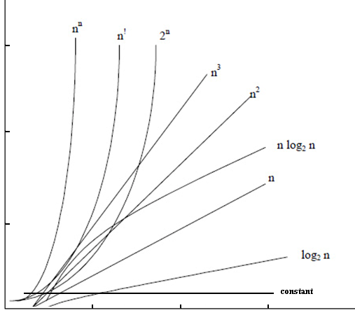
Growth rates Which growth rate is better???
Graph from Adam Drozdek’s book

Slide 17
Comparison of Growth Rates
N | log₂N | N log₂N | N² | N³ | 2^{N}
1 | 0 | 0 | 1 | 1 | 2
2 | 1 | 2 | 4 | 8 | 4
8 | 3 | 24 | 64 | 512 | 256
64 | 6 | 384 | 4096 | 262,144 | 18446744073709551616
128 | 7 | 896 | 16,384 | 2,097,152 | Approx 6 billion years, 600,000 times more than age of univ.
(If one operation takes 10⁻¹¹ seconds)

Slide 18
Big O??
Running Time: O(1)+O(n)+O(n)= O(n)
void print(int * array, int size){
cout<<"Array: ";
for(int i = 0; i < size; i++)
cout <<array[i]<<" ";
cout<<endl;
}
int smallest(int array[], int size, int start){
if(start == size-1)
return start;
else
{
int small = start;
for(int i = start+1; i <size; i++){
if(array[small]>array[i])
small= i;
}
return small;
}
}
void main(){
const int n= 5;
int array[n]={3,5,9,6,1};
cout<<"Smallest: "<<array[smallest(array,n,0)]<<endl;
print(array,n);
}
O(n)
O(1)
O(n)
O(n)
O(1)
O(n)
O(n)

Slide 19
Big-O?
void sortArray(int * a, int size){
for(int i = 0;i<size;i++){
int small = smallest(a,size,i);
int temp = a[i];
a[i] = a[small];
a[small] = temp;
}
}
void main(){
const int n= 5;
int array[n]={3,5,9,6,1};
sortArray(array,n);
print(array,n);
}
O(n²)
O(n)
O(n)
O(1)
Running Time: O(1)+O(n²)+O(n)= O(n²)

Slide 20
Big-O?
void main(){
const int n= 5;
int array[n]={3,5,9,6,1};
for(int i =0; i <n; i++)
sortArray(array,n);
print(array,n);
}
O(n³)
O(n²)
Running Time: O(1)+ O(n³) = O(n³)

Slide 21
Big-O?
bool BinarySearch(int * a,int size, int search){
int high = size-1;
int low = 0;
int mid ;
while (low<=high){
mid = (high+low)/2;
if(a[mid]==search)
return true;
else if(search < a[mid]){
high = mid-1;
}
else
low = mid+1;
}
return false;
}

Slide 22
0 | 1 | 2 | 3 | 4 | 5 | 6 | 7 | 8 | 9 | 10 | 11 | 12 | 13 | 14 | 15
Iteration 1
Low
Mid
High
0 | 1 | 2 | 3 | 4 | 5 | 6 | 7 | 8 | 9 | 10 | 11 | 12 | 13 | 14 | 15
Iteration 2
Low
Mid
High
0 | 1 | 2 | 3 | 4 | 5 | 6 | 7 | 8 | 9 | 10 | 11 | 12 | 13 | 14 | 15
Iteration 3
Low
High
Mid
0 | 1 | 2 | 3 | 4 | 5 | 6 | 7 | 8 | 9 | 10 | 11 | 12 | 13 | 14 | 15
Iteration 4
Low
High
n =16 = 2⁴
Iterations = 4
Log₂2⁴= 4 O(log₂n)
Mid

