Slide 1
Graphs

Slide 2
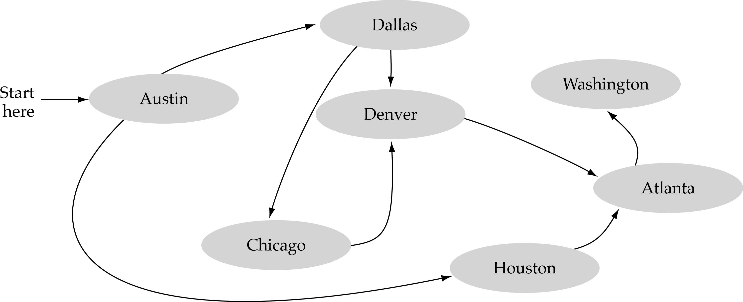
What is a graph?
A data structure that consists of a set of nodes (vertices) and a set of edges between the vertices.
The set of edges describes relationships among the vertices.
1
2
3
4

Slide 3

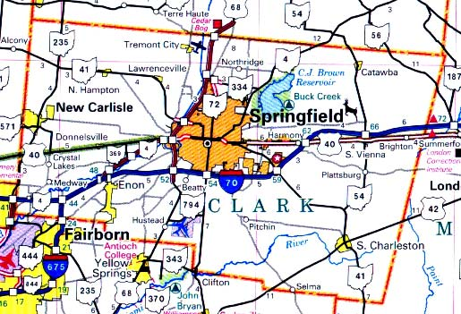

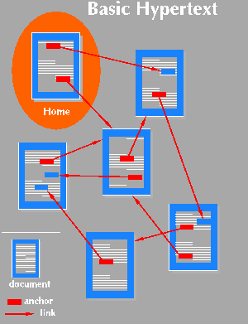
Applications
Computer networks
Maps
Hypertext
Circuits

Slide 4
Formal definition of graphs
A graph G is defined as follows:
G=(V,E)
V: a finite, nonempty set of vertices
E: a set of edges (pairs of vertices)

Slide 5
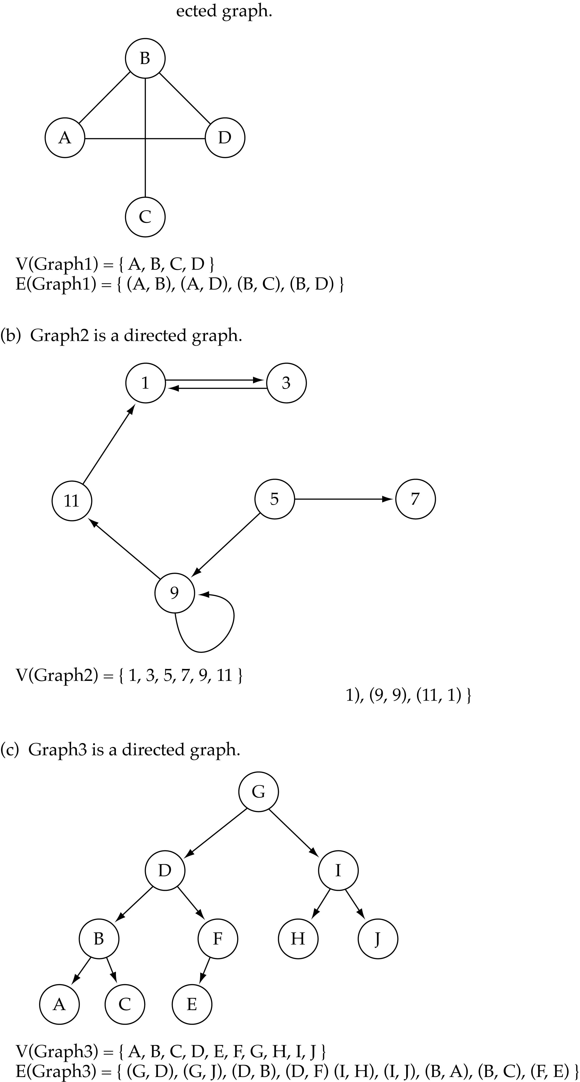
Undirected graphs
When the edges in a graph have no direction, the graph is called undirected
undirected graph
The order of vertices in E
is not important for
undirected graphs!!

Slide 6
Directed graphs
When the edges in a graph have a direction, the graph is called directed.
The order of vertices in E
is important for
directed graphs!!
E(Graph2) = {(1,3) (3,1) (5,9) (9,11) (5,7)

Slide 7
Trees vs graphs
Trees are special cases of graphs!!
I

Slide 8
Graph terminology
Adjacent nodes: two nodes are adjacent if they are connected by an edge
7 is adjacent from 5
or
5 is adjacent to 7
5
7
7 is adjacent from/to 5
or
5 is adjacent from/to 7
5
7

Slide 9
Graph terminology
Path: a sequence of vertices that connect two nodes in a graph.
1
2
e.g., a path from 1 to 4:
<1, 2, 3, 4>
3
4

Slide 10
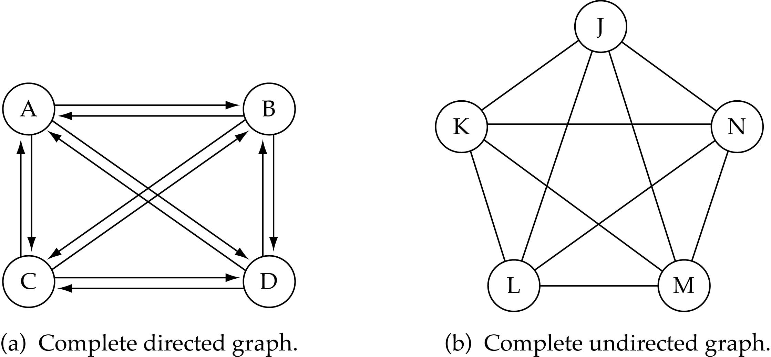
Graph terminology
Complete graph: a graph in which every vertex is directly connected to every other vertex

Slide 11
Graph terminology (cont.)
What is the number of edges E in a complete directed graph with V vertices?
E=V * (V-1)
or E=O(V²)

Slide 12
Graph terminology (cont.)
What is the number of edges E in a complete undirected graph with V vertices?
E=V* (V-1) / 2
or E=O(V²)

Slide 13
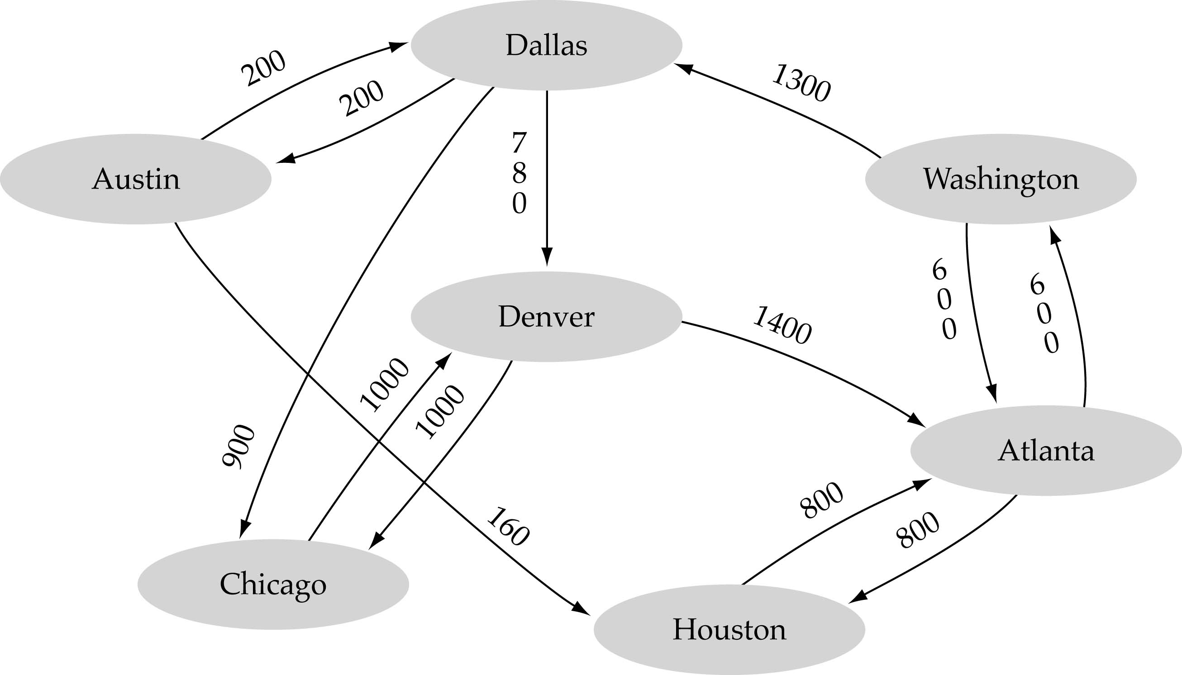
Graph terminology (cont.)
Weighted graph: a graph in which each edge carries a value

Slide 14
Graph Implementation
Array-based
Linked-list-based

Slide 15
Array-based implementation
Use a 1D array to represent the vertices
Use a 2D array (i.e., adjacency matrix) to represent the edges

Slide 16
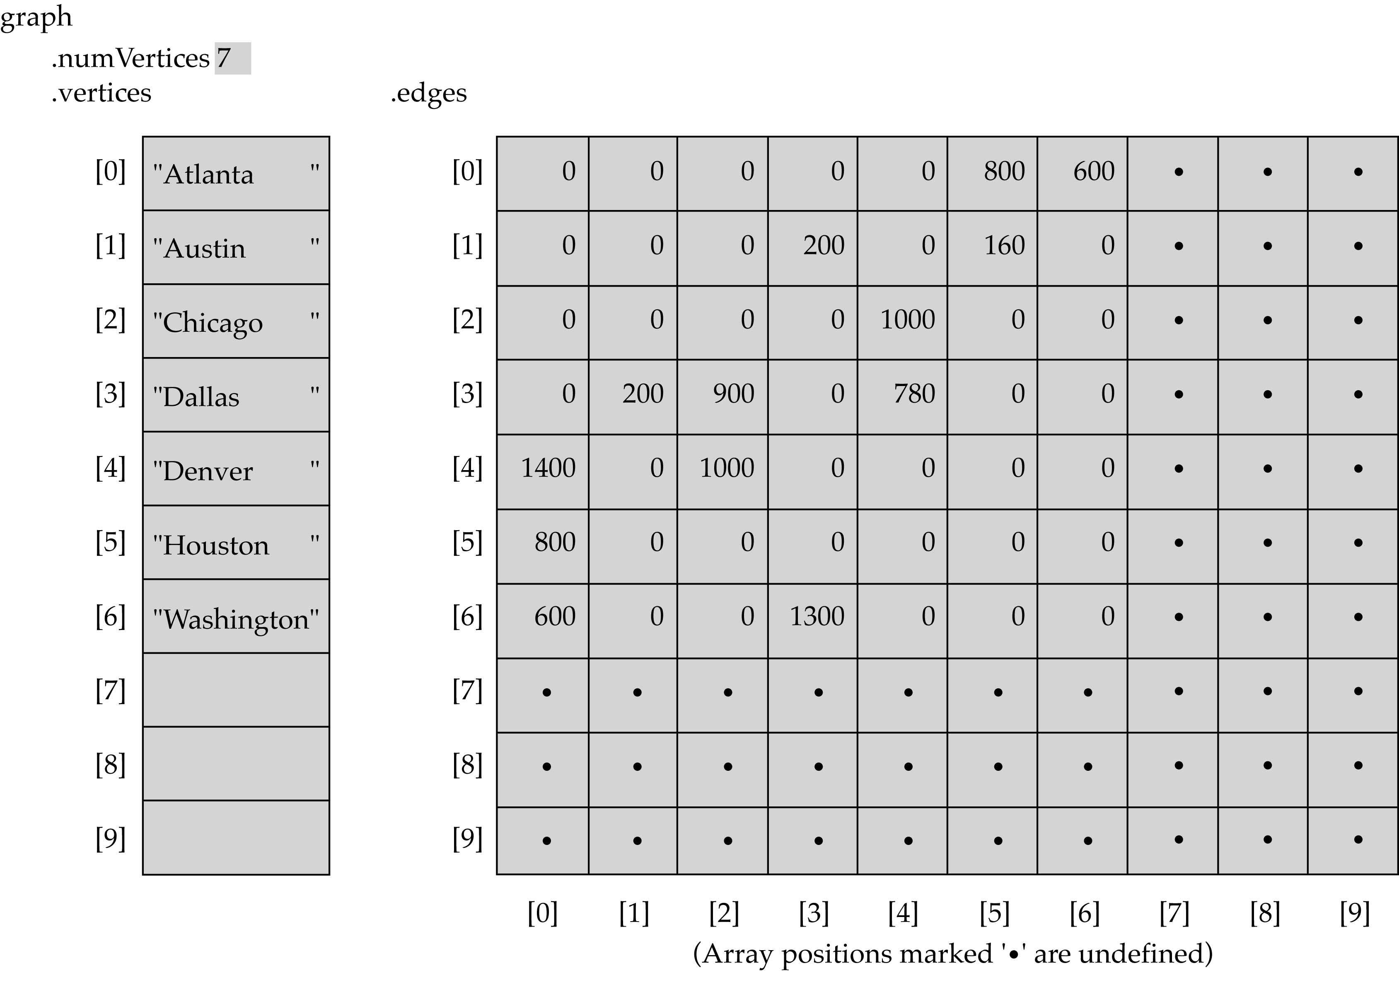
Array-based implementation (cont’d)

Slide 17
Array-Based Implementation (cont.)
Memory required
  O(V+V²)=O(V²)
Preferred when
  The graph is dense: E = O(V²)
Advantage
  Can quickly determine
  if there is an edge between two vertices
Disadvantage
  No quick way to determine the vertices adjacent
  from another vertex

Slide 18
Linked-list-based implementation
Use a 1D array to represent the vertices
Use a list for each vertex v which contains the vertices which are adjacent from v (adjacency list)

Slide 19
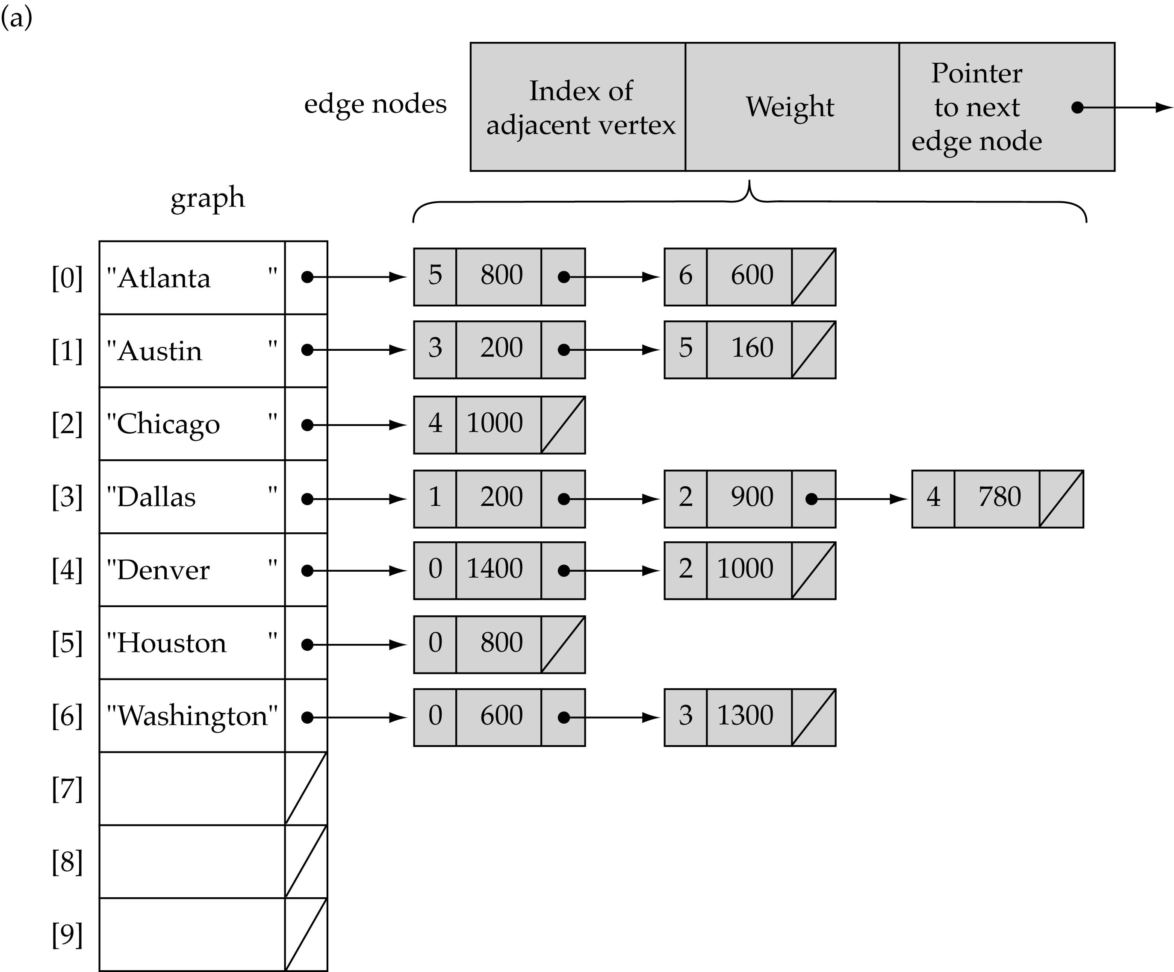
Linked-list-based implementation (cont’d)

Slide 20
Link-List-based Implementation (cont.)
Memory required
  O(V + E)
Disadvantage
  No quick way to determine whether
  there is an edge between vertices u and v
Advantage
  Can quickly determine the
  vertices adjacent from a given vertex

Slide 21
Graph specification based on adjacency matrix representation
const int NULL_EDGE = 0;
template<class VertexType>
class GraphType {
public:
GraphType(int);
~GraphType();
void MakeEmpty();
bool IsEmpty() const;
bool IsFull() const;
void AddVertex(VertexType);
void AddEdge(VertexType, VertexType, int);
int WeightIs(VertexType, VertexType);
void GetToVertices(VertexType, QueType<VertexType>&);
void ClearMarks();
void MarkVertex(VertexType);
bool IsMarked(VertexType) const;
private:
int numVertices;
int maxVertices;
VertexType* vertices;
int **edges;
};

Slide 22
template<class VertexType>
GraphType<VertexType>::GraphType(int maxV)
{
numVertices = 0;
maxVertices = maxV;
vertices = new VertexType[maxV];
edges = new int[maxV];
for(int i = 0; i < maxV; i++)
edges[i] = new int[maxV];
}

Slide 23
template<class VertexType>
GraphType<VertexType>::~GraphType()
{
delete [] vertices;
for(int i = 0; i < maxVertices; i++)
delete [] edges[i];
delete [] edges;
}

Slide 24
void GraphType<VertexType>::AddVertex(VertexType vertex)
{
vertices[numVertices] = vertex;
for(int index = 0; index < numVertices; index++) {
edges[numVertices][index] = NULL_EDGE;
edges[index][numVertices] = NULL_EDGE;
}
numVertices++;
}

Slide 25
template<class VertexType>
void GraphType<VertexType>::AddEdge(VertexType fromVertex, VertexType toVertex, int weight)
{
int row;
int column;
row = IndexIs(vertices, fromVertex);
col = IndexIs(vertices, toVertex);
edges[row][col] = weight;
}

