Slide 1
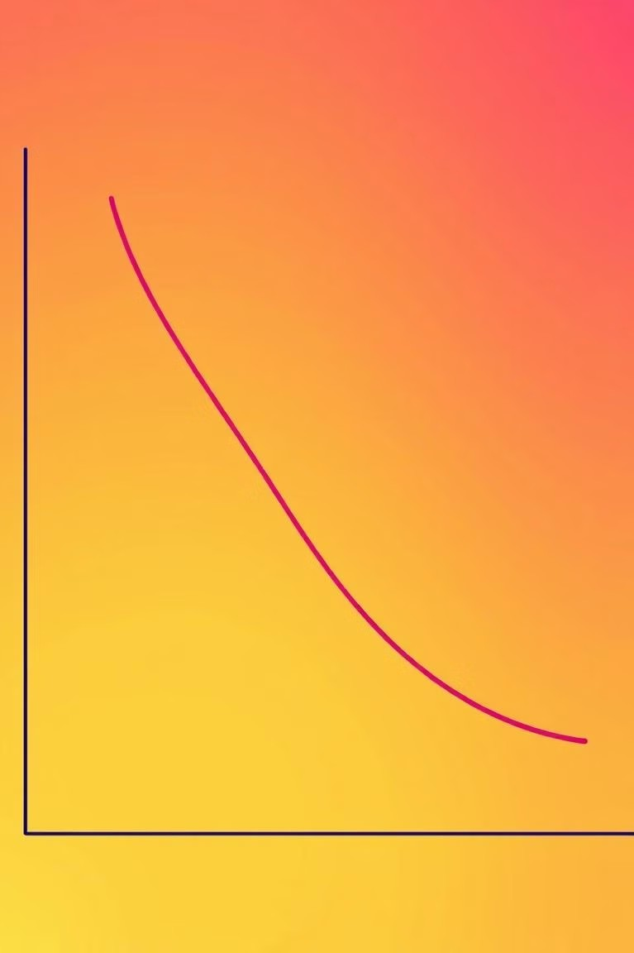

Elasticity of Demand
and Elasticity of Supply

Slide 2

What is the law of demand?
The law of demand states that if the price of the product increases then the quantity demand increases and vice versa.

Slide 3
Exceptions for the law of demand
While the law of demand generally holds true, there are exceptions.
Giffen Goods
Inferior goods for which demand increases as prices rise. These goods are often essential and have few substitutes.
Veblen Goods
Luxury goods that have a higher demand at higher prices, as price is seen as a status symbol.

Slide 4
What is the law of supply?
Law of supply states that an increase in price of goods result in an increase in their supply

Slide 5
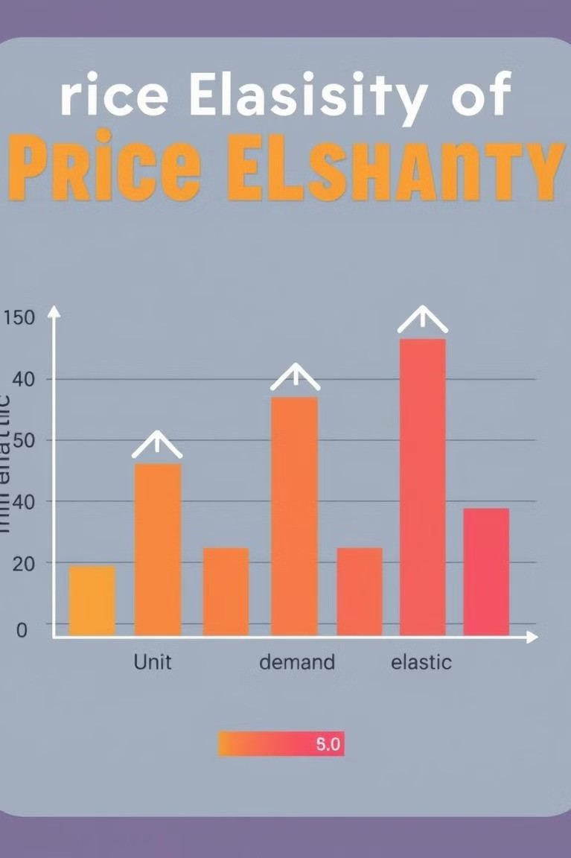
Defining Elasticity of Demand
Elasticity of demand measures the responsiveness of quantity demanded to changes in price. It is a measure of how much the quantity demanded changes in response to a change in price.
Elastic Demand
Quantity demanded changes significantly as price changes
Inelastic Demand
Quantity demanded changes very little or not at all as price changes
Unit Elastic Demand
Quantity demanded changes proportionally to the price change

Slide 6




Factors Affecting Elasticity of Demand
Several factors influence the elasticity of demand for a product.
Availability of Substitutes
Goods with many substitutes tend to have higher elasticity of demand. Consumers can easily switch to alternatives if the price rises.
Necessity vs. Luxury
Essential goods, like food and medicine, tend to have lower elasticity of demand. Consumers are less likely to reduce consumption even if prices rise.
Proportion of Income
Goods that represent a larger proportion of a consumer's income tend to have higher elasticity of demand. Consumers are more sensitive to price changes for these goods.
Time Horizon
Demand tends to be more elastic over longer time periods. Consumers have more time to adjust their consumption patterns in response to price changes.

Slide 7


Calculating Elasticity of Demand
The elasticity of demand can be calculated using a simple formula.
Formula
Elasticity of demand = (% change in quantity demanded) / (% change in price)

Slide 8
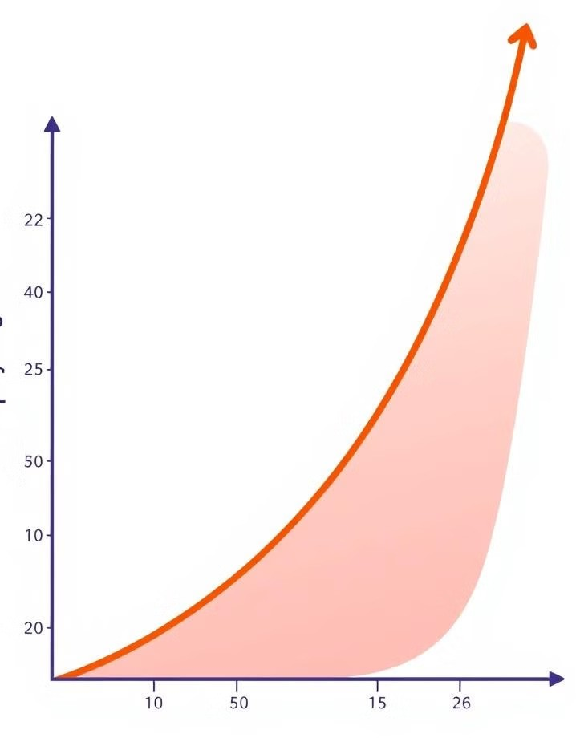


Defining Elasticity of Supply
Elasticity of supply measures the responsiveness of quantity supplied to changes in price.
1
Elastic Supply
Quantity supplied changes significantly as price changes.
2
Inelastic Supply
Quantity supplied changes very little or not at all as price changes.
3
Unit Elastic Supply
Quantity supplied changes proportionally to the price change.

Slide 9
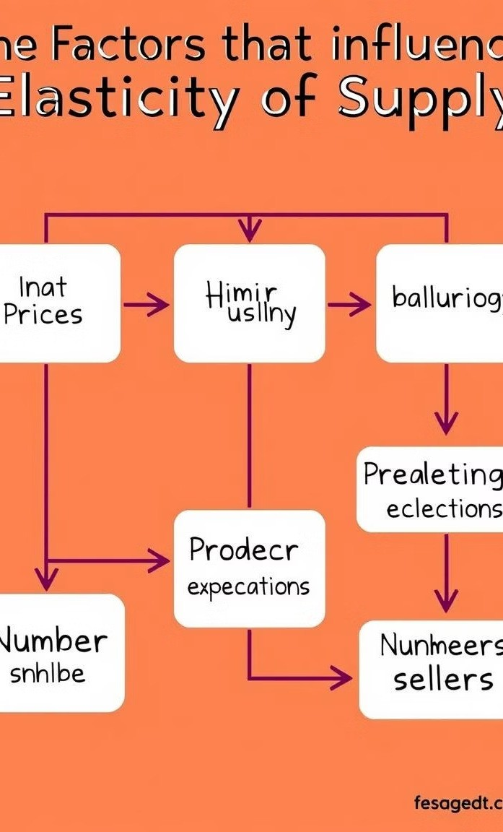




Factors Affecting Elasticity of Supply
Several factors influence the elasticity of supply of a product.
1
Time Horizon
Supply is more elastic in the long run, as producers have more time to adjust production levels in response to price changes.
2
Availability of Resources
Products with readily available resources tend to have more elastic supply. Producers can easily increase output if prices rise.
3
Production Capacity
Producers with excess capacity have more elastic supply. They can increase output without significant costs or delays.
4
Mobility of Resources
Products with resources that can be easily moved or adapted to different uses tend to have more elastic supply.

Slide 10
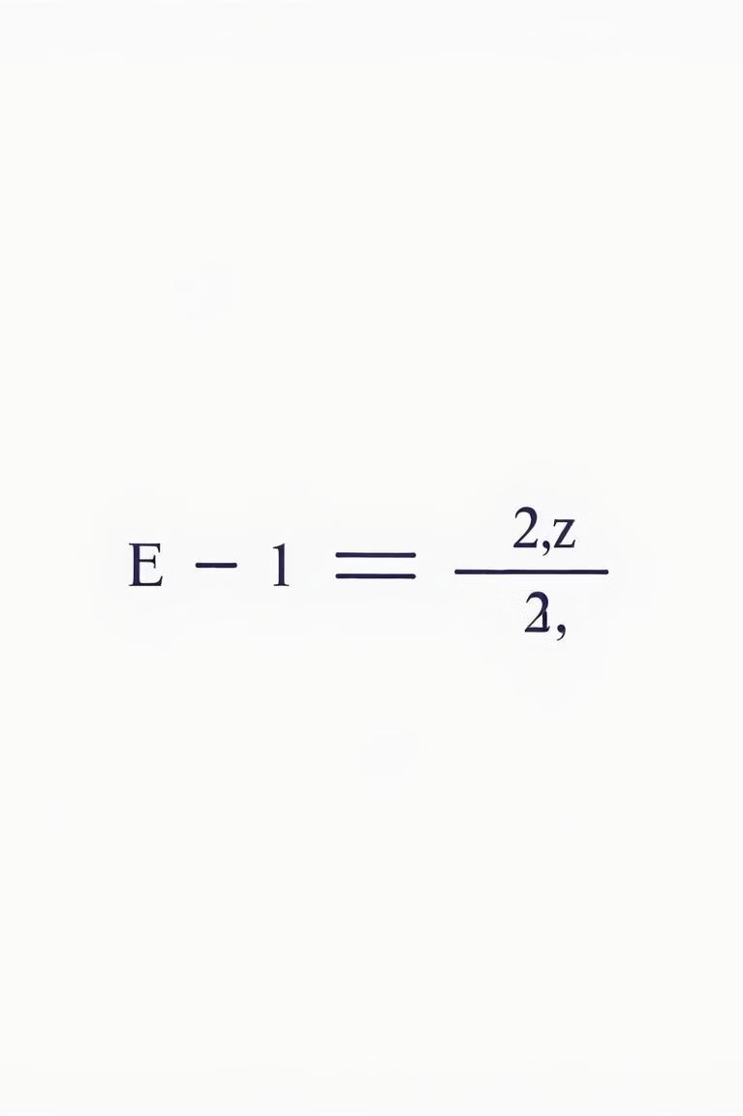

Calculating Elasticity of Supply
The elasticity of supply can be calculated using a simple formula.
Formula
Elasticity of supply = (% change in quantity supplied) / (% change in price)

Slide 11
Thank You

