Slide 1
House Prices & Neighbourhood Venues Data Analysis
Birmingham, UK

Slide 2
Introduction
Facts
Population: 1,111,307 (2017 estimate), 3.8 million in the Greater Metropolitan area, most ethnically diverse city in the UK.
Official Language: English (de facto) with 108 languages being spoken in schools, including Urdu, Punjabi, Bengali, and many others.
GDP Per Capita: $46,296.98 USD
Youthful Population: 45.7% of Birmingham’s population is under 30
Currency: Pound Sterling or Great Britain Pound (£, GBP). As of early 2017, $1 USD = £0.80, €1 EUR = £0.85, $1 CAD = £0.61, $1 AUD = £0.62
Bermingham is the second-largest city of the United Kingdom (UK) with roughly 1.1 million inhabitants within the city area and 3.8 million inhabitants within the metropolitan area. This also makes Birmingham the 17th largest city in the world. Located approximately 100 miles from central London, Birmingham, as one of the United Kingdom's major cities, is considered to be the social, cultural, financial, and commercial center of both the East and West Midlands.

Slide 3
Problem
To identify neighbourhoods of the city with following features -
Venues ( Train Station, Pub and Grocery Store)
Average price

Slide 4
Data Source
To find all the areas and postcode district in and around the city
https://en.wikipedia.org/wiki/B_postcode_area
To find the real estate details ( Average price etc) following service is used as the data source
https://propertydata.co.uk/cities/Birmingham
For getting geo coordinates for the areas.
https://opencagedata.com/
Foursquare API to get the most common venues of Birmingham

Slide 5
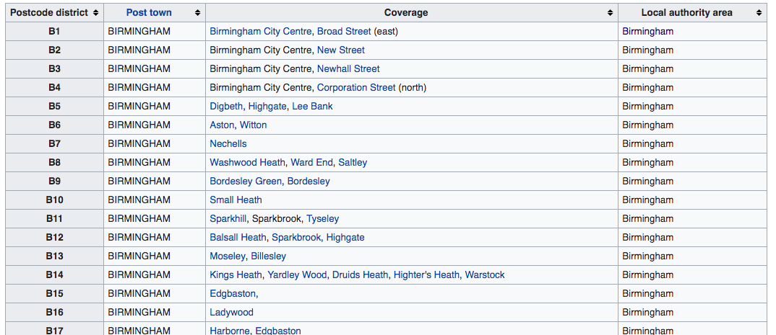
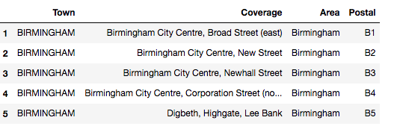
Methodology
Data cleaning - From Wikipedia to Panda Dataframe

Slide 6
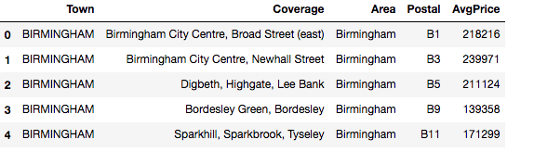
Methodology
Getting average price from PropertyData (https://propertydata.co.uk/cities/Birmingham) and create new dataframe
data=pd.merge(cityData,dataSetPrice,left_on="Postal",right_on="Postal",how="inner")

Slide 7
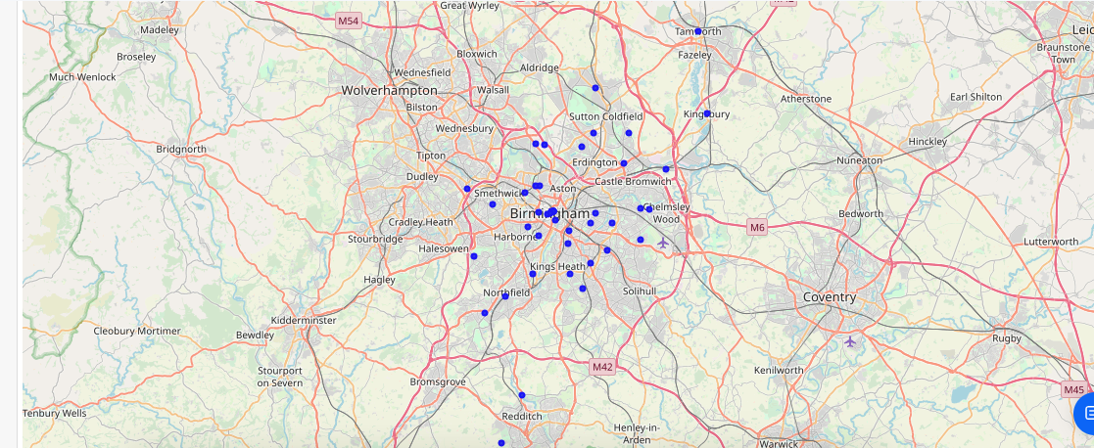
Methodology
Folium Map

Slide 8

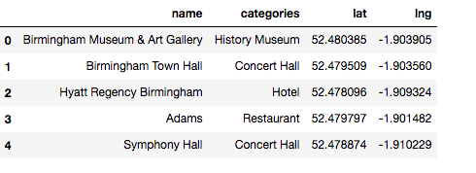
Forsquare API
def getBuiltUrl(neigh_lat,neigh_long,radius=1400):
# type your answer here
LIMIT=100
#radius=1000
url = 'https://api.foursquare.com/v2/venues/explore?&client_id={}&client_secret={}&v={}&ll={},{}&radius={}&limit={}'.format(
CLIENT_ID,
CLIENT_SECRET,
VERSION,
neigh_lat,
neigh_long,
radius,
LIMIT)
return url

Slide 9
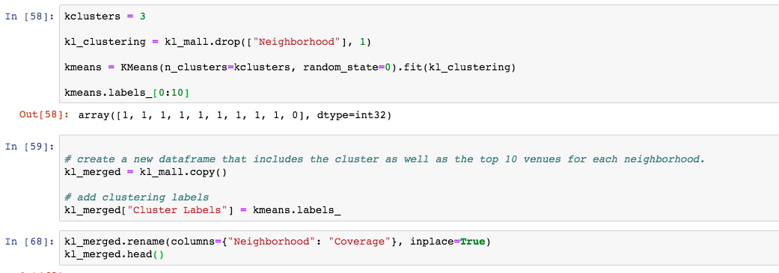
Clustering and K-Means

Slide 10
Results
We concluded ( based on our priorities for the neighborhoods) following neighbourhoods are good places to settle. These neighbourhoods are having decent average price for the households and having categories of the venues that we wanted to test for like ( Grocery store, bar and train station).
Moseley, Billesley
Hall Green
Tamworth, Fazeley, Kingsbury, Polesworth
Water Orton, Coleshill, Nether Whitacre
Northfield, Longbridge, West Heath
Top 5 Neighbourhoods

Slide 11
Thanks

