Slide 1

Hitofun Buyer’s market start from here
企業應用 - 2018 黑客松

Slide 2
Data source from
觀光資訊資料庫
P.O.I (景點)
Hotel data (旅館民宿)
  RAW Hotel Count 9000 Hotels
  Able to Use Around 5100 Hotels

Slide 3
Question to everyone
If you can pay less money for your trip, would you like to pay more?
Who don’t want to save more money?

Slide 4
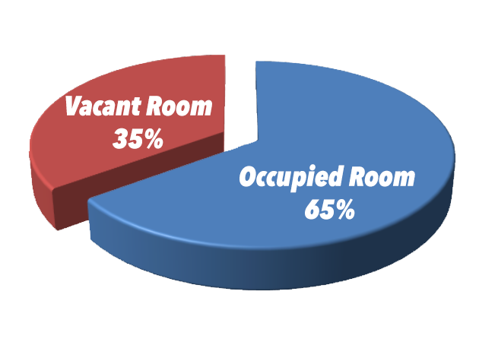
Problems / Taiwan
Any unsold time product after expired will cause money losing for business owner
Hotels room not been fully utilized
For hotel price $8,000 People rather go over sea
2017 Average Occupancy rate too low, around 65%

Slide 5
Problems / Taiwan
2.3 Billion
In trash
4.27 Billion
6.57 Billion total market

Slide 6
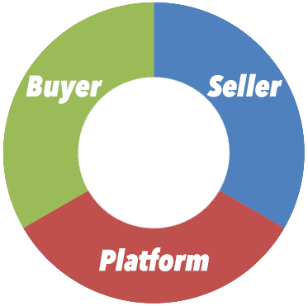
Problems / Taiwan
Cannot afford the hotel’s price
I would like to negotiate my own price
If price are right (Lower), I would like go out more
Any unsold room consider for money losing
I would like to offer the discount, but i don't want to ruining my list price
Perfect
Buyer’s market match maker platform

Slide 7
Solutions
We provide the “Buyer’s Market”, Seller accept variable price offer upon Supply vs. Demand change
Price dynamically change Hotel able to increase room occupancy rate
Price dynamically change Buyer able to get the lower price due to lower occupancy rate

Slide 8
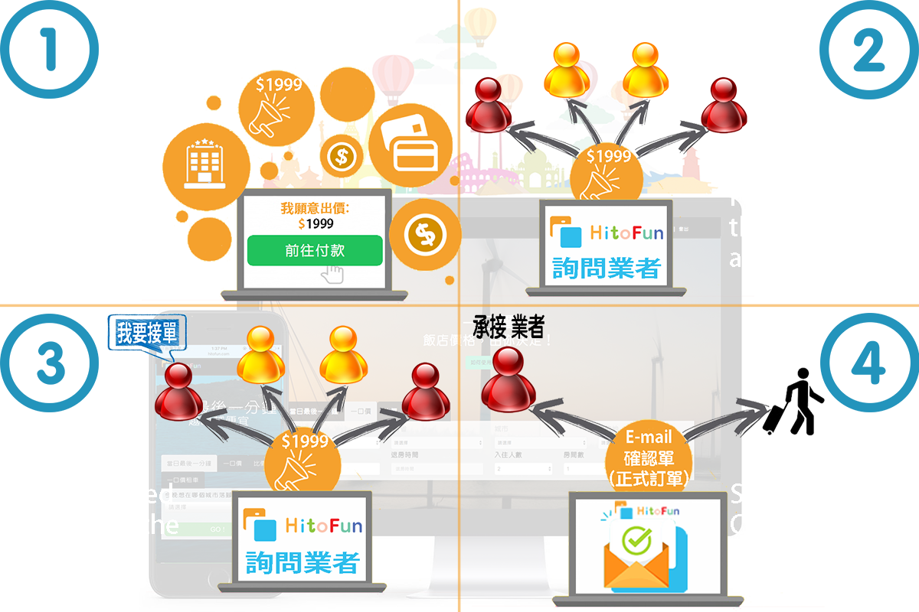
Solutions – Operation flow

Slide 9
Core technology
Buyer’s Market
Data mining
  Pricing
  Contact info
    Contact Person / Email / Phone Number

Slide 10
Problem solve with …
Seller
  Able Increase the Room Occupancy rate
  Able to offer the Non-Transparent Discount Price
Buyer
  Get the Discount (Cheaper) Price

Slide 11
Our Team
Coding Hacker
  Andy Chen
    Code development
Business Hacker
  Hsin Huang
    Business logic development

