Slide 1
URLs
Uniform Resource Locators
Protocol
Name of site
Absolute path
http://www.example.com/2013/samples/first.html
Host name
Domain name
Directory path
Document

Slide 2
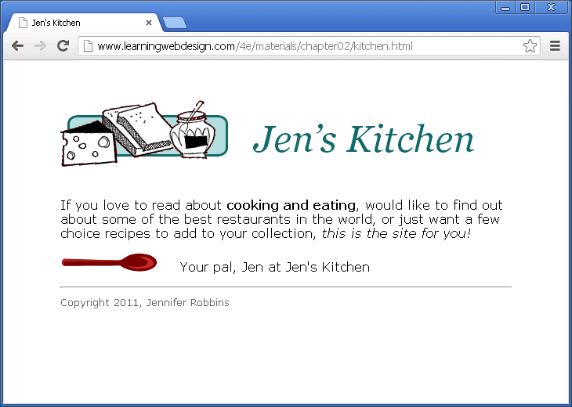
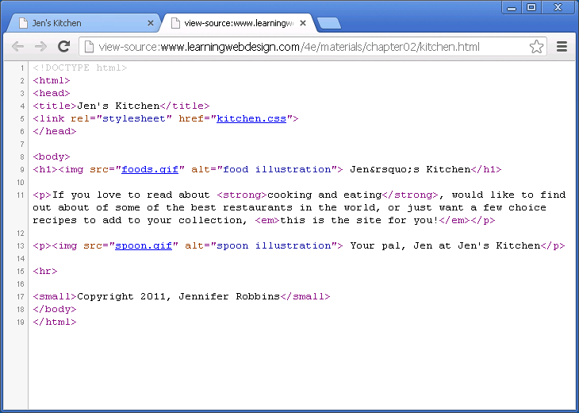
http://www.learningwebdesign.com/4e/materials/chapter02/kitchen.html

Slide 3
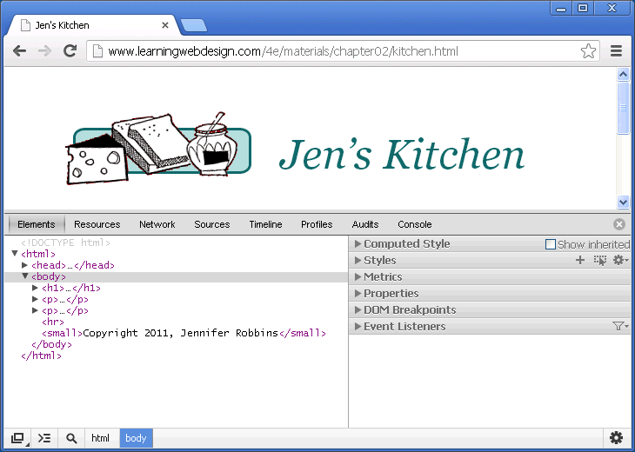
Introducing Dev Tools
Notes:
Need to clarify exactly what to show them
-Element inspection
-Styles including early introduction to idea that browser has default styles
https://chromium.googlesource.com/chromium/blink/+/master/Source/core/css/html.css

Slide 4

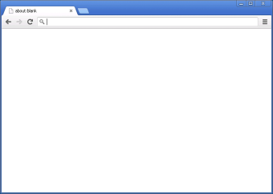
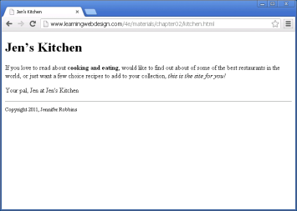





Putting it all together
HTTP request
HTTP response
HTTP request
HTTP response
Server contents
index.html
kitchen.css
foods.gif
spoon.gif
Notes:
https://github.com/teambox/Free-file-icons

Slide 5
A web page, step by step
Start with content
Give the document structure
Identify text elements
Add an image
Change the look with a style sheet

Slide 6


Tools

Slide 7
Start with Content
Type, or copy and paste, the content from blackgoose.txt on Moodle
Save the file as /bistro/index.html
Have a look at the results in the browser

Slide 8
Elements of Markup
This is the content
}
Content

Slide 9
Elements of Markup
This is the content
}
Content

Slide 10
Elements of Markup
<markup>
This is the content
}
Content

Slide 11
Elements of Markup
{
<markup>
This is the content
}
Content

Slide 12
Elements of Markup
Start Tag
{
<markup>
</markup>
This is the content
}
Content

Slide 13
Elements of Markup
Start Tag
{
{
<markup>
</markup>
This is the content
}
Content

Slide 14
Elements of Markup
Start Tag
End Tag
{
{
<markup>
</markup>
This is the content
}
Content

Slide 15
Elements of Markup
Start Tag
End Tag
{
{
<markup>
</markup>
This is the content
}
Content

Slide 16
Elements of Markup
Start Tag
End Tag
{
{
<markup>
</markup>
This is the content
}
}
Content
Element

