Slide 1
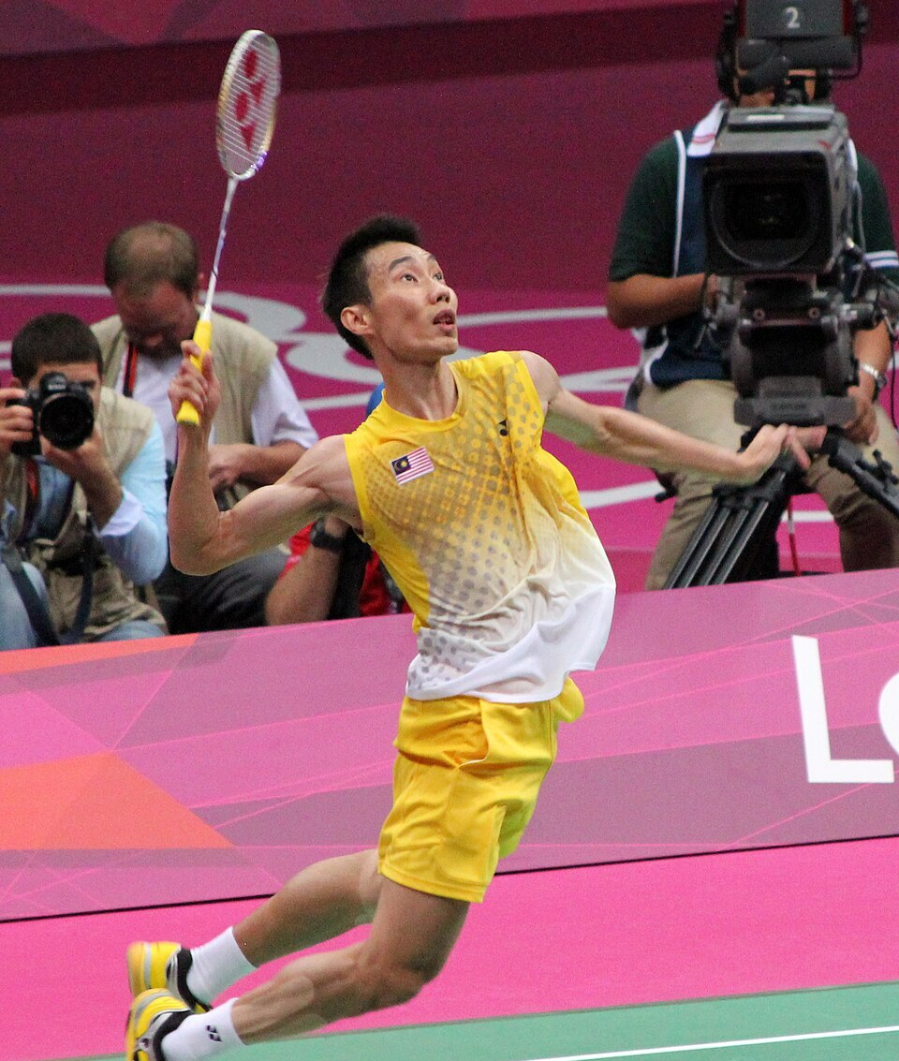
AKP / BADMINTON PERFORMANCE INTELLIGENCE
SHUTTLETRACE
Turn every rally into
a coaching decision.
Real-time badminton notation, player tracking and post-match analytics — using the devices coaches already own.
LIVE MATCH • TRAINING • ANALYTICS
VISUAL DRAFT
Notes:
[Sources]
Lee Chong Wei photograph — Antony Stanley, CC BY-SA 2.0 — https://commons.wikimedia.org/wiki/File:Lee_Chong_Wei_Prepares_To_Smash_cropped.jpg

Slide 2
1. PROBLEM: Traditional Pen-and-Paper Notation is Slow and Inefficient
The Coaching Bottleneck
• Coaches are distracted by manually writing tallies, losing valuable face-time with players.
• No immediate statistics can be calculated during the critical 11-point break or between sets.
• Paper records are easily lost, unorganized, and fail to track player progress over time.
• Existing commercial tech options are locked behind heavy subscription and equipment walls.
THE MANUAL CHAOS WE ARE ELIMINATING:
❌ Tally Marks on Paper
Messy handwriting that coaches must count and calculate by hand after games.
❌ Zero Real-Time Action
Insights arrive too late (usually days after a match) to adjust ongoing game strategies.
❌ Fragile & Lost Data
Physical binders that pile up and offer no historical progress search capability.
Notes:
Highlight that traditional paper-based notation limits real-time tactical adjustments. Coaches cannot calculate percentages on the fly during a tight 11-point break, making raw tallies useless in the moment.

Slide 3
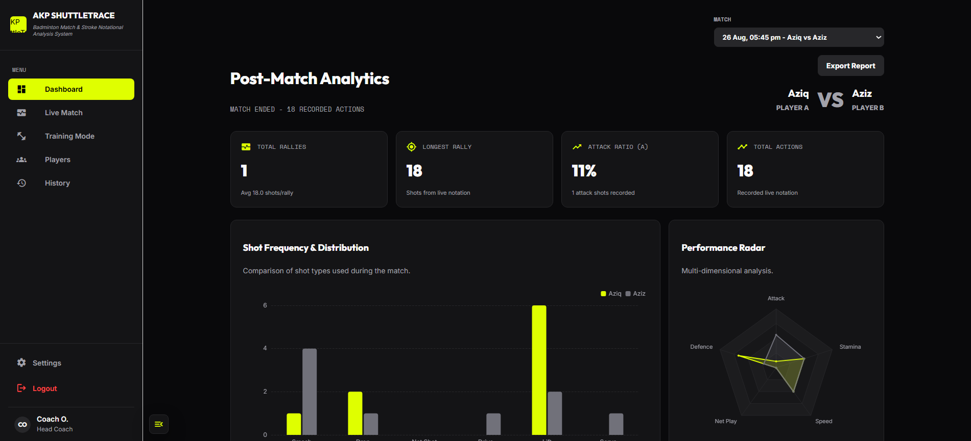
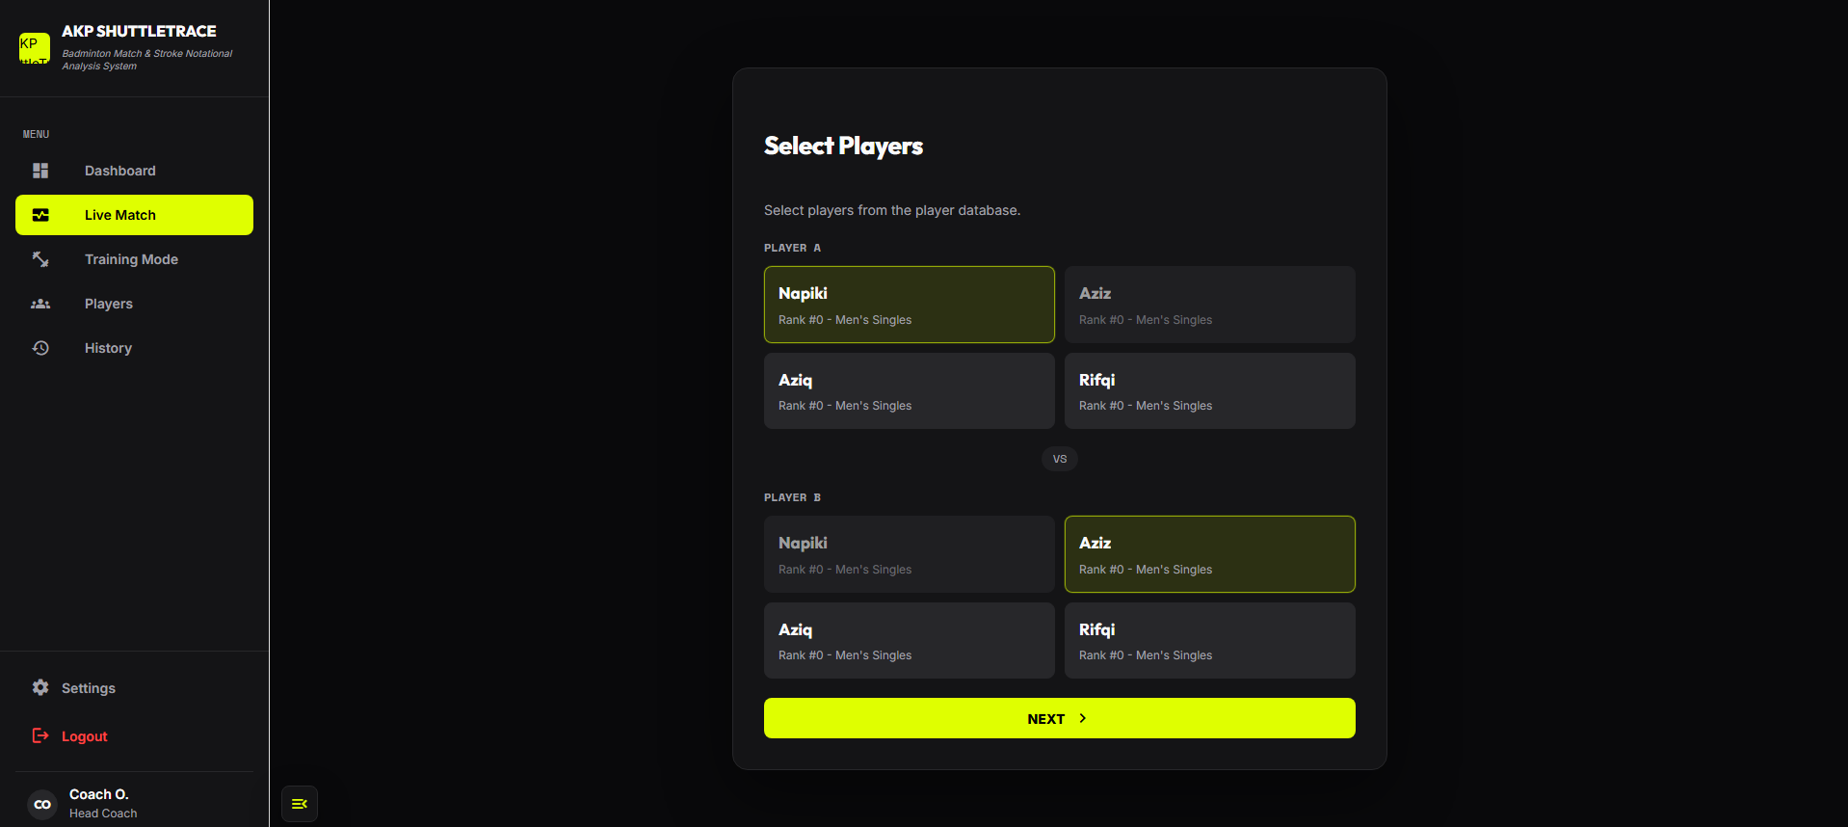
02
PROPOSED INNOVATION
One tap turns
court action into
usable insight.
shuttletrace.ai
The working interface already connects three jobs that coaches normally perform separately.
01
CAPTURE
Record live shots and player actions court-side.
02
ANALYZE
See distribution, attack ratio and rally patterns.
03
REVIEW
Store match history for structured player development.
REAL WORKING INTERFACE
Notes:
[Sources]
Product interfaces supplied by the project team: post-match analytics and live-match player selection screenshots.

Slide 4
3. NOVELTY: Digital Simplicity Over Outdated Manual Workflows
THE OLD WAY
• Paper & pen mess
• Math during breaks
• Easily lost sheets
• Unorganized binder files
SHUTTLETRACE
• Tap-based mobile app
• Real-time dashboard
• Secure cloud archive
• Zero hardware costs (RM0)
VS
Value Proposition: Replaces tedious pen-and-paper with immediate, error-free statistics using coaches' sedia ada mobile devices—requiring no technical setup or training.
Notes:
Explain that the novelty is simplicity itself. Most technology tries to overcomplicate things with cameras and expensive tracking. ShuttleTrace modernizes the classic coaching clipboard digitally and at absolute zero cost.

Slide 5
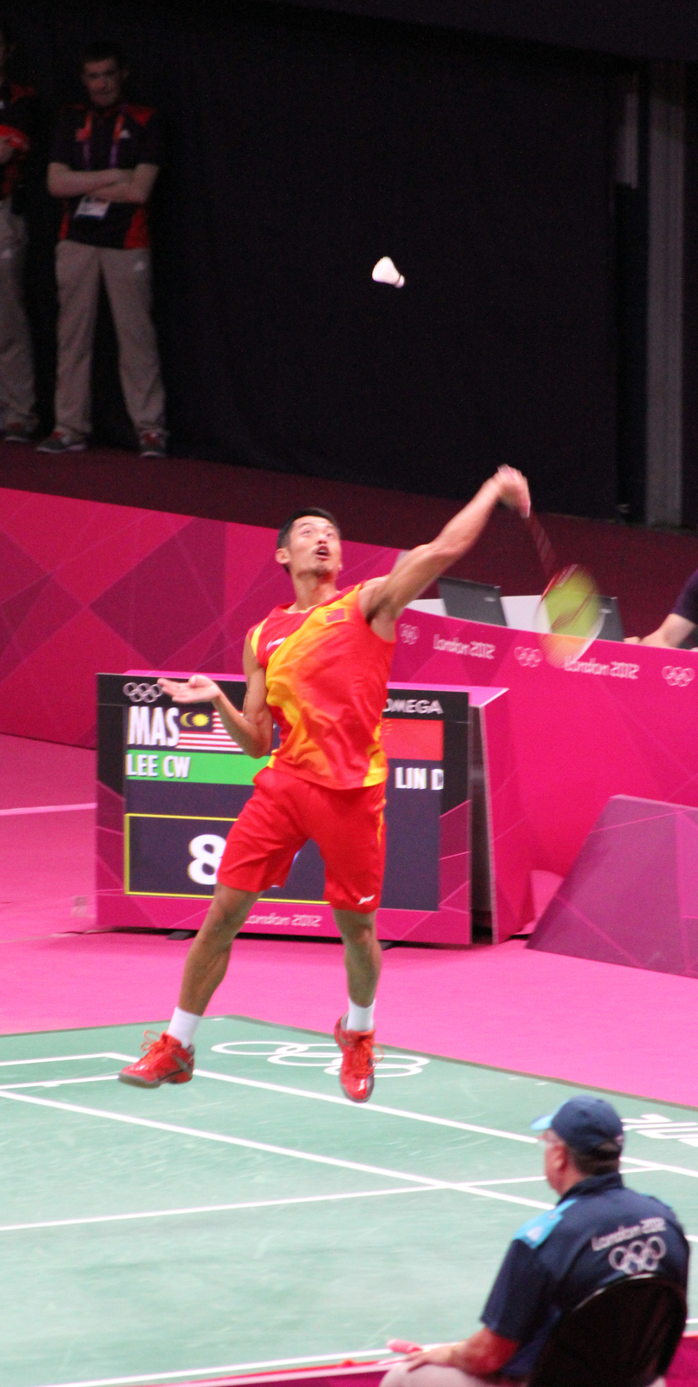
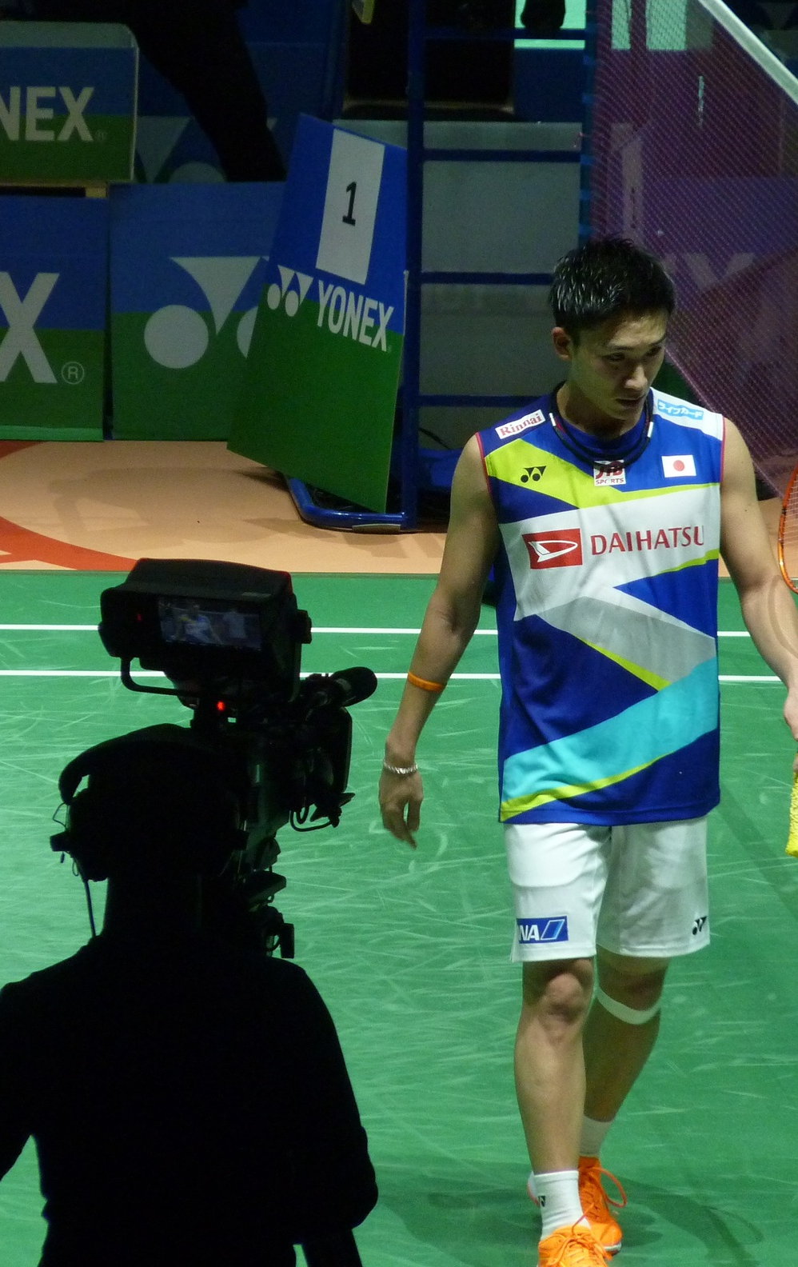
04
TARGET USERS
Elite insight should not be
limited to elite budgets.
ShuttleTrace scales the same disciplined performance mindset from national-level badminton to everyday coaching environments.
01
SCHOOL & UNIVERSITY COACHES
Track development without buying specialist hardware.
02
PRIVATE ACADEMIES
Offer structured reports and measurable player progress.
03
RECREATIONAL PLAYERS
Understand patterns, errors and strengths after every match.
INSPIRED BY THE HIGHEST LEVEL.
DESIGNED FOR EVERY LEVEL.
Notes:
[Sources]
Lin Dan photograph — Antony Stanley, CC BY-SA 2.0 — https://commons.wikimedia.org/wiki/File:Lin_Dan_Returns_The_Shuttlecock_(7758849992).jpg
Kento Momota photograph — Nardisoero, CC BY-SA 4.0 — https://commons.wikimedia.org/wiki/File:Kento_Momota_from_Japan.jpg

Slide 6
5. TECHNICAL FEASIBILITY: Zero Hardware Costs, Highly Reliable Architecture
100% Bring Your Own Device (BYOD)
✔ Hardware Cost = RM0: Runs on iOS and Android smartphones or tablets already owned by coaches and players.
✔ No expensive high-speed cameras, smart rackets, or sensor devices to buy or calibrate.
✔ Extremely lightweight app install size that fits on older devices with low storage.
✔ Runs seamlessly in offline mode, auto-syncing to the database once a Wi-Fi connection is detected.
Simple & Scalable App Architecture
☁ Mobile App (Frontend)
Optimized React Native app that ensures ultra-smooth UI tapping response and zero button lag during rapid badminton rallies.
☁ Cloud Server & Database (Backend)
Stat tallies are compressed and sent as small text files to the cloud, ensuring lightning-fast uploads with extremely low data usage.
☁ Web Dashboard (Alternative View)
Allows academy administrators to print beautifully formatted PDF summaries and progress charts from any desktop browser.
Notes:
Emphasize to the judges that the technology is highly feasible because we rely on React Native (runs everywhere) and simple databases. No hardware issues to debug, ensuring the product can launch in weeks, not years.

Slide 7
6. BENEFITS: Empowering Grassroots Sports Digitization
Real-Time Match Insight
Allows coaches to back up their court-side advice with exact percentages during a 1-minute break, boosting athlete confidence and strategy execution.
Effortless Digital Workflow
Say goodbye to bulky paper binders. Every match is neatly cataloged, searchable, and stored without taking physical storage space.
Highly Inclusive & Scalable
Sifar kos (Zero cost) barrier makes sports analytics accessible to underfunded village schools and small state badminton associations alike.
Actionable Player Progress
Enables players to visualize and understand their performance trends, helping them target specific areas to improve during training.
Notes:
Each benefit addresses a key sports development need: immediate stats, effortless organization, zero cost barrier, and player motivation through numbers.

Slide 8
7. COMMERCIAL POTENTIAL: Low Overhead, High-Growth SaaS Model
How We Scale Profitably
💰 Freemium Mobile App
The basic notation and live scorecard app are 100% free for everyone. This guarantees rapid downloads and viral organic growth among clubs.
💰 Premium Academy Dashboard
SaaS subscription model charging small private academies and leagues for bulk player analysis, PDF reports, and advanced team stats.
💰 In-App Sponsorships
Premium brand placements from Malaysian sports equipment brands targeting active badminton enthusiasts directly on the scorecard UI.
Key Market Strengths
📈 Huge Target Base in Malaysia
Badminton is one of the most widely played sports in Malaysia with thousands of schools and private training courts active nationwide.
📈 Sifar Overhead (RM0 Inventory)
No manufacturing costs, no physical inventory, no delivery logistics, and extremely low server maintenance fees.
📈 Global Scalability
Easily translated into English, Chinese, and other languages to enter massive Asian markets like Indonesia, Thailand, and China instantly.
Notes:
Because we sell software (SaaS), our profit margins are incredibly high. Explain that our free tier drives massive adoption, which naturally funnel-converts larger private academies to our premium analytics plan.

Slide 9
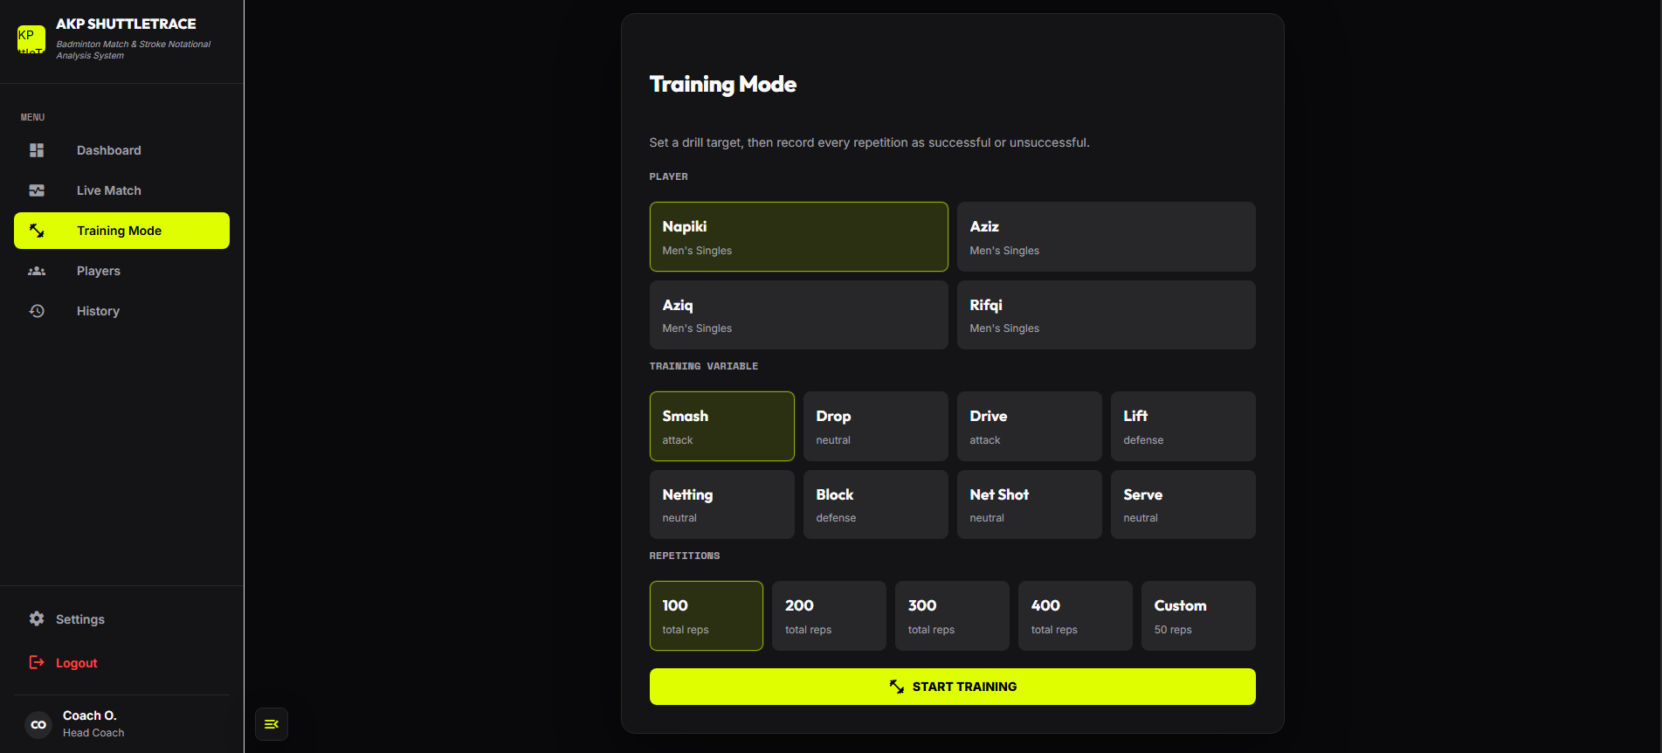
08
PROTOTYPE
One system. Two coaching contexts.
Capture on iPad at court-side. Review on the web after the match.
shuttletrace.ai
iPAD • COURT-SIDE
WEB • POST-MATCH
Notes:
[Sources]
Product interfaces supplied by the project team: Training Mode and Post-Match Analytics screenshots.

Slide 10
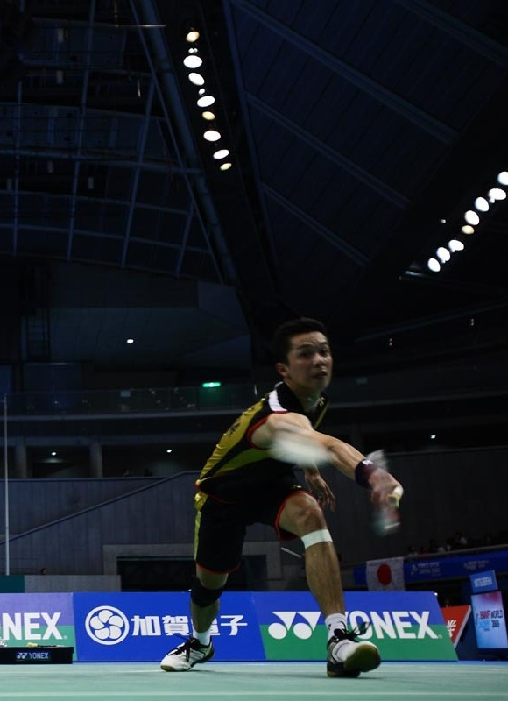
09
CONCLUSION
Elite-level insight.
Grassroots-ready.
ShuttleTrace bridges the gap between manual notation and modern performance analysis — without adding expensive hardware.
REAL-TIME COURT-SIDE CAPTURE
STRUCTURED PLAYER HISTORY
RM0 SPECIALIST HARDWARE
FROM EVERY RALLY → A BETTER DECISION
Notes:
[Sources]
Taufik Hidayat photograph — Tsutomu Takasu, CC BY 2.0 — https://commons.wikimedia.org/wiki/File:Flickr_-_tpower1978_-_Yonex_Open.jpg

Slide 11
THANK YOU
Q&A Session — Open for Discussion
ShuttleTrace: Modernizing Badminton Tactic Notation at Zero Cost
Notes:
Thank the judges and open the floor to any of their questions about technology, scalability, or target audience.

Slide 12
SYSTEM REQUIREMENT ADDENDUM
Project specification for AKP ShuttleTrace
Badminton match and stroke notational analysis system for coaches, analysts and structured training review.
Frontend: Vue 3 + Quasar
Backend: NestJS + Prisma
Database: PostgreSQL
Purpose
Primary user
Deployment target
Record live matches, capture stroke notation, store player profiles, analyze performance and generate post-match reports.
Badminton coach or analyst who needs fast notation during match play and clear review after the session.
Frontend on GitHub Pages, backend on Railway and PostgreSQL connected through DATABASE_URL.
PROJECT SPECIFICATION / 01
AKP SHUTTLETRACE
Notes:
[Sources]
Product interface screenshots supplied in the source deck.
Project requirements derived from the AKP ShuttleTrace project specification requested by the user and the current repository architecture.
Slide added as a new requirement addendum; original pitch content is preserved.

Slide 13
FUNCTIONAL REQUIREMENTS
System scope covers the full coaching workflow
The app must support everything from player setup to live notation, training logging, history review and export.
Authenticate
Manage players
Record matches
Track strokes
Register, login, current user session and logout.
Create, view, edit and delete player profiles.
Select Player A/B, track sets, rallies, score and shot sequence.
Store shot type, rally context, player ownership and performance category.
Analyze dashboard
Training mode
Export reports
Settings/backup
Show match summary, shot frequency, attack ratio, longest rally and radar-style comparison.
Set drill target, record repetitions and review training history.
Generate match reports and export CSV for coach documentation.
Support utility settings, local fallback and data recovery path.
PROJECT SPECIFICATION / 02
AKP SHUTTLETRACE
Notes:
[Sources]
Product interface screenshots supplied in the source deck.
Project requirements derived from the AKP ShuttleTrace project specification requested by the user and the current repository architecture.

Slide 14
FRONTEND REQUIREMENTS
The frontend is the coach-facing control surface
Built with Vue 3, Quasar, Vue Router, Axios and ECharts/Vue-ECharts, with LocalStorage fallback for continuity.
Core pages
Dashboard, Login/Register, Live Match, Training Mode, Players, History, Profile and Settings.
UI responsibility
Fast coach notation, player forms, report views, chart rendering and match/training navigation.
Data handling
Axios API calls with LocalStorage fallback or offline cache for prototype resilience.
PROJECT SPECIFICATION / 03
AKP SHUTTLETRACE
Notes:
[Sources]
Product interface screenshots supplied in the source deck.
Project requirements derived from the AKP ShuttleTrace project specification requested by the user and the current repository architecture.

Slide 15
BACKEND REQUIREMENTS
The backend keeps badminton data structured and consistent
NestJS with TypeScript exposes REST endpoints, Prisma handles persistence and PostgreSQL stores match/training records.
AuthModule
PlayersModule
MatchesModule
User identity, session validation and logout.
CRUD for coach-owned player profiles.
Match report, rallies, sets, shot records and soft delete history.
TrainingModule
PrismaService
Training sessions, drill targets and repetition records.
Database access layer and schema mapping.
PROJECT SPECIFICATION / 04
AKP SHUTTLETRACE
Notes:
[Sources]
Product interface screenshots supplied in the source deck.
Project requirements derived from the AKP ShuttleTrace project specification requested by the user and the current repository architecture.

Slide 16
DATABASE REQUIREMENTS
Database model connects coaching records
The schema must preserve coach ownership, player context, match rallies, shot notation and training repetitions.
Ownership chain
Match structure
Training structure
User > CoachProfile > Player
Each coach owns their player records and session context.
Match > MatchSet > Rally > ShotRecord
Every point sequence stays connected to the match and player.
TrainingSession > TrainingRep
Drill target, player, shot focus and repetition result are saved together.
Reference data
History behavior
Reporting base
ShotType links live shots and training reps so analysis uses a consistent badminton vocabulary.
Match and training records support soft delete so coach history can be hidden without losing data integrity.
Dashboard and export reports pull from Match, Rally, ShotRecord, TrainingSession and TrainingRep.
Key tables: User, AuthSession, CoachProfile, Player, Match, MatchSet, Rally, ShotRecord, ShotType, TrainingSession and TrainingRep.
PROJECT SPECIFICATION / 05
AKP SHUTTLETRACE
Notes:
[Sources]
Product interface screenshots supplied in the source deck.
Project requirements derived from the AKP ShuttleTrace project specification requested by the user and the current repository architecture.
Diagram is an editable summary of the requested database specification.

Slide 17
API AND QUALITY REQUIREMENTS
REST endpoints and quality rules make the prototype production-ready
The backend API is grouped by auth, players, matches, training and system health checks.
Auth
Players
Matches
POST /auth/register
POST /auth/login
GET /auth/me
POST /auth/logout
GET /players
GET /players/:id
POST /players
PUT /players/:id
DELETE /players/:id
GET /matches
GET /matches/:id
POST /matches
POST /matches/reports
POST /matches/:id/rallies
POST /matches/:id/shots
DELETE /matches/:id
Training
System
GET /training
GET /training/player/:playerId
POST /training
DELETE /training/:id
GET /
GET /health
Non-functional: responsive UI, backend validation, user/coach data ownership, soft delete, fast live-notation interaction and LocalStorage fallback.
PROJECT SPECIFICATION / 06
AKP SHUTTLETRACE
Notes:
[Sources]
Product interface screenshots supplied in the source deck.
Project requirements derived from the AKP ShuttleTrace project specification requested by the user and the current repository architecture.

