Slide 1
LECTURE ONE
INTRODUCTION TO ALGORITHM
September 2015
Dr. Zhenyu He
Shenzhen Graduate School, Harbin Institute of Technology

Slide 2
Algorithms
What?
Why?
How?

Slide 3

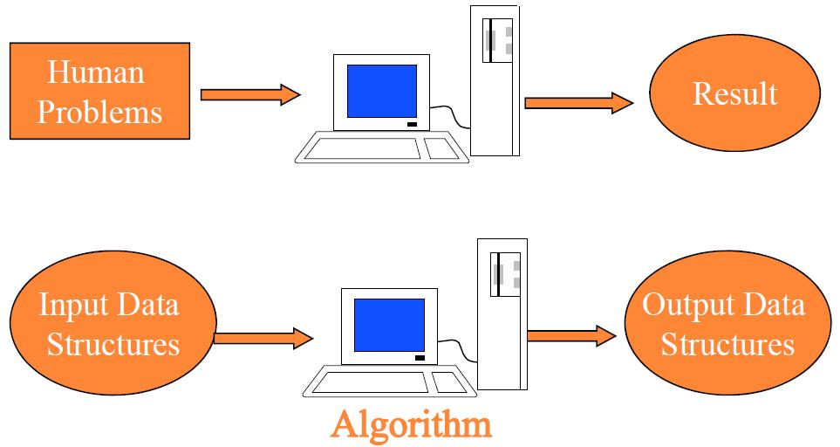
What are algorithms?
An algorithm is a sequence of computational steps that transform the input into the output.

Slide 4
One example: sorting problem
Input: A sequence of n numbers <a₁, a₂,…, a_{n}>
Output: A permutation (recording) sequence <a’₁, a’₂,…, a’_{n}> of the input sequence such that
a’₁≤ a’₂ ≤… ≤ a’_{n.}

Slide 5
Human Problems
Path searching
Input: a road map on which the distance between each pair of adjacent intersections is marked
Output: the shortest route from one intersection to another
Human genome project
Input: 100,000 genes in human DNA.
Output: sequences of 3 billion chemical base pairs.
Internet information management

Slide 6
Why?-The Reasons to Study Algorithm
Become the skilled programmer from the novice.
Cookbook
Master the skills to analysis and design algorithms with high efficiency for new problems

Slide 7
Efficiency
Baseline to evaluate the algorithm
Inserting sort
Merge sort
Cost time: C₁n²
Cost time: C₂nlgn
C₁ < C₂
C₁n² < = > C₂nlgn ?

Slide 8
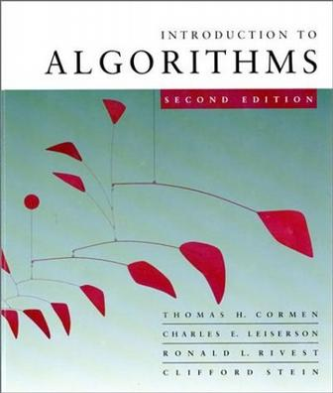
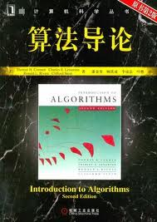
The Trivial
Text book:
Introduction to Algorithm (Second Edition)
Thomas H.Cormen, Charles E.Leiserson, Ronald L.Rivest, Clifford Stein

Slide 9

References
计算机算法设计与分析(第2版)
王晓东编著

Slide 10
Web site:
http://bcc.hitsz.edu.cn/algorithm
ftp://bcc.hitsz.edu.cn,
username: algorithm; password: algorithm.
Prerequisites
Knowledge of Data Structure
A programming Language: C, Java, …, etc.

Slide 11
Schedule
Introduction to Algorithm
Recurrences and Divide-and-Conquer
Quicksort & Sorting in Linear Time
Elementary Data Structures & Hash Function
Binary Search Tree & Red Black Tree & B-Tree
Augmenting Data Structure (Interval Tree)
Dynamic Programming
Greedy Algorithm
Linear Programming
…

Slide 12
Grading
Class participation 5%
Project & Homework 35%
Exam 60%

Slide 13
Teaching Assistants
Mr. Xiao Ma(马骁)
Office: Room G602
Phone: 18980423957
Email: turingki@yeah.net
Miss. Nana Fan (范娜娜 )
Office: Room G602
Phone: 13728857395
Email: 1520329780@qq.com

