Slide 1


Slide 2
Problem Specification
Develop a system which allows the faculty to create , modify and store questions to form sections and those sections can be grouped together to form examinations.

Slide 3
My Project Name:
Online Quiz Test System

Slide 4
Objectives
This Web Application provides facility to conduct online quiz world wide.
It saves time as it allows number of students to give the exam at a time and displays the results as the test gets over, so no need to wait for the result. It is automatically generated by the server.
Administrator has a privilege to create, modify and delete the test papers and its particular questions.
User can register, login and give the test with his specific id, and can see the results as well.

Slide 5
Technologies
1) Object oriented PHP
2)Mysql
3)Web Server (Xampp)
4)jQuery &
5)AJAX

Slide 6
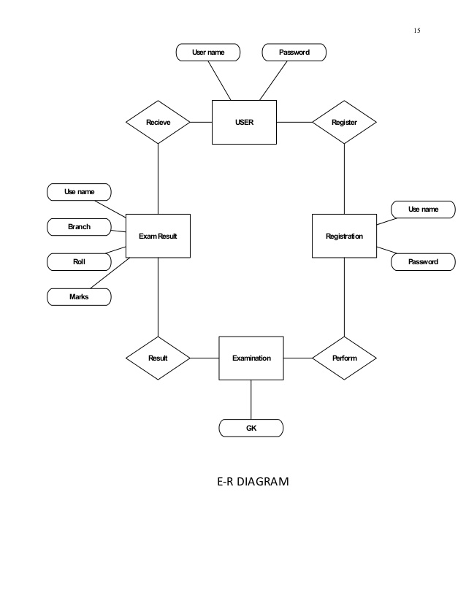

Slide 7
Administrator
Student
Online Quiz
Test
Faculty

Slide 8
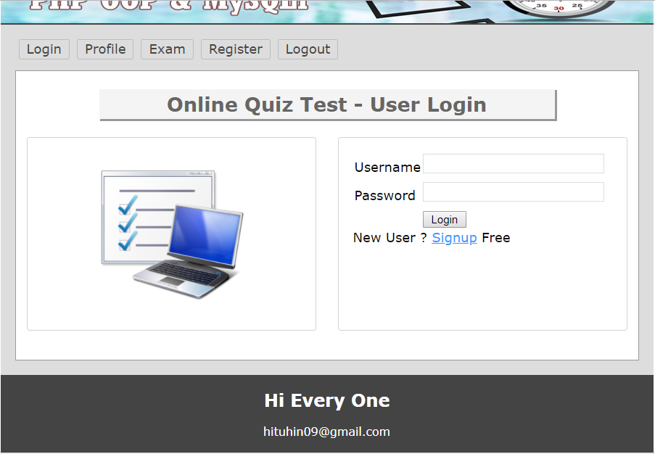

Slide 9
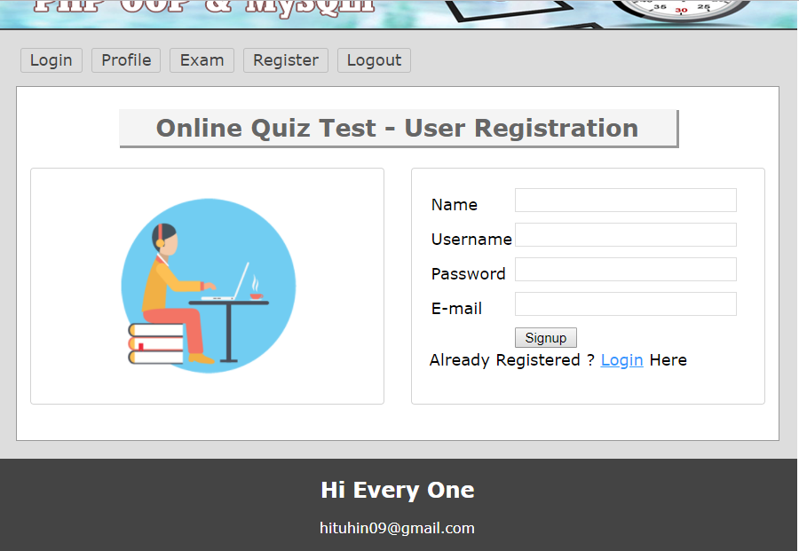

Slide 10
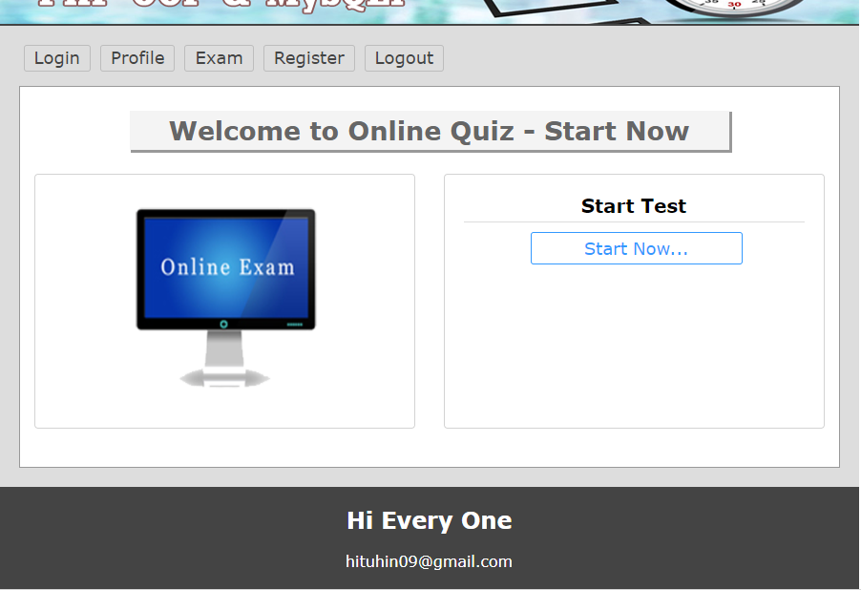

Slide 11
Scopes
On-line Exam system is designed for Educational Institutes (like schools, universities, training centers).
The system handles all the operations, and generates reports as soon as the test is finish, that includes name, mark, time spent to solve the exam.
Allow students to see or display his answers after the exam is finish.
The type of questions is only multiple choice or true and false.

