Slide 1
CNN-RNF
2019-03-02
DeepNLP
현청천

Slide 2
개요
논문: https://arxiv.org/pdf/1808.09315.pdf
소스: https://github.com/bloomberg/cnn-rnf
Python 2.7, TensorFlow, Keras, [CUDA]
Glove vector: http://nlp.stanford.edu/data/glove.840B.300d.zip
데이터: https://github.com/taolei87/text_convnet/tree/master/data

Slide 3
Introduction
Due to the linear nature of the convolution filters, they. lack the ability to capture complex language phenomena, such as compositionality and long-term dependencies
To overcome this, we propose to employ re-current neural networks (RNNs) as convolution filters of CNN systems for various NLP tasks
RNF-based CNN models can be 3-8x faster than their RNN counterparts.
Stanford Sentiment Treebank and the QASent and WikiQA datasets demonstrate that RNFs significantly improve CNN performance over linear filters by 4-5% accuracies and 3-6% MAP scores respectively

Slide 4
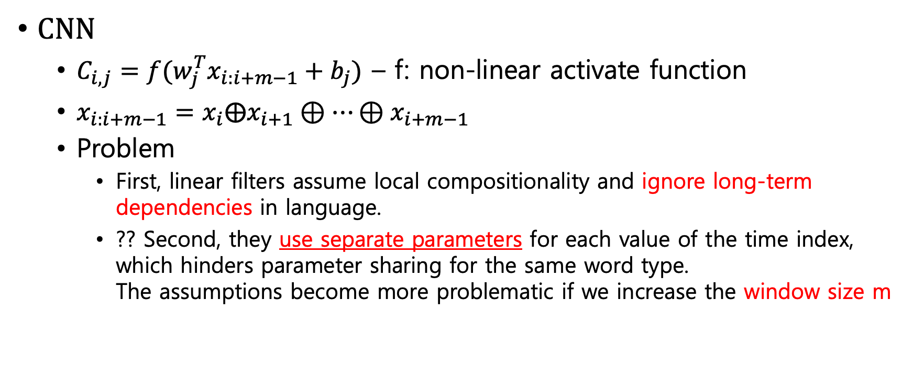
Approach (1/2)
CNN
$C_{i,j}=f(w_{j}^{T}x_{i:i+m−1}+b_{j})$ – f: non-linear activate function
$x_{i:i+m−1}=x_{i}⨁x_{i+1}⊕…⊕x_{i+m−1}$
Problem
First, linear filters assume local compositionality and ignore long-term dependencies in language.
?? Second, they use separate parameters for each value of the time index, which hinders parameter sharing for the same word type. The assumptions become more problematic if we increase the window size m

Slide 5
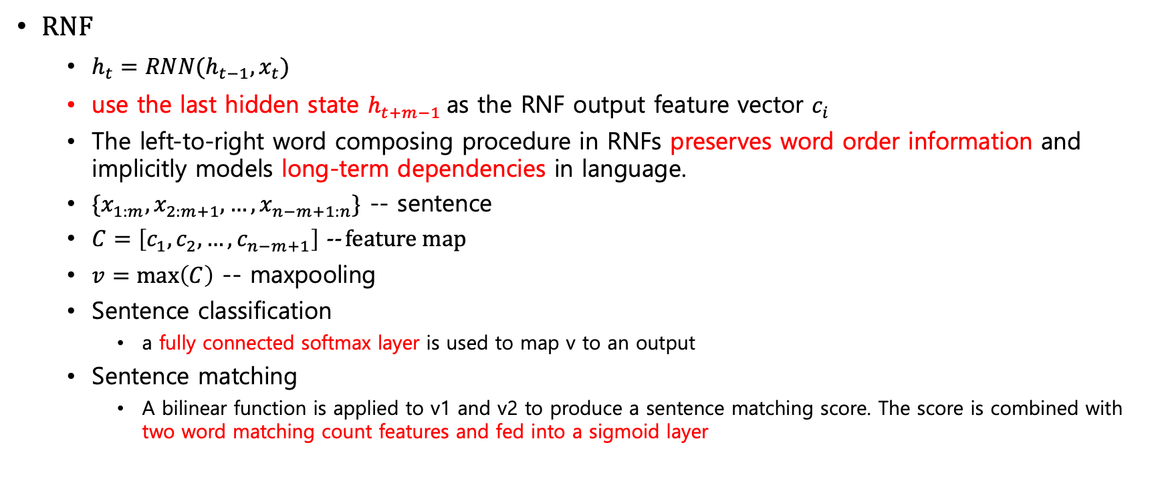
Approach (2/2)
RNF
$h_{t}=RNN(h_{t−1},x_{t})$
use the last hidden state $h_{t+m−1}$as the RNF output feature vector $c_{i}$
The left-to-right word composing procedure in RNFs preserves word order information and implicitly models long-term dependencies in language.
$\{x_{1:m}, x_{2:m+1},…, x_{n−m+1:n}\}$ -- sentence
$C=\left[c_{1},c_{2}, …,c_{n−m+1}\right]$ -- feature map
$v=\max\left(C\right)$ -- maxpooling
Sentence classification
a fully connected softmax layer is used to map v to an output
Sentence matching
A bilinear function is applied to v1 and v2 to produce a sentence matching score. The score is combined with two word matching count features and fed into a sigmoid layer

Slide 6
Rnf: rnn filter
mgram - 1
max length
mgram - 1
mgram
Max length+ filter - 1
mgram
mgram
mgram
mgram
LSTM

Slide 7
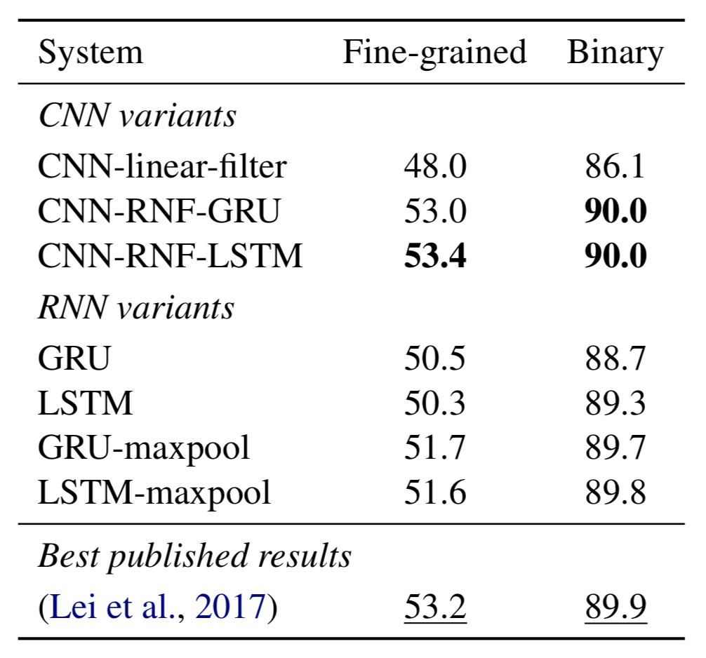
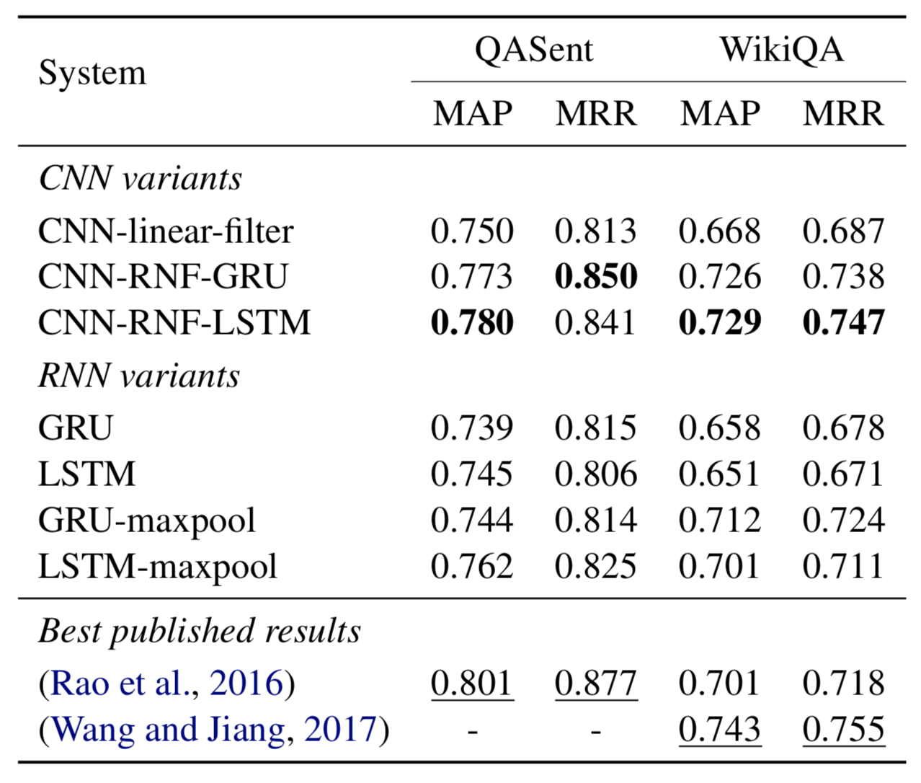
Experiments

Slide 8
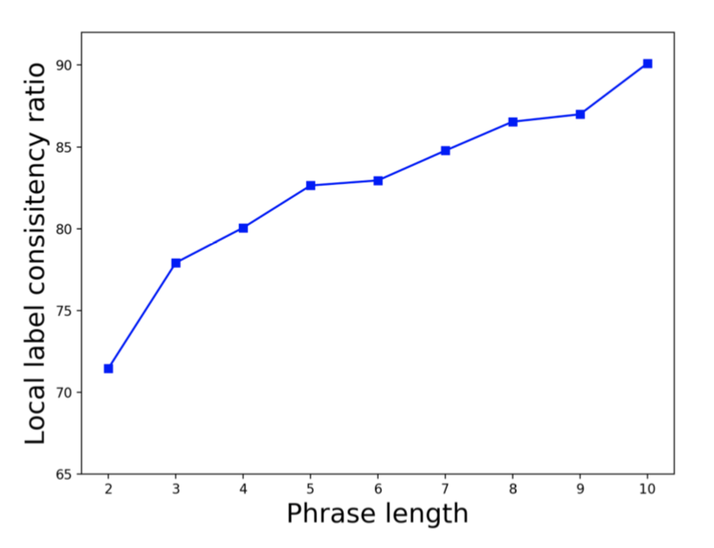
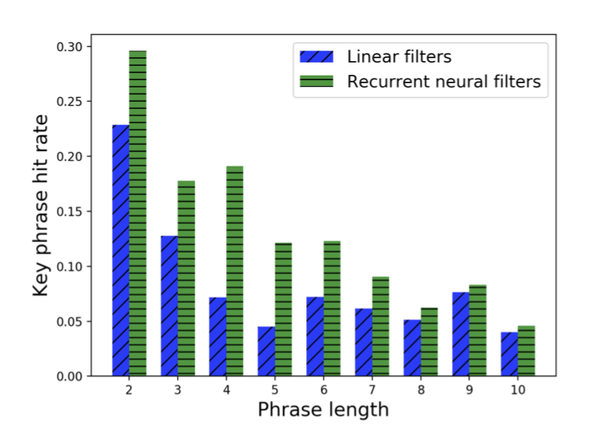
Analysis
We define the local label consistency (LLC) ratio as the ratio of m-grams that share the same sentiment labels as the original sentences
The filter-detected m-gram of a sentence is the one whose convolution feature vector has the shortest Euclidean distance to the max-pooled vector

Slide 9
실행 (binary sentiment classification)
python proc_data.py data/stsa.binary.pkl --train-path data/sst_text_convnet/stsa.binary.phrases.train --dev-path data/sst_text_convnet/stsa.binary.dev --test-path data/sst_text_convnet/stsa.binary.test --emb-path data/glove.840B.300d.txt
python cnn_keras.py --filter-type linear data/stsa.binary.pkl
python cnn_keras.py --filter-type rnf data/stsa.binary.pkl

Slide 10
실행 (fine-grained sentiment classification)
python proc_data.py --train-path data/sst_text_convnet/stsa.fine.phrases.train --dev-path data/sst_text_convnet/stsa.fine.dev --test-path data/sst_text_convnet/stsa.fine.test data/stsa.fine.pkl
python cnn_keras.py --filter-type linear data/stsa.fine.pkl
python cnn_keras.py --filter-type rnf data/stsa.fine.pkl

Slide 11
proc_data.py
시작
train, dev, test
세가지 파일을 읽어 들임
읽어들인 데이터를
파일로 저장 함
build_data
WordVecs
dump
읽어 들인 Word를 Glove
백터로 변경 함
끝

Slide 12
cnn_keras.py
(?, Sentence_length – filter + 1, 300)
(?, 2)
시작
Conv1d / rnf
Dense
embedding
Max pooling
끝
(?, Sentence_length, 300)
(?, 300)

Slide 13
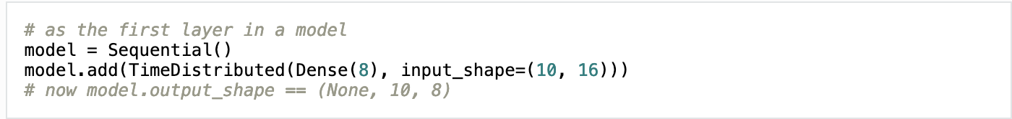
TimeDistributed
Consider a batch of 32 samples, where each sample is a sequence of 10 vectors of 16 dimensions. The batch input shape of the layer is then (32, 10, 16)
You can then use TimeDistributed to apply a Dense layer to each of the 10 timesteps, independently:
TimeDistributed can be used with arbitrary layers, not just Dense, for instance with a Conv2Dlayer:
model = Sequential() model.add(TimeDistributed(Conv2D(64, (3, 3)), input_shape=(10, 299, 299, 3)))

Slide 14
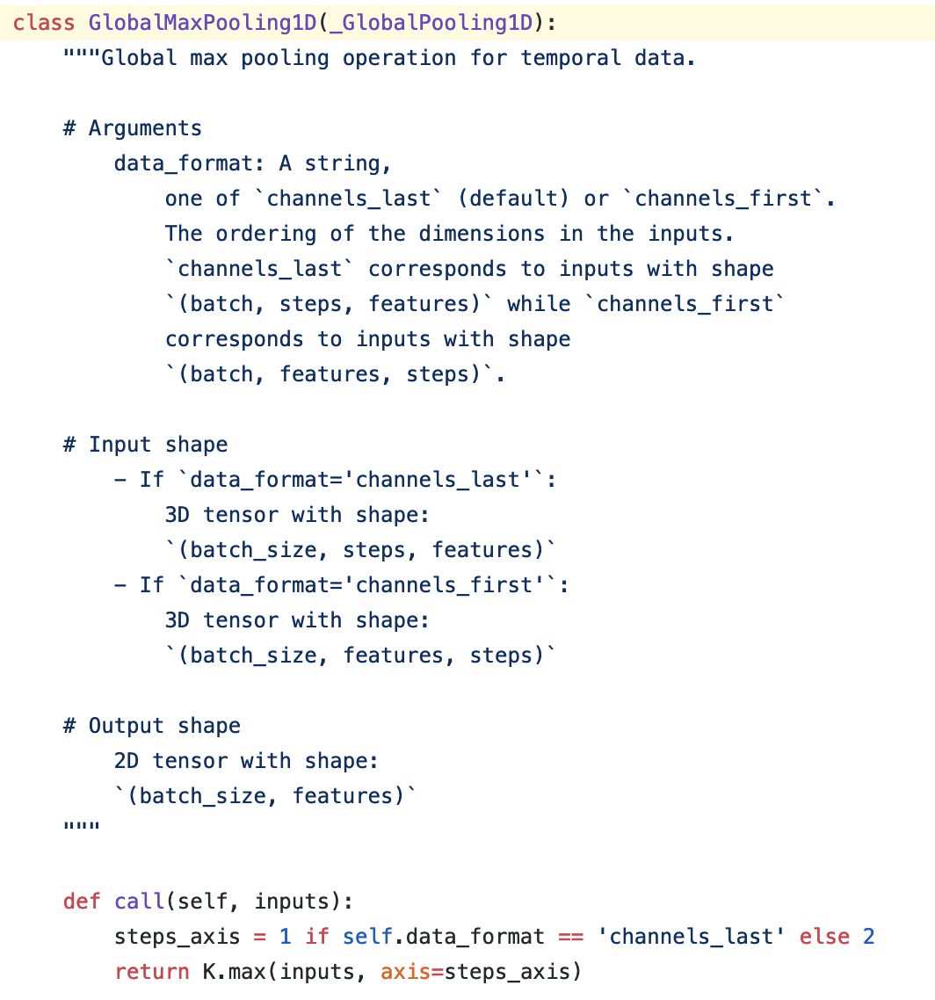
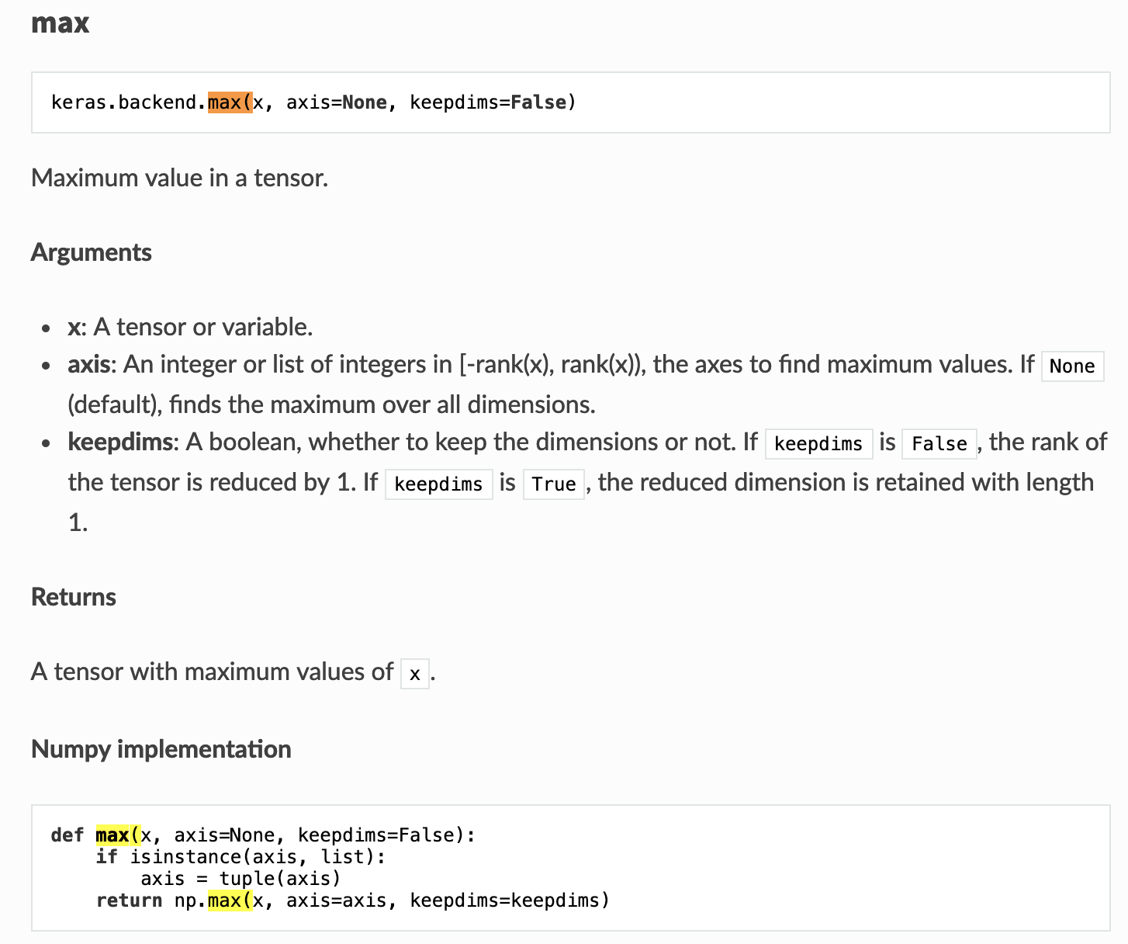
GlobalMaxPooling1D

Slide 15
GlobalMaxPooling1D
import numpy as np
def max(x, axis=None, keepdims=False):
if isinstance(axis, list):
axis = tuple(axis)
return np.max(x, axis=axis, keepdims=keepdims)
x = np.array([
[1, 2, 1, 4],
[2, 1, 5, 1],
[3, 1, 1, 1]
])
print(max(x, 0))
""" [3 2 5 4] """

