Slide 1


An Introduction to K-Means
Introduction to Data Science
Horia-Iulian State
32204606

Slide 2
Topic
This presentation will cover the following:
Supervised, unsupervised and semi-supervised learning
How K-Means works
Potential problems with K-Means
K-Means’ real-world applications
The aim of the presentation is to provide a complete beginner with a good understanding of K-Means and to demonstrate where it can / can’t be used effectively in real world analytical scenarios.

Slide 3
Scope of Presentation
Not discussing most other types or factors in ML such as Active vs Passive, Helpfulness of the teacher, online vs batch learning due to time constraints. Will be including reinforcement learning due to its immediate relevance
Not investigating multi dimensional data sets or any potential adaptations to K-Means from sources other than the recommended text. This is simply a 15 minute introduction assuming no prior knowledge..
There are a number of “open” questions regarding improving K-Means to mitigate the variance in results which will be proposed in the conclusion as areas for “further research”. These may include making it more supervised / controlled, or running the process numerous times with varying numbers of clusters to see how results may converge.
The formulae provided in the recommended text are not within the scope of introducing this topic, and neither is how to actually plot using K-Means in an app / program

Slide 4

Structure
The structure of the rest of the presentation is as follows:
Introduction to Learning Paradigms (Supervised vs Unsupervised)
How K-Means Works
A Potential Problem with K-Means
Real World Applications of K-Means
Conclusion
List of Figures
Bibliography

Slide 5
Different Machine Learning Paradigms
Supervised: Labelled data for model to learn and predict. (Geron, A. (2019).)
Unsupervised: Inheriting structures and pattern detection for input data. Data unlabelled Geron, A. (2019).
Semi Supervised: Use of some label data, and mostly unlabelled data. Mixture of supervised and unsupervised Geron, A. (2019).
Reinforcement: Self-interpreting but based on award system and punishments learned from errors and trial seeking maximum reward Geron, A. (2019).

Slide 6
What is K-Mean ?
Start
widely used clustering algorithm
centroid-based clustering method
generally used in data minig and pattern recognition problems
These are called centroids (?) (Bob, 2014, p7)
Choose Nr. of clusters
Randomly set Centroid
Distance of obj. to centroids
Groupe on min. distance
Any objects left?
Fig. 1. - Initial Scenario Concept
Stop

Slide 7
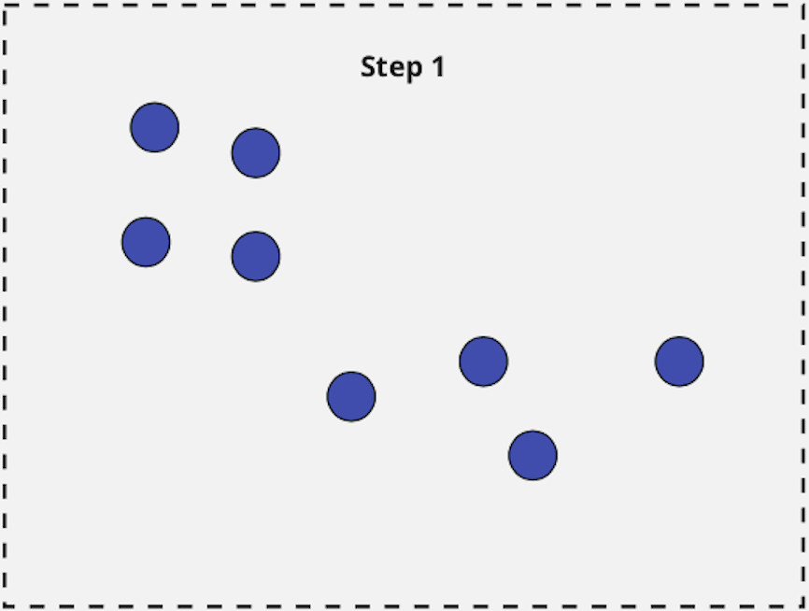
How It works
Main goal is to put members of dataset into smaller clusters that are diffrent from each other,
While members within clusters are similar to each other
These are called centroids (?) (Bob,2014, p7)
Fig. 2.1 - Initial Scenario Concept

Slide 8
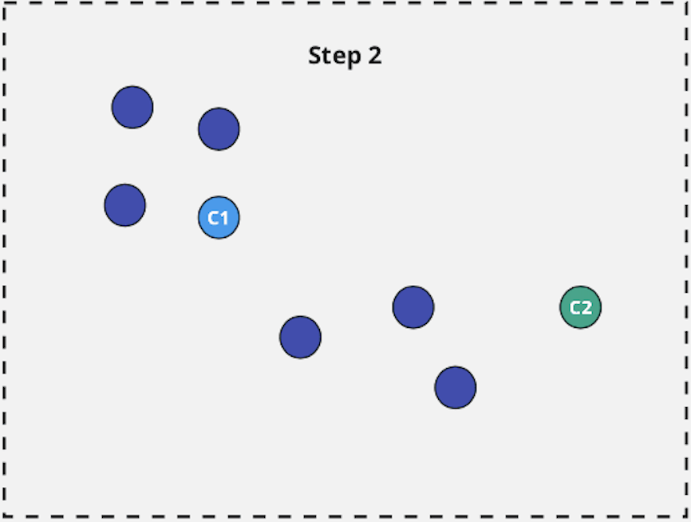
How Many Clusters and Start Points?
1. pick how many clusters we’d like. This choice is a potential problem according to (recommended) as it has a massive effect on the result.
Two completely random points are then chosen as the cluster focal points or centroid (source).
In Fig. 2.2, they are the green circle on the rightest area and the blue circle on the left area.
Each centroid is then evaluated individually.
Fig 2.2

Slide 9
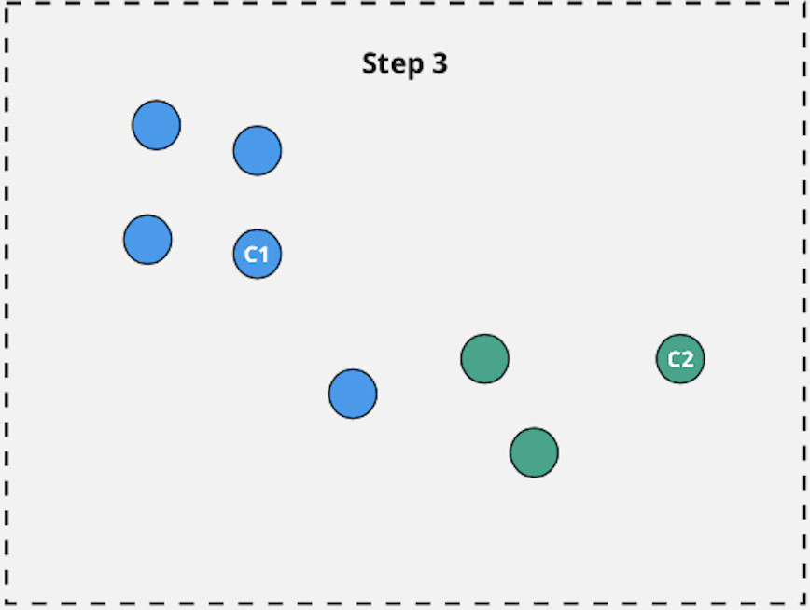
Evaluating and Adding to a Cluster
In simplified terms, we look at every point in a random order and decide if it is closer to the green cluster focal point or the blue.
Using the euclidean distance, in Fig. 2.3 is clearly closer to the green circle than it is the blue one. Therefore it will be added to the ‘green’ cluster.
This will be shown by colouring data points as a green.
Fig 2.3

Slide 10
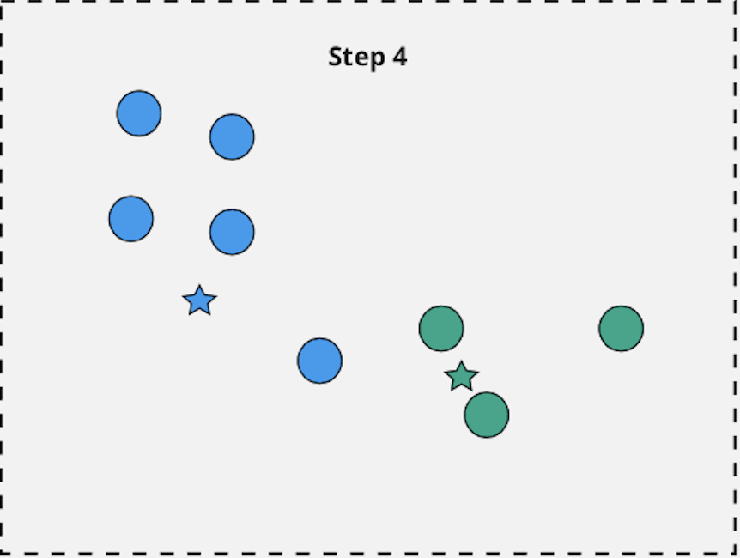
next iteration
As we can see with the free eye, the cluster arn‘t correctly grouped. We do however have two obvious clusters forming that to the human eye look as you’d expect them to.
Previous steps are repeated
Therefore the euclidean distance help move the centroid. And reiterate the algorithm on more time
Fig 2.4

Slide 11
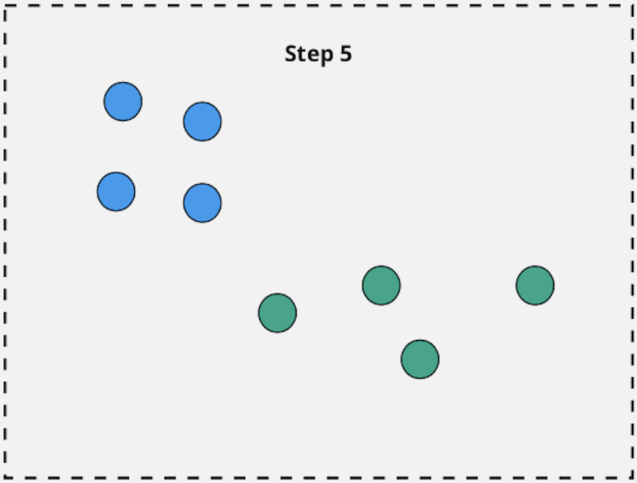
next iteration
Other groups are formed, and the euclidean distance managed to find the best groups
If the classification is well enough, the process will stop
Fig 2.5

Slide 12
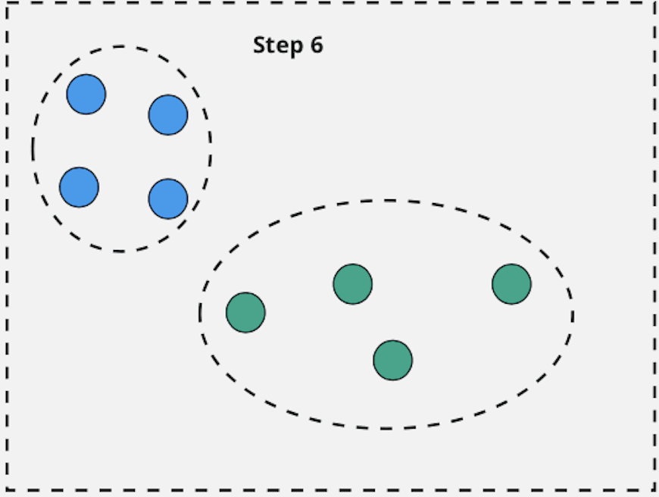
next iteration
As final results we have the best two groups formed.
The end result would likely be that every point in the upper left area is in the blue cluster with every point in the lower right area is the green cluster.
This is a reasonable characterisation and K-Means has been successful on this occasion.
Fig 2.6

Slide 13
A Potential Problem
The problem with the scenario is that for demonstration purposes the points I originally chose were not random.
As a reminder though, a key element is that the points are chosen randomly.
It is quite possible both cluster focal points are actually on the same island as shown in Fig. 2.5.

Slide 14
Variance in Result
Following the same process as before, this would result in a very different clustering, as shown in Fig. 2.6.
In this result, the clusters aren’t evenly sized or broken down.
This result is very different to the previous one. We don’t know if this is a problem or not, as it is scenario specific.
This is somewhat exacerbated in multidimensional data sets.

Slide 15
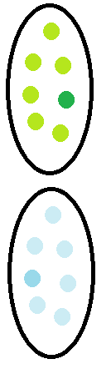
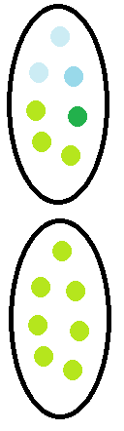
A Potential Problem - Variance in Result
In Fig. 2.7 we can see is that our result is entirely dependent on “whether we got lucky” with the starting points chosen.
Ultimately though, both results return two clusters.
The interpretation of the result relevant to the scenario would then be vitally important.
Some results are more “appropriate” than others in certain scenarios.
VS

Slide 16
A Potential Problem - Variance in Result
In Fig. 2.7 we can see is that our result is entirely dependent on “whether we got lucky” with the starting points chosen.
The algorithm does not behave very well when clusters have varying sizes, different densities, or nonshperical shapes
VS

Slide 17
K-Means - Supervised or Unsupervised?
The variance in result would be much reduced if we could add a “blue” and a “green” label and force one cluster focal point to be blue and one green at the start. This would be an example of supervised (guided) learning / clustering as discussed earlier.
Unfortunately we can’t in the K-Means described in the recommended text. We are completely at the whim of datapoints chosen at random at the start, whether they are “good” or “bad” with no guidance / support or rules whatsoever on the choice.
Therefore, in this form, K-Means is completely unsupervised.
There may be other forms of K-Means or methods of application which move it towards being supervised, however they are not in the recommended text. They are a potential “open question” though.

Slide 18
Identifying real world problems
There are a number of academic journals identifying real world usage of K-Means in analytical scenarios, some of them are listed below:
1 Crime Scene Prediction- Source?
2 Financial Fraud Detection - v Min, X., & Lin, R. (2018)
3 E-Commerce Churn Prediction Xiahou, X., & Harada, Y. (2022)
4 Opera Clustering: K-mean on librettos dataset Harim, Joo (2022)
5 Education Management & Student Achievments Wang, Z. (2022)
6 Tourist Profile Analysis Yildirim, Kaya, Furkanlnce (2022)

Slide 19
The most interesting one

Slide 20
Conclusion
Seen a few different paradigms
Identified how kmeans works
Based on that, determined which paradigm kmeans is
Seen a few exams of kmeans in the ‘real world’
Open ended questions (must be in the scope)

Slide 21
“List of Figures”
Fig 1.1 - Graphical Representation of Different Learning Paradigms, source
Figs 2.1 to 2.7 - Graphical Representations of the stages of “How K-Means Works”, self produced, inspired by source

Slide 22
Bibliography
Citations in alphabetical order of sources
Books:
GBruce, P. C., Bruce, A., & Gedeck, P. (2020). Practical statistics for data scientists: 50+ essential concepts using R and Python (Second edition). O’Reilly Media, Inc.
Géron, A. (2019). Hands-on machine learning with Scikit-Learn, Keras, and TensorFlow: Concepts, tools, and techniques to build intelligent systems (Second edition). O’Reilly Media, Inc.
Articles / Journals:
Harim Jeong & Joo Hun Yoo. (2022). Opera Clustering: K-means on librettos datasets. Journal of Korean Society for Internet Information, 23(2), 45-45–52. Business Source Ultimate. https://doi.org/10.7472/jksii.2022.23.2.45
Min, X., & Lin, R. (2018). K-Means Algorithm: Fraud Detection Based on Signaling Data (edseee.8495776). 21-21–22. IEEE Xplore Digital Library. https://doi.org/10.1109/SERVICES.2018.00024
Wang, Z. (2022). Higher Education Management and Student Achievement Assessment Method Based on Clustering Algorithm. Computational Intelligence & Neuroscience, 1-1–10. Academic Search Ultimate. https://doi.org/10.1155/2022/4703975
Xiahou, X., & Harada, Y. (2022). B2C E-Commerce Customer Churn Prediction Based on K-Means and SVM. Journal of Theoretical & Applied Electronic Commerce Research, 17(2), 458-458–475. Business Source Ultimate. https://doi.org/10.3390/jtaer17020024
.

