Slide 1
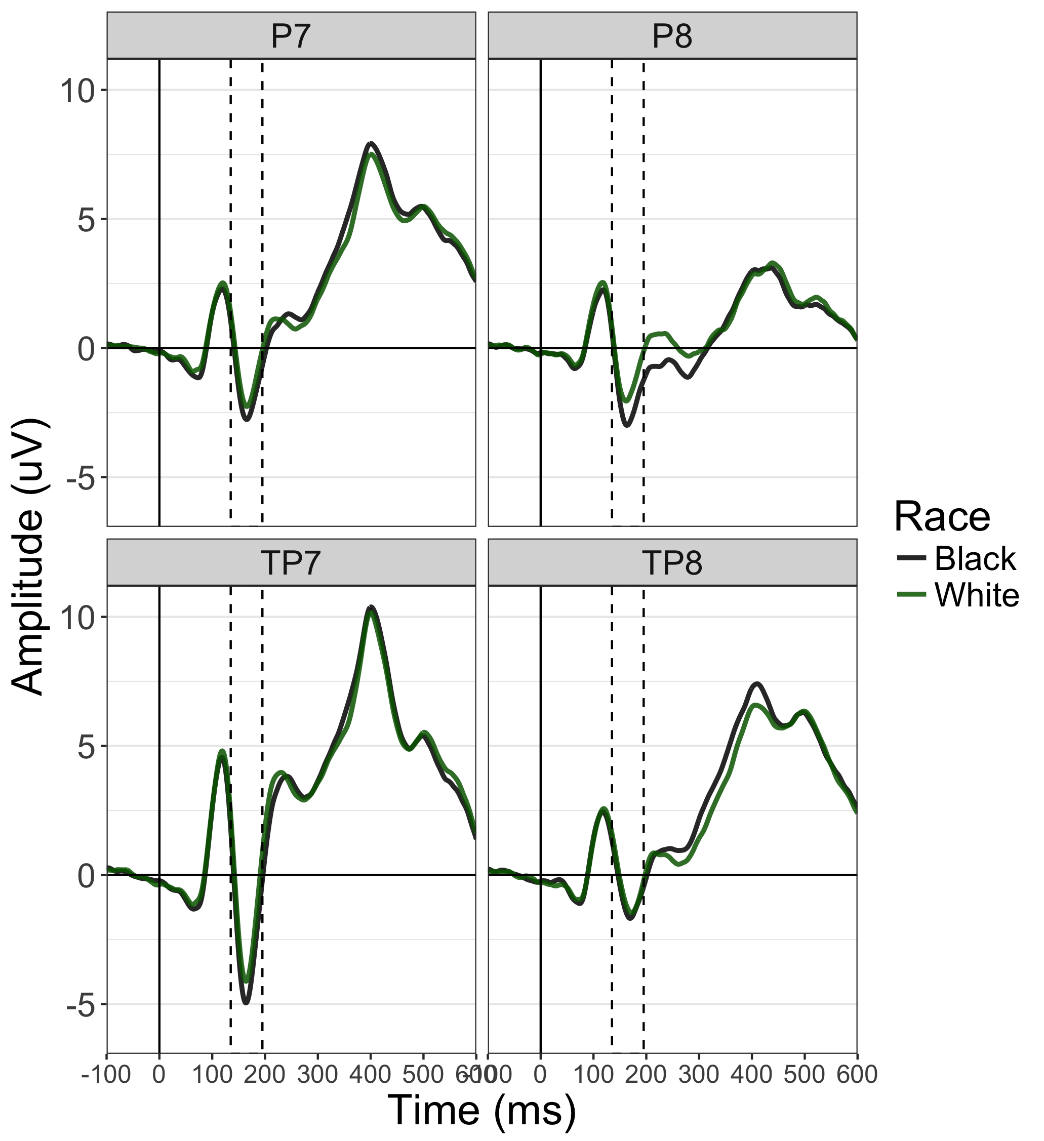
Notes:
Figure 1

Slide 2
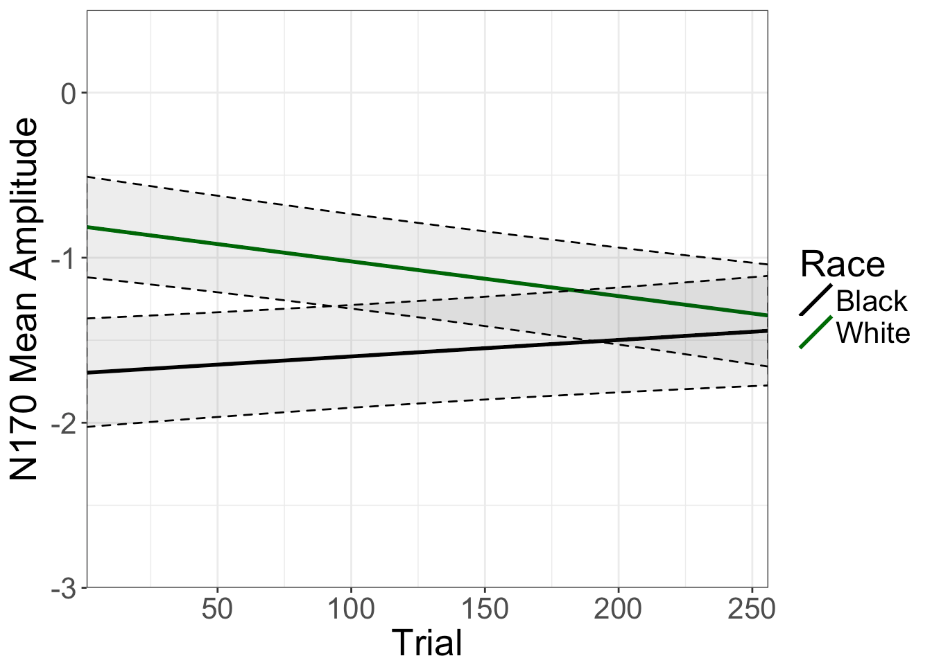
Use jpeg from R
Notes:
Figure 1

Slide 3
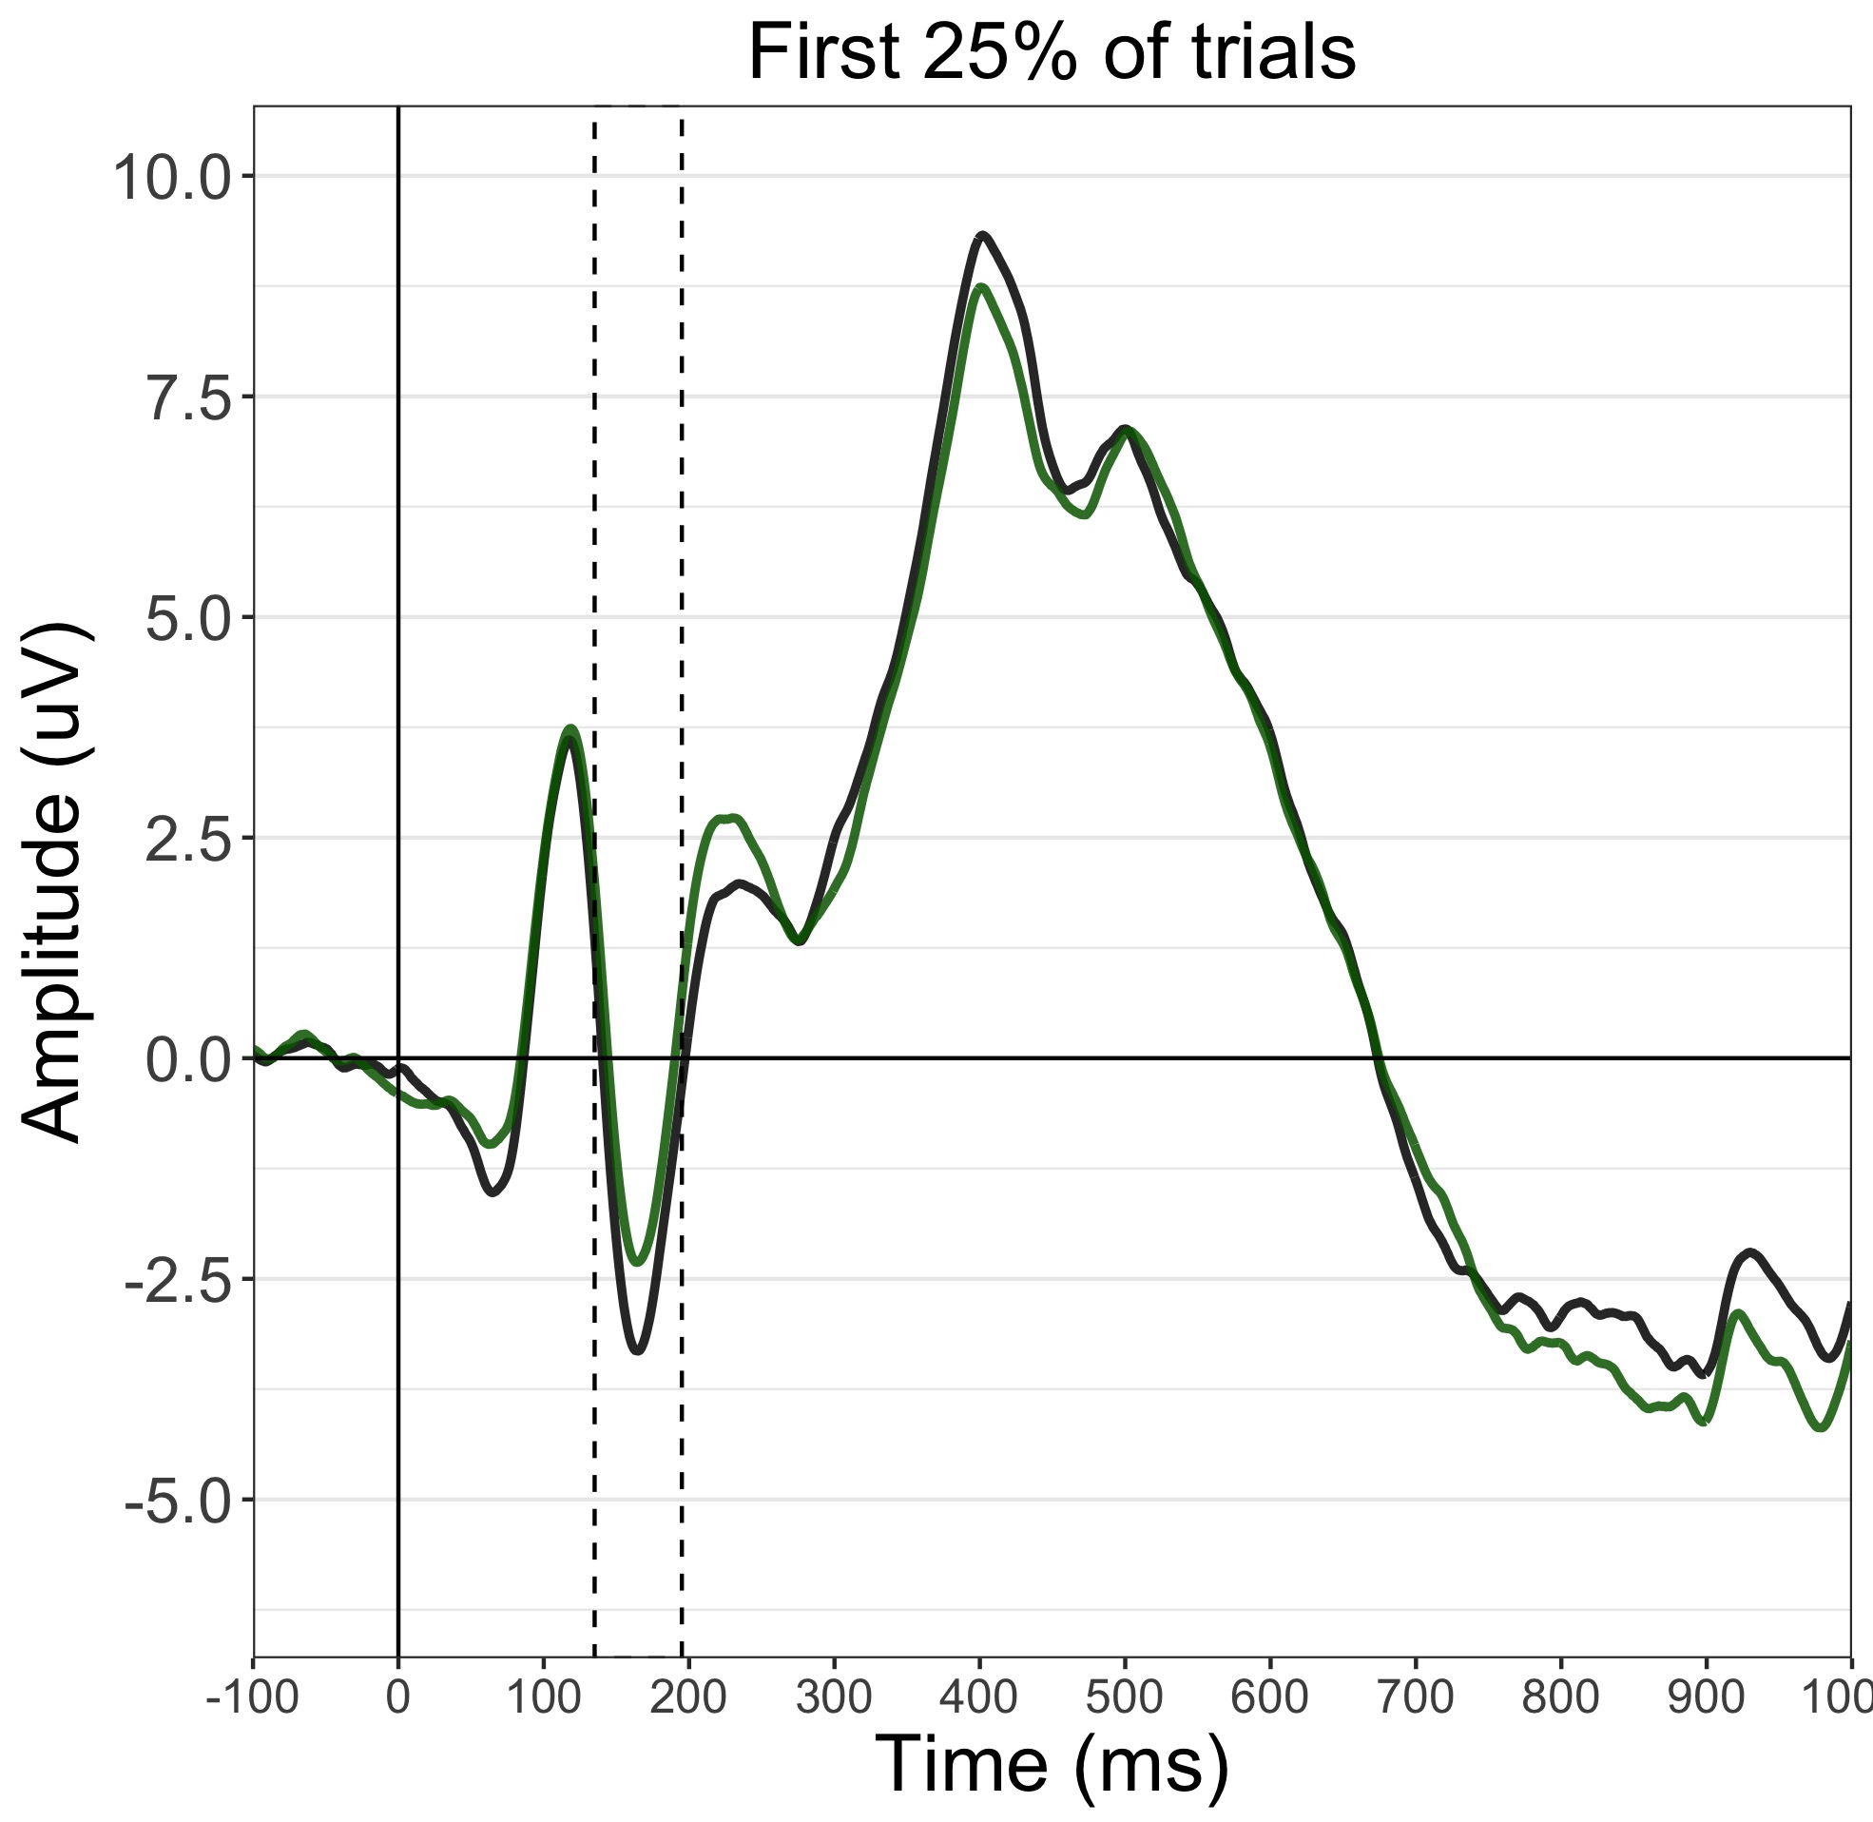
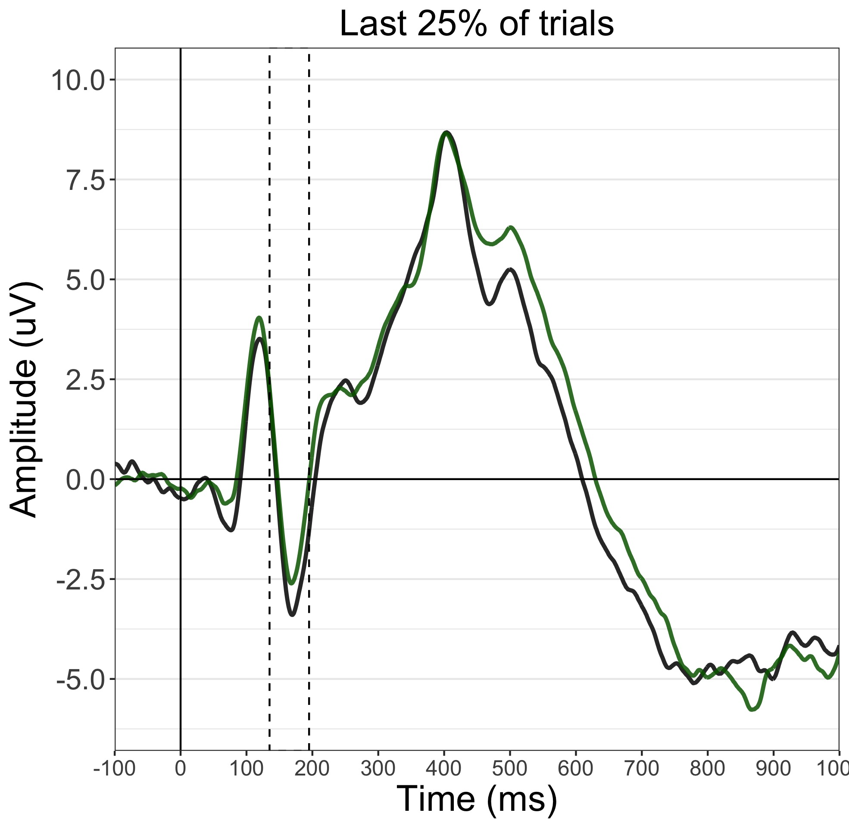
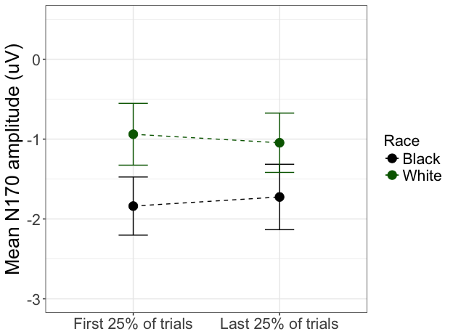
A)
B)
Notes:
Plotted at an average of TP8, TP7, P8, P7
Figure 2

Slide 4
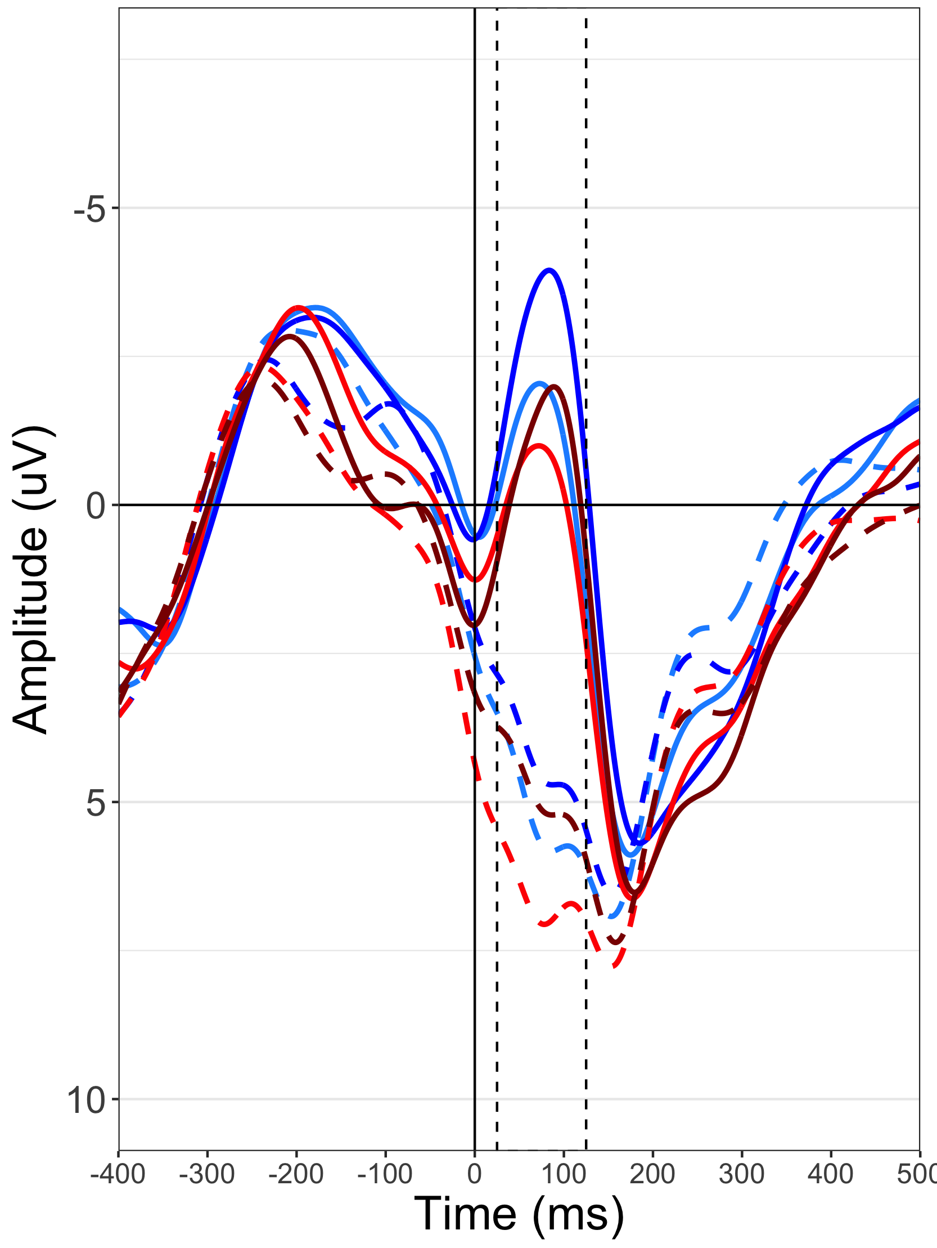
Incorrect
Gun
Tool
Black
White
Correct
Gun
Tool
Black
White
Notes:
Figure 3

Slide 5
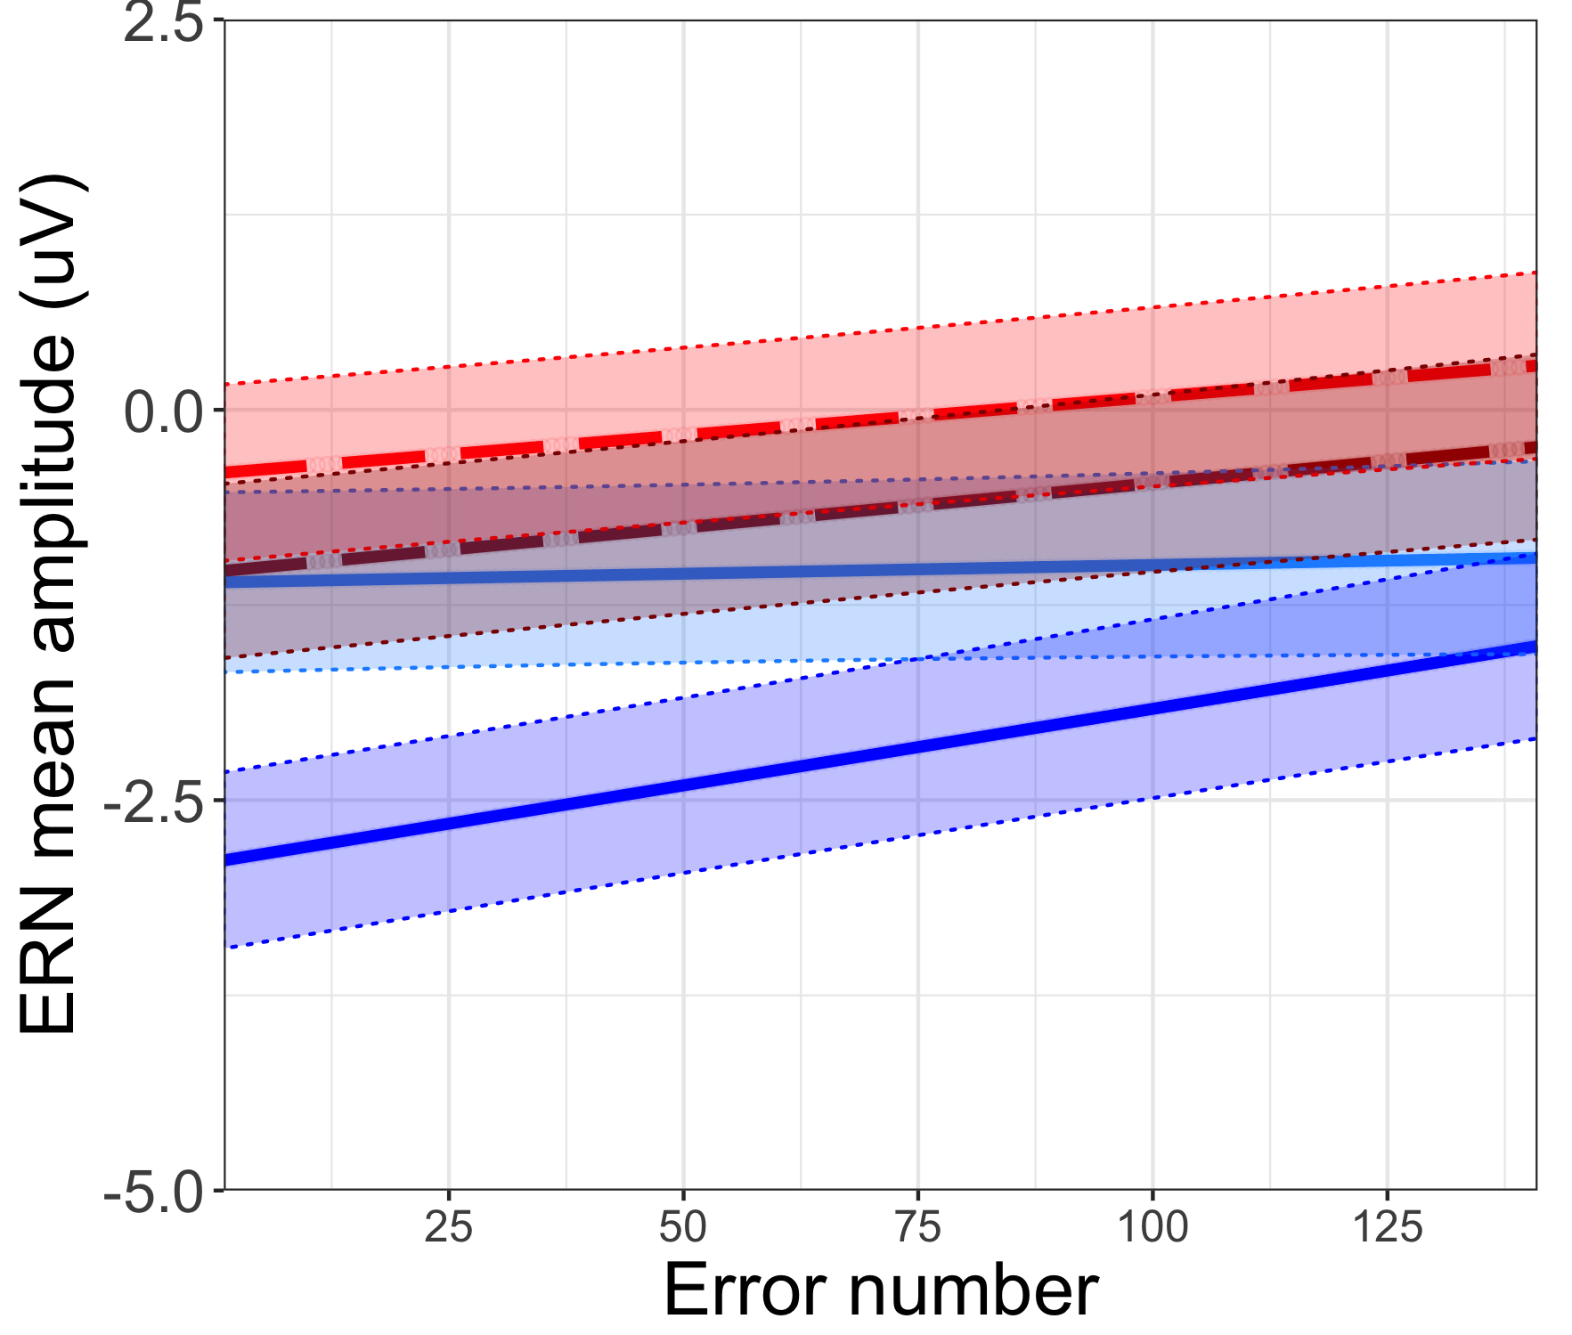
Gun
Tool
Black
White
Notes:
Figure 4

Slide 6
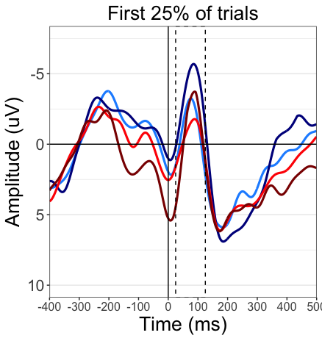
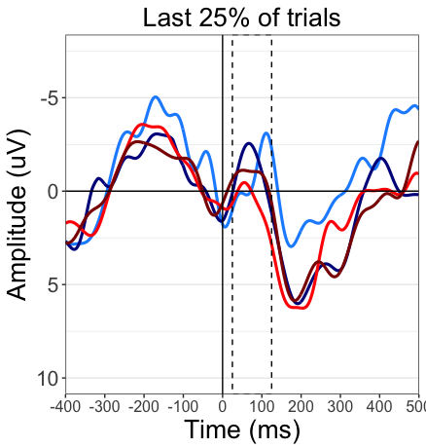
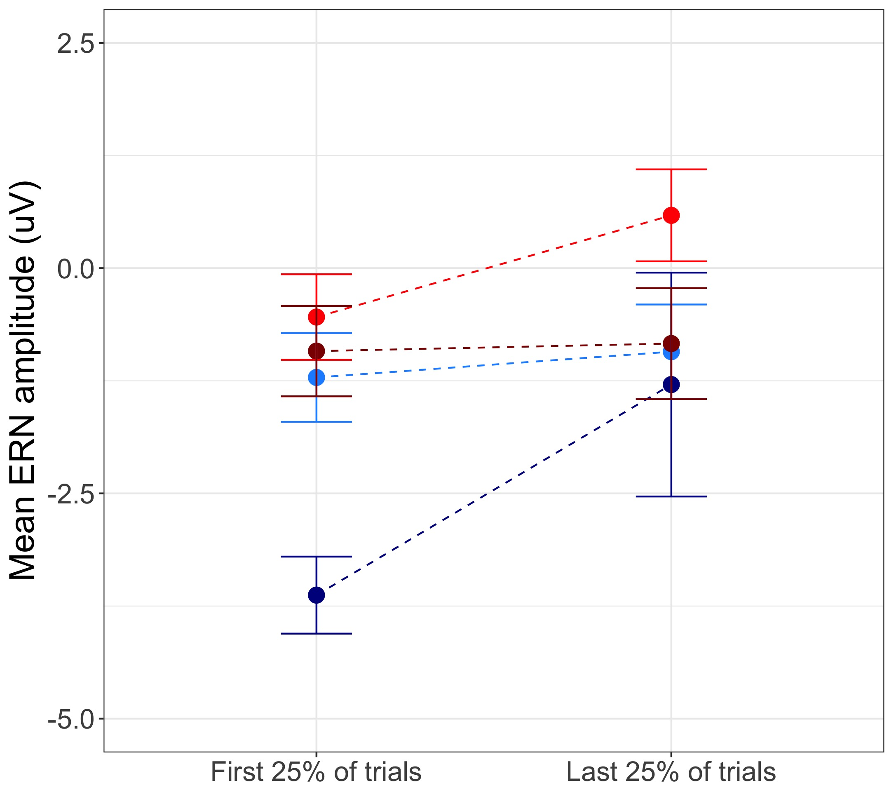
A)
B)
Gun
Tool
Black
White
Notes:
Maybe take CRN out of waveforms?

Slide 7
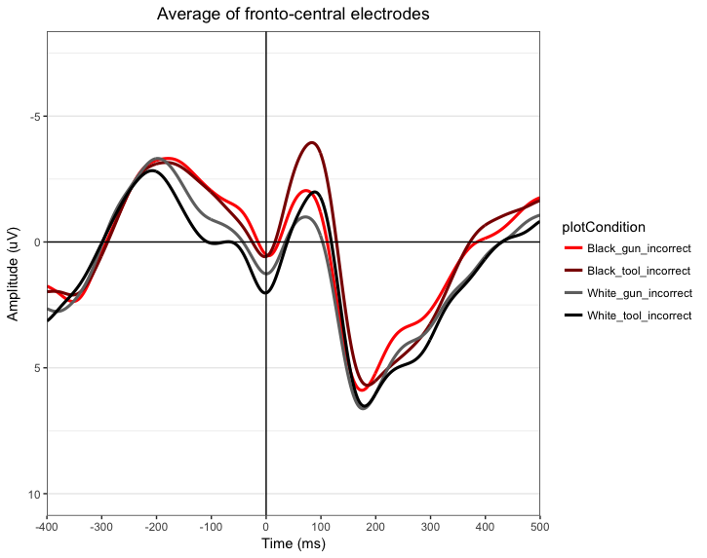
Gun
Tool
Black
White
Notes:
For book chapter

