Slide 1
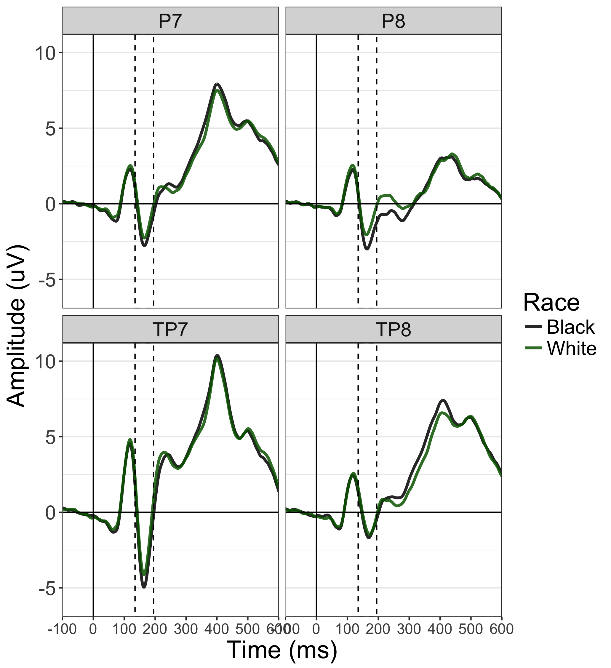
Notes:
Figure 1

Slide 2
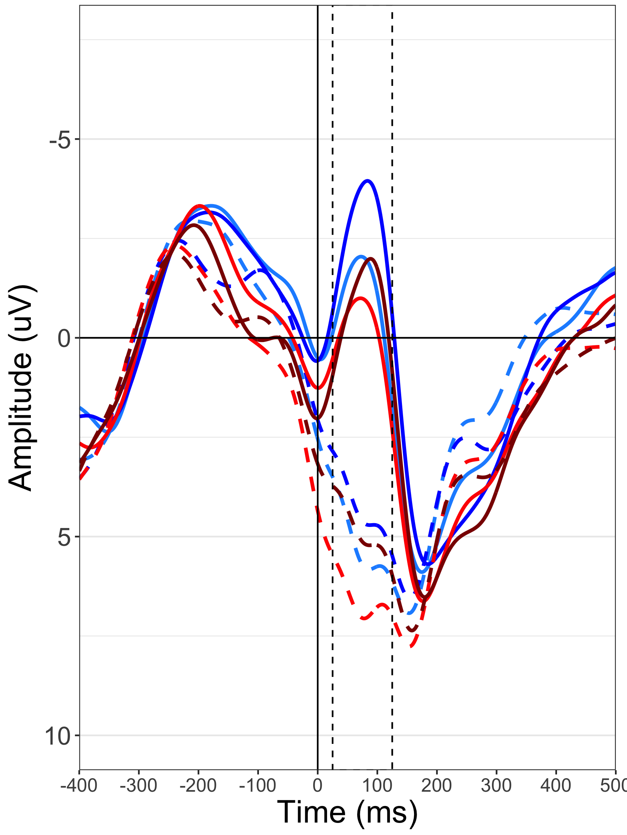
Incorrect
Gun
Tool
Black
White
Correct
Gun
Tool
Black
White
Notes:
Figure 3

Slide 3
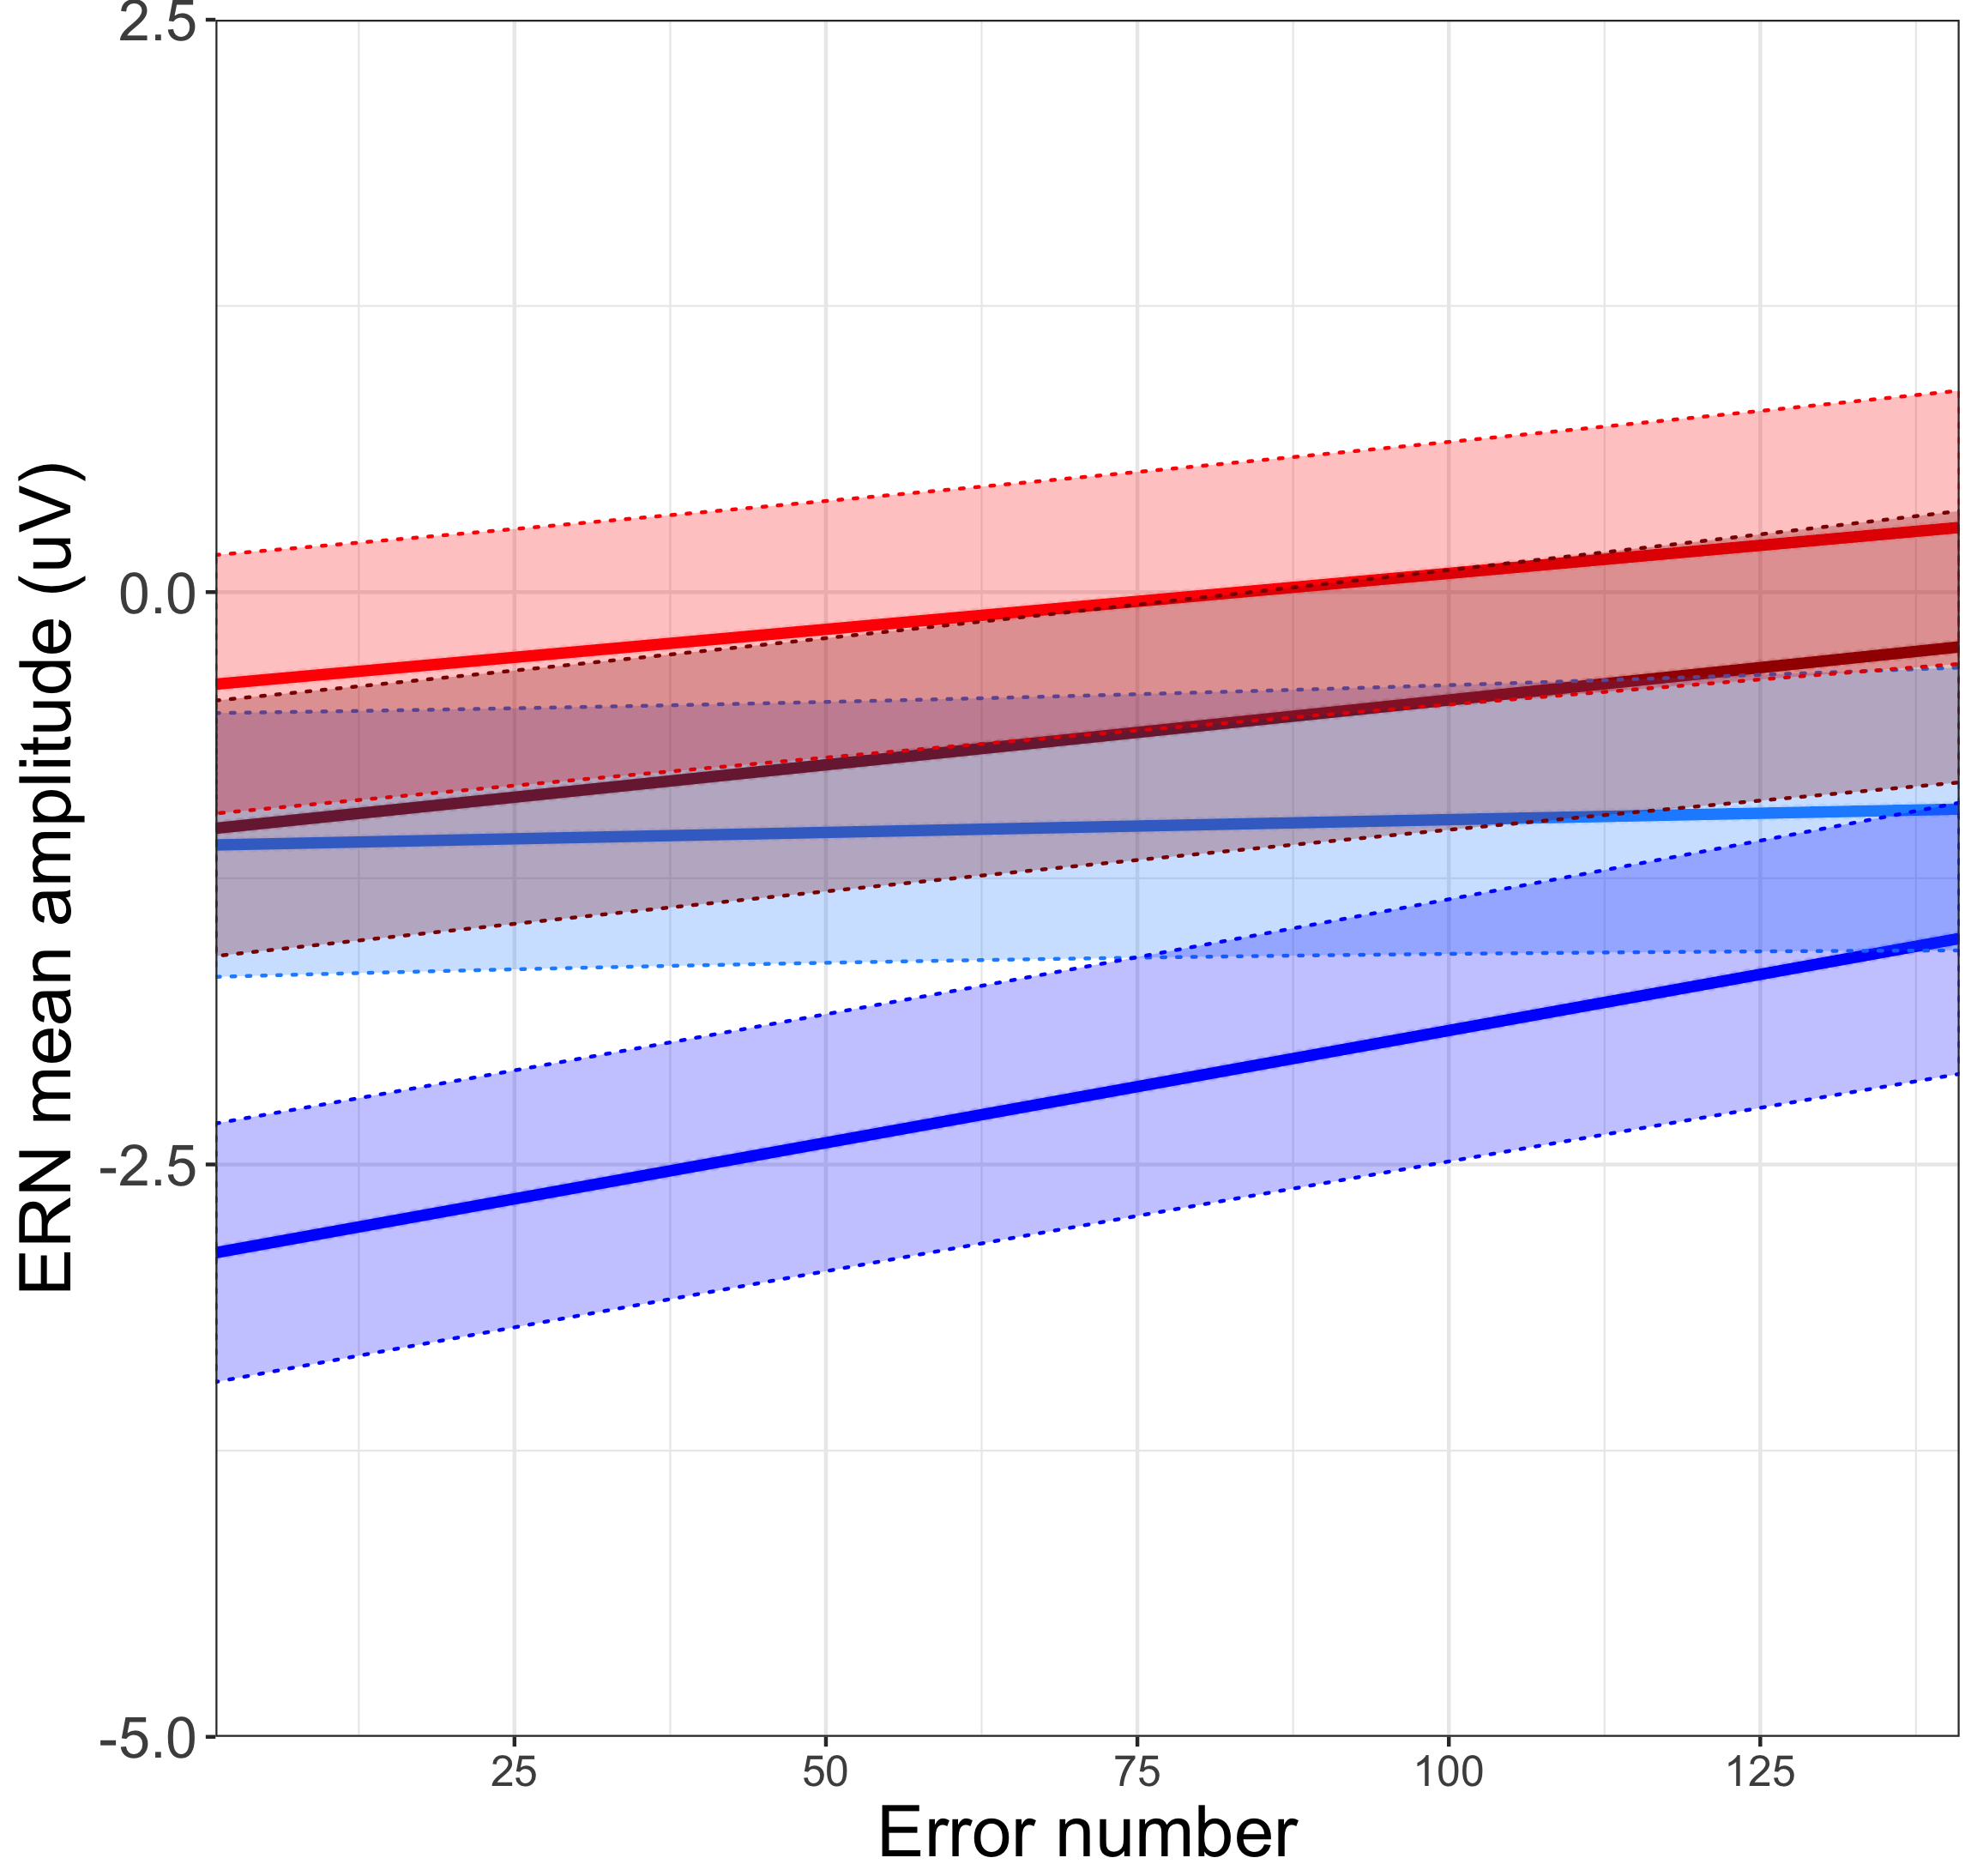
Gun
Tool
Black
White
Notes:
Figure 4

Slide 4
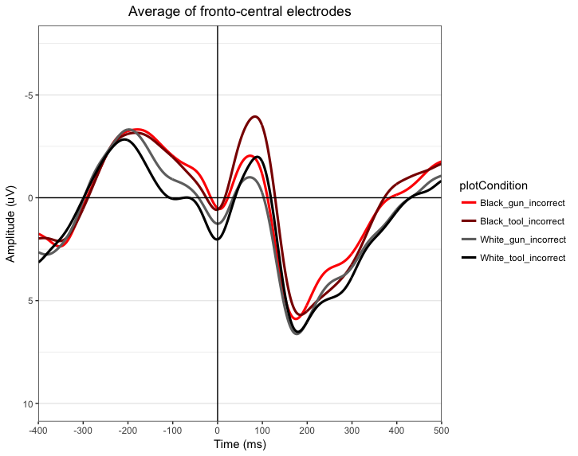
Gun
Tool
Black
White
Notes:
For book chapter

