Slide 1

Capstone Project :
Rock-Paper-Scissors Game
Prepared By : 22CE007-Naisargi Bhatt
22CE089-Hival Patel

Slide 2


Rock-Paper-Scissors
Welcome to the classic Rock-Paper-Scissors game, where you'll pit your skills against the computer in a thrilling battle of strategy and luck. This Python-based console game puts a modern twist on the timeless playground favorite, offering an engaging and educational experience for beginner to intermediate programmers.

Slide 3

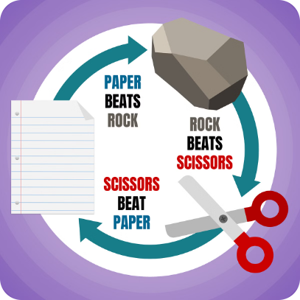
Game Mechanics
1
Player Choices
2
Computer Opponent
Players can choose to play rock, paper, or scissors, each with its own unique strengths and weaknesses.
The computer opponent will randomly select its own choice, creating an unpredictable and exciting gameplay experience.
3
Win, Lose, and Tie Conditions
The game follows the classic rules: rock beats scissors, scissors beat paper, and paper beats rock. Matching choices result in a tie.

Slide 4
Code Structure
play_game()
main()
Supporting Functions
The main function that handles the game loop, user input, and result determination.
The entry point of the program, responsible for initiating the game and managing the overall flow.
Additional functions that encapsulate specific logic, such as generating the computer's choice and calculating the winner.

Slide 5

User Interaction
1
Input Options
Players can choose rock, paper, or scissors by entering the first character corresponding word.
2
Quit Functionality
Users can exit the game at any time by entering the "q“(quit) command.
3
Real-time Feedback
The game provides immediate feedback on the player's choice, the computer's choice, and the outcome of the round.

Slide 6
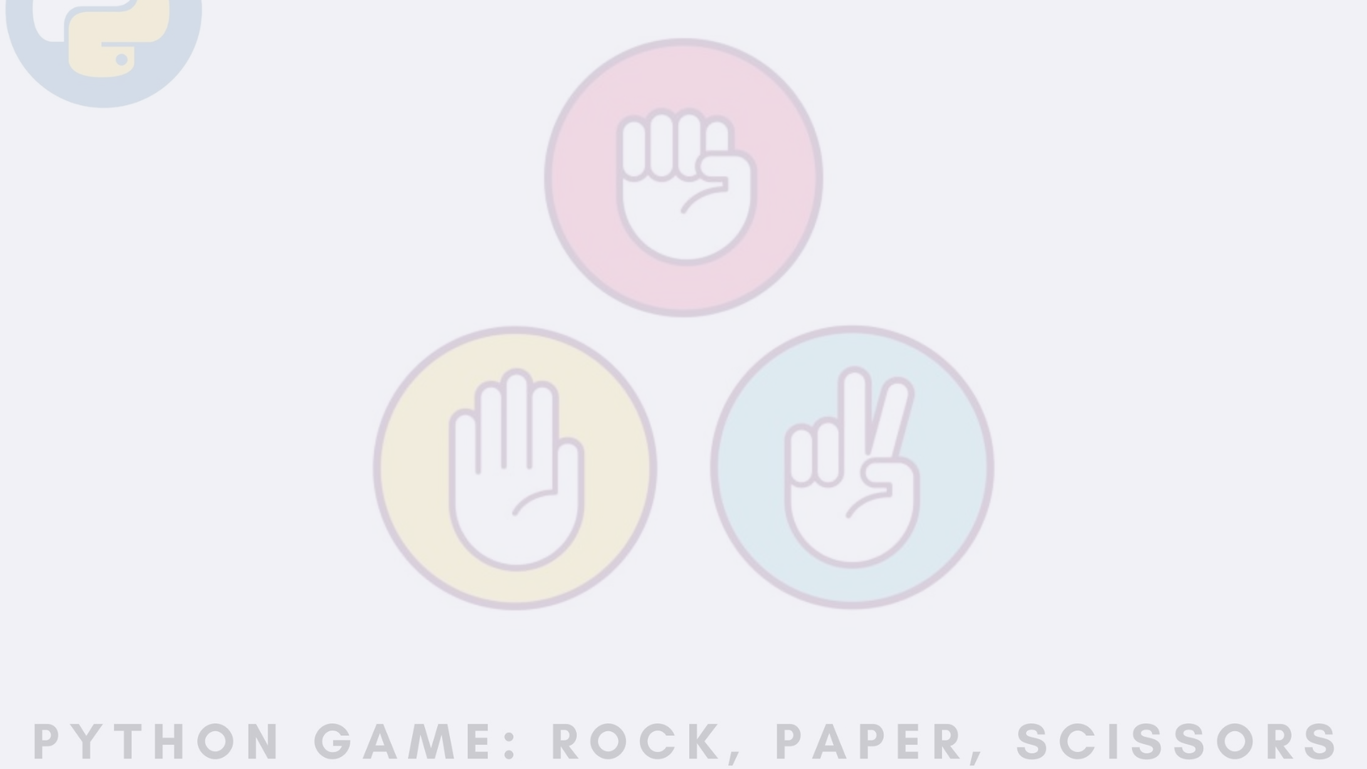
Scoring System
Points Awarded
Current Score
High Score
Each win earns the player 1 point, while a tie results in 0 points.
The game keeps track of the player's current score, displayed after each round.
The highest score achieved is also recorded and shown to encourage players to improve.

Slide 7

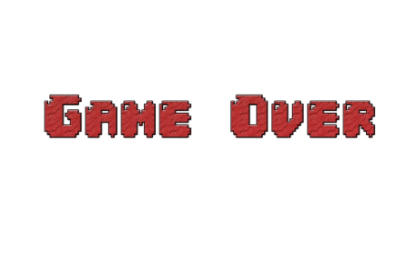

Game Demo
Winning Scenario
Losing Scenario
Tie Scenario
The game showcases a player's victory against the computer opponent.
The presentation also includes a scenario where the player loses to the computer.
When the player and computer choose the same option, resulting in a tie.

Slide 8
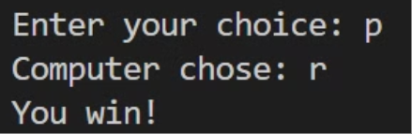
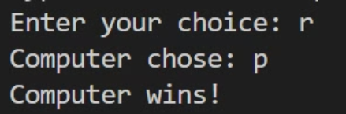
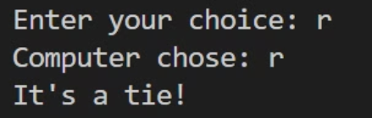
Winning Scenario
Losing Scenario
Tie Scenario

Slide 9



Conclusion
Summary
Play the Game
Feedback
The Rock-Paper-Scissors game showcases the power of Python in creating engaging, console-based experiences.
We encourage you to try the game and experience the thrill of the classic rock-paper-scissors challenge.
Your input and suggestions are valuable to help us improve the game and further enhance the learning experience.

Slide 10
Thank You

