Slide 1




Team Leader : 22CE007
Team members : 22CE089
Project Name

Slide 2

AGENDA
Problem Statement
Project Overview – Introduction
End Users
Wow Factor in Project
Flow Chart
Result
Conclusion
Future Perspective

Slide 3
PROBLEM STATEMENT
Develop a Python console-based Rock-Paper-Scissors game that allows players to compete against a computer opponent. The game should prompt users to choose between rock, paper, or scissors, and then display the computer's randomly generated choice. Implement a scoring system to keep track of wins, losses, and ties. Additionally, ensure the game provides an option to quit and displays the highest score achieved during gameplay. The objective is to create an engaging and intuitive game experience for players while demonstrating proficiency in Python programming fundamentals and logical decision-making.

Slide 4



INTRODUCTION
Welcome to the classic Rock-Paper-Scissors game, where you'll pit your skills against the computer in a thrilling battle of strategy and luck. This Python-based console game puts a modern twist on the timeless playground favorite, offering an engaging and educational experience for beginner to intermediate programmers.

Slide 5
WOW Factor:
play_game()
main()
Supporting Functions
The main function that handles the game loop, user input, and result determination.
The entry point of the program, responsible for initiating the game and managing the overall flow.
Additional functions that encapsulate specific logic, such as generating the computer's choice and calculating the winner.

Slide 6
END USERS:
End users of the Rock-Paper-Scissors game encompass a diverse audience, including casual gamers, students, families, office workers, and gamers of all ages. Whether it's a quick break during the day or a fun activity for family and friends, our game provides an enjoyable and interactive experience for individuals seeking entertainment and relaxation

Slide 7
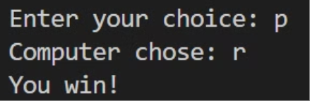
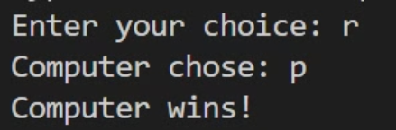
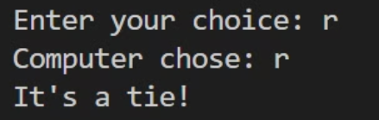
RESULT
Winning Scenario
Losing Scenario
Tie Scenario

Slide 8
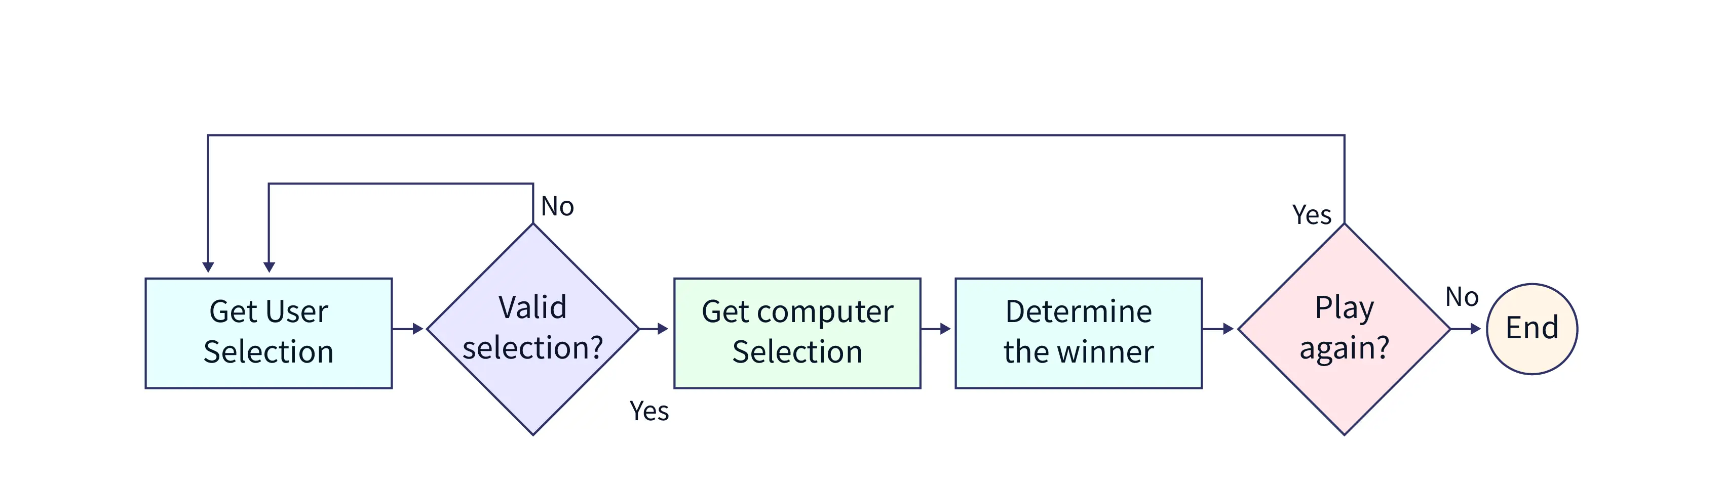
FLOW CHART:

Slide 9
CONCLUSION:
Integration of advanced technology and innovative design creates a unique and engaging gaming experience.
Seamlessly blending physical activity, education with interactive gameplay aims to promote health, cognitive skills, and social interaction.
Versatile, affordable, and available in diverse environments, our platform empowers users to create their own clickable games, enhancing engagement and customization.

Slide 10
FUTURE PERSPECTIVE:
1)Mobile Integration: Developing a mobile version of the game to reach a broader audience and provide on-the-go entertainment.
2)Multiplayer Functionality: Adding multiplayer functionality to allow users to play against friends or other online players, enhancing the social aspect of the game.
3)Customization Options: Introducing customization features such as different themes, avatars, or game modes to increase engagement and appeal to diverse preferences.

Slide 11
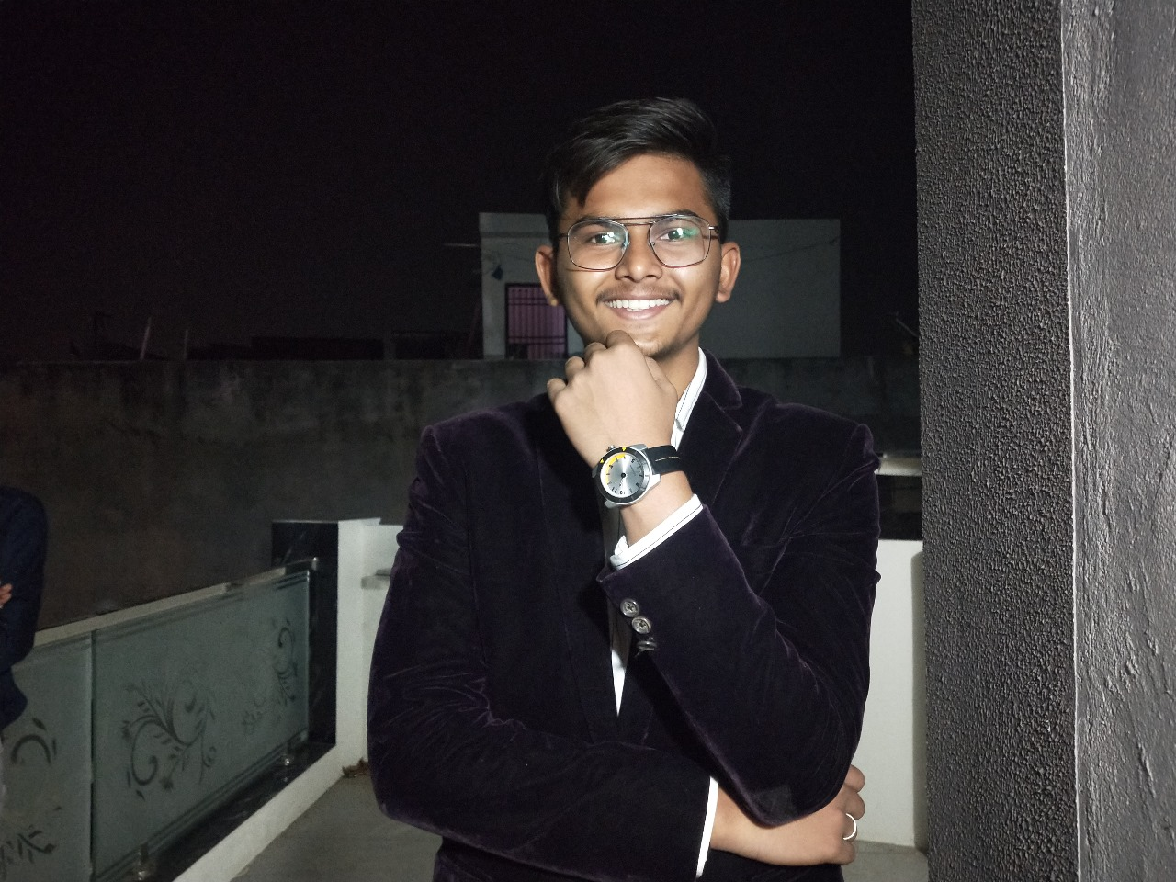
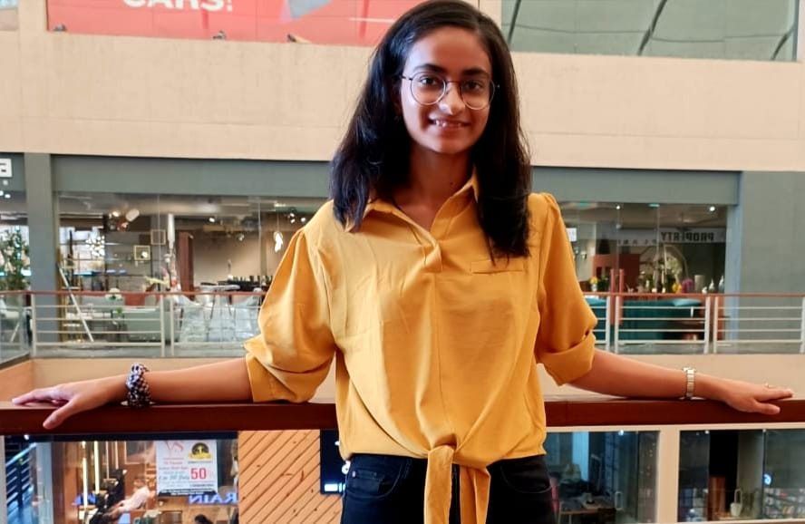
Meet Our Team
Hival Patel
Naisargi Bhatt
Notes:
11

Slide 12
Thank You

Slide 13
githhub link : https://github.com/hival01/code_unnati

