Slide 1
Consumer Behaviour
By Room 2?

Slide 2
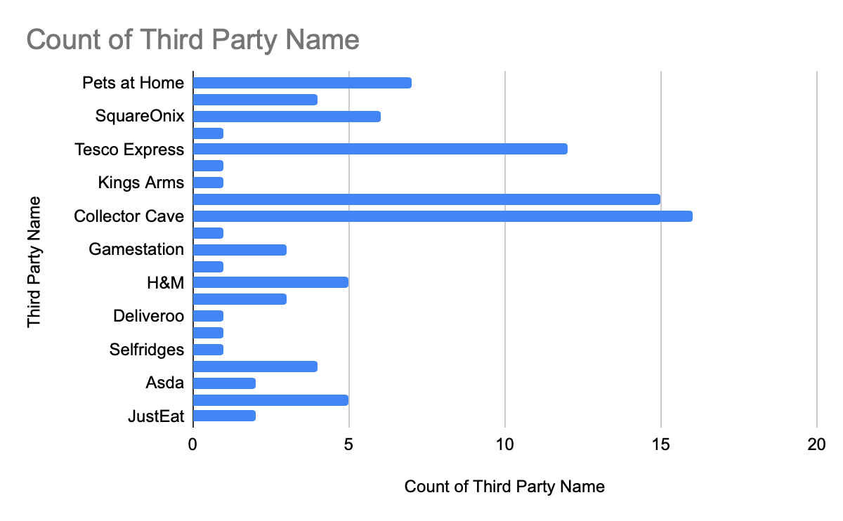
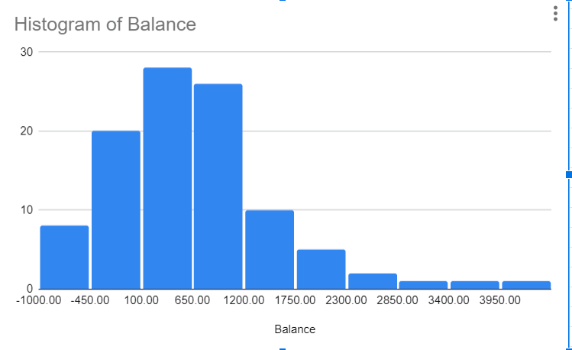
Individual Customer Simulated Transactions
Individual
· They work at Pets at Home and earn the same amount each month.
· They spend a lot of money collecting items.
· Send 2300 to a different account. This could be savings or a fixed bill.
Ways they could avoid overdrafts.
· Reduce how much they save; it is better to not be overdrawn.
· Set a monthly budget for their collector items.
· Shop at a Tesco Extra instead of an express, might be slightly cheaper.

Slide 3
20 Customer Simulated Transactions
Looking in particular at the spending habits of people in their overdrafts:
Many people had subscriptions to Disney+, Netflix, Amazon, Gym
Clothing store expenditures such as from H&M were also common
There were common spendings on games and game subscriptions
Things that can be implemented by the bank:
Reminders about subscriptions either every few months or once people enter overdraft
Banks could partner up with companies such as Mojang, Blizzard, Xbox to aid transactions

Slide 4
100 Consumer Transactions
In general,Companies
Sum of Balance
Adidas
£ 1,621.97
Recommendations: Based on the insights gathered, the bank could consider the following recommendations:
Amazon
£ 1,416.34
Tailored Financial Services: Provide personalized financial services to companies with negative balances, such as credit lines or loans to support their operations. For companies with positive balances, offer investment advice or options for managing surplus funds.
Asda
£ 19.14
Sector-Specific Solutions: Tailor financial solutions based on the sector the company operates in. For instance, gaming companies might benefit from payment processing solutions, while retail companies might need assistance with inventory management.
Blizzard
£ 770.45
Risk Management: Monitor companies with high negative balances closely to assess their financial health. Consider offering financial planning and restructuring services to help them get back on track.
Collector Cave
£ 15,741.94
Data-Driven Insights for Future: Apply similar data analysis techniques to other customer data to identify patterns and trends. Use these insights to proactively offer financial products and services to meet customer needs.
Deliveroo
£ 766.59
Early Warning System: Develop algorithms that can automatically flag companies with sudden balance drops or spikes. This could help the bank reach out to the companies before financial issues escalate.
Fitted Stitch
£ 756.65
Customer Segmentation: Use machine learning to segment customers based on their financial behavior and needs. This can help provide targeted recommendations and solutions.
Full of Beans
£ 1,840.22
Gamestation
£ 3,439.21
To spot patterns in the future, banks could use machine learning models to predict financial behavior based on historical data. By identifying key indicators that correlate with positive or negative balances, the bank could intervene early and offer appropriate assistance to their customers.
H&M
-£ 454.06
JD Sports
£ 2,185.55
JustEat
£ 401.45
Kings Arms
£ 1,732.59
Loosely Fitted
-£ 235.94
Mojang Studios
£ 3,698.18
Pets at Home
£ 18,133.10
Reebok
£ 856.47
Revella
£ 1,743.34
Selfridges
£ 437.86
SquareOnix
£ 3,700.65
Tesco Express
£ 3,626.74
(blank)
£ 4,473.35
Grand Total
£ 66,671.78...

Slide 5
Companies
Sum of Balance
Adidas
£ 1,621.97
Recommendations: Based on the insights gathered, the bank could consider the following recommendations:
Amazon
£ 1,416.34
Tailored Financial Services: Provide personalized financial services to companies with negative balances, such as credit lines or loans to support their operations. For companies with positive balances, offer investment advice or options for managing surplus funds.
Asda
£ 19.14
Sector-Specific Solutions: Tailor financial solutions based on the sector the company operates in. For instance, gaming companies might benefit from payment processing solutions, while retail companies might need assistance with inventory management.
Blizzard
£ 770.45
Risk Management: Monitor companies with high negative balances closely to assess their financial health. Consider offering financial planning and restructuring services to help them get back on track.
Collector Cave
£ 15,741.94
Data-Driven Insights for Future: Apply similar data analysis techniques to other customer data to identify patterns and trends. Use these insights to proactively offer financial products and services to meet customer needs.
Deliveroo
£ 766.59
Early Warning System: Develop algorithms that can automatically flag companies with sudden balance drops or spikes. This could help the bank reach out to the companies before financial issues escalate.
Fitted Stitch
£ 756.65
Customer Segmentation: Use machine learning to segment customers based on their financial behavior and needs. This can help provide targeted recommendations and solutions.
Full of Beans
£ 1,840.22
Gamestation
£ 3,439.21
To spot patterns in the future, banks could use machine learning models to predict financial behavior based on historical data. By identifying key indicators that correlate with positive or negative balances, the bank could intervene early and offer appropriate assistance to their customers.
H&M
-£ 454.06
JD Sports
£ 2,185.55
JustEat
£ 401.45
Kings Arms
£ 1,732.59
Loosely Fitted
-£ 235.94
Mojang Studios
£ 3,698.18
Pets at Home
£ 18,133.10
Reebok
£ 856.47
Revella
£ 1,743.34
Selfridges
£ 437.86
SquareOnix
£ 3,700.65
Tesco Express
£ 3,626.74
(blank)
£ 4,473.35
Grand Total
£ 66,671.78

Slide 6
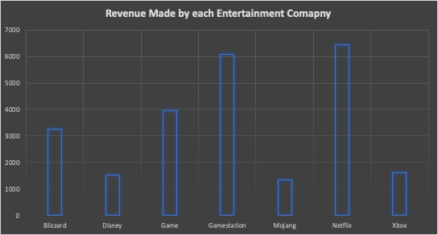
100 Consumer Transactions - Entertainment Industry
The following chart shows the amount of revenue made by each entertainment company.
Through further analysis, we see that subscription based firms seem to attract more on the whole - not in terms of revenue, but through the number of transactions.

Slide 7
What does this mean?
This could be suggesting the behavioural phenomena: the endowment effect.
Thus we see that subscriptions are luring in consumers and thus profiting off accounts in unintended ways.
We could find ways of implementing and creating warnings/notifications before a subscription company withdraws money from an individual's account.
To prevent it becoming an irritance, it could be an option which is turned on by default on the app and can be turned off.

Slide 8
Thank you for listening :)

