Slide 1
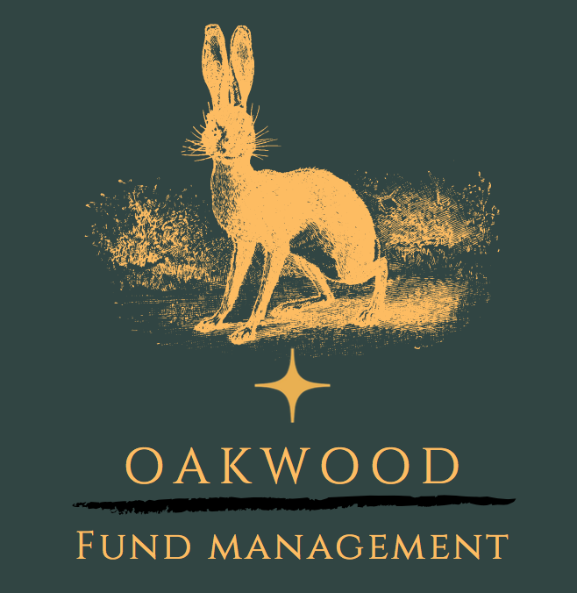
My journey in Oakwood Fund
By Ivan Hung

Slide 2
Agenda
Brief background on what the Oakwood Fund is
The evolution of Oakwood
Overview of my journey in the fund
Projects I have undertaken
How I have developed as a person
Conclusion

Slide 3
What is Oakwood?
Oakwood was founded in 2020 by Michael Prince and is a student-led fund.
It’s investment philosophy prioritizes ESG-based equities
We currently have seven teams which focus on different industries in the market (bonds, commodities, financials, healthcare tech, ESG & Macro).
We produce reports regularly and propose stock pitches on stocks we think are profitable within the short run horizon (typically 3-5 years).
The fund was designed to simulate the expectations a typical work environment.

Slide 4
Background – Oakwood’s Before and Now
Originally when I joined, Oakwood was (one may say) in ‘shambles’:
Before:
Lack of engagement with analysts leaving left, right and centre.
The only pieces produced were stock pitches that occurred once a year.
Lack of structure and organisation within the fund.
Lack of speaker events and workshops.
No way for analysts to know when events occurred other than via. Instagram
Before:
Lack of engagement with analysts leaving left, right and centre.
The only pieces produced were stock pitches that occurred once a year.
Lack of structure and organisation within the fund.
Lack of speaker events and workshops.
No way for analysts to know when events occurred other than via. Instagram
Now:
Majority of analysts are now engaged with material provided.
We produce mini reports, full industry reports & stock pitches.
There is a clear structure within the fund (not authority, but who to contact if needs be).
Speaker events and workshops every other week.
New communication systems such as Outlook Calendar and Trello were introduced.

Slide 5
My Roles in Oakwood
Joined in 2022 as a Junior Analyst for the bond’s teams
Promoted to Senior Analyst of bond’s team in February 2023
Applied and got accepted to become the ESG and Risk Director in May 2023
Internal reorganization led me to become Director of HR & Operations

Slide 6
Projects I have taken on as Director
With ESG being a new team at the beginning of the academic year, I was assigned to creating pre-knowledge and a structure for ESG/Macro reports.
Hosted workshops on ESG Analysis via. SWOT (Strengths, Weaknesses, Opportunities, Threats) & ratings.
Organised a recruitment day which consisted of an AC-styled task and interviews.
Dealt with interpersonal issues, such as re-delegating JA’s and lack of engagement.
Created an automated system for inquires future applications.
Currently working on producing a happiness survey, OSS (Oakwood’s Satisfaction Survey) to enhance diversity & inclusion and identify areas of improvement.

Slide 7
Outcomes the fund has achieved through my projects
Successfully executed the ESG and Macro reports team using my template.
Achieved distributed teams (SA:JA ratio), despite many members leaving due to personal or academic reasons.
Increased engagement rate by ~50% through increasing the number of speaker events and workshops we hosted.
Increased diversity (sexuality and academic background) within the fund by reaching out to all school bulletins.
Creating the application system in the new academic year ensured culture and dedication to be prioritized

Slide 8
Key takeaways I have from Oakwood
AGE IS JUST A NUMBER!
Constructive criticism shouldn’t be taken personally, but instead a motivation to do better next time.
It is inevitable to create a perfect society, despite the immense progress we made this year.
The ability to multitask between society work and academic work is not only a skill, but self-driven motivation.
Oakwood is more than just a CV building activity; it has created a community and developed individual’s professionalism.

Slide 9
Thank you for listening!
Any questions?

