Slide 1
It is a good thing that shops impose restrictions during a vegetable shortage
By Ivan, Suhas, Rinon & Max

Slide 2
Who did what:
Presenters - Everyone
Script - Everyone
Research - Ivan, Suhas, Max
Intro - Rinon
Point 1 - Ivan
Point 2 - Suhas
Point 3 - Max
Conclusion - Rinon

Slide 3
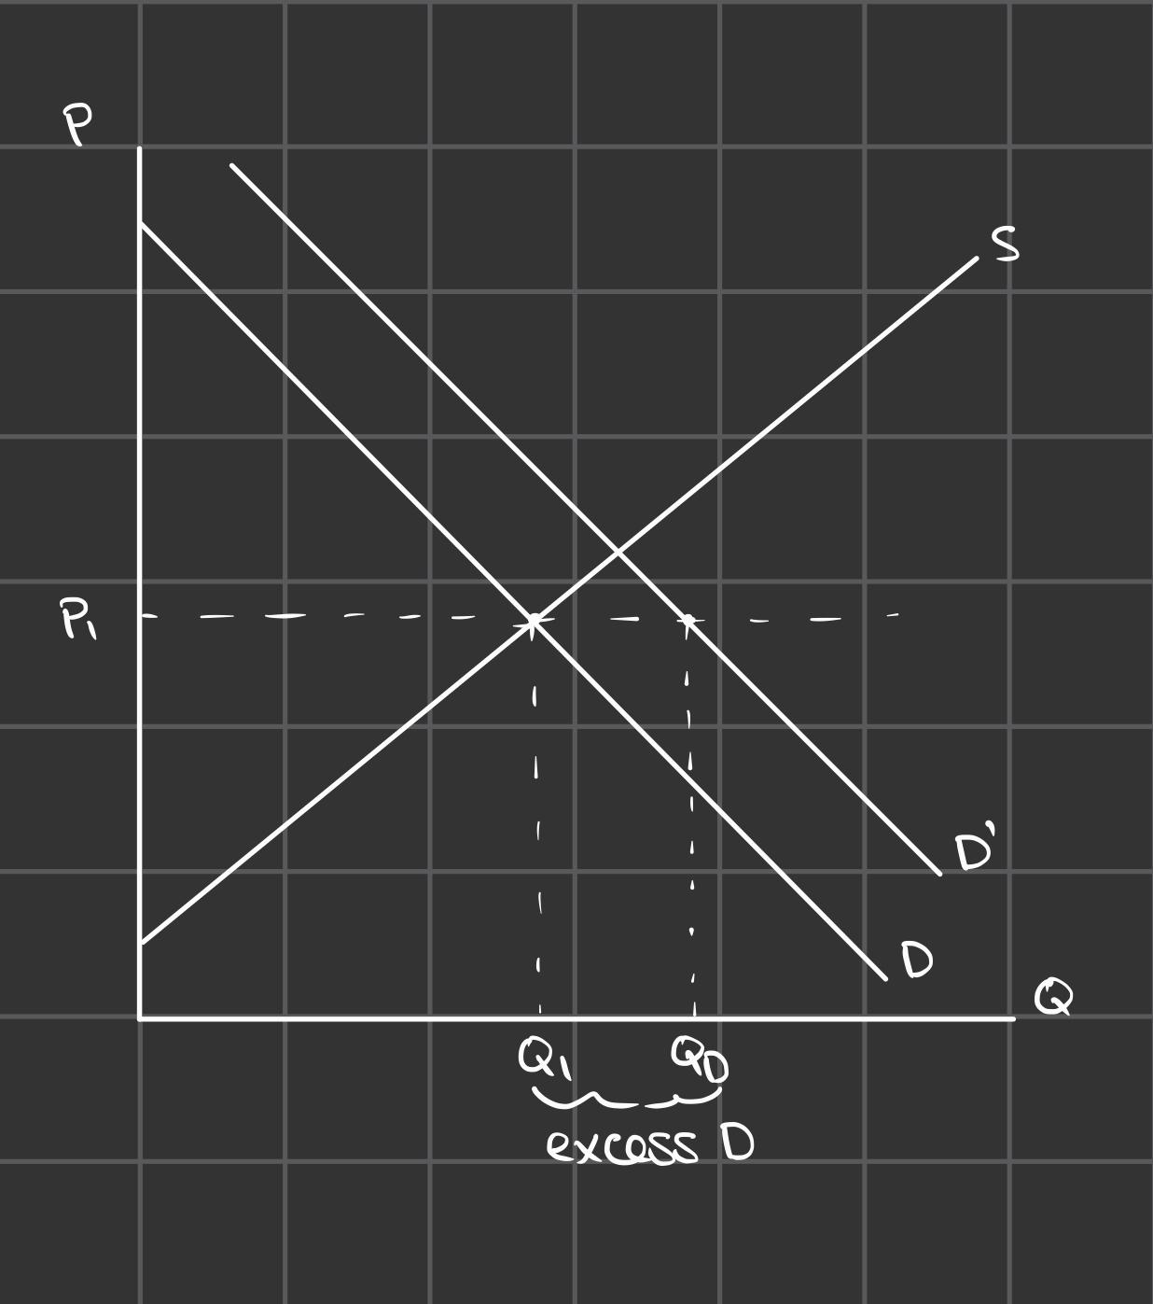
Why may shops even consider restricting?
Despite aiming to be profit maximisers, they may believe a rational decision would be to play the long run game
Having consistent revenue across the shortage (since they will have consistent supply) could be considered better than allowing consumers to purchase as they want at the start and then not being able to have access to it later on.
Game theory could be considered here, supermarkets are oligopolies, if one store rations/restricts their goods and the others don’t, they could potentially become a monopoly over the period of shortage - shown on Table 1
Gain in Mkt Power | Restrict | Don’t Restrict
Restrict | 0,0 | 1,-1
Don’t Restrict | -1,1 | -2,-2
To prevent welfare loss (DWL) and increase in prices
Excess demand leads to inefficiency and reduces consumer surplus
Table 1
Figure 1

Slide 4
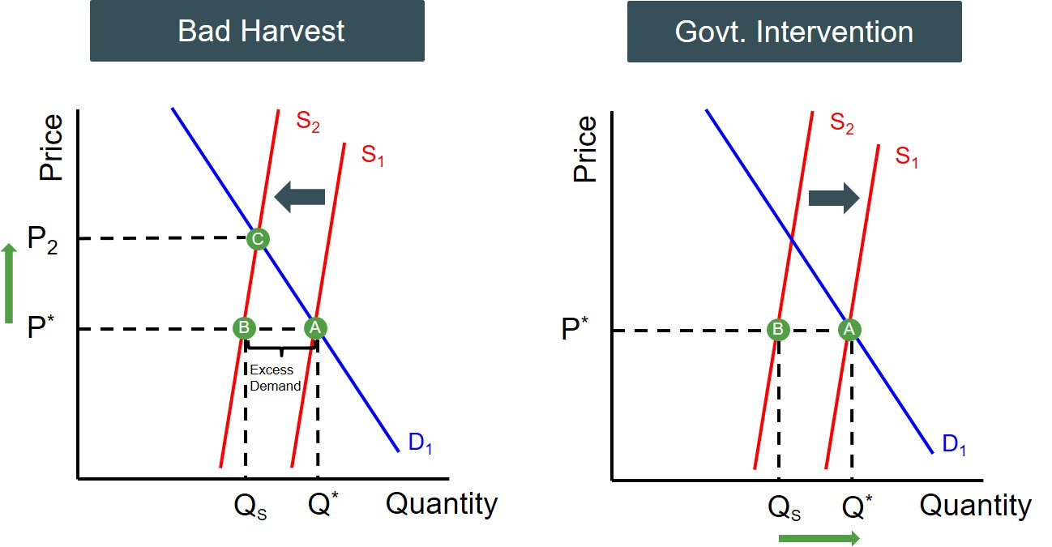
Buffer Stocks to prevent fluctuation
Using buffer stocks could help to prevent fluctuation since the idea imposes that the government should keep a certain amount of the good after harvest behind
This allows the prices to stay relative during a shortage since they keep stock of what they are able to distribute out (shown on figure 2).
Figure 2

Slide 5
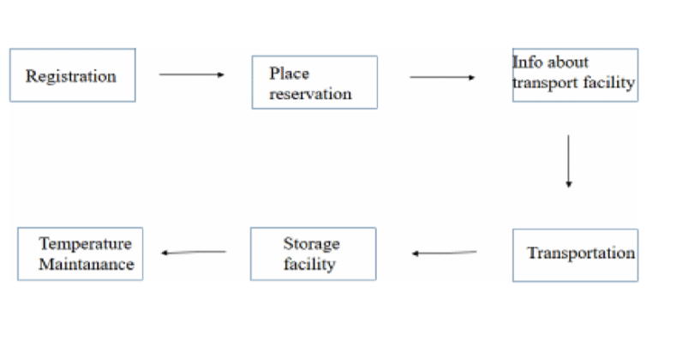
Buffer Stocks to prevent fluctuation
New methods have been found to create buffer stocks specifically for buffer stocks
Figure 3
‘Cost savings will be realised by farmers… as a result of the system’s involvement in food preservation and storage…’ - Pushpalatha N. et al (2023) [A]
The idea is to use modern practices to create a storage for commodities so that they can last for a longer period of time
‘The financial health of farmers will be improved and field work will become easier in order to enhance food production.’ [A] - crucial to counter shortages

Slide 6
Despite the benefits of this policy…
A key problem with using this method is that vegetables are perishable goods
Harvest makes it difficult to keep them ready and in stock all year round
How long will it take to implement this modern method into real practises?
External factors could impact the way consumers interact with the shortage
News with the toilet paper and petrol ‘shortages’
Reports may in turn lead to an actual shortage due to excess demand

Slide 7
2. Keeping equality and Preventing hoarding
UK supermarkets imposed purchasing restrictions on certain fruit and vegetables in February 2023 due to extreme weather conditions in Spain and North Africa which has affected harvests.
Restrictions were brought in temporarily to manage supply shortages
The common objective for supermarkets was to maintain equality and prevent hoarding
Left unrestricted, Some consumers may purchase far more than required in fear of a current or perceived future shortage leaving others unable to purchase the vegetables they’re looking for.
Can lead to a misallocation of resources

Slide 8
3. Positive externalities
Vegetable consumption generates positive externalities in consumption.
Healthier workers are more productive, (Gates, et al 2008). With obese workers being 4.2% less productive. Resulting in £569 in lost productivity
Therefore vegetable restrictions are vital in making sure the population has equal access to vegetables in the case of a shortage. Without sales restrictions sharp increases in price caused by hoarding could lead to consumers substituting vegetables out of their diet, replacing it with less healthy options. Resulting in a welfare loss to society.
While restrictions of vegetable sales wouldn’t cause vegetable consumption to reach socially optimal levels, it would help stop its increase under conditions of a supply shortage.

Slide 9
To think about in the future
In the long-run it is essential to impose restrictions on vegetables to ensure sustainable distribution and prevent hoarding.
Along with alleviating customers’ irrational decision-making, such as panic buying, which we have observed during the COVID-19 pandemic, and being ready for future supply shocks.
Restrictions such as rationing and buffer stocks can ensure that the available supply is distributed fairly among consumers.
While these measures may have short-term economic impacts they are necessary for securing long-term sustainability in the economy.

Slide 10
Thank you for listening!

Slide 11
Bibliography
[A] - N, P., K, S.D., S, S.O., Jabeera, S., R, S. and R, M. (2023). IoT based Modern Agriculture Buffer Stock System AAF-Availability Accessibility Feasibility. [online] IEEE Xplore. doi:https://doi.org/10.1109/ICCMC56507.2023.10084174.
[B] - Gates, D.M., Succop, P., Brehm, B.J., Gillespie, G.L. and Sommers, B.D. (2008). Obesity and Presenteeism: The Impact of Body Mass Index on Workplace Productivity. Journal of Occupational and Environmental Medicine, [online] 50(1), pp.39–45. Available at: https://www.jstor.org/stable/44997614.
‌

