Slide 1

HiveOT - The Hive Of Things
Introduction and Demo
Why HiveOT
Security of Things
Using the WoT TD
Hub Digitwin
Event Flow
Action Flow
Services
TD Challenges
Affordances
Operations and Forms
Other

Slide 2
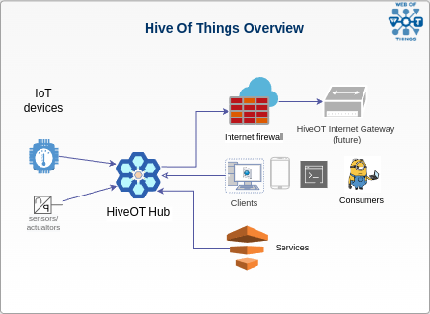
Introduction & Demo
What is it?
A Digital Twin IoT Hub
Objectives
Share information between IoT Devices, Services and Consumers
Secure
Extensible. Integrate with existing IoT Systems and services.
Based on WoT-1.1 Thing Specification
Digital Twin
But first, a little demo

Slide 3
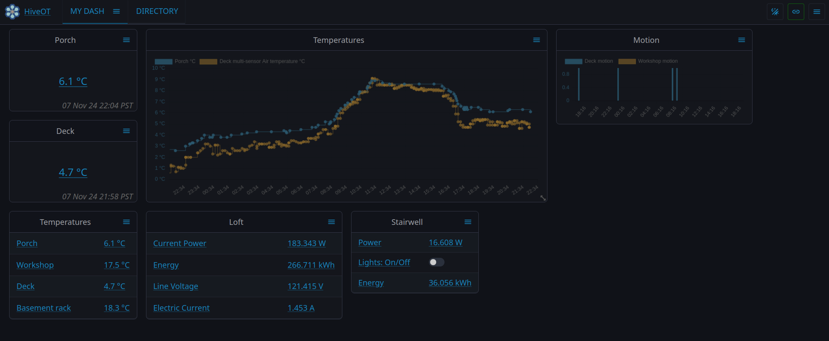
Demo time
(but, .. where is the pumphouse?)

Slide 4
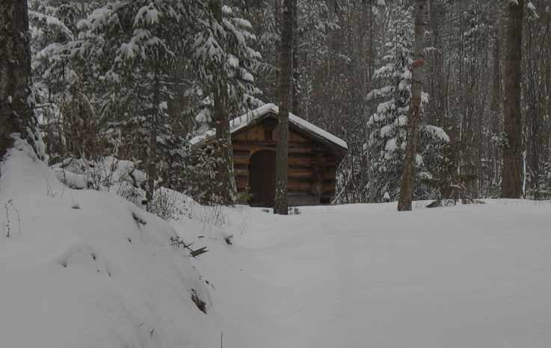

Why HiveOT?
A long time ago, like in 2010, there was a pump house. But, there were questions…
Does the heater still work?
Will it freeze in there?
How much energy is it using?
Any ‘unauthorized’ minions visitors?
So many questions!

Slide 5
Why HiveOT - Evolution
myzone
MyZone provides a 'it just works' approach to IoT data collection and automation using IoT sensors, devices and services.
NGSI-LD based
API based variant based on NGSI.
HiveOT
Redesign based on WoT TD-1.1 web of things. Multi-protocol.
2017
2020
2022/2023
lost in time…
2019
2021
2024 and beyond
Iot train
Connecting IoT devices and services using MQTT.
iotdomain
Simple standard for M2M discovery and exchange of information from IoT devices and related services.
gRPC / Cap’nProto
RPC based variants to explore RPC instead of message bus approach.
(Because its fun)

Slide 6
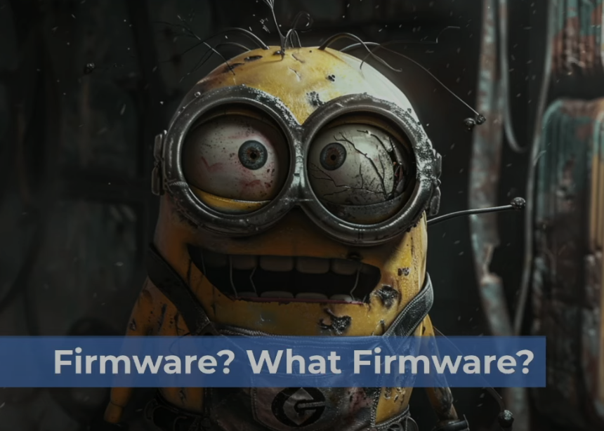
Security Of Things - concerns
IoT devices have a particularly large attack surface due to their internet-supported connectivity. ⁽¹⁾
Concerns:
Missing firmware updates
Weak authentication
Shared network access
Lack of encryption
… on and on and on …
Some examples:
The 2016 Mirai botnet was made possible by unsecured IoT devices.
Target’s credit card breach (2013) stole login credentials from an HVAC vendor IoT sensors.
… on and on and on …
(Credits: https://www.youtube.com/watch?v=Cxrwpij2MSQ)
https://www.techtarget.com/iotagenda/definition/IoT-security-Internet-of-Things-security#:~:text=Lack%20of%20encryption.,devices%20are%20secured%20and%20encrypted.

Slide 7

Security of Things - HiveOT
Rule #1: HiveOT devices do not run (network) servers.
IoT devices connect to a HiveOT Hub through a provisioning process.
Greatly reduced attack surface. No direct access to the device.
Encrypted network connections.
HiveOT Hub provides centralized:
Authentication & authorization
Consumer facing connectivity
Security protocols
Firmware updates

Slide 8
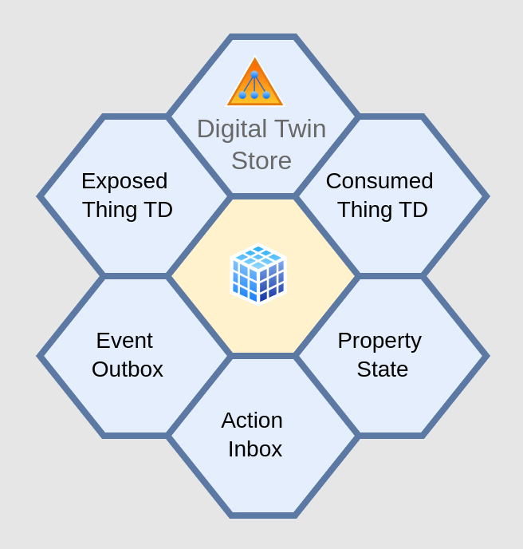

Use of the Thing Description Document (TDD)
Device TDD
Sent by device agents
Digital Twin TDD
Served to consumers
Forms replaced with with Hub endpoints
A new Thing ID: dtw:{agentID}:{thingID}
Only one set of top level operations needed to use all things.

Slide 9
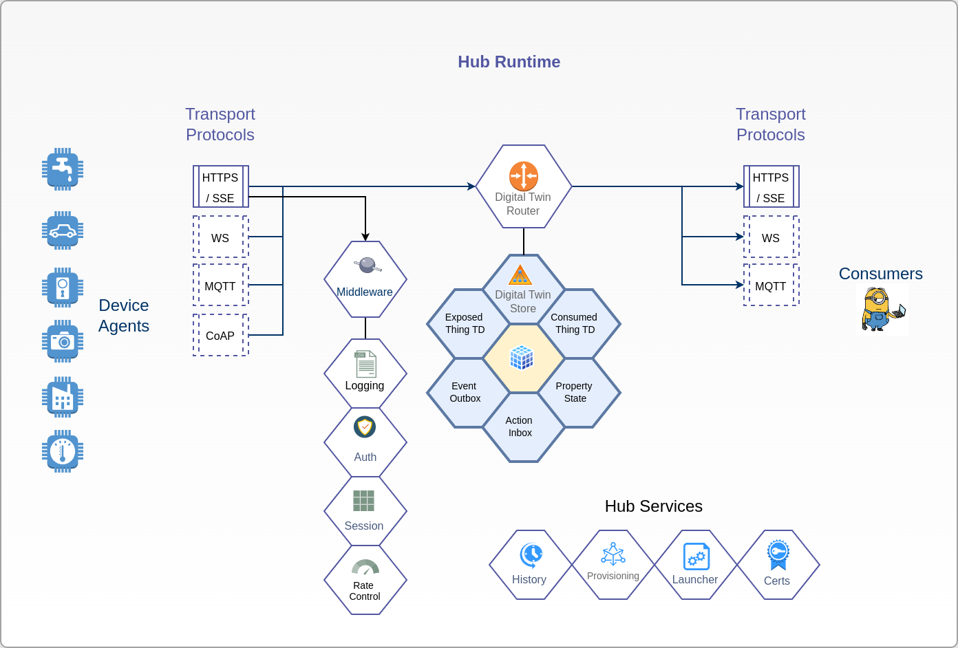
HiveOT Hub
Transport Protocols
Middleware
Digital Twin Runtime
Hub Services
Launcher
Provisioning
History
State storage
HiveOView (web view)
…
Protocol bindings
Zwave
Insteon
1-wire
Coap
LoRa
…

Slide 10
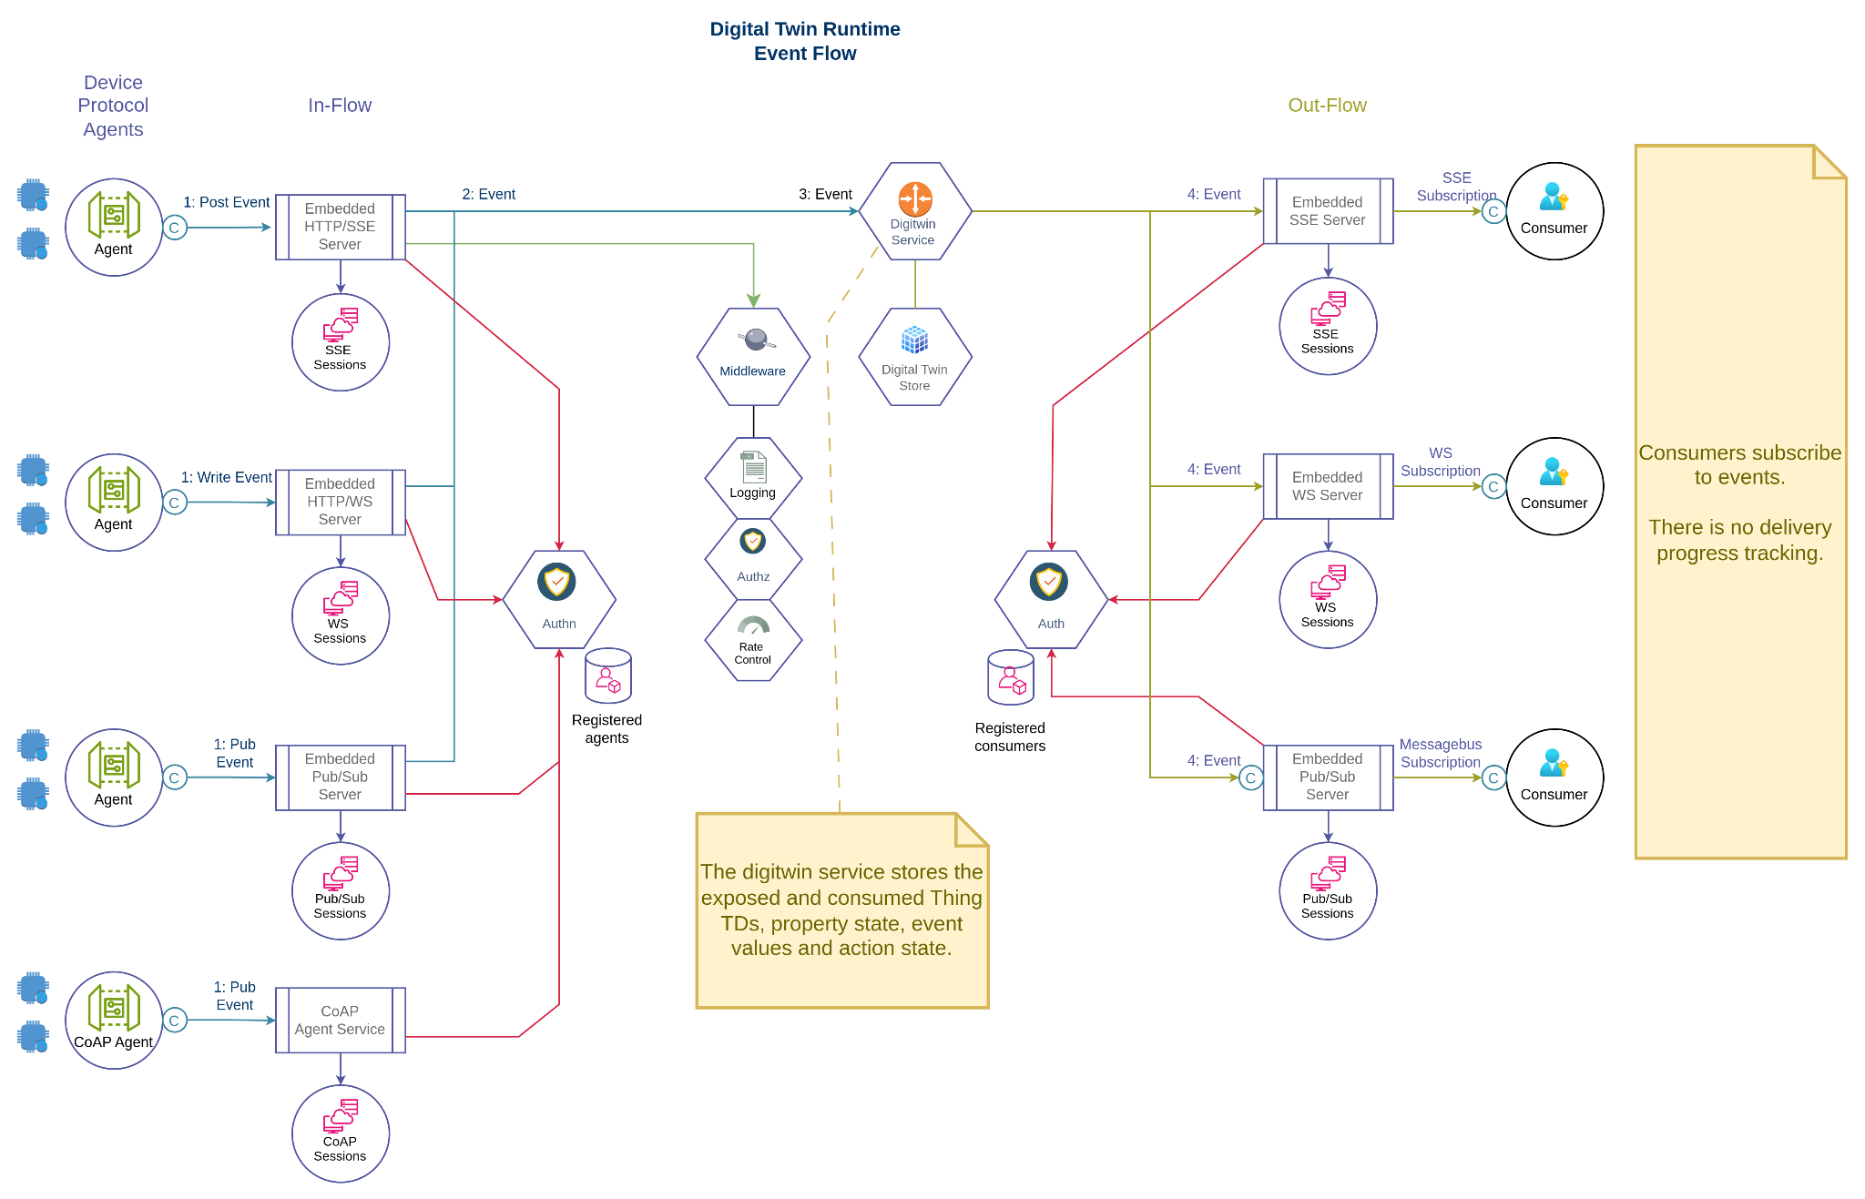
HiveOT Hub - Event Flow

Slide 11
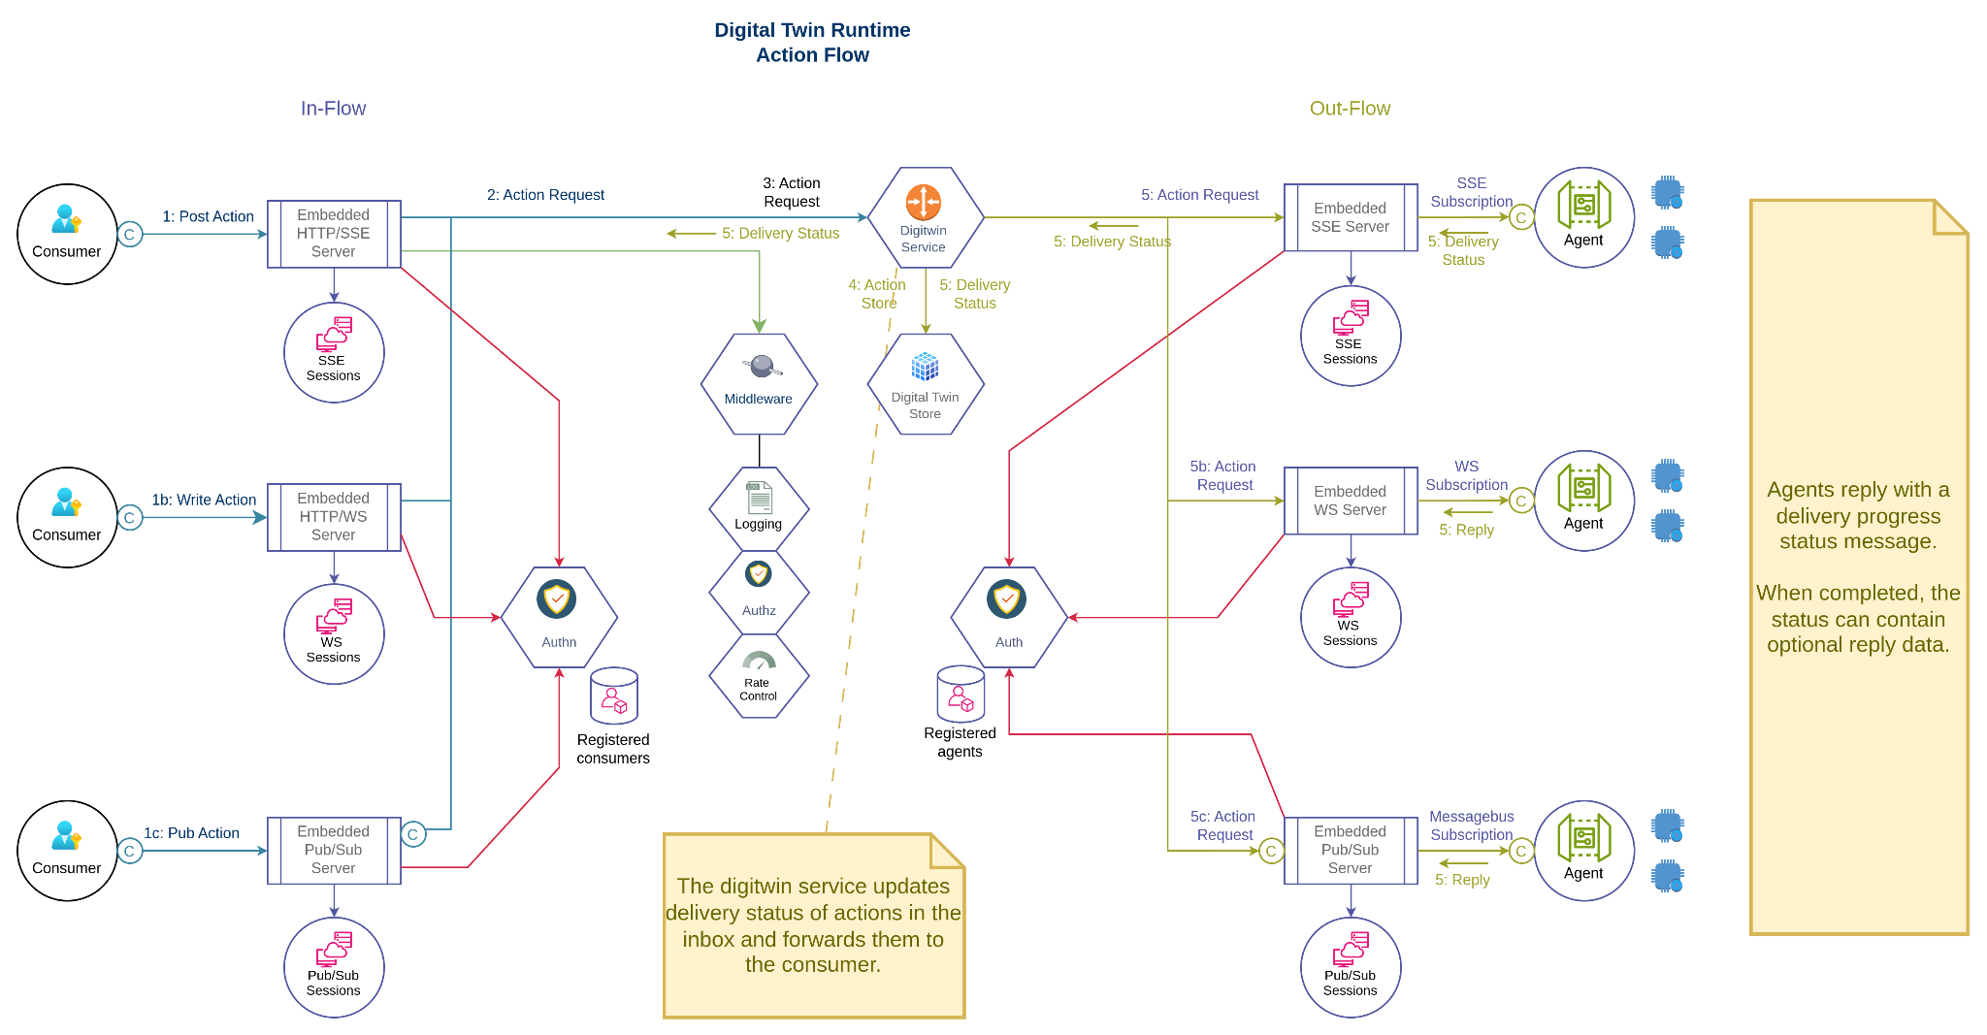
HiveOT Hub - Action Flow

Slide 12

Hub Services - Batteries Included
Certificates - server certificate management
Provisioning - provisioning of devices
Launcher - starting and stopping services
State - small storage for agents, services and consumers
History - event history
Hiveoview - web ui

Slide 13

Hub Protocol Bindings
Integration with 3rd party protocols. Currently only proof of concept.
ZWave
Insteon
1-wire
… many more to come …
WoT compatible devices
Coap devices
LoRa devices
Internet services
IFTTT

Slide 14
Hub Commandline Utilities
hubcli - console admin tool to manage users and device, view events and inspect TDs.
tdd2api - proof of concept to generate a (golang) API from a TD

Slide 15
TD Challenges - Affordances (1)
How to implement affordances in golang without inheritance or unions?
The TD describes a property affordance as a subclass of interaction affordance and a dataschema. A dataschema however has several subclasses: ArraySchema, BooleanSchema, NumberSchema, … How can the (compile time) inheritance tree depend on the value of the type field? How can a property affordance be a subclass of all these subclasses? Golang has no union support.
Workaround: implement DataSchema as a flattened union of all schemas, containing all fields.
Alternative: use a map[string]any and determine the expected data schema at runtime. Waste of CPU cycles though, especially on small devices.
How to identify the actual ‘meaning’ of a property, event or action?
Without a standard vocabulary it is up to the human to determine what something means. This stands in the way of automating integration.
Workaround: for now just define a ‘ht:’ namespace vocabulary in @context and use these in @type fields.
How to correlate actions with events and properties. Is there an implied relationship?
If action A is invoked how to know what the result is?
Workaround: In HiveOT assume an implicit relationship. An action named ‘switch’ can result in an event named ‘switch’ and updates a state property named ‘switch’. It would be confusing to repurpose the same name with a different meanings between actions, events and properties, so this is prohibited in HiveOT.

Slide 16
TD Challenges - Affordances (2)
Support for enum titles?
Enums are just a list of keys in the TD. When using these in the TD, how to provide a proper presentation for them? Eg, a title?
Workaround: don’t use enums for human consumption. Use OnOff if possible, which supports a const as value and Title for consumption. Enjoy.
How to add multi-line descriptions?
Documenting properties, inputs or outputs can sometimes take more than a single line. However the TDD only accepts a single string and JSON doesn't do multi-line strings.
Workaround: accept an ‘array’ of strings here. The awesome TD playground validator will complain. It is tough to be a validator.
How to support multi-line comment fields:
Same problem as with multi-line ‘description’ fields.
Current Solution: Accept an array of strings here. Same as previous point.

Slide 17

TD Challenges - Affordances (3)
How to describe a map of objects in the action output dataschema?
Workaround: don't use maps, use arrays.
How to read the latest event value?
A UI that displays events might want to show the last known event. However, the TD has no operations for ‘readevent’ and ‘readallevents’.
Workaround: HiveOT adds these operations in the “ht:” namespace.
How to describe basic vs advanced properties, events and actions in the TD?
Use case: human consumers might be interested in some properties, events or actions but not all of them. The human consumer should be able to just look at the essential data without being overwhelmed with more advanced ones. Some zwave devices have close to 100 properties of which only a handful are useful to the regular consumer. How to differentiate them?
Option 1: use the ht vocabulary to indicate basic properties. This is not compatible with anything.
Option 2: don’t put advanced properties in the TD. Uhm, right ….
Option 3: convince the WoT group to add a ‘advanced’ property affordance field to TD 2.0

Slide 18
TD Challenges - Operations, Forms, Protocols (1)
The TD describes consumer - device interaction. How to describe agent - hub interaction?
Agents (devices) publish a TD, events, and property updates
Agents receive (or subscribe) actions and property writes.
Workaround: define as custom operations of the ‘digitwin’ service.
Where does the encoding/decoding of input and output payloads take place?
TD Forms define a "contentType" field that describes the encoding of the payload.
Answer: this is clear now. Encoding is handled in the transport protocol. The forms in the TD contain the available transport protocols and its encoding, for every single property, event and action affordance. It just took some time to figure it out.
How to include metadata (thingID, name, clientID) in SSE messages?
Use-case: agent receives an action for a Thing via its SSE connection (agents connect to the Hub). The SSE data is the input data as per TDD, but how to convey the thingID, action name and messageID?
Workaround 1: Encapsulate the message in a message envelope and use the additionalResponses field in a Form to define the envelope schema. However this has to be repeated for every single action/property/event which is *very* wordy.
Workaround 2: Push this to the transport protocol. In case of SSE use the ID field: {thingID}/{name}/{messageID}. However, how can this be described in a Form? (chosen workaround)
Why is a form required for every .. property .. event .. and .. action?
Top level operations can describe pretty much anything. Reducing TD size and processing cycles.

Slide 19

TD Challenges - Operations, Forms, Protocols (2)
How to link asynchronous responses to their request?
Use-case: Consumer invokes action which will return one or more responses after some time. How to describe this?
Workaround: Use events and/or properties with the same name and include a ‘messageID’ in the headers. The ‘headers’ implementation depends on the protocol but most support some sort of metadata. No idea how to describe this in the TD.
Can authorization rules (eg required roles) be expressed to a TD?
Use case: For things only include allowed actions in the TD, based on the consumer’s role. It wouldn’t be good to allow the ‘detonate’ action to be used by tourists.
The problem is that there is no authorization support in the TD. Some workarounds:
Take a 'capabilities' approach. Split actions requiring different authorization into multiple Things. The service agent programmatically tells the authorization service which roles can use a Thing it publishes.
Add a custom 'allow' and 'deny' field to each action that lists which roles are allowed/denied invoking an action.
How does a client know if an output or alternative response is received?
Use case: client invokes action and expects an output value. The TD describes a form with additionalResponses, for example to report an error. The client receives the response as per TD and needs to differentiate somehow between normal and additional responses. Section "5.3.4.2.2 Response-related Terms Usage" describes a response name-value pair that can be used, but where is it described? How does this fit in the response data?
Workaround 1: parse the expected output and on failure parse using the schemas from additionalResponses. The ‘try it until it works' approach is not really a good specification. (although Python users might like it ;)
Workaround 2: include a 'dataschema' metadata field in a transport header that describes the dataschema used in the result. (currently being tested). This might be a good way with nr 1 as a fallback.

Slide 20
Challenges - Other
Size of the TD
The TD defines fields that can contain different types (string vs array). How to implement this is a strictly typed language such as golang.
Workaround. Use (*cough cough*) ‘any’ and provide a GetMethod that uses reflection to convert to a single type.
How to define global/shared constants in the TD.
How to describe a RPC service API in the TD?
The TD doesn’t do X, how to do it?
Just because a TD can be used to describe a toaster that doesn’t mean it can be used as a toaster. Can’t do everything.
SecurityScheme definition (5.3.3.1)
The forth paragraph: "Security schemes generally may require additional authentication parameters, such as a password or key. The location of this information is indicated by the value associated with the name in, often in combination with the value associated with name."
Is this an example of security through obscurity? ;)

Slide 21
Future
Improve WoT interoperability.
Websocket and Mqtt transport protocol implementations.
Lots .. LOTS .. more IoT protocol bindings (once things are stable).
A HiveOT bridge to connect Hub instances, building a real hive of hubs.
… apparently a lot more work …

