Slide 1
TEMPEST sniffing monitor
KAIR neural network to denoise image
Ondrej Mikle • ondrej.mikle@gmail.com • 16.4.2025

Slide 2
Electromagnetic emanations
all time-varying voltage and current interfaces emit electromagnetic waves
  chips, cables, all PCB traces act as transmitter antennas
  signal can be -50 dBm or lower (less than 0.01 μW), even -130 dBm workable
  current off-the-shelf SDRs can capture it, generally have >=90 dB dynamic range
  e.g. BladeRF, USRP B210, H-field probe

Slide 3
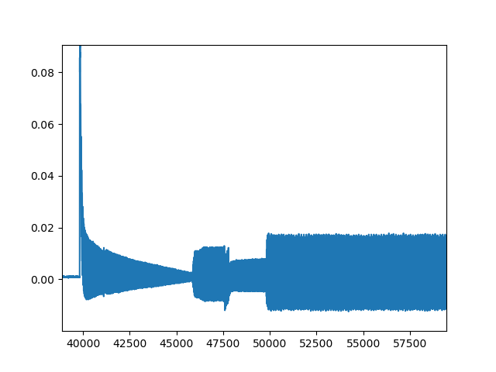
Sample EM trace of ARM chip

Slide 4
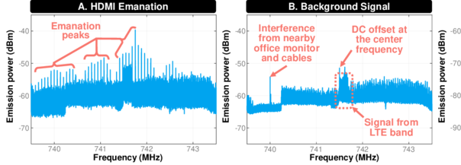
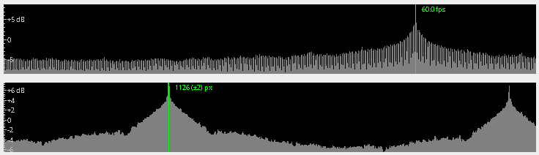
HDMI emanation & interference

Slide 5
VGA/HDMI/DisplayPort/USB-C
VGA is trivial to sniff, analog
HDMI & LVDS (LVDS is used in notebooks) have differential signalling, but still sniffeable
DisplayPort is differential signalling, but with some PRNG to not make it so easy, can be partially filtered out, but with loss
USB-C is network that encapsulates DisplayPort – hard to catch pixelclock

Slide 6
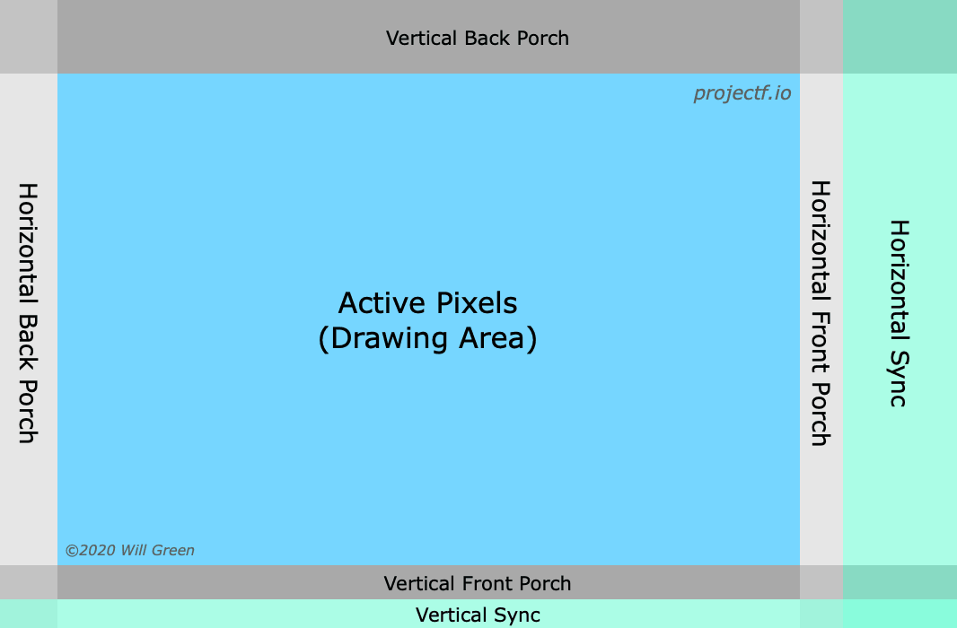
Front/back porch/pixelclock (1)

Slide 7
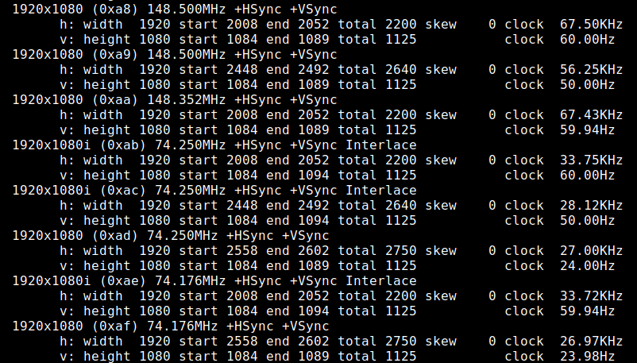
Front/back porch/pixelclock (2)
Resolution alone does not give horizontal/vertical or pixelclock timings, depends
on display and other things

Slide 8
Front/back porch/pixelclock (3)
pixelclock in MHz gives you timing for whole image, all these values neeed to be correct
horizontal and vertical pixels are needed to make sense of the signal
I found 5th harmonic frequency of pixelclock works best for me
  e.g. pixelclock of 148.5 MHz has 3rd harmonic 445.5 MHz and 5th 742.5 MHz

Slide 9
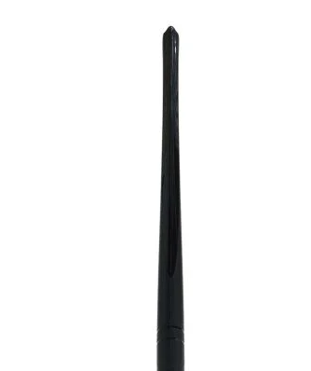
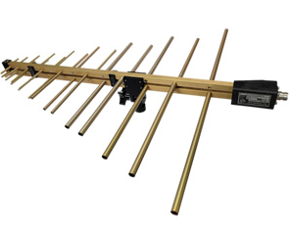
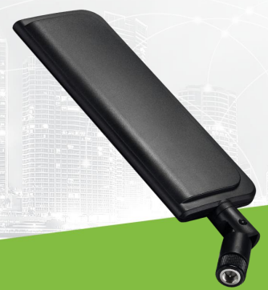
Antennas & filters
better antennas and filters result in better images, i.e. better specify what is sniffed
I used generic omnidirectional antennas, but log-periodic can be better
log-periodic antenna
omnidirectional antennas

Slide 10
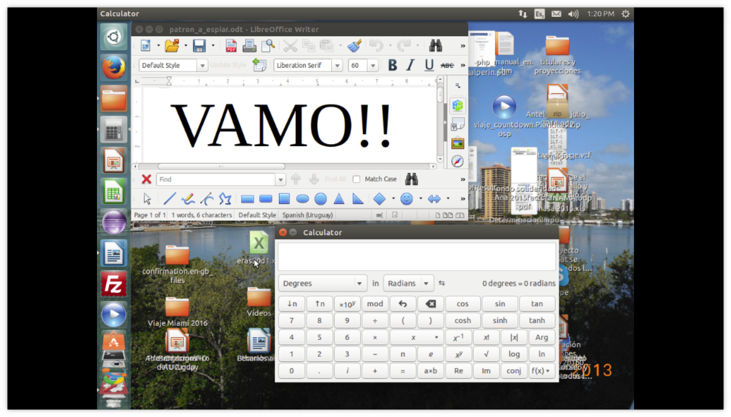
First results, monitor original

Slide 11
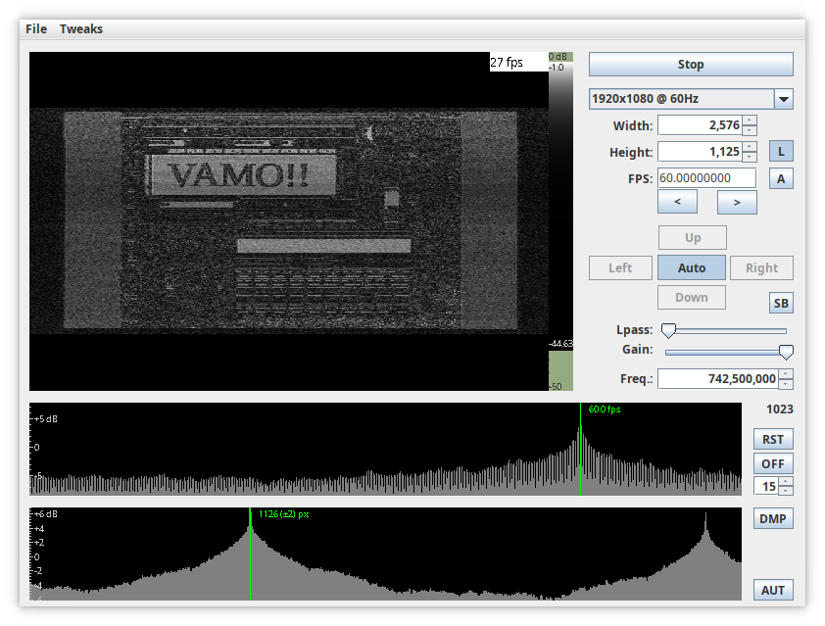
First results, TEMPEST image

Slide 12
Thanks
Ondrej Mikle • ondrej.mikle@gmail.com

