Slide 1
HUMANOID
DATA FLYWHEEL
Chọn dữ liệu có ích cho lần
cải thiện kỹ năng tiếp theo
Model Engine: GR00T N1.5 qua FluxVLA
Notes:
Project proposal: IDEA.md sections 6, 9 and 10; docs/implementation-plan/skill-a1/05-data-decision-and-run-contracts.md; idea-v3-2026-10-05/16-model-ai-va-data-flywheel.md. Proposed workflow and illustrative decisions, not measured native A1 results. Engineers approve hypotheses and interventions. Root splits precede augmentation, failed trajectories are not positive BC labels, independent final evaluation remains outside the adaptive development loop.
Core value hypothesis: achieve agreed task quality and coverage with fewer independent robot roots or lower total work than a competent comparator. Data quality and data selection are the central proposed contribution, while model architecture, controller and latency can still be bottlenecks.

Slide 2

Chi phí của mỗi vòng cải thiện
Kỹ sư phải quyết định nên sửa gì và cần thêm dữ liệu nào
Figure Index: 16 triệu video, 15 triệu USD trả creators. Payout chỉ là một phần chi phí dataset.
Công việc | Chi phí phải ghi | Quyết định còn thiếu
Thu mẫu và reset | Giờ operator, thiết bị | Mẫu nào bổ sung tình huống cần học?
QA, debug và training | Giờ kỹ sư, GPU, lượt thử | Sửa dữ liệu, model hay controller?
Giả thuyết: giảm các vòng thu mẫu và training sai hướng
Data Core và Model Engine
Chưa có baseline chi phí DENSO. Pilot cần đo quy trình thực tế cùng task owner.
02 / 23
Notes:
Project proposal: IDEA.md sections 6, 9 and 10; docs/implementation-plan/skill-a1/05-data-decision-and-run-contracts.md; idea-v3-2026-10-05/16-model-ai-va-data-flywheel.md. Proposed workflow and illustrative decisions, not measured native A1 results. Engineers approve hypotheses and interventions. Root splits precede augmentation, failed trajectories are not positive BC labels, independent final evaluation remains outside the adaptive development loop.
Figure Index, August 25, 2026: https://www.figure.ai/news/introducing-index . 16 million uploaded videos and USD 15 million creator payouts. Payout is not total dataset cost. The previously supplied video https://www.youtube.com/watch?v=zKaeODg7xeE was checked against transcript/source descriptions, not audited frame by frame.
FOCA, arXiv:2606.20867v1, section 5 Q2, Table 2, Appendix D.3. https://arxiv.org/html/2606.20867v1 . LIBERO 40% demonstrations (approximately 20/task): pi0 89.9%, FOCA + DreamGen 95.7%. Action-free generated video phase learns future alignment with a frozen future target encoder. Robot adaptation still uses action supervision plus the implicit objective. These are external results in their own protocol.
Do not infer causality for the proposed flywheel from these results. The two columns are independent studies, not comparable benchmarks.
Problem hypothesis for the engineer developing a new or changed robot skill. Do not claim measured DENSO time loss or cost savings. External evidence and exact limitations appear in appendix slide 15.

Slide 3
Đóng góp của idea
Kế thừa từ nền tảng
Đội đề xuất xây
FluxVLA
Training, evaluation, inference
GR00T N1.5
Eagle VLM và DiT Action Expert
Quyết định dữ liệu theo bằng chứng lỗi
Nối release với phạm vi cập nhật model
Đo lợi ích và tổng công của can thiệp
Mỗi can thiệp có lý do, dữ liệu truy nguyên và phép kiểm lợi ích
Data Core và Model Engine
Đây là đóng góp hệ thống dự kiến. Ưu thế cần đo với quy trình kỹ sư có năng lực tương đương.
03 / 23
Notes:
Project proposal: IDEA.md sections 6, 9 and 10; docs/implementation-plan/skill-a1/05-data-decision-and-run-contracts.md; idea-v3-2026-10-05/16-model-ai-va-data-flywheel.md. Proposed workflow and illustrative decisions, not measured native A1 results. Engineers approve hypotheses and interventions. Root splits precede augmentation, failed trajectories are not positive BC labels, independent final evaluation remains outside the adaptive development loop.
Li et al. (2026), FluxVLA Engine, arXiv:2609.17210v1. https://arxiv.org/html/2609.17210v1 . Original extracted Figures 1 and 2, CC BY 4.0. Figures and upstream results belong to the authors. Integrations use different budgets and are not a controlled leaderboard for A1. Figure 1, page 2, full original figure. Right-hand benchmarks are author results with different integration budgets.
Selected public FluxVLA GR00T N1.5 recipe: https://github.com/FluxVLA/FluxVLA/blob/main/configs/gr00tn15/gr00tn15_eagle_3b_robocasa_30_eps_full_finetune.py . Pin commit, checkpoint, transforms, optimizer groups and gradient manifest before running. Official NVIDIA N1.5 uses a frozen VLM; selected Flux recipe permits visual adaptation and freezes language. https://research.nvidia.com/labs/gear/gr00t-n1_5/ . A1 integration has not run. The reason to select FluxVLA is the common lifecycle from data/training to simulation evaluation and real-world inference runners/operators. Upstream support is not evidence that our A1 robot integration exists.
QA, lineage, active selection, simulation generation and train/eval loops individually are established practices. The proposal claims a task-specific integrated decision workflow, not a new foundation model or global novelty. Intervention choices also include reuse, repair, defer and stop.

Slide 4
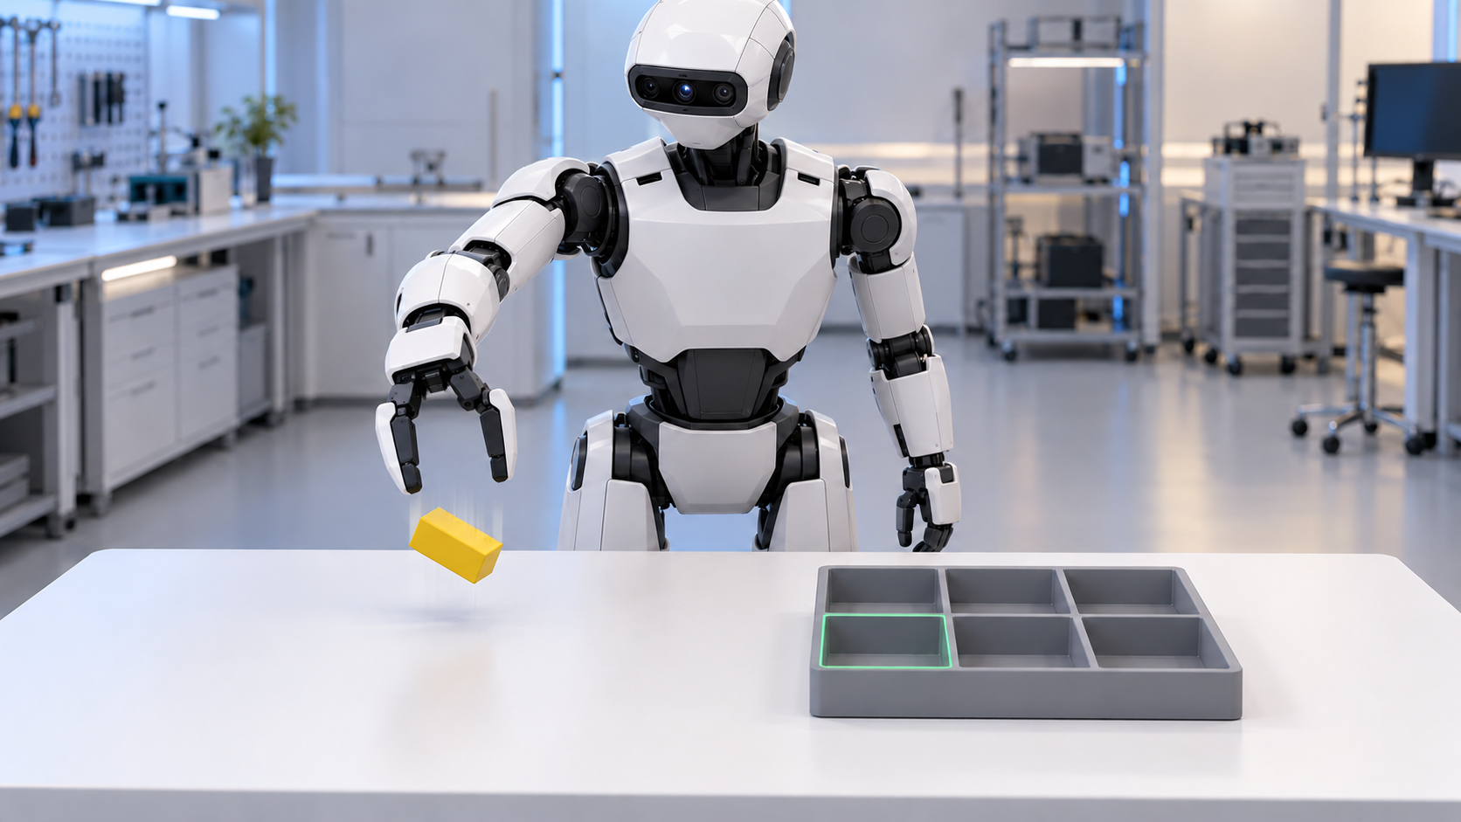
Một lỗi, nhiều hướng xử lý
Kiểm command và response trước
Binding / controller sai
Sửa hệ thống, chạy lại baseline
Thiếu coverage có bằng chứng
Chọn correction hoặc sim execution
Robot làm rơi vật trước ô A1
Mỗi nhánh dẫn tới một can thiệp khác nhau
Phạm vi
Ảnh minh họa AI. Bằng chứng chưa đủ thì kiểm tiếp, chưa chọn training.
04 / 23
Notes:
Project proposal: IDEA.md sections 6, 9 and 10; docs/implementation-plan/skill-a1/05-data-decision-and-run-contracts.md; idea-v3-2026-10-05/16-model-ai-va-data-flywheel.md. Proposed workflow and illustrative decisions, not measured native A1 results. Engineers approve hypotheses and interventions. Root splits precede augmentation, failed trajectories are not positive BC labels, independent final evaluation remains outside the adaptive development loop.
AI-generated explanatory robot scene retained from original deck, not a real rollout. No native episode E0 or measured diagnosis exists. A dropped object establishes full-task failure, not its cause. Replay sent commands and measured response before considering a data/model intervention. A matched expert-grasp transport test can support, but not conclusively prove, a grasp-context hypothesis.

Slide 5
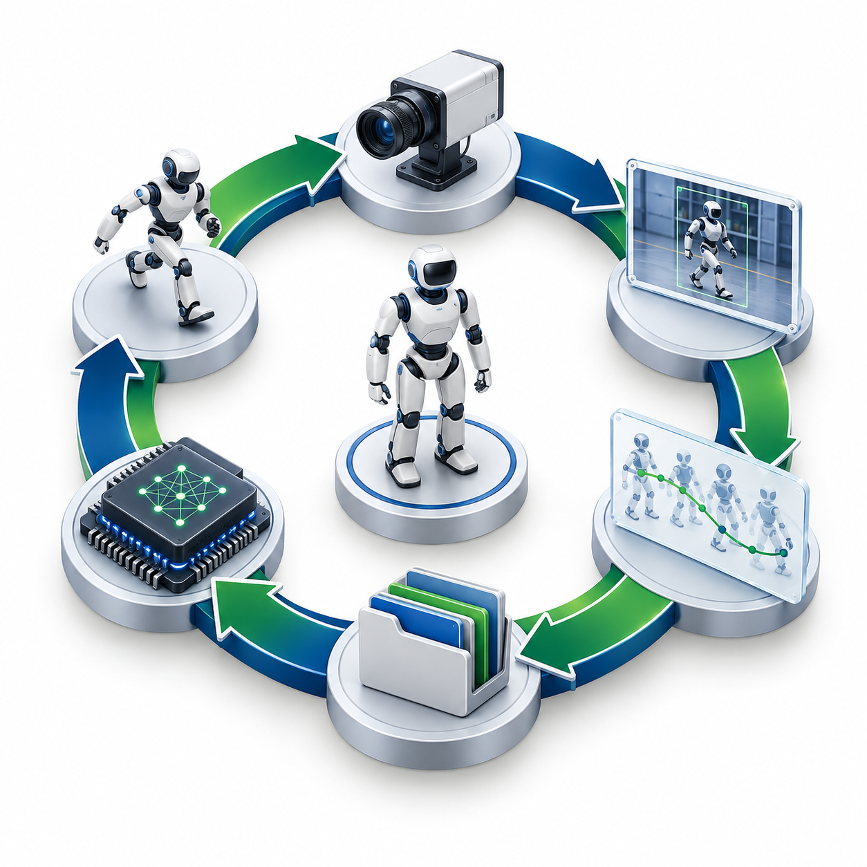
Data flywheel hoạt động
01 Chạy và ghi lỗi
Trace, outcome, điều kiện xảy ra
02 Kiểm giả thuyết
Phân biệt hệ thống và dữ liệu
03 Chọn can thiệp
Reuse, correction, sim hoặc repair
04 QA và phát hành
Giữ nguồn gốc, targets và splits
05 Cập nhật model
Recipe xác định, có replay
06 Đo và quyết định
Gain / no-gain, regression, tổng công
Kết quả vòng này quyết định dữ liệu vòng sau
Data Core và Model Engine
Kỹ sư chốt quyết định. Final độc lập nằm ngoài vòng phát triển. Hình minh họa AI.
05 / 23
Notes:
Project proposal: IDEA.md sections 6, 9 and 10; docs/implementation-plan/skill-a1/05-data-decision-and-run-contracts.md; idea-v3-2026-10-05/16-model-ai-va-data-flywheel.md. Proposed workflow and illustrative decisions, not measured native A1 results. Engineers approve hypotheses and interventions. Root splits precede augmentation, failed trajectories are not positive BC labels, independent final evaluation remains outside the adaptive development loop.
Concept illustration generated with the built-in imagegen tool and saved to docs/assets/data-flywheel-concept.png. Prompt: clean editorial cutaway of a physical flywheel with six connected components, central humanoid, camera frame, trajectory, dataset folder and AI processor, clockwise blue/green ribbon on white, no text or logo. Image is a conceptual metaphor, not a model or implemented system diagram. The numbered native text defines the proposed workflow. Evidence acquisition may lead to repair or deferral, skipping release/training. Final held-out data never drives this adaptive loop.

Slide 6
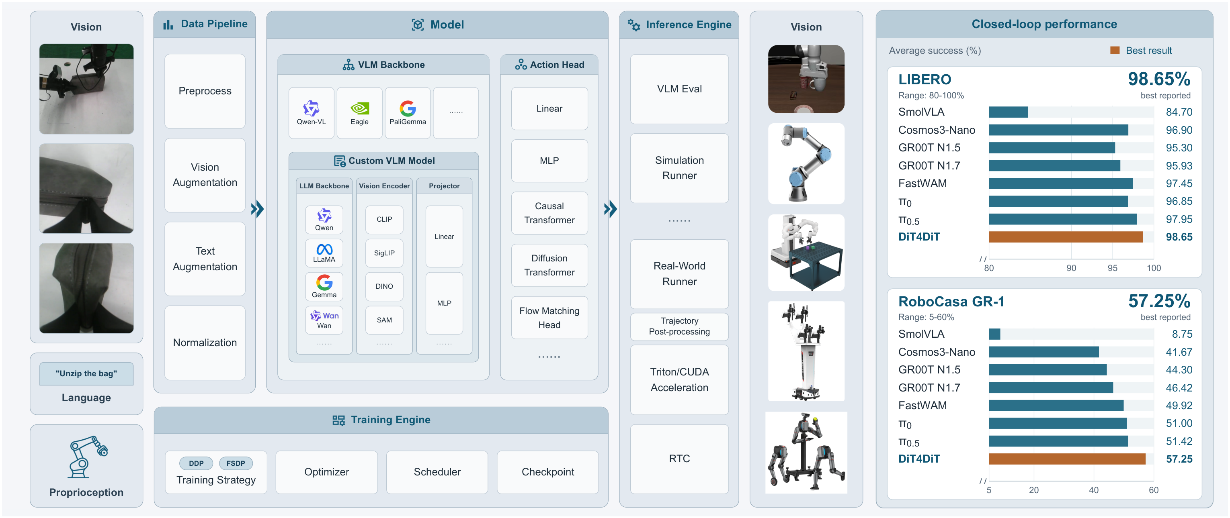
Model Engine Core
Li và cộng sự, FluxVLA Figure 1 (2026), CC BY 4.0. Benchmarks trong hình là của tác giả.
Framework: FluxVLA Policy nền: GR00T N1.5 Môi trường đầu: RoboCasa / GR1
MVP A1 trong mô phỏng
FluxVLA hỗ trợ training, eval và robot thật. Đề xuất nối engine với flywheel. Native A1 chưa kiểm chứng.
06 / 23
Notes:
Li et al. (2026), FluxVLA Engine, arXiv:2609.17210v1. https://arxiv.org/html/2609.17210v1 . Original extracted Figures 1 and 2, CC BY 4.0. Figures and upstream results belong to the authors. Integrations use different budgets and are not a controlled leaderboard for A1. Figure 1, page 2, full original figure. Right-hand benchmarks are author results with different integration budgets.
Selected public FluxVLA GR00T N1.5 recipe: https://github.com/FluxVLA/FluxVLA/blob/main/configs/gr00tn15/gr00tn15_eagle_3b_robocasa_30_eps_full_finetune.py . Pin commit, checkpoint, transforms, optimizer groups and gradient manifest before running. Official NVIDIA N1.5 uses a frozen VLM; selected Flux recipe permits visual adaptation and freezes language. https://research.nvidia.com/labs/gear/gr00t-n1_5/ . A1 integration has not run. The reason to select FluxVLA is the common lifecycle from data/training to simulation evaluation and real-world inference runners/operators. Upstream support is not evidence that our A1 robot integration exists.
The full unmodified original Figure 1 is retained. Benchmark panels belong to the paper authors, not this project. Our A1 adaptation and real robot integration are pending. Data Core determines the release and intervention scope, rather than claiming ownership of this engine.

Slide 7
Dữ liệu đi vào Model AI
R_A1 là nền. S_exec bổ sung khi qua QA và có ích.
01 Episode
02 Model batch
03 Model và loss
04 Cập nhật
RGB trong MP4
State / action trong Parquet
Instruction và metadata
Frames và text tokens
State theo đúng profile
Future action chunks + masks
Eagle mã hóa ảnh / text
DiT: features, state,
action nhiễu và time
Flow velocity action loss
ACT + visual theo recipe
Language giữ cố định
Checkpoint + stats + config
Baseline học từ R. Candidate thử dữ liệu đã chọn với cùng recipe.
Data Core và Model Engine
Recipe FluxVLA được chọn: tune ACT và visual, freeze language. A1 cần pin config và kiểm gradients.
07 / 23
Notes:
Project proposal: IDEA.md sections 6, 9 and 10; docs/implementation-plan/skill-a1/05-data-decision-and-run-contracts.md; idea-v3-2026-10-05/16-model-ai-va-data-flywheel.md. Proposed workflow and illustrative decisions, not measured native A1 results. Engineers approve hypotheses and interventions. Root splits precede augmentation, failed trajectories are not positive BC labels, independent final evaluation remains outside the adaptive development loop.
Li et al. (2026), FluxVLA Engine, arXiv:2609.17210v1. https://arxiv.org/html/2609.17210v1 . Original extracted Figures 1 and 2, CC BY 4.0. Figures and upstream results belong to the authors. Integrations use different budgets and are not a controlled leaderboard for A1. Figure 2, original full region.
Selected public FluxVLA GR00T N1.5 recipe: https://github.com/FluxVLA/FluxVLA/blob/main/configs/gr00tn15/gr00tn15_eagle_3b_robocasa_30_eps_full_finetune.py . Pin commit, checkpoint, transforms, optimizer groups and gradient manifest before running. Official NVIDIA N1.5 uses a frozen VLM; selected Flux recipe permits visual adaptation and freezes language. https://research.nvidia.com/labs/gear/gr00t-n1_5/ . A1 integration has not run. MP4 frames are decoded and sampled with synchronized state/action. Prompt tokenization and image transforms produce model inputs. Normalization, action chunk horizons and masks must match the checkpoint. Future target actions are for training, never inference inputs.
Selected public FluxVLA GR00T N1.5 recipe: https://github.com/FluxVLA/FluxVLA/blob/main/configs/gr00tn15/gr00tn15_eagle_3b_robocasa_30_eps_full_finetune.py . Pin commit, checkpoint, transforms, optimizer groups and gradient manifest before running. Official NVIDIA N1.5 uses a frozen VLM; selected Flux recipe permits visual adaptation and freezes language. https://research.nvidia.com/labs/gear/gr00t-n1_5/ . A1 integration has not run.
FOCA, arXiv:2606.20867v1, section 5 Q2, Table 2, Appendix D.3. https://arxiv.org/html/2606.20867v1 . LIBERO 40% demonstrations (approximately 20/task): pi0 89.9%, FOCA + DreamGen 95.7%. Action-free generated video phase learns future alignment with a frozen future target encoder. Robot adaptation still uses action supervision plus the implicit objective. These are external results in their own protocol.
Project specification: IDEA.md, docs/implementation-plan/skill-a1/README.md, 04-evaluation-and-cost.md, 05-data-decision-and-run-contracts.md and idea-v3-2026-10-05/16-model-ai-va-data-flywheel.md. Proposed native pilot, not measured native success or saving. Training flow target is executed future actions minus sampled noise, under the selected interpolation convention and action masks. N1.5 selected input example: state padded 64, active action 29 / padded 32, horizon 16. Verify actual tensor semantics rather than inventing shapes. Official N1.5 frozen-VLM learning is distinct from the selected Flux visual-unfreeze recipe. Human comparator R_common versus R_common+H keeps architecture, robot wrist objective and VLM freeze identical. Human loss updates the common head/shared trunk, not the native robot decoder directly. FOCA/H are unintegrated research branches with separate gates and budgets.
R_A1 and S_exec are proposed, not existing collected data. S_exec derives from train roots by controlled transformation and re-execution, producing fresh images, measured states and executed actions. Loader constructs conditioning from current observations and targets from future actions. At training, DiT also receives noisy action chunks and interpolation time. Flow-velocity target is action minus noise under the pinned convention. No action labels or future targets enter runtime inference. This slide summarizes the MVP robot-action recipe; human and video branches are separate in the appendix.

Slide 8
Ví dụ chọn dữ liệu cho A1
Ví dụ giả định: thiếu pose gắp, đã có expert correction
Quyết định | Lý do chọn và dữ liệu đi tiếp
Ưu tiên correction | Expert làm được cùng pose, lấy đoạn gắp–nâng–chuyển
Chưa chọn S_exec | Biến thể sim chưa qua kiểm contact và action labels
Release và huấn luyện | QA correction, giữ roots/splits, replay R, cập nhật theo recipe
Đo trên development | So baseline, kiểm regression, cộng công thu / QA / train / thử
Không có lợi thì giữ baseline và đổi quyết định vòng tiếp theo
Data Core và Model Engine
Ví dụ có điều kiện, chưa phải kết quả đo. Logs thất bại giữ làm evidence, chưa dùng làm positive BC.
08 / 23
Notes:
Project proposal: IDEA.md sections 6, 9 and 10; docs/implementation-plan/skill-a1/05-data-decision-and-run-contracts.md; idea-v3-2026-10-05/16-model-ai-va-data-flywheel.md. Proposed workflow and illustrative decisions, not measured native A1 results. Engineers approve hypotheses and interventions. Root splits precede augmentation, failed trajectories are not positive BC labels, independent final evaluation remains outside the adaptive development loop.
Illustrative conditional example only. Assumptions: binding checks pass, controlled tests support a grasp-pose coverage hypothesis, an expert provides a successful correction in the matched context, and sim variants have not yet passed contact/action QA. The example therefore chooses the eligible correction first and defers S_exec. It does not assert that correction always outperforms simulation. Reconsider S_exec after it passes QA if expected benefit and cost fit the acquisition cap. No native result, actual contact diagnosis, collected sample count, measured gain or saved cost is asserted. Correction episodes contain current RGB, measured state and executed future actions for the complete grasp-lift-transport context. Split roots before variants and keep rights and QA records. Failed policy trajectories remain evidence, not positive behavior cloning targets. A fixed-recipe R vs R+S comparison is a source test, while adaptive decision-loop benefit needs a separate competent workflow comparator.

Slide 9
Inference và phản hồi
Checkpoint mới phải thể hiện lợi ích qua thực thi
Giai đoạn | Dữ liệu đi vào | Đầu ra trả về
Model inference | RGB, instruction, state hiện tại | Eagle features, DiT action chunks
Robot thực thi | Action đã denormalize và binding | Commands, response, quan sát mới
Đánh giá development | Object / contact / tiêu chí task | Full-task outcome, trace và tổng công
Evidence quay về Data Core để chọn can thiệp tiếp theo
Data Core và Model Engine
MVP kiểm trong mô phỏng. Robot thật cần binding camera, SDK và controller cùng nghiệm thu riêng.
09 / 23
Notes:
Project proposal: IDEA.md sections 6, 9 and 10; docs/implementation-plan/skill-a1/05-data-decision-and-run-contracts.md; idea-v3-2026-10-05/16-model-ai-va-data-flywheel.md. Proposed workflow and illustrative decisions, not measured native A1 results. Engineers approve hypotheses and interventions. Root splits precede augmentation, failed trajectories are not positive BC labels, independent final evaluation remains outside the adaptive development loop.
Selected public FluxVLA GR00T N1.5 recipe: https://github.com/FluxVLA/FluxVLA/blob/main/configs/gr00tn15/gr00tn15_eagle_3b_robocasa_30_eps_full_finetune.py . Pin commit, checkpoint, transforms, optimizer groups and gradient manifest before running. Official NVIDIA N1.5 uses a frozen VLM; selected Flux recipe permits visual adaptation and freezes language. https://research.nvidia.com/labs/gear/gr00t-n1_5/ . A1 integration has not run.
Project specification: IDEA.md, docs/implementation-plan/skill-a1/README.md, 04-evaluation-and-cost.md, 05-data-decision-and-run-contracts.md and idea-v3-2026-10-05/16-model-ai-va-data-flywheel.md. Proposed native pilot, not measured native success or saving. A latent is an actual encoder vector with a known hook, source and version. Do not invent grounding text or claim a latent probe establishes causality. Log prediction, command and response separately. Reload parity and upstream GR1 smoke tests precede A1 trials. Real-robot inference is an upstream capability requiring a separate local integration and acceptance protocol.
Current RGB and text become Eagle features. DiT conditions on features, measured state and its sampling noise/time. No future ground-truth action is an inference input. Controller executes the pinned action prefix and the policy observes again. Independent scorer may use privileged object/contact state but those scorer-only fields must not leak into policy input. Failure evidence is a hypothesis input, not automatic attribution or retraining authorization.

Slide 10
Cách chứng minh điểm khác biệt
Đo cả lợi ích dữ liệu và lợi ích của quyết định
Câu hỏi | Đối chứng | Kết quả cần đo
Dữ liệu bổ sung có ích? | R so với R + S_exec Cùng roots, recipe và task | Task success, regression Chi phí thêm của S_exec
Flywheel quyết định tốt hơn? | Workflow kỹ sư hiện có Cùng case, cap và quyền can thiệp | Tổng công tới cùng quality Số vòng sửa / train lại
Tổng công gồm operator, kỹ sư, robot, generation, QA, GPU và eval
Task thứ hai đo công tái sử dụng. Final độc lập chỉ chạy sau khi khóa candidate.
Data Core và Model Engine
Hai phép so riêng. Source gain chưa chứng minh workflow tốt hơn. Native A1 và savings chưa đo.
10 / 23
Notes:
Project proposal: IDEA.md sections 6, 9 and 10; docs/implementation-plan/skill-a1/05-data-decision-and-run-contracts.md; idea-v3-2026-10-05/16-model-ai-va-data-flywheel.md. Proposed workflow and illustrative decisions, not measured native A1 results. Engineers approve hypotheses and interventions. Root splits precede augmentation, failed trajectories are not positive BC labels, independent final evaluation remains outside the adaptive development loop.
Project specification: IDEA.md, docs/implementation-plan/skill-a1/README.md, 04-evaluation-and-cost.md, 05-data-decision-and-run-contracts.md and idea-v3-2026-10-05/16-model-ai-va-data-flywheel.md. Proposed native pilot, not measured native success or saving. Independent final is outside the adaptive flywheel. Fix task strata, seeds, scorer, binding and recipe before opening final. Both arms passing a quality gate is not statistical equivalence. Under true success 95%, probability of passing the draft gate is about 43.6%; under 97%, about 81.8%, so task owner must accept the power tradeoff. Reference: examples/engineering-loop/README.md, linear 35x4 predictor with ideal sim state, scripted sequence and proximity-weld grasp, 32 tests; S 12/12, R 0/12, C 0/12 final in that restricted scope. These are not GR00T/GR1 performance or data efficiency evidence.
Competent ordinary engineering workflow is an empirical comparator, not an assumed practice of blindly collecting more data. Use matched parent/case pairs, equal budgets and intervention access, and counterbalance case order. Log negative/no-gain decisions. Report quality and cost separately until a comparable acceptance level is reached. Data-budget curves are needed to claim fewer robot roots, rather than a single fixed-budget result. Initial setup cost is separate from marginal effort for task 2.

Slide 11
Ngân sách pilot
5.187,20 USD
20 accepted train roots, giả định yield 50%
40 attempts, compute có cap và replan
Khoản đã tính | Cơ sở planning | USD
Capture / reset | 4 operator giờ × 10 USD | 40,00
QA | 2 engineer giờ × 20 USD | 40,00
Integration / chuẩn bị / báo cáo | 240 engineer giờ × 20 USD | 4.800,00
GPU cap | 180 A100 giờ × 1,59 USD | 286,20
Storage | 100 GB × 3 tháng × 0,07 USD | 21,00
Hiện trạng DENSO, chi phí lặp lại, lợi ích năm và ROI cần số liệu thực tế từ task owner.
MVP A1 trong mô phỏng
Ngân sách giả định, chưa đo. Chưa gồm robot/cell, CPU riêng, data/license, thuế và downtime.
11 / 23
Notes:
Project specification: IDEA.md, docs/implementation-plan/skill-a1/README.md, 04-evaluation-and-cost.md, 05-data-decision-and-run-contracts.md and idea-v3-2026-10-05/16-model-ai-va-data-flywheel.md. Proposed native pilot, not measured native success or saving. Budget assumptions from deliverables/DENSO-Noi-dung-form-y-tuong.md and docs/implementation-plan/skill-a1/04-evaluation-and-cost.md. Capture/reset 40 attempts x 6 minutes = 4 operator hours. QA 40 x 3 minutes = 2 engineer hours. Labor rates, yield and integration hours are editable planning assumptions, not DENSO/Vietnam wages. Public Runpod pricing checked October 6, 2026: https://www.runpod.io/pricing . 180 GPU hours is a capacity cap, not a measured runtime forecast. Total: 40 + 40 + 4800 + 286.20 + 21 = 5187.20 USD. H, FOCA and real hardware have separate gates/caps.

Slide 12
Lộ trình 8–12 tuần
Chặng | Công việc chính | Điều kiện qua mốc
01 2–3 tuần | Feasibility và native baseline Upstream smoke, A1 replay, update/reload | Useful baseline Memory / throughput có số đo
02 2–3 tuần | Release R và S_exec Thực thi, QA, dedup, roots/splits | Action / contact đúng Yield và công QA trong cap
03 2–3 tuần | Development và chọn dữ liệu R/R+S, trace, kiểm gain / no-gain | Regression + actual cost Khóa RunPlan trước final
04 2–3 tuần | Freeze và independent final Bàn giao dataset / policy / report | Đạt gate mới promote Fail thì report hoặc round mới
Task thứ hai đo phần dùng lại. Human/video và robot thật đi qua gate riêng.
MVP A1 trong mô phỏng
Ước lượng sau khi có task owner, kỹ sư, GPU và checkpoint. Gate chưa qua thì repair, thu hẹp hoặc replan.
12 / 23
Notes:
Project specification: IDEA.md, docs/implementation-plan/skill-a1/README.md, 04-evaluation-and-cost.md, 05-data-decision-and-run-contracts.md and idea-v3-2026-10-05/16-model-ai-va-data-flywheel.md. Proposed native pilot, not measured native success or saving. Four stages, each estimated 2–3 weeks, total 8–12 conditional weeks. No committed date or production deployment promise. Team and task ownership are not yet named. Separate optional human/action-free/workflow studies and hardware acceptance may require additional resources and schedule.

Slide 13

DỮ LIỆU CÓ ÍCH CHO KỸ NĂNG ROBOT
Data Core chọn can thiệp. Model Engine học và thực thi.
Giá trị cần chứng minh: cùng chất lượng, ít tổng công hơn.
Đề nghị pilot: chốt task owner, một công đoạn và baseline chi phí trước khi chạy.
Hồ sơ chi tiết: hiwe0305.github.io/denso-challenge/
Notes:
Project proposal: IDEA.md sections 6, 9 and 10; docs/implementation-plan/skill-a1/05-data-decision-and-run-contracts.md; idea-v3-2026-10-05/16-model-ai-va-data-flywheel.md. Proposed workflow and illustrative decisions, not measured native A1 results. Engineers approve hypotheses and interventions. Root splits precede augmentation, failed trajectories are not positive BC labels, independent final evaluation remains outside the adaptive development loop.
Core pitch closes on measured data utility and total work, not simply the availability of a VLA engine. Current evidence is a small reference and specifications. Native A1, human/video transfer, savings, real-world robot performance and production readiness remain unproven. Detailed dataset, training, evaluation, sources, model alternatives and submission checklist follow in the appendix.

Slide 14
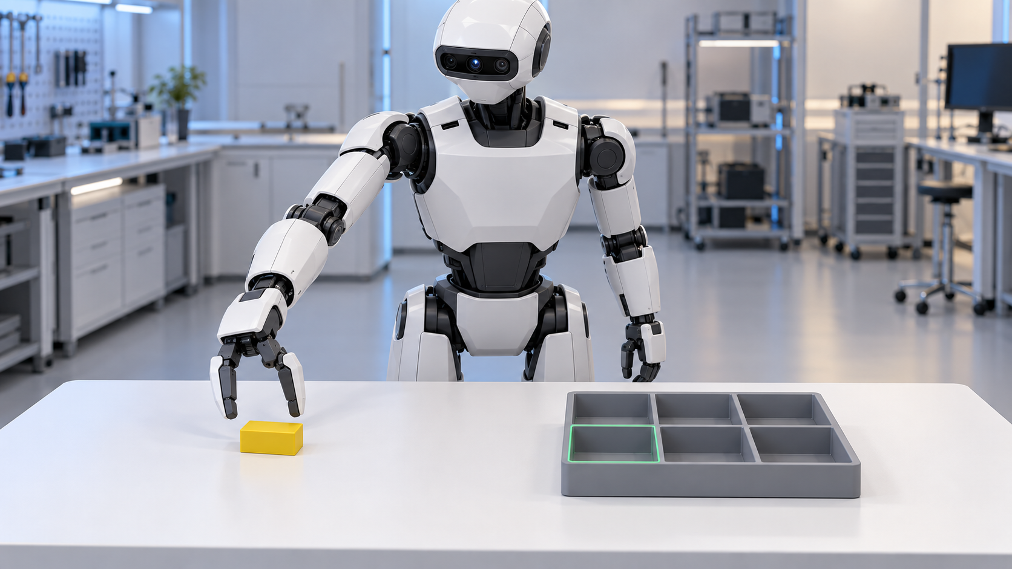
Bài toán A1
“Lấy linh kiện vàng, đặt vào A1,
nhả rồi rút tay.”
Lấy đúng ID vật
Footprint nằm trọn trong A1
Có mặt đỡ, vật ổn định
Đã nhả và tay đã rút
Ảnh minh họa AI, chưa là rollout native.
Geometry đề xuất: vật 40 × 25 × 15 mm, vùng trong A1 80 × 60 mm.
Draft: timeout 30 s, ổn định 2 s. Không yêu cầu yaw trong MVP.
Phụ lục kỹ thuật và bằng chứng
GR1 gắp–đặt trong mô phỏng. Geometry, cycle time và ngưỡng cần task owner chốt.
14 / 23
Notes:
Project specification: IDEA.md, docs/implementation-plan/skill-a1/README.md, 04-evaluation-and-cost.md, 05-data-decision-and-run-contracts.md and idea-v3-2026-10-05/16-model-ai-va-data-flywheel.md. Proposed native pilot, not measured native success or saving. Existing AI illustration, not a recorded GR1 rollout. Draft geometry: object 40 x 25 x 15 mm, A1 interior 80 x 60 mm, timeout 30 s and stable 2 s. Task owner must calibrate before final protocol. Fixed torso, no walking or precision assembly in the MVP.

Slide 15
Bằng chứng cho cơ hội
16 triệu video
89,9% so với 95,7%
15 triệu USD trả creators
FOCA + DreamGen trên LIBERO
Figure Index vẫn cần filtering, dedup,
cân bằng dữ liệu và annotation.
Payout chỉ là một phần chi phí dataset.
π0 baseline và FOCA + DreamGen,
cùng setting 40% robot demos.
Robot adaptation vẫn dùng action labels.
Supervision phù hợp và phép kiểm quyết định giá trị sử dụng của dữ liệu.
Phụ lục kỹ thuật và bằng chứng
Số liệu bên ngoài theo protocol riêng. Chưa phải kết quả A1 hoặc số đo chi phí tại DENSO.
15 / 23
Notes:
Figure Index, August 25, 2026: https://www.figure.ai/news/introducing-index . 16 million uploaded videos and USD 15 million creator payouts. Payout is not total dataset cost. The previously supplied video https://www.youtube.com/watch?v=zKaeODg7xeE was checked against transcript/source descriptions, not audited frame by frame.
FOCA, arXiv:2606.20867v1, section 5 Q2, Table 2, Appendix D.3. https://arxiv.org/html/2606.20867v1 . LIBERO 40% demonstrations (approximately 20/task): pi0 89.9%, FOCA + DreamGen 95.7%. Action-free generated video phase learns future alignment with a frozen future target encoder. Robot adaptation still uses action supervision plus the implicit objective. These are external results in their own protocol.
Do not infer causality for the proposed flywheel from these results. The two columns are independent studies, not comparable benchmarks.

Slide 16
Dataset cho MVP
Dữ liệu | Format và trường chính | Cách sử dụng
FluxVLAData Kiểm compatibility | LeRobot v2.1 MP4 + Parquet + metadata | 24 tasks / 720 episodes Giữ task gốc, không đổi nhãn thành A1
R_A1 Expert / correction | RGB MP4 + signals Parquet Instruction JSONL + calibration / QA | Robot state + executed action 20 train roots là giả định planning
S_exec Dẫn xuất từ R train | Cùng schema robot + parent root Transform recipe + sim/contact log | Biến đổi seed, thực thi lại, QA Tạo RGB/state/action mới
Video / human Pilot bổ sung | MP4 + text / timestamps Pose, camera và confidence nếu có | Action-free dùng future objective Wrist labels dùng common-motion
Chia roots trước khi sinh biến thể. 100 variants từ một root vẫn chỉ là một nguồn độc lập.
Phụ lục kỹ thuật và bằng chứng
Synthetic là cách tạo dữ liệu. Loader và loss phụ thuộc supervision thực có, không phụ thuộc tên nguồn.
16 / 23
Notes:
Project specification: IDEA.md, docs/implementation-plan/skill-a1/README.md, 04-evaluation-and-cost.md, 05-data-decision-and-run-contracts.md and idea-v3-2026-10-05/16-model-ai-va-data-flywheel.md. Proposed native pilot, not measured native success or saving.
Selected public FluxVLA GR00T N1.5 recipe: https://github.com/FluxVLA/FluxVLA/blob/main/configs/gr00tn15/gr00tn15_eagle_3b_robocasa_30_eps_full_finetune.py . Pin commit, checkpoint, transforms, optimizer groups and gradient manifest before running. Official NVIDIA N1.5 uses a frozen VLM; selected Flux recipe permits visual adaptation and freezes language. https://research.nvidia.com/labs/gear/gr00t-n1_5/ . A1 integration has not run. FluxVLAData public GR1 setting has 256x256 RGB at 20 fps, 29-D active robot state/action. These are compatibility examples and do not determine the pending A1 binding. R_A1 is proposed data, not an already collected 20-root dataset. Appearance augmentation preserves labels only when semantics are invariant. Generated video usually lacks native action labels. Human wrist motion is not robot joint action or contact/finger supervision.

Slide 17
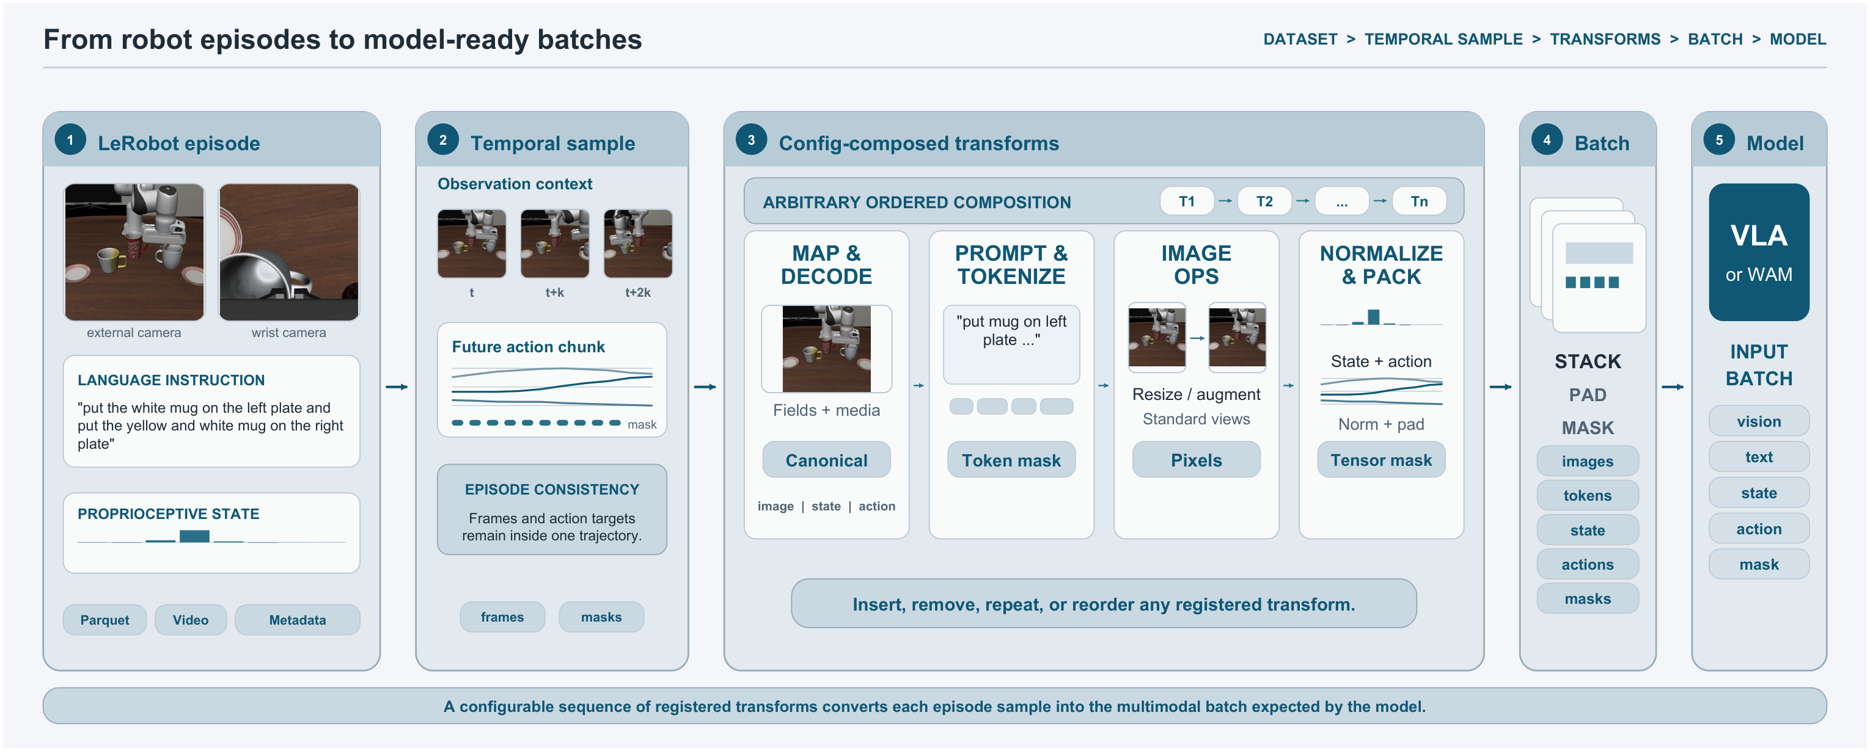
Episode thành model batch
Li và cộng sự, FluxVLA Figure 2 (2026), CC BY 4.0. Hình trích nguyên từ paper.
Episode lưu trữ, sample thời gian và batch model là ba mức dữ liệu khác nhau
Phụ lục kỹ thuật và bằng chứng
Hình gốc FluxVLA Figure 2. Đội phải kiểm sample–batch, camera, timebase, units và action masks cho A1.
17 / 23
Notes:
Li et al. (2026), FluxVLA Engine, arXiv:2609.17210v1. https://arxiv.org/html/2609.17210v1 . Original extracted Figures 1 and 2, CC BY 4.0. Figures and upstream results belong to the authors. Integrations use different budgets and are not a controlled leaderboard for A1. Figure 2, original full region.
Selected public FluxVLA GR00T N1.5 recipe: https://github.com/FluxVLA/FluxVLA/blob/main/configs/gr00tn15/gr00tn15_eagle_3b_robocasa_30_eps_full_finetune.py . Pin commit, checkpoint, transforms, optimizer groups and gradient manifest before running. Official NVIDIA N1.5 uses a frozen VLM; selected Flux recipe permits visual adaptation and freezes language. https://research.nvidia.com/labs/gear/gr00t-n1_5/ . A1 integration has not run. MP4 frames are decoded and sampled with synchronized state/action. Prompt tokenization and image transforms produce model inputs. Normalization, action chunk horizons and masks must match the checkpoint. Future target actions are for training, never inference inputs.

Slide 18
Model AI học như thế nào
Bước | Tensor / target đi qua model | Phần được học
01 Robot baseline | RGB + text thành Eagle features State + noisy actions + time vào DiT Target velocity = future action − noise | Action loss theo flow velocity ACT + visual tune Language frozen
02 Candidate R + S_exec | Cùng robot schema, labels qua QA Replay R giữ điều kiện đã làm tốt | Cùng recipe với baseline Ghi thêm generation / QA / compute
03 Video pilot riêng | Current / future frames thành features Future target encoder frozen | FOCA-style implicit alignment Robot phase vẫn có action loss
04 Human pilot riêng | Tracked wrists + geometry / masks Common motion target 18D | Common head + shared motor trunk VLM frozen ở cả hai đối chứng
Robot recipe: tune ACT + visual, language frozen. Kiểm optimizer groups và gradients trước run.
Phụ lục kỹ thuật và bằng chứng
MVP kế thừa pretrained weights. Không pretrain lại foundation VLM từ đầu. A1 recipe cần pin và kiểm gradients.
18 / 23
Notes:
Selected public FluxVLA GR00T N1.5 recipe: https://github.com/FluxVLA/FluxVLA/blob/main/configs/gr00tn15/gr00tn15_eagle_3b_robocasa_30_eps_full_finetune.py . Pin commit, checkpoint, transforms, optimizer groups and gradient manifest before running. Official NVIDIA N1.5 uses a frozen VLM; selected Flux recipe permits visual adaptation and freezes language. https://research.nvidia.com/labs/gear/gr00t-n1_5/ . A1 integration has not run.
FOCA, arXiv:2606.20867v1, section 5 Q2, Table 2, Appendix D.3. https://arxiv.org/html/2606.20867v1 . LIBERO 40% demonstrations (approximately 20/task): pi0 89.9%, FOCA + DreamGen 95.7%. Action-free generated video phase learns future alignment with a frozen future target encoder. Robot adaptation still uses action supervision plus the implicit objective. These are external results in their own protocol.
Project specification: IDEA.md, docs/implementation-plan/skill-a1/README.md, 04-evaluation-and-cost.md, 05-data-decision-and-run-contracts.md and idea-v3-2026-10-05/16-model-ai-va-data-flywheel.md. Proposed native pilot, not measured native success or saving. Training flow target is executed future actions minus sampled noise, under the selected interpolation convention and action masks. N1.5 selected input example: state padded 64, active action 29 / padded 32, horizon 16. Verify actual tensor semantics rather than inventing shapes. Official N1.5 frozen-VLM learning is distinct from the selected Flux visual-unfreeze recipe. Human comparator R_common versus R_common+H keeps architecture, robot wrist objective and VLM freeze identical. Human loss updates the common head/shared trunk, not the native robot decoder directly. FOCA/H are unintegrated research branches with separate gates and budgets.

Slide 19
Inference trên robot
Ranh giới | Dữ liệu đầu vào | Dữ liệu đầu ra
Camera và preprocessing | RGB + instruction + measured state Processor / camera / timing đã pin | Image tensors, tokens, masks State theo robot profile
Eagle VLM | Images + text | Encoded features có layer/shape/version
DiT Action Expert | Features + state + noise/time | Action chunk theo horizon đã khóa
Binding và controller | Chunk đã denormalize Order, units, limits, execution prefix | Sent commands + robot readback Quan sát mới cho closed-loop
Scorer độc lập | Object / contact / task criteria | Full-task, stage, timeout, unknown Evidence gửi về flywheel
Sim trước. Robot thật cần SDK/controller/camera binding và nghiệm thu riêng.
Phụ lục kỹ thuật và bằng chứng
Inference dùng quan sát hiện tại. Future action targets và privileged scorer state không đi vào policy.
19 / 23
Notes:
Selected public FluxVLA GR00T N1.5 recipe: https://github.com/FluxVLA/FluxVLA/blob/main/configs/gr00tn15/gr00tn15_eagle_3b_robocasa_30_eps_full_finetune.py . Pin commit, checkpoint, transforms, optimizer groups and gradient manifest before running. Official NVIDIA N1.5 uses a frozen VLM; selected Flux recipe permits visual adaptation and freezes language. https://research.nvidia.com/labs/gear/gr00t-n1_5/ . A1 integration has not run.
Project specification: IDEA.md, docs/implementation-plan/skill-a1/README.md, 04-evaluation-and-cost.md, 05-data-decision-and-run-contracts.md and idea-v3-2026-10-05/16-model-ai-va-data-flywheel.md. Proposed native pilot, not measured native success or saving. A latent is an actual encoder vector with a known hook, source and version. Do not invent grounding text or claim a latent probe establishes causality. Log prediction, command and response separately. Reload parity and upstream GR1 smoke tests precede A1 trials. Real-robot inference is an upstream capability requiring a separate local integration and acceptance protocol.

Slide 20
Benchmark và evaluation
Câu hỏi | Đối chứng | Cách giữ phép so công bằng
Nguồn synthetic có ích? | R so với R + S_exec | Cùng roots, recipe, domain, scorer Ghi thêm công và compute của S
Flywheel chọn tốt hơn? | Quy trình thường so với quy trình có evidence | Matched parent–case pairs, cùng cap Cùng quyền can thiệp, đảo thứ tự case
Skill đạt yêu cầu? | Freeze rồi independent final | 100 scene starts độc lập, full-task Ghi cả timeout / unknown / intervention
Gate đề xuất: lower bound exact một phía 95% ≥ 90%
Với n = 100 và giả định IID Bernoulli, cần ít nhất 96 successes.
Chất lượng đạt gate chưa chứng minh saving. So tổng công ở cùng quality và coverage.
MVP A1 trong mô phỏng
Native A1 chưa đo. Reference MuJoCo chỉ kiểm pipeline, scorer và gates trong mô hình thu nhỏ.
20 / 23
Notes:
Project specification: IDEA.md, docs/implementation-plan/skill-a1/README.md, 04-evaluation-and-cost.md, 05-data-decision-and-run-contracts.md and idea-v3-2026-10-05/16-model-ai-va-data-flywheel.md. Proposed native pilot, not measured native success or saving. Independent final is outside the adaptive flywheel. Fix task strata, seeds, scorer, binding and recipe before opening final. Both arms passing a quality gate is not statistical equivalence. Under true success 95%, probability of passing the draft gate is about 43.6%; under 97%, about 81.8%, so task owner must accept the power tradeoff. Reference: examples/engineering-loop/README.md, linear 35x4 predictor with ideal sim state, scripted sequence and proximity-weld grasp, 32 tests; S 12/12, R 0/12, C 0/12 final in that restricted scope. These are not GR00T/GR1 performance or data efficiency evidence.

Slide 21
Phụ lục: các hướng model
Hướng | Supervision / cách học | Mapping vào idea
OpenVLA / π0 | Robot trajectories có actions Action tokens hoặc flow objective | Pretrained policy adaptation Freeze / tune phụ thuộc recipe
GR00T N1.5 | Eagle + DiT, robot action learning Official frozen VLM + FLARE | Policy nền MVP qua FluxVLA Selected visual-unfreeze khác official
FOCA | Video action-free học future alignment Robot phase học action + implicit | Pilot few-shot có gate riêng Chưa port vào A1
DreamGen | Sinh video offline theo task Video sinh thường không có robot actions | Nguồn kinh nghiệm bổ sung Cần objective / nhãn thích hợp
DreamZero / DreamerV3 | Joint world-action hoặc dynamics / RL Objective và runtime riêng | Alternative stack để nghiên cứu Chưa là component bắt buộc MVP
Human wrist pilot: common motion 18D, giữ native robot head riêng, kiểm transfer bằng đối chứng.
Phụ lục kỹ thuật và bằng chứng
Các phương pháp giải bài toán khác nhau. Không ghép kết quả khác robot, task và budget thành một leaderboard.
21 / 23
Notes:
FOCA, arXiv:2606.20867v1, section 5 Q2, Table 2, Appendix D.3. https://arxiv.org/html/2606.20867v1 . LIBERO 40% demonstrations (approximately 20/task): pi0 89.9%, FOCA + DreamGen 95.7%. Action-free generated video phase learns future alignment with a frozen future target encoder. Robot adaptation still uses action supervision plus the implicit objective. These are external results in their own protocol.
Selected public FluxVLA GR00T N1.5 recipe: https://github.com/FluxVLA/FluxVLA/blob/main/configs/gr00tn15/gr00tn15_eagle_3b_robocasa_30_eps_full_finetune.py . Pin commit, checkpoint, transforms, optimizer groups and gradient manifest before running. Official NVIDIA N1.5 uses a frozen VLM; selected Flux recipe permits visual adaptation and freezes language. https://research.nvidia.com/labs/gear/gr00t-n1_5/ . A1 integration has not run.
OpenVLA: https://arxiv.org/abs/2406.09246 . pi0: https://arxiv.org/abs/2410.24164 . DreamGen: https://research.nvidia.com/labs/gear/dreamgen/ . DreamZero: source catalog in idea-v3-2026-10-05/15-dataset-training-blueprint.md . DreamerV3: https://arxiv.org/abs/2301.04104 . Project synthesis: idea-v3-2026-10-05/15-dataset-training-blueprint.md and the website research catalog. Do not present any optional branch as integrated functionality.
FOCA single-task A1 needs train-only task-mismatched negatives or an explicit objective adaptation. Code/interface and extra generation/learning compute remain gates. Human wrist transfer does not establish native finger/contact skill.

Slide 22


CHECKLIST TỰ ĐÁNH GIÁ TRƯỚC KHI NỘP
CHỦ ĐỀ: HUMANOID & ROBOT
Ý tưởng của nhóm thuộc chủ đề nào trong các nhóm sau?
AI - Dự báo & Tri thức
Humanoid & Robot
Data - Chuẩn hóa & Khai thác
CÂU HỎI | TRẢ LỜI
1. Trình bày điểm mới, đột phá so với các giải pháp truyền thống? | Data quyết định từ trace, QA/lineage và cost gate. Lợi ích riêng cần đối chứng.
2. Ý tưởng này đang giải quyết vấn đề gì tại Denso? | Giảm công phát triển skill. Hiện trạng DENSO cần task owner xác nhận.
3. Phương pháp/công cụ áp dụng và thời gian thực hiện dự án? | FluxVLA / GR00T N1.5, R rồi R+S_exec. Planning 8–12 tuần có gate.
4. Ý tưởng này mang lại hiệu quả gì? Cho số liệu. | Ngân sách giả định 5.187,20 USD. Native quality, saving và ROI chưa đo.
5. Khả năng mở rộng, triển khai ngang của dự án là gì (trong nội bộ Denso hoặc các nhà máy khác)? | Task 2 cùng robot để đo reuse. Robot mới cần binding và nghiệm thu riêng.
6. Nhóm đã có những kiến thức hoặc kinh nghiệm nào giúp thực hiện giải pháp? | Cần bổ sung tên đội, thành viên, năng lực và task owner trước nộp.
Phụ lục kỹ thuật và bằng chứng
Chọn dữ liệu có ích, kiểm cả kỹ năng và tổng công, giữ bằng chứng cho mỗi quyết định.
DENSO Factory Hacks 2026 | Submission Template
22 / 23
Notes:
Project specification: IDEA.md, docs/implementation-plan/skill-a1/README.md, 04-evaluation-and-cost.md, 05-data-decision-and-run-contracts.md and idea-v3-2026-10-05/16-model-ai-va-data-flywheel.md. Proposed native pilot, not measured native success or saving. Official DENSO submission checklist preserved. This is a review draft. Team identities and capability evidence are still missing. Interests can include data while the challenge topic remains Humanoid & Robot.

Slide 23
Phụ lục: đội triển khai
Thông tin đội cần bổ sung
Chưa có tên đội, thành viên hoặc hồ sơ năng lực thực tế.
Vai trò cần có | Phần việc
Robot learning engineer | Native trainer, bridge và kiểm loss/gradient
Robotics / simulation engineer | Binding, controller, TaskSpec và scorer
Operator / data engineer | Thu seed, correction, QA và lineage
Task owner | Chốt domain, yêu cầu và nghiệm thu
Phụ lục kỹ thuật và bằng chứng
Vai trò là nhu cầu triển khai. Chưa xác nhận nhân sự hoặc kinh nghiệm của đội.
23 / 23
Notes:
Project specification: IDEA.md, docs/implementation-plan/skill-a1/README.md, 04-evaluation-and-cost.md, 05-data-decision-and-run-contracts.md and idea-v3-2026-10-05/16-model-ai-va-data-flywheel.md. Proposed native pilot, not measured native success or saving. Team names, member capabilities and ownership have not been supplied. Listed roles describe required work, not verified team credentials.

