Slide 1
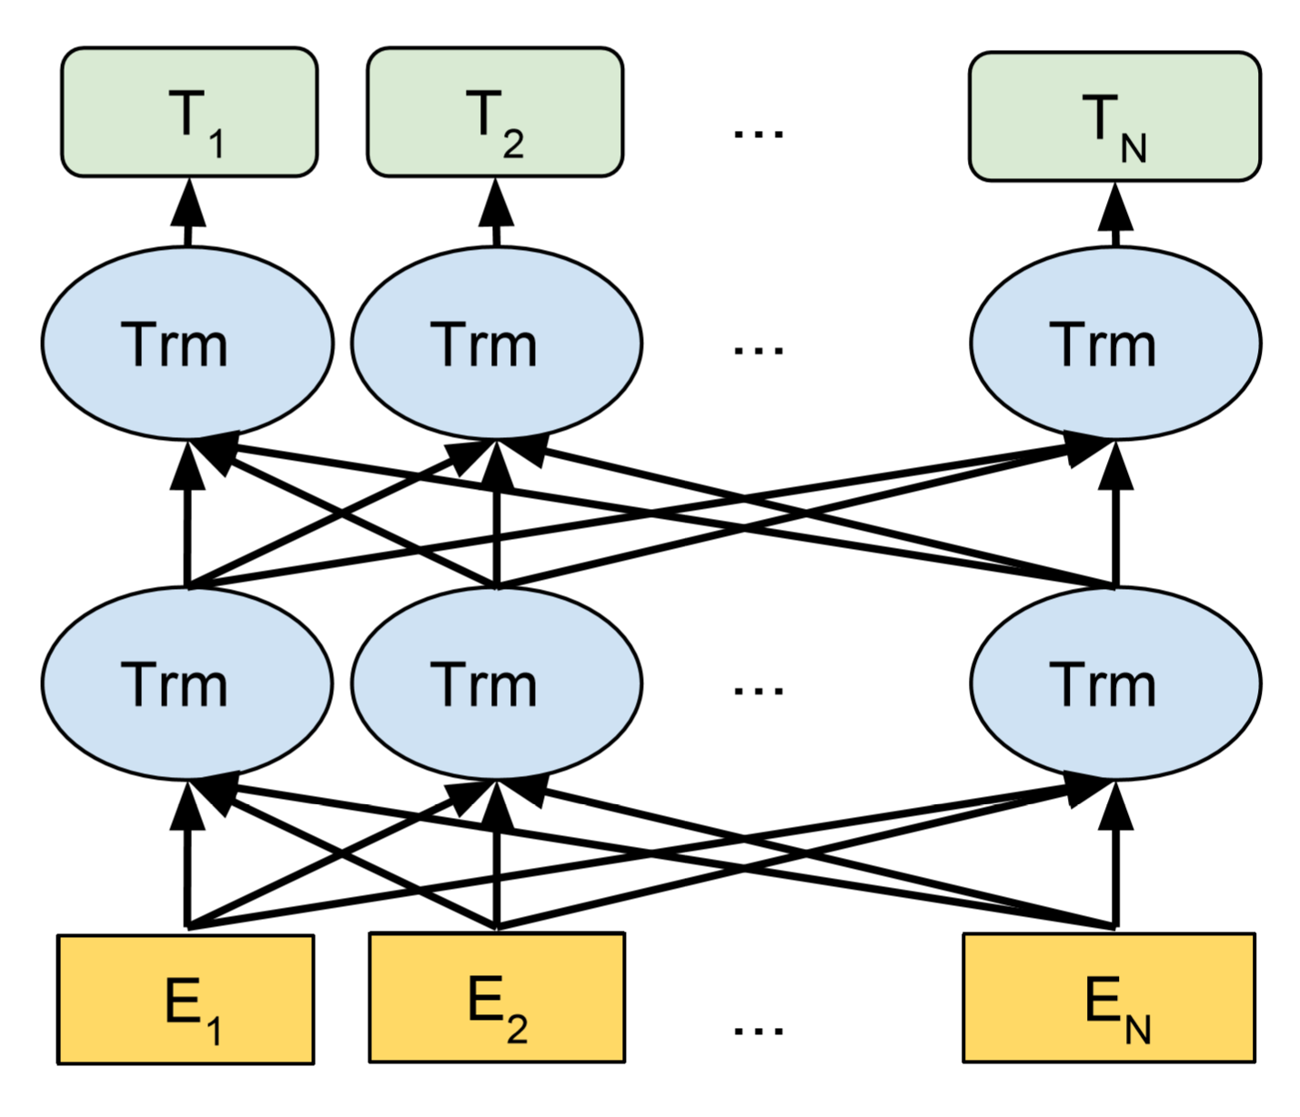

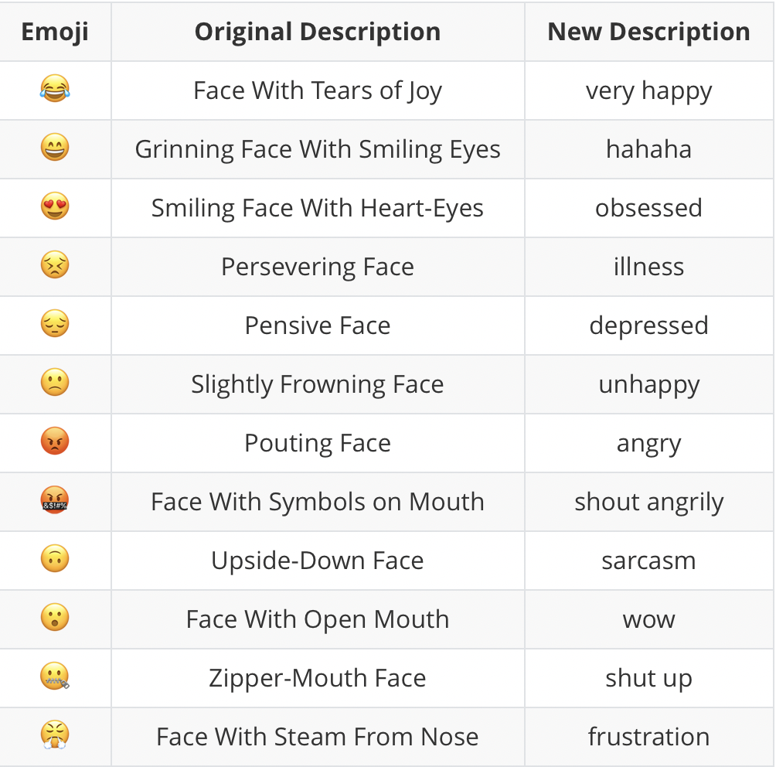
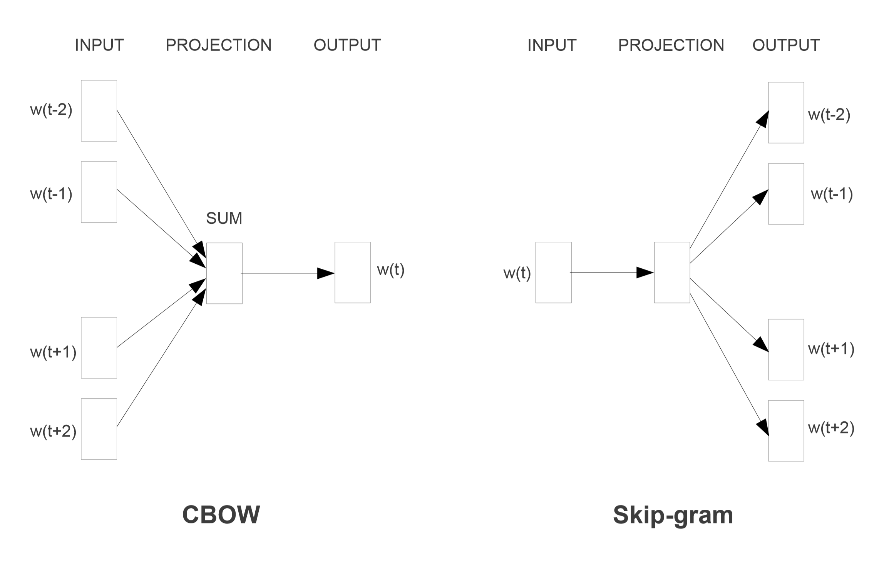
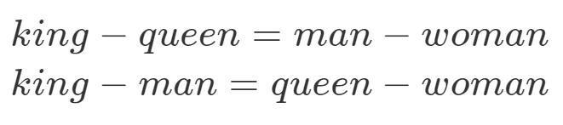
Natural Language Processing in Emotional Context Prediction by Using Bidirectional Encoder Representations from Transformers Y.P. Long ^{1,*}, Z.H. Huang ¹, Z.M. Xu ¹
Supervisor: Prof. W.F. Su, Dr. Jefferson Fong ¹ Computer Science and Technology, Division of Science and Technology, BNU-HKBU United International College * Corresponding student author. Tel: +86-17666373546, E-mail: m730026075@mail.uic.edu.hk
Abstract
In the field of artificial intelligence, Emotion Classification in Conversations is a subtask of Natural Language Processing (NLP). When people chat in social media and social applications, they usually express their emotions with slang words, popular phrases on the Internet, or even a couple of sentences that seem to be unrelated. The emotions could be happiness, sadness, anger or other complicated emotions. In order to comprehend the emotion of a piece of context, a method combined with data pre-processing and deep learning model comes up to classify the emotions in the context.
Google researchers released an improved model named Bidirectional Encoder Representations from Transformers (BERT). It is based on fine-tuning on the pre-trained model and aimed to solve NLP tasks with high accuracy and high efficiency. It performs the best in 11 different NLP tasks. Based on BERT, we pre-process the data before it is fed into the model. We translate the emojis with human’s understanding, replacing them with direct emotional phrases. Meanwhile, sentences that are unrelated to the emotions are removed while training the model. After data pre-processing, our model gains more than 10% precision increase in classifying emotions.
This task is from International Workshop on Semantic Evaluation 2019. With our efforts of data-preprocessing before feeding into BERT, we got a world ranking of 27 out of 150 groups of researchers from all over the world which consist of graduated students and PhD students.
BERT
The emergence of BERT (Figure 4) has completely changed the relationship between pre-training generated word vectors and downstream specific NLP tasks. BERT introduces multiple features to complete the operation of most downstream NLP tasks. With the support of massive corpus and powerful computing power, BERT can fully describe the relationship between character level, word level and even sentence level.
Figure 4. Pre-training model architecture of BERT
As a keel-level NLP model, BERT only needs to use a lightweight output layer to achieve transfer learning between NLP tasks. This greatly improves the model's learning efficiency.
Introduction
The task provides short conversations which only contains three sentences (an example is in Figure 1). The emotion of the first and third sentences will be classified.
Figure 1. Emotion of the sentences in green is angry.
In this section, we focus on the advantages of BERT over other NLP models (word2vec and ELMo).
word2vec
word2vec is a linear model that embodies the relationship between high-dimensional word vectors and real-world semantics (Figure 2). The most important feature, “linear word vector”, allows the word vector to perform linear operations to express the semantics of the real world (Figure 3). The disadvantage of word2vec is that word vectors are static, or context-insensitive.
Figure 2. Model architectures of word2vec
Figure 3. Sample expressions on word vectors in word2vec
ELMo
In order to solve the context-insensitive defects of word vectors in word2vec, ELMo uses multi-layer stacked Bidirectional Long-Short-Term Memory (Bi-LSTM) network in the model to reason the change and association of word vectors in context. The training weights are introduced for the original word vectors and each layer of Bi-LSTM to meet the needs of different downstream NLP tasks.
Related Work
The input layer of BERT needs two sentences as the input. There are three sentences in each conversation, which means there are several kinds of ways to put the training set into BERT. We try every possible combination of input, and finally we discover that input the first and third sentence separately is the best.
Then, we discover that the ratio of 4 classes in the training set is different from the ratio of the test set. Therefore, we adjust the ratio by placing duplicate data in the training set, then we get a better score (see Figure 5, from A to B).
Also, BERT cannot well recognize the emojis, which truly indicate the emotion of the speakers. We use Emojipedia to replace emojis in the training set with definition of emojis, but it does not perform well in the classification stage. The definition from Emojipedia only gives the description of every single emoji, which is not easy for BERT to “understand” the related emotion. Hence, we translate some of the emojis by ourselves (see Table 1), then we get performance increase (see Figure 5, from C to D).
Table 1 Figure 5
Table 1 illustrates the difference with and without emoji translation.
Figure 5 shows the F1 scores of 3 different pre-processing. A represents the original training set. B represents adjusting the ratio of conversations labeled with “others” to be 0.88. C represents replacing the emojis with the definition from Emojipedia. D represents replacing the emojis with our translation.
Conclusion
By using BERT, we can classify the emotion of the speaker in the conversations. We increase the accuracy of classification after data pre-processing. Therefore, it is proved that data pre-processing such as emoji translation and ratio adjustment could help the classification of emotion in conversations.

