Slide 1
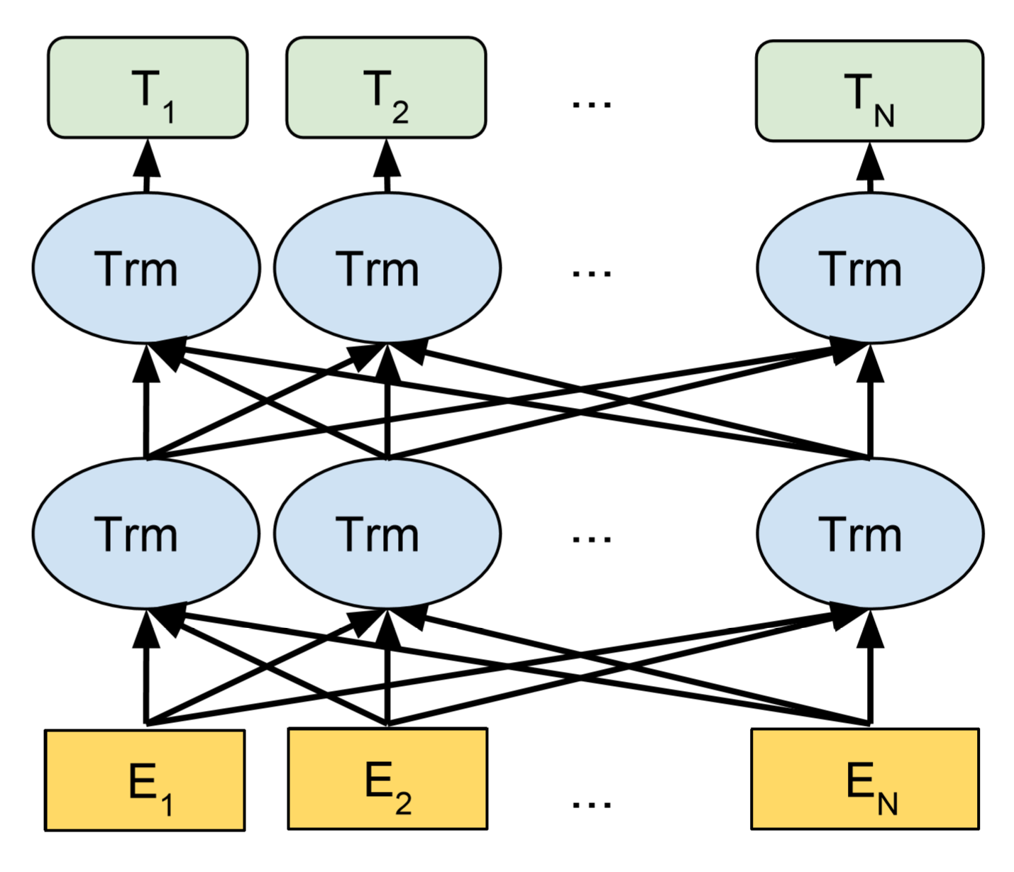
BiLSTM based metaphor Identification and Interpretation in context Z.M. Tian*, Q.Z. Wang, Z.H. Huang
Supervisor: Prof. W.F. Su, Dr. Jefferson Fong ¹ Computer Science and Technology, Division of Science and Technology, BNU-HKBU United International College * Corresponding student author. Tel: +86-13172650285, E-mail: m730026102@mail.uic.edu.hk
Abstract
Metaphor expressions appear broadly in daily life, furnishing vivid and concrete explanations for abstract experience and perception. In light of linguistic theories, a metaphor is identified if the literal meaning of a word contrasts with the meaning that word takes in this context. The computational realization of metaphor identification and interpretation is hence a crucial segment in the NLP translation field. Current word embedding based metaphor identification models may perform a decent performance, whereas the considering aspect of metaphor detection may be single. In this study, we propose to use a Bi-LSTM model. It consists of domain representation of each word from pre-training in big language datasets, which helps to figure fine tone of the model.
Our model have good performance on some popular metaphor dataset by useing GloVe word vector to embedding and training on an Bi-LSTM based model. We also implemented self-attention layer to increase our accuracy.
Our model adopts three widely used metaphor datasets. U Amsterdam Metaphor Corpus (VUA): the largest publicly available metaphor dataset, MOH-X: sentences from WordNet, and TroFi: consists of sentences from the 1987-89Wall Street Journal Corpus. We evaluate the model with a plethora of data, performing that our model has an evident better result.
Methodology and data
The emergence of BERT (Figure 4) has completely changed the relationship between pre-training generated word vectors and downstream specific NLP tasks. BERT introduces multiple features to complete the operation of most downstream NLP tasks. With the support of massive corpus and powerful computing power, BERT can fully describe the relationship between character level, word level and even sentence level.
Figure 4. Pre-training model architecture of BERT
Introduction
Formerly, the majority of work on the metaphor processing hinged on limited linguistic forms. For instance, given fix SVO (Subject-Verb-Object) sentence structure "She devoured novels" to the model. In daily condition, we notice that long and sophisticated sentences may provides crucial hints for comprehending the metaphor in a sentence, only considering the main sentence trunk may lead to bias.
Our task is that for a given target verb in a sentence, classify if the verb is metaphorical or not, then interpret it into the most fit word. We propose an metaphor processing model with ElMo+BiLSTM+GloVe. Specifically, our model is built upon 7.5 F1 on the VU Amsterdam Metaphor Corpus (VUA) for the sequence labeling task (Steen et al., 2010), by 2.5 F1 on the VUA verb classification dataset, and by 4.9 F1 on the MOH-X dataset (Mo- hammad et al., 2016).
LSTM
Long Short Term Memory (LSTM) is a very special kind of recurrent neural network (RNN), which is created to solve the problem of Long-Term dependencies in RNN. Different from RNN, the repeating module has a special structure with four neural network layers instead of one (figure). It mainly uses gates to control the state of each cells helping to pick up the related information and throw away the unrelated information. Besides, there are various versions of LSTM greatly improves the learning efficiency of the model.
GLoVe
Related Work
For computational metaphor processing, enormous methods has been exploited. Some classified metaphorical and literal words through the word concreteness. Some other researchers use word embedding to classify metaphor. They measured the value of cosine similarity of phrases containing target domain and their input vector of Skip-gram word embedding. If the value is over a threshold, then the phrases can be considered as metaphorical.
Various features and architectures were introduced in the 2018 VUA Metaphor Detection Shared Task, including LSTM-based models, CRFs augmented on linguistic features with WordNet, concreteness score, word clusters and POS tags. In comparison, our model is highly dependent on the contextual information and not limits in the words level.
Conclusion
We developed an BiLSTM based model for detecting metaphorical word in context, which can learn from context which contributes much in figurative language. Over model base on the state-of-the-art verb metaphor detection model, give a slightly better performance on the results. Our model still requires more improvement on detection and interpretation on metaphor.

