Slide 1
Data Engineering Track
Extract, Transform and Load
By: Jasmine Hix and Haylton Ilonga

Slide 2

Project Scenarios
A request for a public API that helps:
Local community members find businesses in their communities
Urban planners analyze business distribution
Developers integrate location data into apps

Slide 3

Places of Interest for Community Members
Columbus, OH

Slide 4

Agenda
Overview of the ETL Process
Technology Stack Used
Data Extraction Methods
Data Transformation Techniques
Data Loading Processes
Future Expansions and Improvements

Slide 5
ETL Process
Extract
Using Python and Pandas for CSV and Geojson files
Transform
Python Geopy Library
Python Dataframe methods
Load
SQL Database
Flask API

Slide 6
Tech Stack
Backend:
Flask (Python micro-framework for API development)
SQLAlchemy (ORM for database interactions)
PostgreSQL (Relational database for storing business and community data)
API Design:
RESTful endpoints (JSON-based responses)
CRUD operations (via HTTP methods like GET, POST, etc.)
Database Schema:
business table: Stores business locations (latitude, longitude), names, types, and associated community_id.
community table: Contains community details (community_name, community_no, global_id).

Slide 7
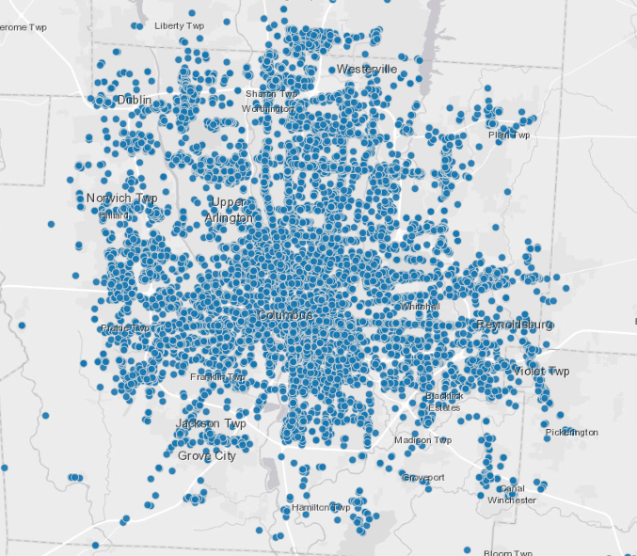
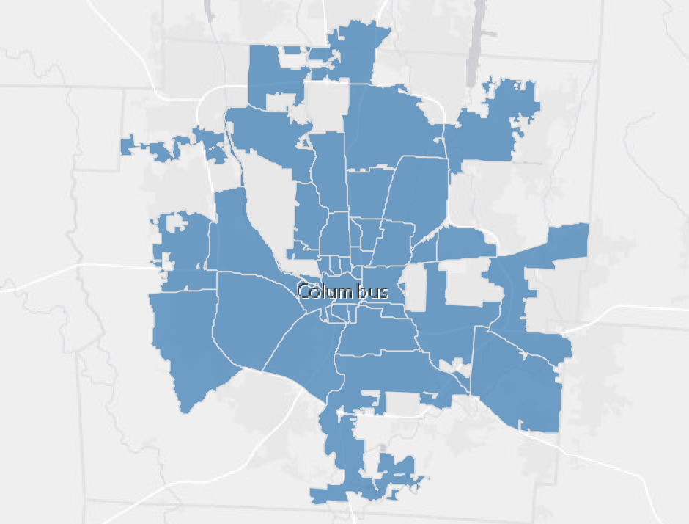
Extract
Columbus Points of Interest
Columbus Communities

Slide 8
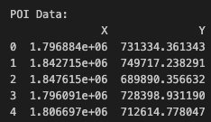
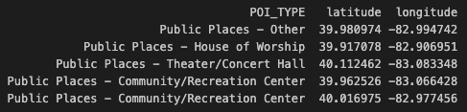
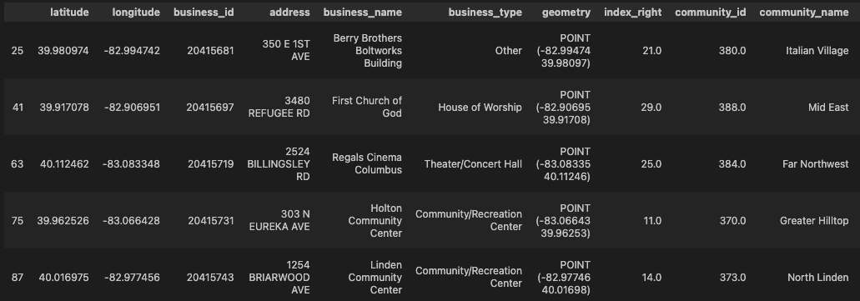
Transform
Notes:
Narrow Down data focus
Geocode
Align Lattitude/Longitude based on community shape
Save files for database creation

Slide 9
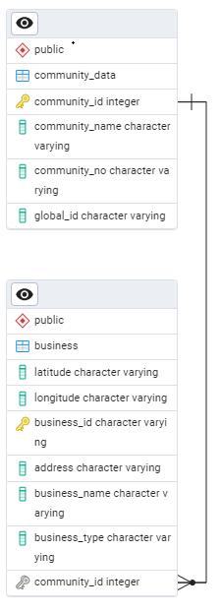
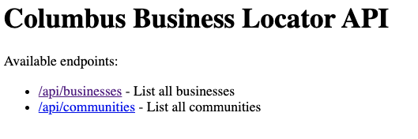

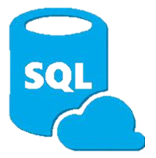
Load
Postgres Database
Allows transformed data to be stored and loaded into targeted systems

Slide 10

Future Expansions and Improvements
Map app using the geocoded data
Scaling for other cities and businesses
Add business reviews/ rating system
Support for updating data
Using Google maps API

