Slide 1
Personal Finance Forecasting Using Machine Learning
An interactive dashboard for expense prediction and income analysis
Jasmine Hix and Haylton Ilonga
OSU Data Analysis Bootcamp

Slide 2
AGENDA
Project analysis​
Model overview​
Tech Stack
Dashboard Insights
Future Recommendations

Slide 3
Project analysis

Slide 4
CURRENT ANALYSIS
Many individuals struggle to track and forecast their monthly expenses.​
Lack of visibility into spending trends can lead to poor budgeting and financial planning.
There is a need for a smarter way to analyze past transactions and forecast future spending.​

Slide 5
the solution
Use historical transaction data to group and analyze spending by category
Predict upcoming expenses using machine learning.​
Visualize income vs. spending with interactive graphs.
Help individuals:
Anticipate future spending
Adjust budgets proactively
Make informed financial decisions

Slide 6
Model analysis

Slide 7
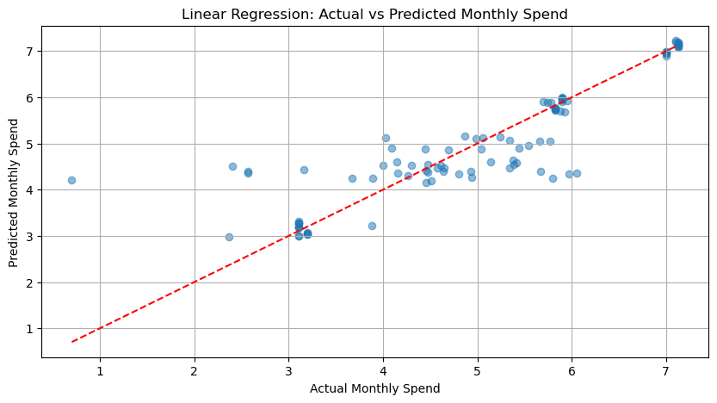
Linear regression with temporal & category features
Features
Month, Year
One-hot encoded categories
Lagged features (previous months spend)
Evaluation Metrics
MSE: 0.2660
R-Squared: 0.8323
RMSE (in $): $72.10

Slide 8
Tech stack

Slide 9
Technology, tools & libraries used
Languages & Frameworks
Python – Data processing, modeling, and visualization
Pandas/NumPy – Data manipulation and transformation
Machine Learning
Scikit-learn – Linear Regression, model evaluation
Lag Features & Temporal Engineering – Custom features for time-aware predictions
Visualization
Matplotlib – Static charts for model validation
Plotly – Interactive, web-embedded charts and graphs
Web Integration
HTML/CSS/JavaScript – Embedded dashboard design
Plotly.js CDN – Allows for interactivity to HTML pages
Data Source
Excel – Imported historical transactions

Slide 10
Dashboard insights
Income trends from 2018-2019 show consistent bi-monthly pay​
Forecasted expenses in Oct-Dec 2019 highlight:
Highest spend in rent and utilities
Variability in shopping and dining
Actual vs. Predicted expense trends allow for quick validation.

Slide 11
Future recommendations

Slide 12
Next steps & enhancements
Incorporate features such as:
Holidays
Account Balance
​
Integrate classification model to flag overspending risks and help with budgeting limits for each category.
Support for real-time data from banking transaction feeds.
Expand model to include savings and investment forecasting

Slide 13
Thank You

