Slide 1
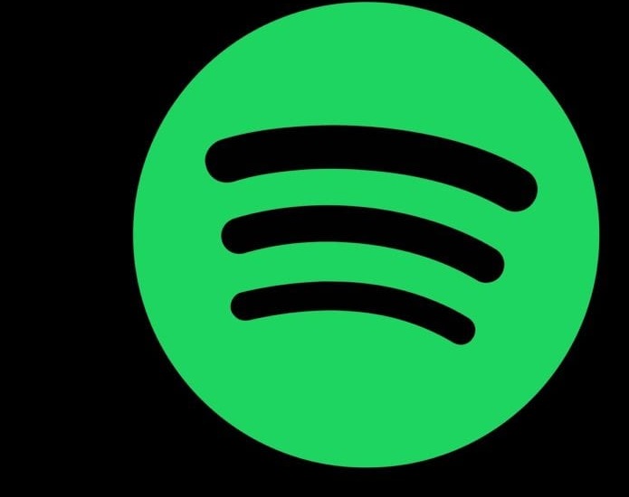
Spotify
A statistical analysis of popular songs and artists
This Photo by Unknown Author is licensed under CC BY-NC-ND

Slide 2
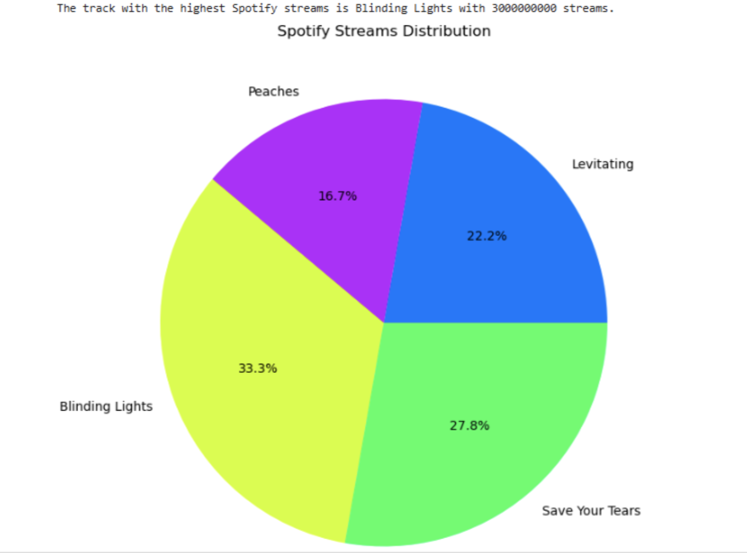
What tracks have the highest Spotify Streams?

Slide 3
Summary
The question "Which track has the highest Spotify streams?" is asking to identify the most-streamed song on the Spotify platform. Spotify, a popular music streaming service, tracks how many times each song is played by users worldwide. The track with the highest number of streams is considered the most popular or widely listened-to song on the platform. As of the latest data available (January 2025), the song "Blinding Lights" by The Weeknd holds the record for the most Spotify streams. It has surpassed previous records due to its massive popularity, long chart performance, and wide-reaching appeal across various demographics to summarize :
The question seeks to find the song with the most streams on Spotify. "Blinding Lights" by The Weeknd is currently the record holder for this title, based on available data. The ranking is based on total stream counts and is continuously updated as new streams are added.

Slide 4
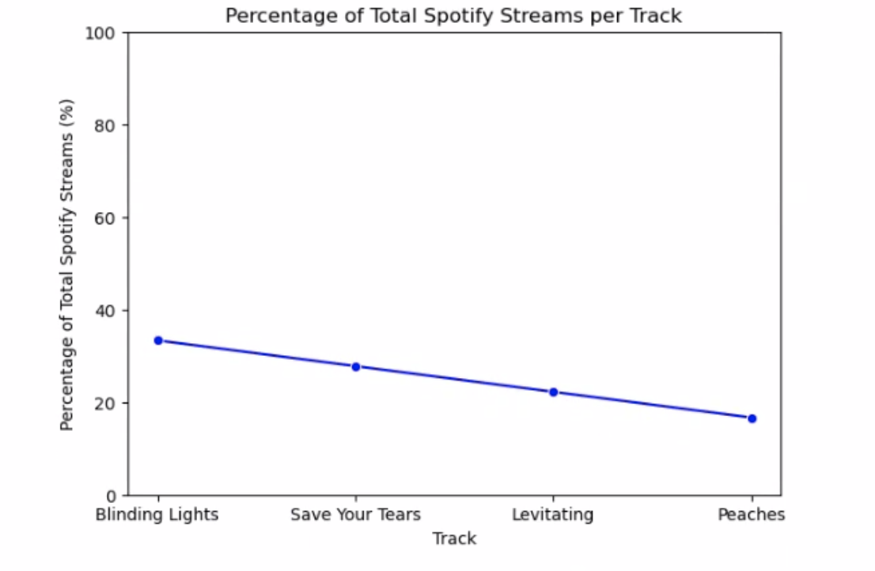
What is the percentage of Total Spotify Streams per Track?

Slide 5
Summary
The question "What is the percentage of total Spotify streams the highest streamed track has?" is asking for the proportion of the total streams on Spotify that the most-streamed song represents. In other words, it’s asking: How much of the total streams on Spotify does the song with the highest streams account for? This would be expressed as a percentage, showing the share of Spotify’s total streaming activity that comes from this one track.
Here’s how to break it down:1 . Total Spotify Streams: This refers to the sum of all plays across every song on Spotify. 2 . Highest-Streamed Track: This is the song with the highest number of streams, such as "Blinding Lights" by The Weeknd (as of 2025). 3 . Percentage Calculation: The percentage is calculated by dividing the number of streams of the highest-streamed track by the total number of s streams on Spotify, then multiplying by 100.SUMMARYThe question "What is the percentage of total Spotify streams the highest streamed track has?" is asking for the proportion of the total streams on Spotify that the most-streamed song represents. In other words, it’s asking: How much of the total streams on Spotify does the song with the highest streams account for? This would be expressed as a percentage, showing the share of Spotify’s total streaming activity that comes from this one track.

Slide 6
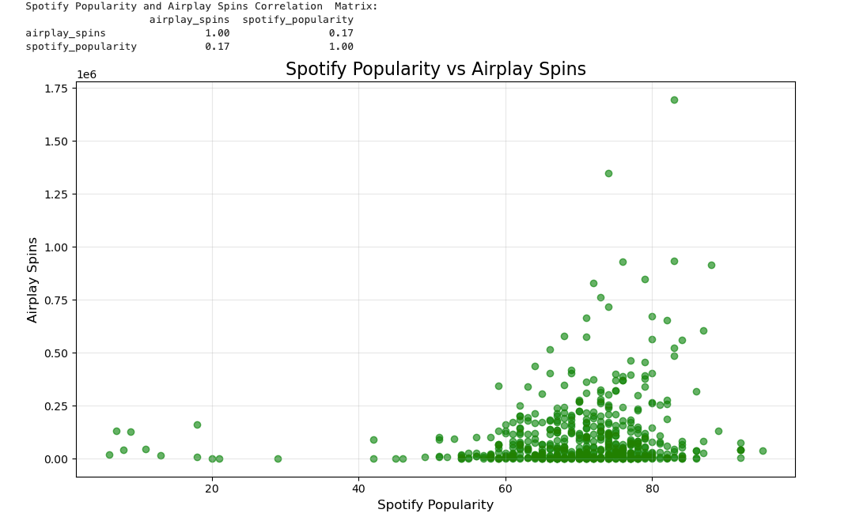
Does Spotify Popularity influence Airplay spins?

Slide 7
Summary
The chart shows a positive but weak correlation between Spotify Popularity and Airplay spins. This is verified by the calculation of the correlation coefficient of 0.17, showing that there is no strong correlation between the two data points.
Key findings:
Spotify Popularity and Airplay spins showed a positive but weak correlation as verified with the calculation of the correlation coefficient.
Visual Insights
Spotify Popularity and Airplay spins:
A positive relationship is evident visually as the data looks to align with each other.

Slide 8
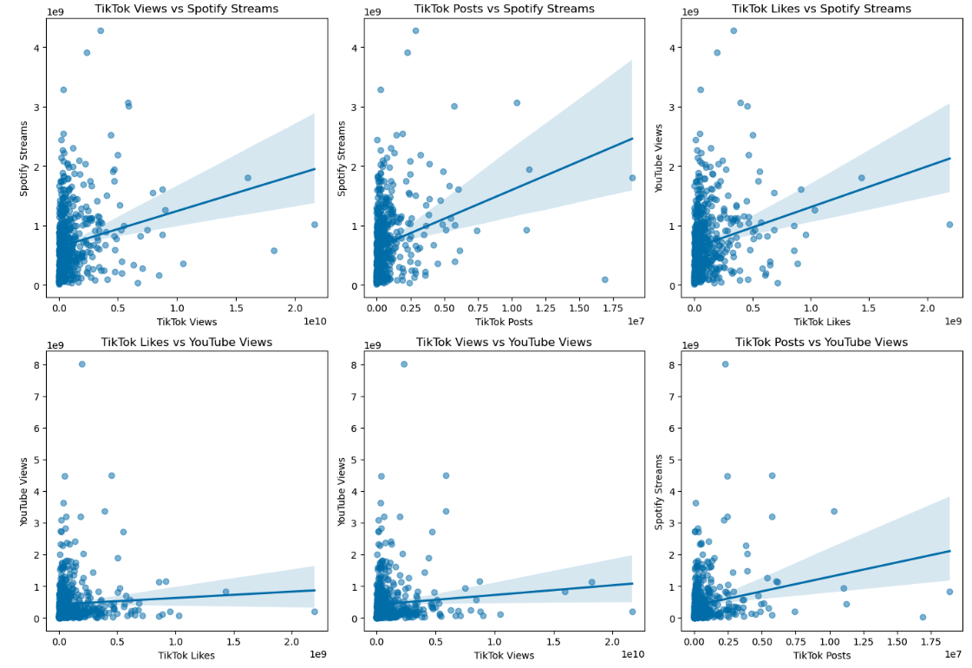
How Does a songs Virality in Tik Tok Correlate with other platforms?

Slide 9
Correlation Matrix

Slide 10
Summary
Spotify Streams showed a strong positive correlations with YouTube Views.
Visual Insights
TikTok Views vs Spotify Streams:
A positive relationship is evident. Higher TikTok Views tend to align with increased Spotify Streams.
The scatter plot indicates a potential linear trend.
TikTok Posts vs Spotify Streams:
The number of TikTok Posts appears positively associated with Spotify Streams.
Outliers might represent songs that went viral with fewer posts but gained traction in Spotify streams.
TikTok Likes vs YouTube Views:
Likes on TikTok correlate positively with YouTube Views, suggesting audience engagement on TikTok may spill over to YouTube.
The scatter plot demonstrates a consistent upward trend.
TikTok Views vs YouTube Views:
A positive correlation is observed, indicating that higher TikTok Views may contribute to higher YouTube Views.

Slide 11
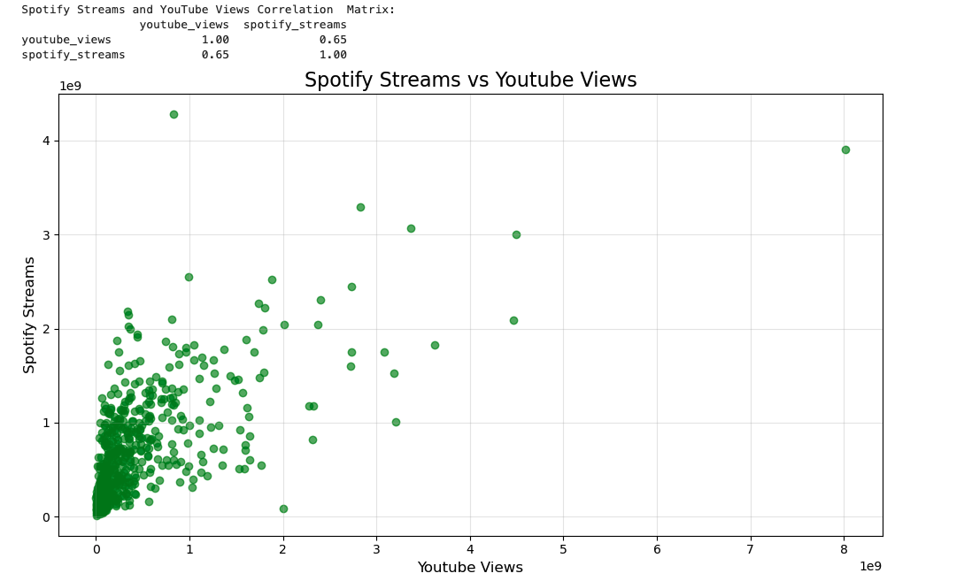
What does the relationship between Spotify Popularity and YouTube Views look like?

Slide 12
Summary
The chart shows a strong correlation between Spotify streams and YouTube views. This is verified by the calculation of the correlation coefficient of 0.65
Key findings:
Spotify Streams showed a strong positive correlations with YouTube Views as verified with the calculation of the correlation coefficient.
Visual Insights:
A positive relationship is evident visually as the Spotify Streaming data looks to align with increased YouTube Views.

