Slide 1
HTML

Slide 2
About HTML
Stands for HyperText Markup Language
Is a language for describing web pages
Current Standard version HTML 5
World Wide Web Consortium (W3C)
WHATWG (Web Hypertext Application Technology Working Group)

Slide 3
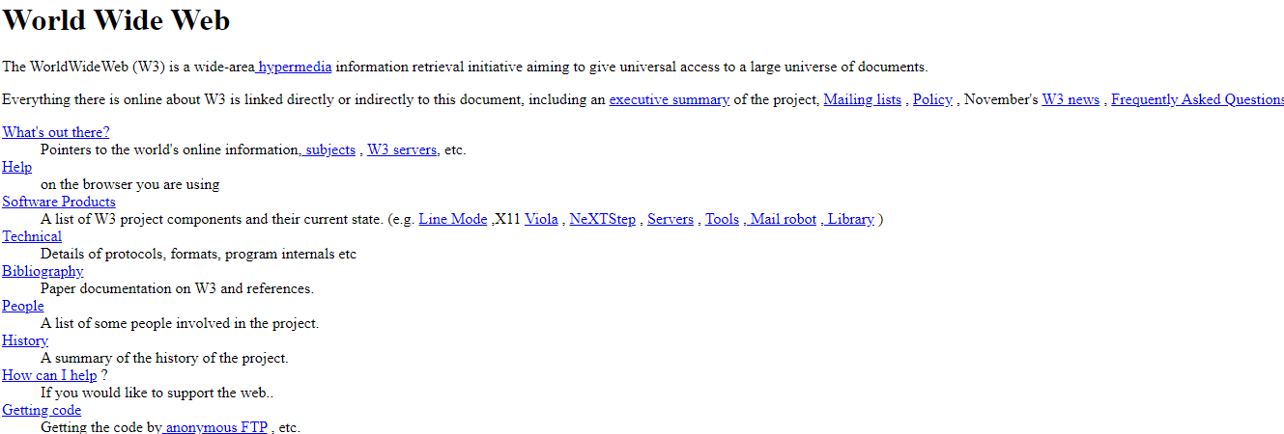
First HTML page

Slide 4
Evolution of HTML
Year | Version
1989 | Tim Berners-Lee invented www
1991 | Tim Berners-Lee invented HTML
1993 | Dave Raggett drafted HTML+
1995 | HTML Working Group defined HTML 2.0
1997 | W3C Recommendation: HTML 3.2
1999 | W3C Recommendation: HTML 4.01
2000 | W3C Recommendation: XHTML 1.0
2008 | WHATWG HTML5 First Public Draft
2012 | WHATWG HTML5 Living Standard
2014 | W3C Recommendation: HTML5
2016 | W3C Candidate Recommendation: HTML 5.1
2017 | W3C Recommendation: HTML5.1 2nd Edition
2017 | W3C Recommendation: HTML5.2

Slide 5
HTML DOCTYPE
HTML 5
<!DOCTYPE html>
HTML 4.01 Strict
<!DOCTYPE HTML PUBLIC "-//W3C//DTD HTML 4.01//EN" "http://www.w3.org/TR/html4/strict.dtd">
HTML 4.01 Transitional
<!DOCTYPE HTML PUBLIC "-//W3C//DTD HTML 4.01 Transitional//EN" "http://www.w3.org/TR/html4/loose.dtd">
HTML 4.01 Frameset
<!DOCTYPE HTML PUBLIC "-//W3C//DTD HTML 4.01 Frameset//EN" "http://www.w3.org/TR/html4/frameset.dtd">

Slide 6
Browser Mode
Quirks mode refers to a technique used by some web browsers for the sake of maintaining backward compatibility with web pages designed for old web browsers
Standards mode strictly complying with W3C and Internet Engineering Task Force (IETF) standards

Slide 7
Anatomy of HTML Elements
HTML elements are written with a start tag, with an end tag, with the content in between:
<tagname>content</tagname>
Eg. <h1>Manipal University</h1>
Container Tags come in pairs (paired tags)
Eg. <P>This is in Center</P>
Empty Tags do not
Eg. <BR/>, <HR/> (Break and Horizontal line)
HTML Tag types

Slide 8
HTML Element attributes
Attributes provide additional information about HTML elements
ATTRIBUTE="value", the value should really be in quotes.
For example, <p style=“color:green;”>
Tags can also have default attributes.
Some browsers don't support the some tags and some attributes.

Slide 9
Basic Document Structure
The bare minimum HTML document
HTML version declaration
<html> – <meta> – <head> – <title> – <body>
Sequential (top to bottom) rendering

Slide 10
Semantic html element
Element that implies some meaning to the content
Human and/or machine can understand meaning of content surrounded by a semantic element better
May help search engine ranking, i.e., SEO
Semantic elements allow for a more meaningful expression of the structure of our HTML page.

Slide 11
Content Models
A description of the element's expected contents
Block-Level Elements
Inline Elements
Render to begin on a new line (by default)
May contain inline or other block-level elements
Roughly Flow Content (HTML5 category)
Render on the same line (by default)
May only contain other inline elements
Roughly Phrasing Content (HTML5 category)
W3C content models: https://www.w3.org/TR/2011/WD-html5-20110525/content-models.html

Slide 12
HTML validator
W3C Markup Validation Service: https://validator.w3.org/
HTML/CSS component support: https://caniuse.com/

Slide 13
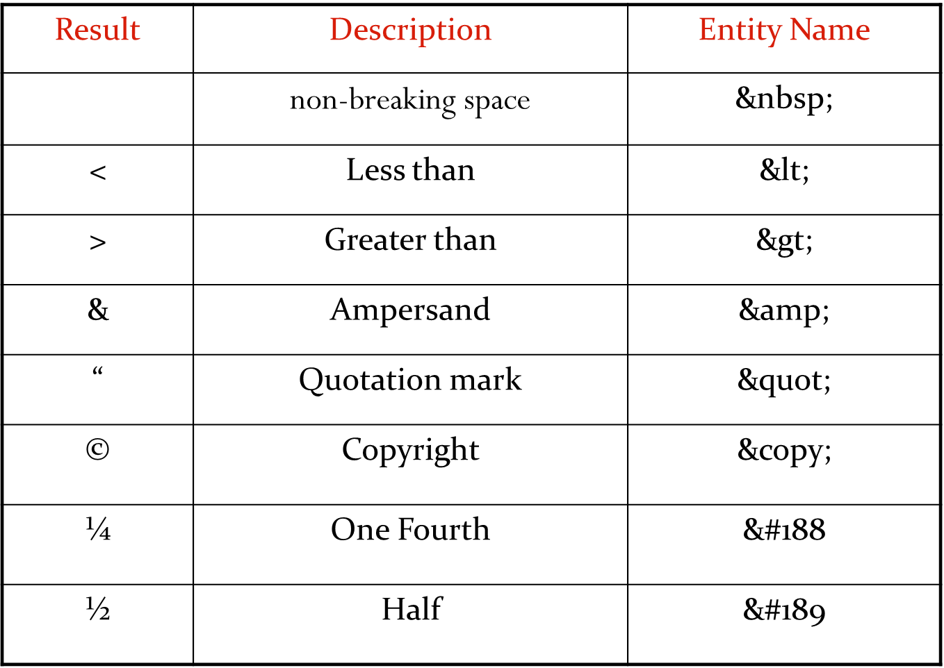
HTML Character Entity References

Slide 14
HTML Character Entity References
Help avoid rendering issues
Safeguard against more limited character encoding
Provide characters not available on a keyboard

Slide 15
List elements
Lists provide a natural and commonly used grouping of content
Very often, lists are used for structuring navigation portions of the web page
Lists are segregated into three types, namely :
Ordered lists : lists are numbered according to the standard chosen
Unordered lists : lists are arranged in bulleted sequence
Definition lists : list consists of a term followed by its definition

Slide 16
Unordered Lists
They are delimited by the <UL> and </UL> tags. Each item in the list is delimited by the <LI> and </LI> tags.
The syntax of the <UL> tag is:
<UL TYPE=“ ”> <LI> </LI> </UL>
Attributes
TYPE= “DISC”, “SQUARE” or “CIRCLE”.
disc (solid bullet), square (solid block) or a circle (hollow bullet)
The default appearance for list is disc
</LI> is optional

Slide 17
Ordered Lists
They are used when the items in the list have a natural order.
To make an ordered list, simply change the <UL> tag to <OL>.
Attributes
TYPE= (1 | A | a | I | i ) – changes the style of the list
1 – Arabic numbers
A – Uppercase alphanumeric
a – lowercase alphanumeric
I - Uppercase roman numerals
i – lowercase roman numerals
Start = value – indicates where the list numbering should begin

Slide 18
Creating Links
A link moves us from the current page to a destination that is specified in the HTML page or resource
The Anchor tag (<a></a>) is used to create links between different objects like HTML pages, files, web sites etc.
Attribute
HREF -- defines the destination of the link.
TARGET -- is used to specify where to open the linked document
NAME -- attribute is used to create a bookmark inside an HTML document
Internal linking to other pages in the site
External linking to other web sites
Linking to sections of a document

Slide 19
Images
Images can enhance your site
Remember to specify width and height attributes whenever possible
Specify the alternate attribute

Slide 20
Path Convention
Absolute Vs. Relative Pathnames
An absolute pathname includes the full pathname of the file.
This means that if you move your files or change your directory, you have to edit every IMG tag in your document.
Example
<IMG SRC=“D:\htmleg\Images\picture.jpg”>
<IMG SRC=“http://xyz.com/Images/picture.jpg”>

Slide 21
Path Convention
A relative pathname indicates the pathname of the image file relative to the pathname of the file. This is the recommended naming convention.
Example : <IMG SRC=“picture.jpg”>
Example : <IMG SRC=“images/picture.jpg”>
If your image file is stored one directory level up from your HTML file, use two dots(..) in the pathname to move up a directory level.
Example : <IMG SRC=“../picture.jpg”>

Slide 22
Table tags
Tag | Description
<table> | Defines a table
<th> | Defines a header cell in a table
<tr> | Defines a row in a table
<td> | Defines a cell in a table
<caption> | Defines a table caption
<colgroup> | Specifies a group of one or more columns in a table for formatting
<col> | Specifies column properties for each column within a <colgroup> element
<thead> | Groups the header content in a table
<tbody> | Groups the body content in a table
<tfoot> | Groups the footer content in a table

Slide 23
HTML Form
Web form is container with labels and the form fields
Example forms used in websites and applications
Login/registration
Purchase order
Ticket reservation
Room booking
Payment checkout
Newsletter/subscription
Consultation/audit request
Donation
Survey
Custom form.

Slide 24
HTML Form design
Usability issues
- Group Similar categories
Easy access to the form elements
Design issues
Text emphases
Use headings
Input specifiers
Messages
Tooltips
Help messages
Validation messages
- Visual separate groups
- Use line breaks and spacing appropriately
The information collected from the form can then be used for processing

Slide 25
HTML Form Designing best practices
Single-column layout
Read from top to bottom which creates a simple interaction with a form
Avoid zigzag field placements
Path to completion and align
Left-align is better than center-align as the best way to reduce the path to completion time
Left-align eyes don’t need to jump across the page

Slide 26
HTML Form Designing best practices..
Use wizard for long forms and progress bar
Group related information
Mention optional and required field/s
Use autocomplete
Choose the input format wisely
Call to action
Use inline form field validation
Use styles effectively

Slide 27
Form tag
The key attributes within the form tag are
- ACTION – indicates the program on the HTTP server that will process the output from the form
- METHOD – tells the browser how to send the data to the server with the POST and the GET method.
Ex:
<FORM METHOD = “POST” ACTION = “http://www.XYZ.reg.php”>
Input elements…..
</FORM>

Slide 28
Form methods
GET: Form data is sent in URL of GET request
POST: Form data is sent in HTTP message body of POST request
NOTE:
GET request can be cached
GET request remains in browser history and or server log
GET request can be bookmarked
GET request cannot be used to send sensitive data
GET request have length restriction
application/x-www-form-urlencoded encoding type is used in GET

Slide 29
Form methods..
POST request cannot be cached
POST parameters are not stored in browser history and or server log
POST request cannot be bookmarked
POST request can be used to send sensitive data
POST request has no length restriction
application/x-www-form-urlencoded or multipart/form-data encoding type is used in GET

Slide 30
Label
<label for="male">Male</label>
<input type="radio" name="gender" id="male" value="male"><br>
<label for="female">Female</label>
<input type="radio" name="gender" id="female" value="female"><br>
<label for="other">Other</label>
<input type="radio" name="gender" id="other" value="other">
It provides a usability improvement for mouse users
If the user clicks on the text within the <label> element, it toggles the control.

Slide 31
INPUT tag
The input element is used to select user information.
An input element can vary in many ways, depending on the type attribute.
An input element can be of type text field, checkbox, password, radio button, submit button, and more.
The attributes for the INPUT tag are
type = (text |password|checkbox|radio|file|hidden|button| image|submit|reset)
name: is used to specify a name
value:“text” is used along with radio buttons and checkboxes
size:“n” – indicates visible size.
maxlength : “n” in characters
checked: specifies element should be pre-selected when loaded

Slide 32
Examples
Example for text box, radio button & check box
<FORM>
First Name : <input type="text" name="fname" size="20" maxlength="30“/>
<input type="radio" name=“gender" value="male“ checked /> Male<br > <input type="radio" name=“gender" value="female" /> Female
<input type="checkbox" name="vehicle" value="Bike" /> I have a bike<br /> <input type="checkbox" name="vehicle" value="Car" /> I have a car
</FORM>

Slide 33
Password & Hidden fields
Password fields work like text fields but display “*” in browser
<input type = “password” name=“newpass” size=“10” maxlength= “10” />
Hidden fields are not visible in the browser but can be used to pass information to programs receiving input.
<input type=“hidden” name = “success” value = “http://www.xmission.com/...”
Better to place them on the top after FORM tag

Slide 34
To insert a button
<input type="submit" /> defines a submit button.
A submit button is used to send form data to a server.
The data is sent to the page specified in the form's action attribute.
The file defined in the action attribute usually does something with the received input:
<form name="input" action="html_form_action.asp" method="get"> Username: <input type="text" name="user" /> <input type="submit" value="Submit" /> </form>
To define an ordinary button
<input type="button" value="Hello world!">
To define an image instead of submit button
<input type=“image” src=“submit.gif” alt=“Submit” />

Slide 35
File Field & Text Area
File fields allow visitors to upload files like pictures, scanned documents, spreadsheets etc.
<input type="file" name="pic" />
Text areas are places within a form for extensive text input. <textarea>
Attributes include
name, rows, cols
Ex:
<textarea name=“comments” cols =“30” rows = “5”> pl type comments if any
</textarea>

Slide 36
Select Fields
<select>: Sets an area in a form for a select field that can look like a drop down list or a larger select field
Attributes include
name – used for form processing
size – sets visible size for the select field
multiple – accepts more than one selection
selected – indicates default selection
Elements to include
Option – used to specify list values or items
Optgroup- is used to group related options in list

Slide 37
Example for select
<form>
<select name="referal" multiple>
<option value ="print" selected>print ads </option>
<option value ="visit">instore visits </option>
<option value ="rec">recommendation </option>
</select>
<input type="submit" value="submit">
<input type="reset" value="reset“>
</form>

Slide 38
Example on optgroup
<select name="c">
<optgroup label="8.01 Physics I: Classical Mechanics">
<option value="8.01.1">Lecture 01: Powers of Ten
<option value="8.01.2">Lecture 02: 1D Kinematics
<option value="8.01.3">Lecture 03: Vectors
<optgroup label="8.02 Electricity and Magnestism">
<option value="8.02.1">Lecture 01: What holds our world together?
<option value="8.02.2">Lecture 02: Electric Field
<option value="8.02.3">Lecture 03: Electric Flux
<optgroup label="8.03 Physics III: Vibrations and Waves">
<option value="8.03.1">Lecture 01: Periodic Phenomenon
<option value="8.03.2">Lecture 02: Beats
<option value="8.03.3">Lecture 03: Forced Oscillations with Damping
</select>

Slide 39
Example for field set
<html>
<body>
<form>
<fieldset>
<legend>Health information:</legend>
Height <input type="text" size="3">
Weight <input type="text" size="3">
</fieldset>
<form>
</body>
</html>

Slide 40
INPUT element new types
color
date
datetime-local
time
email
url
month
week
number
range

Slide 41
INPUT element new attributes
autocomplete
autofocus
list
min
max
disabled
readonly
multiple
pattern
placeholder
required
step

Slide 42
Example on Datalist
<input list=“items"> <datalist id=“items"> <option value=“Item1"> <option value=“Item2"> <option value=“Item3"> <option value=“Item4"> <option value=“Item5">
</datalist> </form>

Slide 43
Summary
Understood semantics of the element and its attribute set
Compared the block-level and inline-level content elements
Discussed the importance of UX best practices when designing the form
Advantages of using relative path conventions

