Slide 2
Simulation guided engineering of Signal peptides in Aspergillus with ConStrain

Slide 3
Why Signal peptides in Aspergillus?
Underexplored in the literature
Industrially relevant
The combinatorial space for signal peptides is massive and using IT and ConStrain would be beneficial.

Slide 4
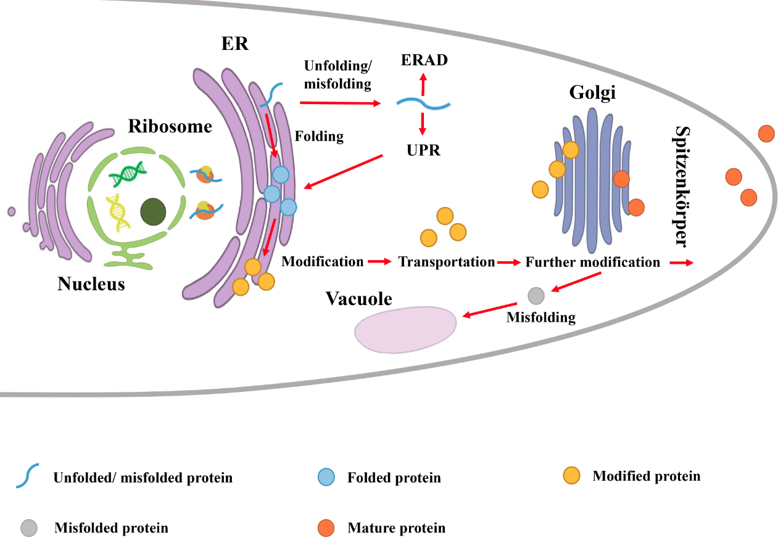
Signal peptides in Aspergillus

Slide 5
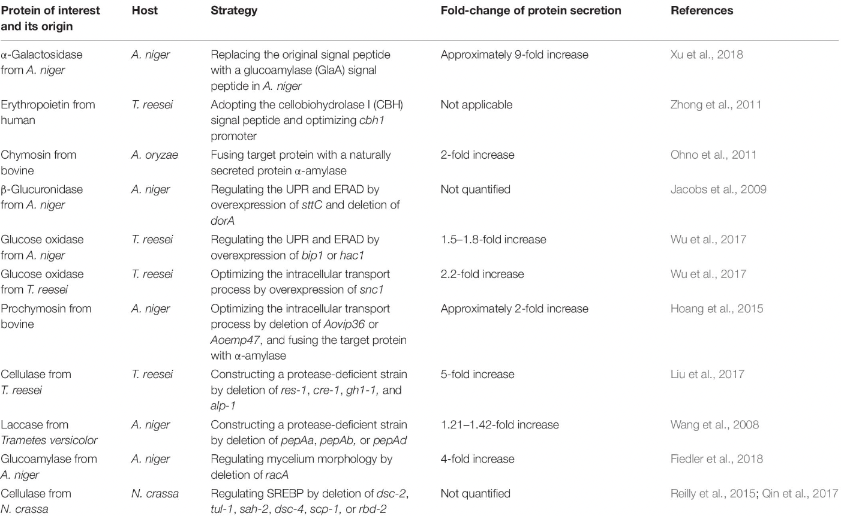
Strategies for enhanced protein Secretion
https://doi.org/10.3389/fbioe.2020.00293

Slide 6
Approach: Simulation guided engineering
Retrieve all sequences of Aspergillus oryzae
Learn about distribution of AA in signal peptides (regions that are fixed, non-fixed)
Use ML models to guide new designs in the sequence space (19^20 how can we limit?)
Rank top designs and decide on a library (Pooled library approach or directed?)
DESIGN experiments for integration of signal peptides with GFP - CONSTRAIN
BUILD the constructs - CONSTRAIN
TEST the strains (with platereader) – make script to automate data analysis
LEARN from the results and update model
Repeat…
Special project (computational)
Master thesis (experimental)

Slide 7
Research questions - Computational DESIGN
How do we limit the combinatorial explosion of signal peptide combinations?
Chemical properties: If we see patterns like the following we can limit the combinatorial explosion:
Nonpolar amino acids
Polar, uncharged amino acids
Acidic amino acids
Basic amino acids
Finding fixed positions in secreted signal peptides
Make position weight matrix
Use deeploc to predict signal peptide location
Can we through statistical models/analysis learn more about optimal length of signal peptides?
Investigate length and incorporate statistics/statistical models

Slide 8
Research questions - Computational DESIGN
Can we decipher the rules of signal peptides from comparing different kinds of signal peptides i.e. secretion vs. to internal organelles.
Use deeploc
How does signal peptides differ between aspergillus species?
Can we use that to make a platform signal peptide (check diversify)

Slide 9
Project plan - : Simulation-guided engineering of Signal peptides in Aspergillus species
Special-project - DRYLAB- JANUARY - 3 weeks:
Supervisors: Lucas, Marti and (Marjan)
GOAL: Simulation-guided design of Signal peptides in Aspergillus species - In silico analysis of Signal peptides + data gathering, build notebooks with ConStrain for experimental design. - Learnings: Use of ML for simulation-guided engineering of biological systems. Biology of Signal peptides. Version control (git). Organize Python code so it's maintainable and shareable.
FEBRUARY- JUNE - MASTER THESIS - WETLAB:
Supervisors: Marti Lucas and Marjan and Uffe
Goal: Through several rounds of the DBTL cycle - use the ML predictions to guide the construction of signal peptides in the Lab. Marti will be closer to this part of the project. We will add more to this part later.
Learning: both drylab and wetlab

Slide 10
Resources
Watch the Richard fox videos https://www.inscripta.com/resources
Richard fox articles
GitHub repo made (cookiecutter, vid)
AutoML https://docs.h2o.ai/h2o/latest-stable/h2o-docs/automl.html

