Slide 1
OBJECT ORIENTED PROGRAMMING · COURSE PROJECT
Company
Internship Management System
Student
Internship
built with Object-Oriented Design in Java
Hiya Shah (R055) · Manyata Rao (R049)
Admin
Application
SVKM’s NMIMS MPSTME, Mumbai
Source code and UML: github.com/hiyashah18/InternshipManagementSystemOOP
Notes:
Welcome. In this project we built a complete internship management system in Java. Companies post internships, students search and apply, companies accept or reject applicants, and an administrator oversees all records. It is a web application, but it needs no libraries, no framework and no database: only the JDK. The point of the project is the object-oriented design underneath, so we will show the problem, the design, the diagrams, a short walkthrough of the screens, and how we checked that it works.

Slide 2
One shared record for every internship
THE PROBLEM
Internship placement is often run through e-mail threads, spreadsheets and notice boards. A student misses an opening because it was posted in a different chat group. A company loses track of who was shortlisted. A coordinator cannot say how many students applied.
The same student can apply to the same posting twice, or to one that closed last week, and nobody finds out. One shared record that everyone reads and updates removes most of this.
3 user roles
student, company representative and administrator
5 internships
with 6 users, 2 companies and 1 application in the sample data
Our question:
Can one plain-Java system give students, companies and the administrator the same trustworthy record?
Source: report, Section I and Table III · the sample data is fictional
Notes:
Start with the everyday picture. Today a lot of internship placement runs through e-mail, spreadsheets and notice boards. Students cannot see every opening, companies lose track of applicants, and nobody has a single record of who applied where. The same student can apply twice, or apply to something that closed last week. Our sample data has three user roles and five internships, which is enough to show every screen. Our question is whether one plain-Java system can give all three roles the same trustworthy record.

Slide 3
One application, six steps
THE SOLUTION
Our way
1
Register
2
Post
3
Search
Student or company creates an account
A company posts an internship
A student filters by keyword and location
4
Apply
5
Review
6
Track
One application per posting; closed ones are blocked
The owning company accepts or rejects
The student sees PENDING, ACCEPTED or REJECTED
The obvious way
Openings, applications and decisions are scattered over many channels. Nobody sees all of it.
What it looks like
Aarav Sharma (B.Tech Computer Engineering) applies to the Java Developer Intern at TechNova Solutions, Mumbai: ₹12,000 per month for 3 months. The application starts as PENDING, and TechNova’s representative can accept or reject it.
Source: sample data (report Table III) · see the screens on slide 8
Notes:
Think of a placement coordinator’s desk. The obvious way, on the left, is many channels that nobody can see in full. Our way, on the right, is six steps that the system handles. A user registers, a company posts an internship, a student searches by keyword and location, applies, the owning company reviews the application, and the student tracks the status. The example at the bottom is real data from our sample set: Aarav applies to the Java Developer Intern at TechNova, and the application starts as pending.

Slide 4
Six packages, one front door
THE DESIGN
web
One front door
WebServer, Html: routing, session cookie, role check, page templates
WebServer checks the role before every page. The services never see HTTP.
service
Rules live in the service
UserService · CompanyService · InternshipService · ApplicationService, behind the interfaces Manageable<T>, Searchable<T> and Applicable
Duplicate applications and ownership are checked in the service, not in the page.
model
util
exception
main
Data stays separate
8 files · 345 lines
5 files · 181 lines
7 files · 69 lines
1 file · 48 lines
Entities know nothing about files. DataStore<T> saves four .dat files.
User and 3 subclasses, Company, Internship, Application, ApplicationStatus
DataStore<T>, Validator, PasswordUtil, IdGenerator, SampleData
A base error class and 6 specific errors, all checked
Main loads the data, seeds the samples and starts the server
Plain Java
30 files, 1,860 lines, no library, framework or database.
Source: report, Section IV-A and Table I · lines of Java include comments
Notes:
This is the shape of the program. At the top is the web package. WebServer receives every request, reads the session cookie, checks that the user has the role the page needs, and then calls the services. The four services keep the records in memory and save them through a generic DataStore. Underneath are the model classes, the utilities and the exception classes, and Main wires everything together. The services never see HTTP, which is why we could test and benchmark them directly. In total it is 30 files and 1,860 lines of plain Java.

Slide 5
Eleven ideas, each with a job
THE OOP TOOLKIT
Classes & objects
Encapsulation
Inheritance
Polymorphism
A blueprint and the buildings made from it
A locked cabinet with a front desk
A family tree of users
Same question, each role answers its own way
Student, Company, Internship, Application, Administrator
Private fields and validating setters
Student, CompanyRepresentative and Administrator extend User
getMenuLinks() per role; overloaded search()
Abstraction
Interfaces
Collections
Exceptions
Ask for “a user”, not a role
A badge any service can wear
Shelves and lookup lists
A smoke alarm, not a crash
abstract User with three abstract methods
Manageable<T>, Searchable<T>, Applicable
LinkedHashMap, ArrayList, HashMap for sessions
InternshipSystemException and 6 specific errors, shown as a message
File handling
Generics
Packages
Validation
A save game
A box labelled for what is inside
Departments of one company
A bouncer at the door
DataStore writes four .dat files with object streams
DataStore<T>, Searchable<T>, Manageable<T>
model, exception, service, util, web, main
Validator checks input; Html.esc escapes output
Written in plain Java with no libraries · Source: report, Table II (requirements O1 to O11)
Notes:
These are the eleven concepts from the project brief and where each one lives in our code. Classes and objects: the model classes. Encapsulation: every field is private and the setters validate. Inheritance and abstraction: three user types extend an abstract User. Polymorphism: each role supplies its own menu, and the search method is overloaded. Interfaces and generics: three small generic interfaces and one generic DataStore. Collections, exceptions, file handling and packages are all used as described. The twelfth card is not in the brief, but validation and output escaping are what keep bad input from breaking the pages.

Slide 6
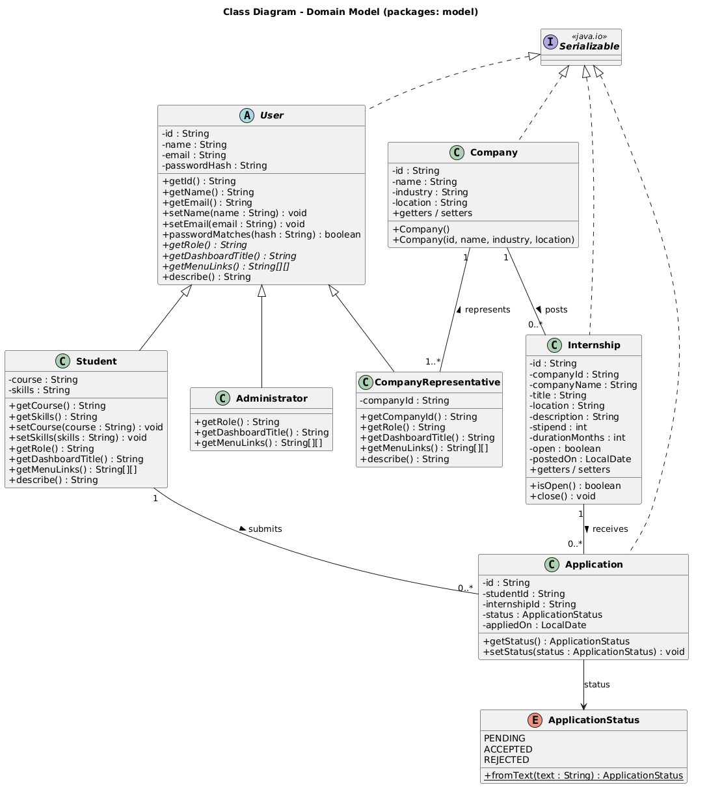
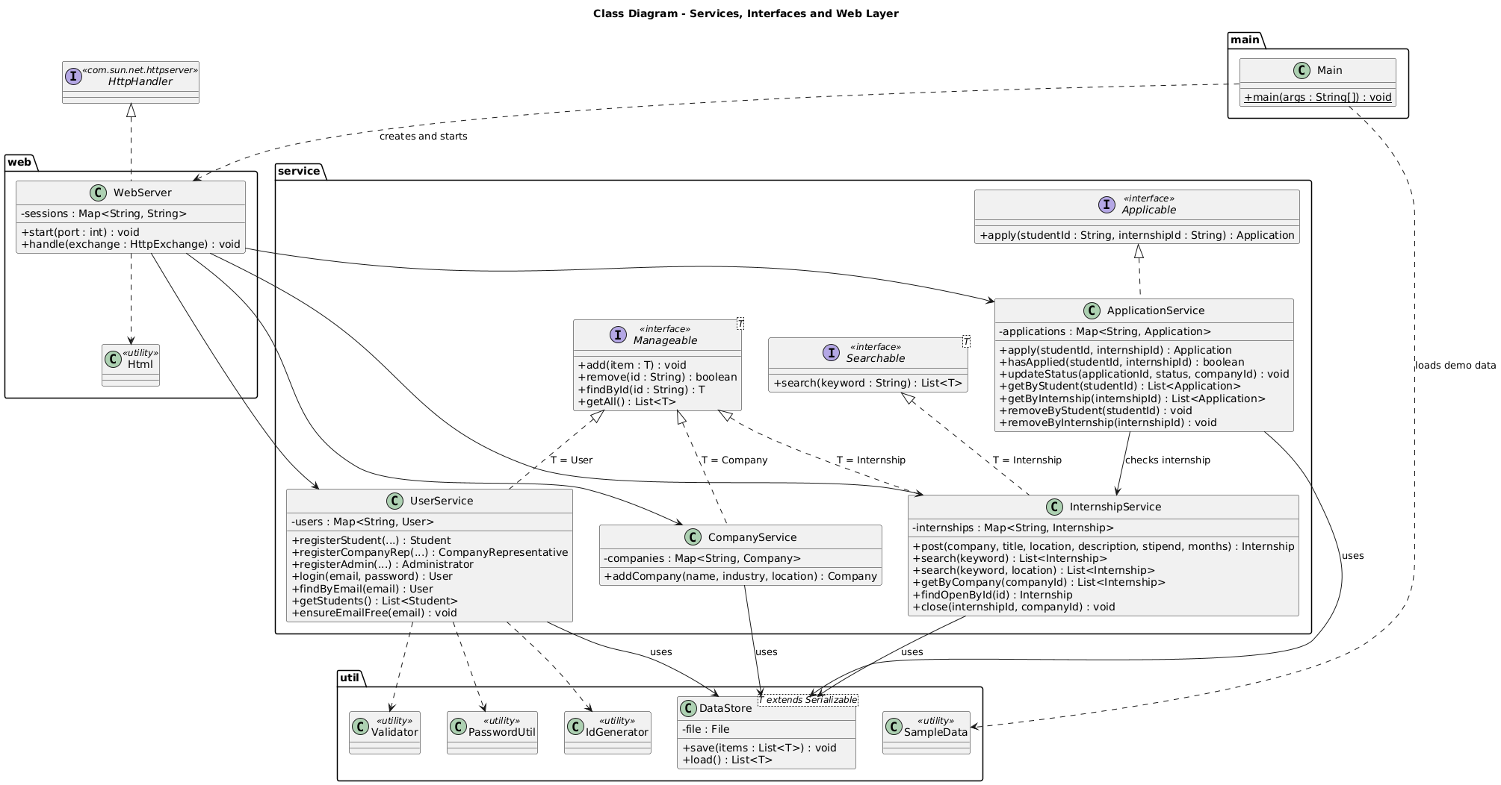
UML class diagrams
THE BLUEPRINT
Read it like this
Dashed arrows with hollow heads: a class implements an interface. Solid hollow heads: a subclass.
Look for
User in italics: abstract. Its three children override the menu and dashboard.
Also drawn
Exception hierarchy, use case, sequence and activity diagrams.
Domain model
Services, interfaces and the web layer
Source: report, Appendix C, Figs. 10 and 11 · full set of six diagrams in docs/img
Notes:
This is the blueprint. On the left is the domain model: the abstract User at the top with Student, CompanyRepresentative and Administrator below it, then Company, Internship and Application with the status enumeration. On the right are the services, the three interfaces and the web layer. Hollow arrowheads mean inheritance or implementation. The report also contains the exception hierarchy, a use case diagram, a sequence diagram of a student applying, and an activity diagram of the application process.

Slide 7
One User, three roles
POLYMORPHISM AT WORK
Who is using it?
What does a service offer?
abstract User: each role supplies its own menu
three small generic interfaces
STUDENT
Dashboard · Browse Internships · My Applications
Manageable<T>
add, remove, findById and getAll for users, companies and internships
Finds and applies
Add, find, list
COMPANY
Dashboard · My Internships · Post Internship
Searchable<T>
search(keyword): case-insensitive over open internships
Posts and decides
Keyword search
ADMIN
Dashboard · Manage Records
Applicable
apply(studentId, internshipId) with duplicate and closed checks
Sees everything
Apply
Why it matters: the web layer calls getMenuLinks() on a User reference and draws whatever comes back, so it has no per-role menu code. Search is also overloaded: search(keyword) and search(keyword, location).
Source: report, Sections IV-B and IV-C · the three roles are Student, CompanyRepresentative and Administrator
Notes:
This is polymorphism and abstraction put to work. User is abstract and declares three abstract methods: the role, the dashboard title and the menu links. Student, CompanyRepresentative and Administrator each answer them differently, so a student sees Browse Internships and My Applications, a company sees My Internships and Post Internship, and the administrator sees Manage Records. The web layer just asks the User for its menu. On the right are three small interfaces: Manageable, Searchable and Applicable, which separate what a service offers from how it stores data. The search method is overloaded, with one version taking a keyword and another taking a keyword and a location.

Slide 8
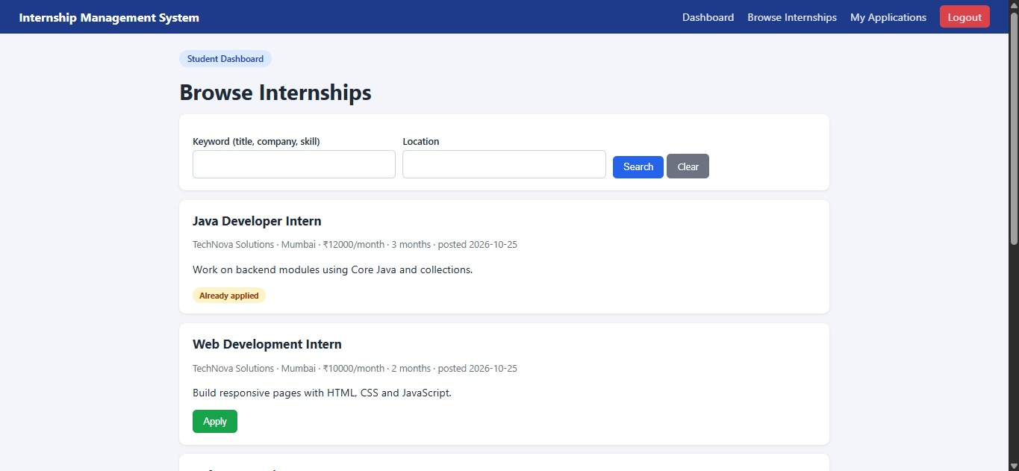
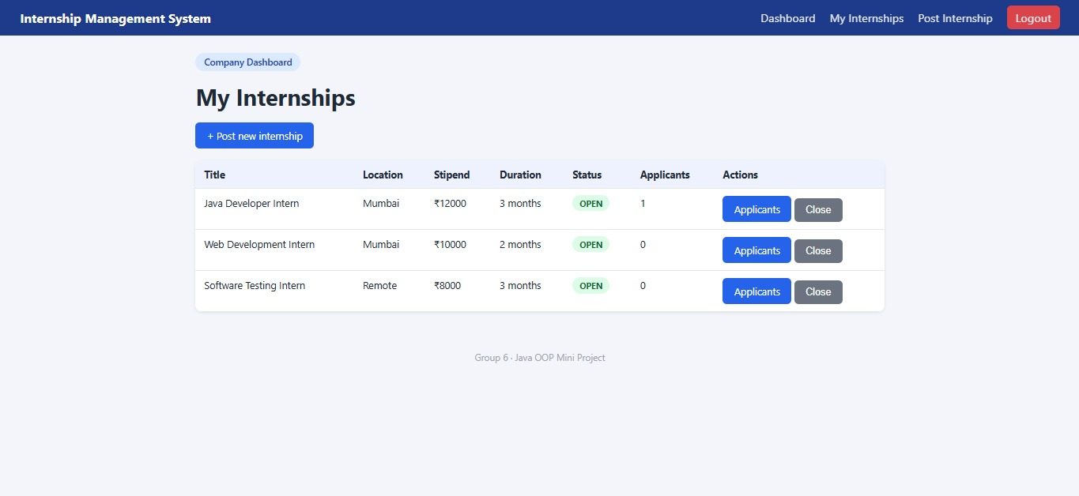
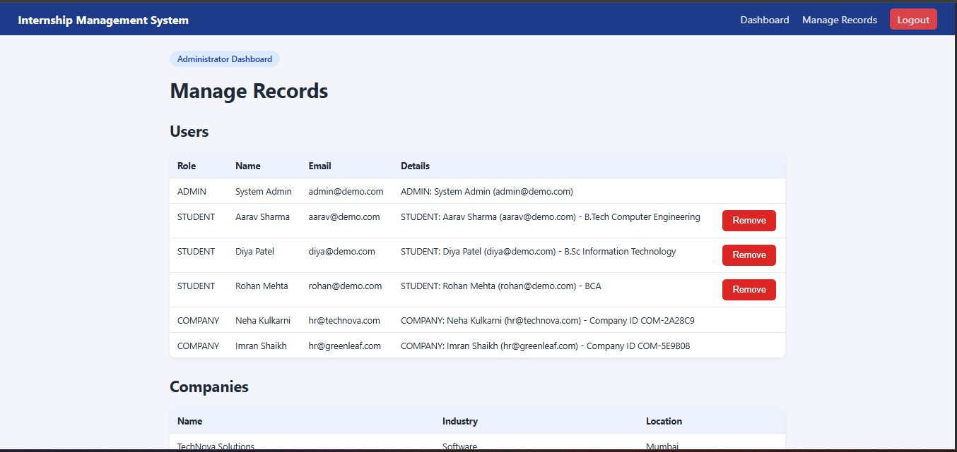
From login to ACCEPTED
LIVE DEMO · ABOUT 5 MINUTES
Student: browse, filter, apply
Company: applicants and Close
Admin: users, internships, Remove
1 · Apply
2 · Review
3 · Track
Log in as a student (aarav@demo.com / pass123), filter by keyword or location and press Apply. The status starts as PENDING.
Log in as hr@technova.com / pass123. My Internships shows applicant counts; open Applicants and press Accept or Reject.
The student’s My Applications page shows the new status. The admin (admin@demo.com / admin123) sees every record.
Captured from the running application with the sample data · run.bat or sh run.sh, then open http://localhost:8080 · screenshots in docs/screenshots
Notes:
Live demo, about five minutes. Start the application with run.bat or sh run.sh and open localhost:8080. Step one: log in as the demo student, search for java or filter by Pune, and apply to a posting. The status starts as pending, and a second click on the same posting is refused with a message. Step two: log out, log in as the TechNova representative, open My Internships, see the applicant count, open the applicants and accept one. Step three: log back in as the student and show that the status changed to accepted. Finally log in as the administrator to show the record lists and the Remove buttons. The demo accounts are on the login page.

Slide 9
How we know it works
THE PROOF
test cases
page speed
18 of 18
≈ 1 ms
documented test cases passed against a running instance
median response on the sample data (0.67 to 1.07 ms)
search at scale
code size
1.2 ms
1,860
median keyword search over 10,000 internships
lines of Java in 30 files, with no external library
Every case ran against a freshly started server, and one case after a restart. There is no JUnit suite yet; we list that as a limit.
Source: report, Table IV (test cases), Tables V and VI (measurements) · one run on one machine, so the figures show the trend
Notes:
Because we claim the system works, we checked it. The project documents 18 test cases, from a wrong password to a restart of the server. We ran every one against a freshly started instance, using a script that sends the same requests as the browser, and all 18 passed. One of them checks that the data survives a restart. On the sample data every page answers in about one millisecond, and a keyword search over ten thousand internships takes about 1.2 milliseconds. To be honest about the limits: there is no unit-test suite and no coverage figure yet, and the timings come from one run on one machine.

Slide 10
Search stays fast, saving is the bottleneck
WHAT WE LEARNED
1.4 → 15.9 ms
to post one internship, from 100 to 10,000 stored
0.06 → 1.18 ms
for a keyword search over the same range
The trade-off
Everything lives in memory, so reads are cheap. Every save rewrites the whole data file, so writes grow with the data. A database, or saving only the changed record, would fix it.
One run per size on one machine (2 vCPU cloud container, JDK 21). Synthetic internships, fixed random seed.
Source: report, Section VIII-C, Table VI and Fig. 9
Notes:
Now the payoff of the measurements. We called the services directly with 100, 1,000, 5,000 and 10,000 internships. Searching is a linear scan and stays cheap: about 0.06 milliseconds at 100 internships and 1.2 milliseconds at 10,000. Writing is the limit. Each save serialises the complete list again, so posting one internship takes 1.4 milliseconds at 100 records and almost 16 at 10,000. That is still unnoticeable for one user, and a placement season is likely to involve hundreds of postings, so the design is fine for its intended use. If it had to grow, the services only depend on DataStore through load and save, so a database could replace it. These are single runs on one machine, so they show the trend, not precise values.

Slide 11
CONCLUSIONS
A clean design that works, with honest limits
What we found
Limits
Next
Three roles share one abstract User and the design covers all eleven OOP concepts.
All 18 documented test cases pass; pages answer in about 1 ms.
Keyword search over 10,000 internships takes about 1.2 ms.
All data is fictional and there was no user study.
Passwords use unsalted SHA-256 and sessions never expire.
Every save rewrites the whole file, and there is no JUnit suite yet.
Add JUnit tests and a coverage report.
Move to a database; use a salted, slow password hash.
E-mail notices, resume upload and interview scheduling.
FAQs
Is this real placement data? No. Everything is fictional sample data.
Why no unit tests? The project has none yet. We ran the 18 documented cases with a script and list this as a limit.
Internship Management System · Shah, Rao · full report: Design and Evaluation of an Object-Oriented Internship Management System
Notes:
To conclude. The design uses an abstract User with three roles, small generic interfaces, a checked exception hierarchy and a generic data store, which together cover all eleven object-oriented concepts in the brief. All 18 documented test cases pass, pages answer in about a millisecond, and search over ten thousand internships takes about 1.2 milliseconds. The limits are real: the data is fictional, passwords are hashed without a salt, sessions never expire, every save rewrites the whole file, and there is no unit-test suite yet. Next steps are tests, a database and a stronger password scheme, then e-mail notices and resume upload. Thank you, we are happy to take questions.

