Slide 1

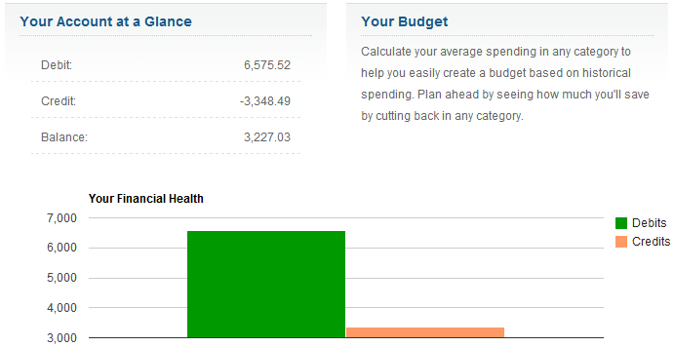
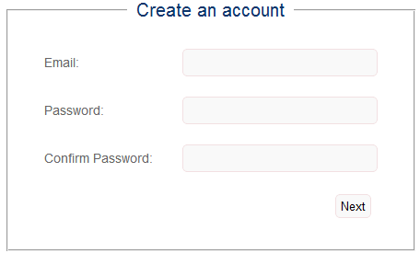
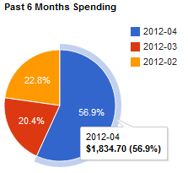
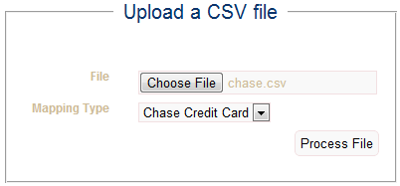
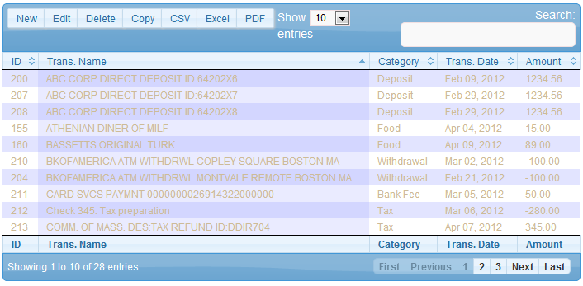
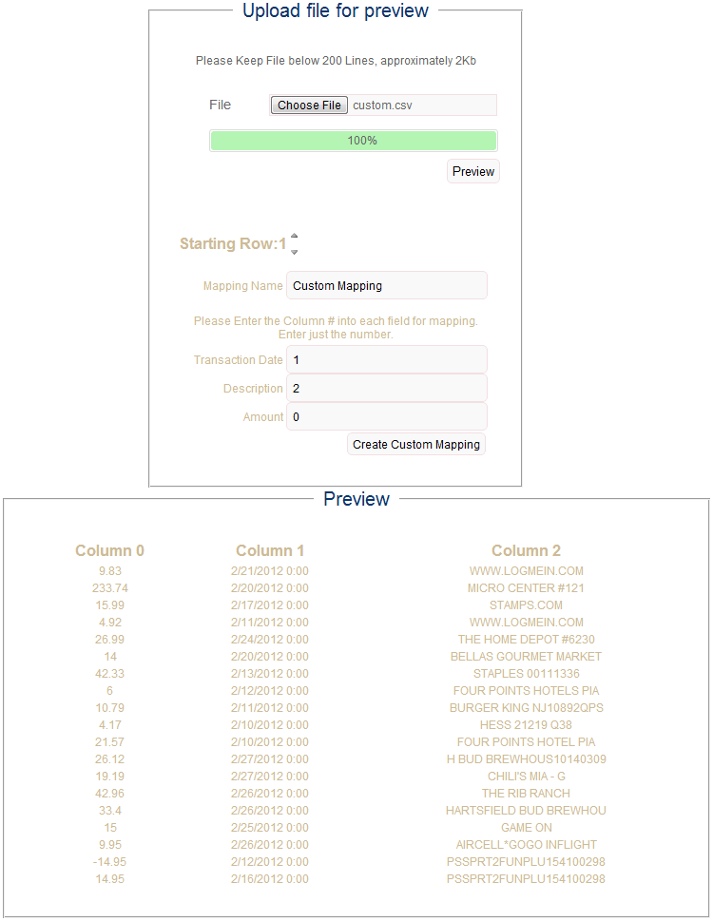
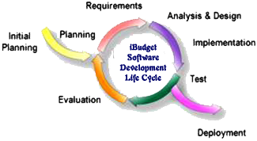
iBudget: A more private and secure way to manage your financial transactions.
A BU Software Engineering Class Group Project by Laurène Assayah, Vanya Dineva, Churk Y. Leung, Quan C. Pham, Jonathan Reimels and Vladimir Velev
♦ Abstract
♦ Dashboard View
♦ Registration & Chart Views
♦ Upload CSV from Major Banks
The iBudget project started out as a group project for a software engineering class. Our main goal in this project is to immediately apply what we learn about the various methods, techniques, design patterns throughout the software development life cycle in order to have a better understanding of the concepts covered in the course. iBudget is a web application that enables you to manage your financial expenses. You can personalize all your uploaded statements by putting them in any category you have created.
♦ Introduction
♦ Transaction View
♦ Create Custom CSV Mapping
At iBudget, we believe money is for living. So we make everything simple and streamlined. Sign up takes less than five minutes. Then iBudget automatically pulls all your financial information into one place, so you can finally get the entire picture. iBudget helps you reach your goals: set a budget and create a plan to reach your personal financial goals. You can track your progress online or stay up-to-date with monthly emails. And we'll help you achieve your goals faster with helpful free advice and next steps. iBudget values the privacy of its clients and ensures it is always secure. That's because we use 128-bit SSL encryption-the same security that banks use-and all data is protected and validated. Plus, since iBudget is read-only, no money can be moved in or out of any account.
♦ Software Development Life Cycle
♦ Acknowledgements
Thanks to all the developers behind Apache, MySQL, PHP, JQuery plus many of its useful plugins & members of the iTeam.
$ $ $ $ $ $ $ $ $ $ $ $ $ $ $ $ $ $ $ $ $ $ $ $ $ $ $ $ April 30th, 2012 $ $ $ $ $ $ $ $ $ $ $ $ $ $ $ $ $ $ $ $ $ $ $ $ $ $ $ $

