Slide 1



Slide 2
















Real
G_2
Fake
D_2
Over multiple epochs
Fake image pool
Randomly choose one and scale up
G_1
D_1
G_0
D_0

Slide 3








Scale 0
Scale 1
Scale 2
Simple Loss
Patch Loss
Scale 0
Scale 1
Scale 2
Simple Loss
Patch Loss

Slide 4
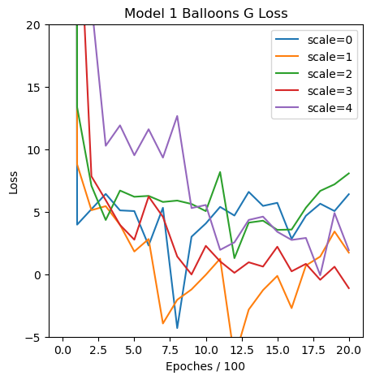
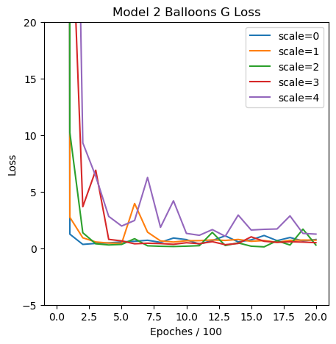
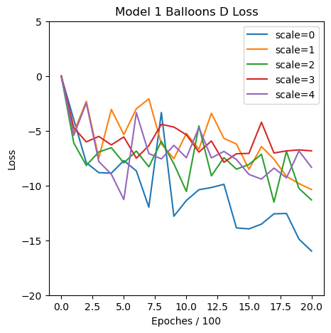
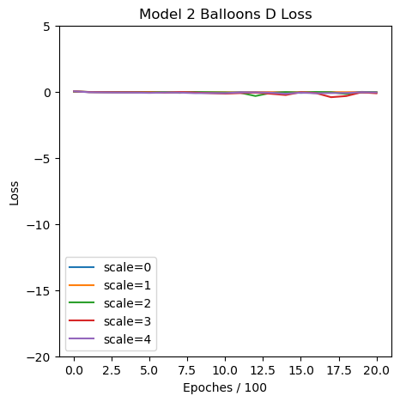

Slide 5
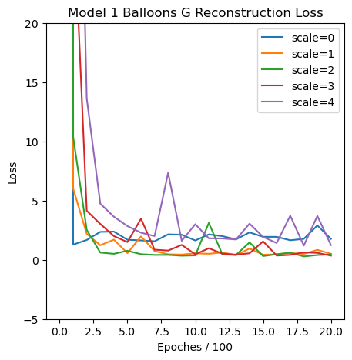
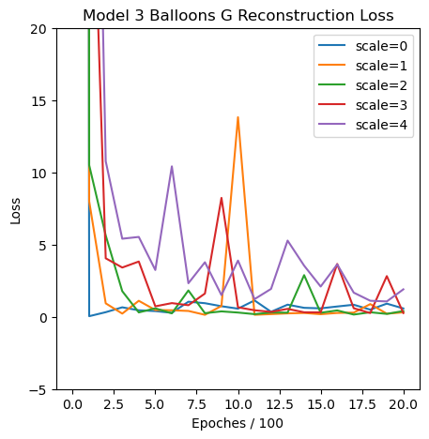
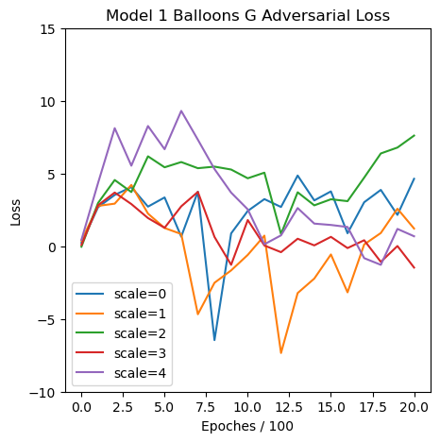
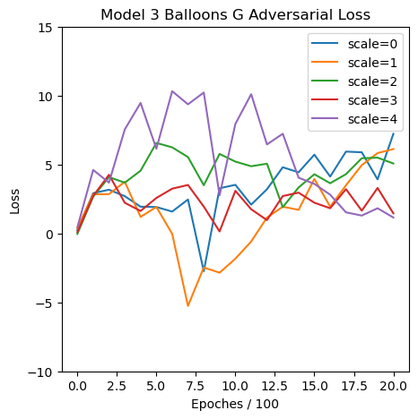

Slide 6


Scale 0
Scale 1
Scale 2

Slide 7
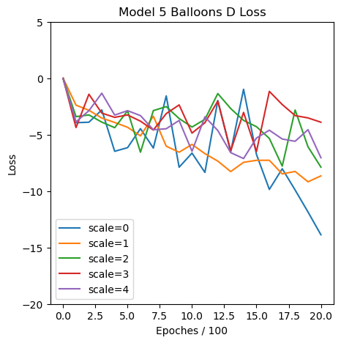
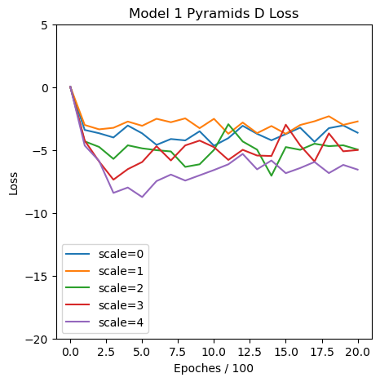
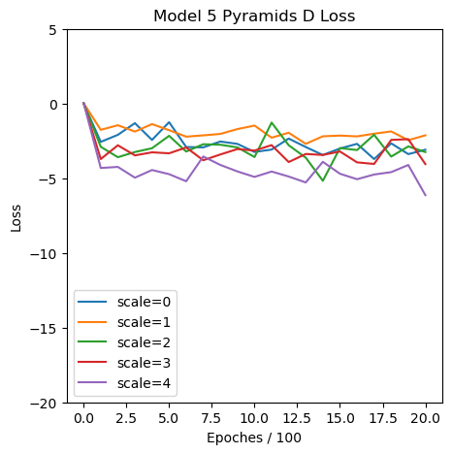

Slide 8










Scale 4
Model 1
Model 5

Slide 9




Scale 0
Scale 1
Scale 2
Model 1
Model 4

Slide 10





Slide 11
Model List: | Model 1 | Model 2
Loss: | Image Loss | Patch Loss
Changes: | Default | Default (Patch Size = 11)
Model 3 | Model 4 | Model 5
Image Loss | Image Loss | Image Loss
Number of Fixed Noises = 3 | Scale Factor = 0.35 | Alpha = 1.0

