Slide 1
MULTI-STREAM FACE DETECTION AND INTELLIGENT PERSON TRACKING PIPELINE
Group Members:
Shahzeb Amin
Hizb Ullah
1

Slide 2
1. Project Objective
• Detect faces from uploaded videos.
• Create a face embedding for every detected face.
• Compare the embedding with registered people in the database.
• Show the person's name when the similarity is at least 60%.
• If the face is not recognized, generate an Unknown / Alert event.
• Process multiple videos using a shared GPU pipeline.
2

Slide 3
• Video → NVDEC GPU decode
• SCRFD on TensorRT
• Face crop + IoU tracking
• W600K on TensorRT
• 512-D embedding
• Persistent gallery embeddings
• Cosine similarity on GPU
• 60% threshold → Known / Unknown alert
The core face-recognition flow
3

Slide 4
3. Registered Face Database (Gallery)
Registered People
SCRFD
Face Detection
Face Crop
112 × 112
W600K
512-D Embedding
• Images can be uploaded as individual files or a ZIP.
• Person name can come from a folder name or filename.
• Duplicate images are skipped.
• Embeddings are saved and reused for future videos.
Persistent Gallery Database
Name + embedding
4

Slide 5
4. Video Input and Face Detection
Uploaded
Videos
NVDEC
GPU Decode
SCRFD
TensorRT
Face
Crop
IoU
Tracking
• FFmpeg NVDEC is used for GPU video decoding.
• SCRFD detects faces using a TensorRT engine.
• The system keeps track of detected faces between detection rounds.
• Every output frame is written in order for file processing.
5

Slide 6
5. Face Embedding and Recognition
Detected Face
112 × 112
Face Crop
W600K
TensorRT
512-D
Embedding
• W600K converts each face crop into a 512-dimensional numerical vector.
• The video embedding is compared with registered embeddings.
• Embeddings are normalized before cosine similarity is calculated.
• The matching step can run as one GPU batch for faces from multiple streams.
6

Slide 7
6. Cosine Similarity and Alert
≥ 60%
Known Person
Video Face
Embedding
Cosine
Similarity
Compare with
Gallery
< 60%
Unknown
• Threshold in the notebook: 0.60 (60%).
• A score at or above 60% is treated as a known match.
• A lower score is treated as Unknown.
• Unknown tracks can create an alert after the configured number of unknown hits.
• The final video can show the identity and similarity score on the face box.
7

Slide 8
7. Multi-Video Processing — Important Notebook Addition
Video 1
Video 2
ONE Shared
GPU Worker
SCRFD + W600K
TensorRT Batches
Reader +
Frame Buffer
Video 3
Video 4
• The concurrent 4 streams.
• Each stream has a bounded frame buffer.
• Only one controlled GPU worker accesses TensorRT, trackers and writers.
8

Slide 9
8. GPU and CPU Responsibilities
NVIDIA GPU
CPU
• NVDEC video decoding
• SCRFD face detection
• W600K face embeddings
• Cosine similarity / gallery comparison
• TensorRT inference and batching
• Frame buffering and control
• Face crop and image operations
• Lightweight IoU tracking
• Drawing boxes and labels
• Video writing and final H.264 encoding when NVENC is not used
9

Slide 10
9. Performance Features
Frame Sampling
TensorRT Batching
Recognition Cache
Process up to the target FPS instead of running heavy AI work on every source frame.
Send multiple detection or recognition jobs in one inference call.
Reuse a recent identity for a tracked face until re-recognition is due.
IoU Tracking
Background Encoding
Bounded Buffers
Keep a stable track ID between detection rounds.
H.264 encoding can run in the background while GPU processing continues.
Limit queued frames so memory use stays controlled.
10

Slide 11
10. Complete System Flow
Registered
Face Images
SCRFD
Detection
W600K
Embedding
Gallery
Database
Video 1..N
NVDEC
GPU Decode
SCRFD
Face Detection
Face Crop +
Tracking
W600K
512-D
Cosine
Similarity
≥ 60% → Known
< 60% → Unknown / Alert
11

Slide 12
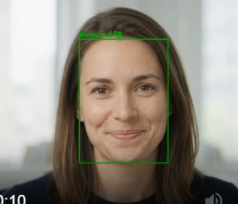
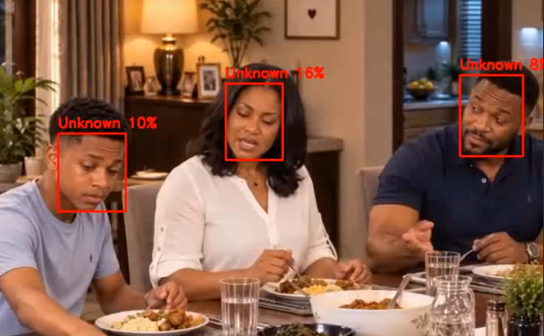
Unknown
known

Slide 13
11. Conclusion
• The notebook implements the flow with InsightFace SCRFD, W600K and TensorRT.
• The gallery stores reusable face embeddings for registered people.
• Cosine similarity is used to identify known and unknown faces.
• A 60% threshold is used for the current known/unknown decision.
• The notebook adds multi-video processing, tracking, batching and performance controls.
• The design is ready to be extended from uploaded videos toward multiple camera streams.
Final Flow: Multiple Videos → GPU Decode → SCRFD → W600K → Embedding Match → Known / Alert
12

