Slide 1
Fitness Application
Team: Casual

Slide 2
Project Description
Our project is a fitness application.
We provide a platform for workout coach who can post free workout videos. In addition, our users can access all the the video posted by the coaches. Here is the specific functions of our app.

Slide 3
Use-Case

Slide 4
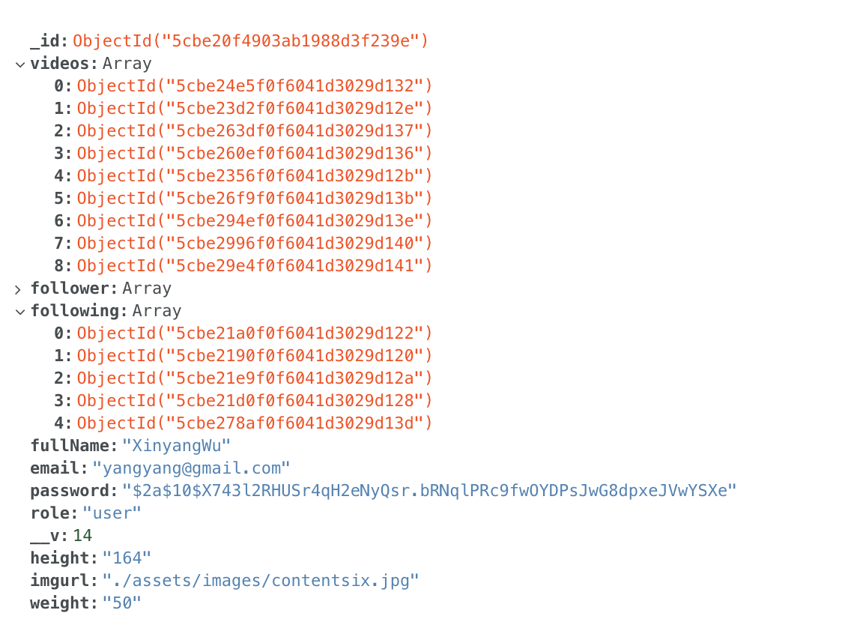
User/coach data structure

Slide 5
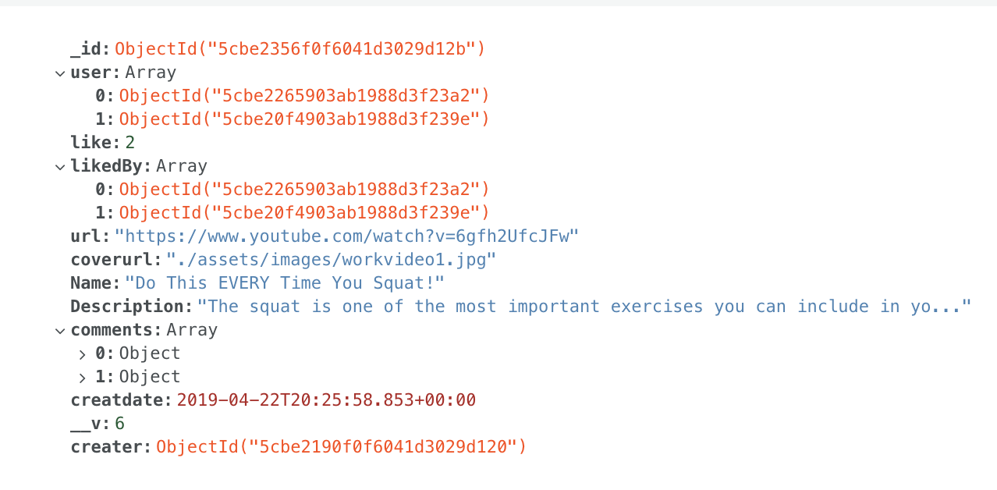
Video data structure

Slide 6
For users:
Register account
Sign up
View all videos
(Cancel)Following a coach
(Cancel)Like a video
(Cancel)Favorite a video
View followed coaches and their videos
Add comment to the video

Slide 7
For coaches:
Add videos
Delete videos
View my videos
View followers video and their videos
View all the comments and reply the comment.

