Slide 1

FeDQN: A Federated Learning Approach for Training Reinforcement Learning Agent of Atari Games
Hızır Can Bayram - 504201585
Abdullah Akgül - 504201504

Slide 2
Intro
Atari games have started to be popular across computer scientists
Controlled environment
Non-complex games, easy to benchmark accross different AI agents
Reinforcement learning is successful to train computer game agents in return for
Huge amount of game time to gain knowledge
Data variability in order to prevent an agent from a biased manner
Federated learning has various advantages such as
Data privacy
Decentralized learning
Data variability

Slide 3
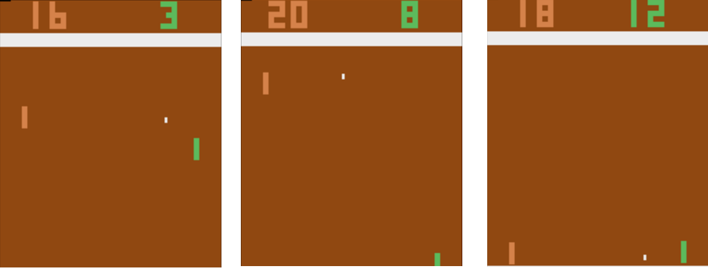
Pong: Atari Game
Table Tennis
2 players
Computer
Agent
6 Possible action
Noop, Fire, Left, Right, LeftFire, RightFire
Maximum score: 21

Slide 4
Methods: Preprocessing Steps
Gym provides 210×160×3 image
Convert to gray-scale
Resize
Crop

Slide 5
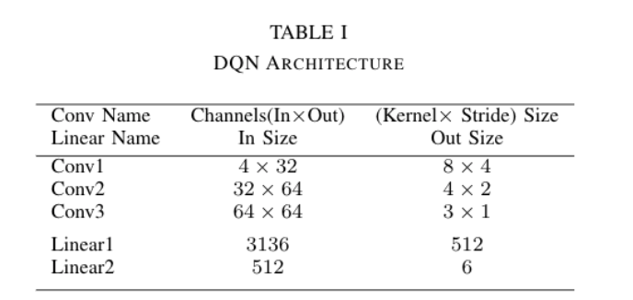
Methods: Deep Q Learning
Discrete action space
Q Learning
Q-table to Q Network

Slide 6


Slide 7


Slide 8
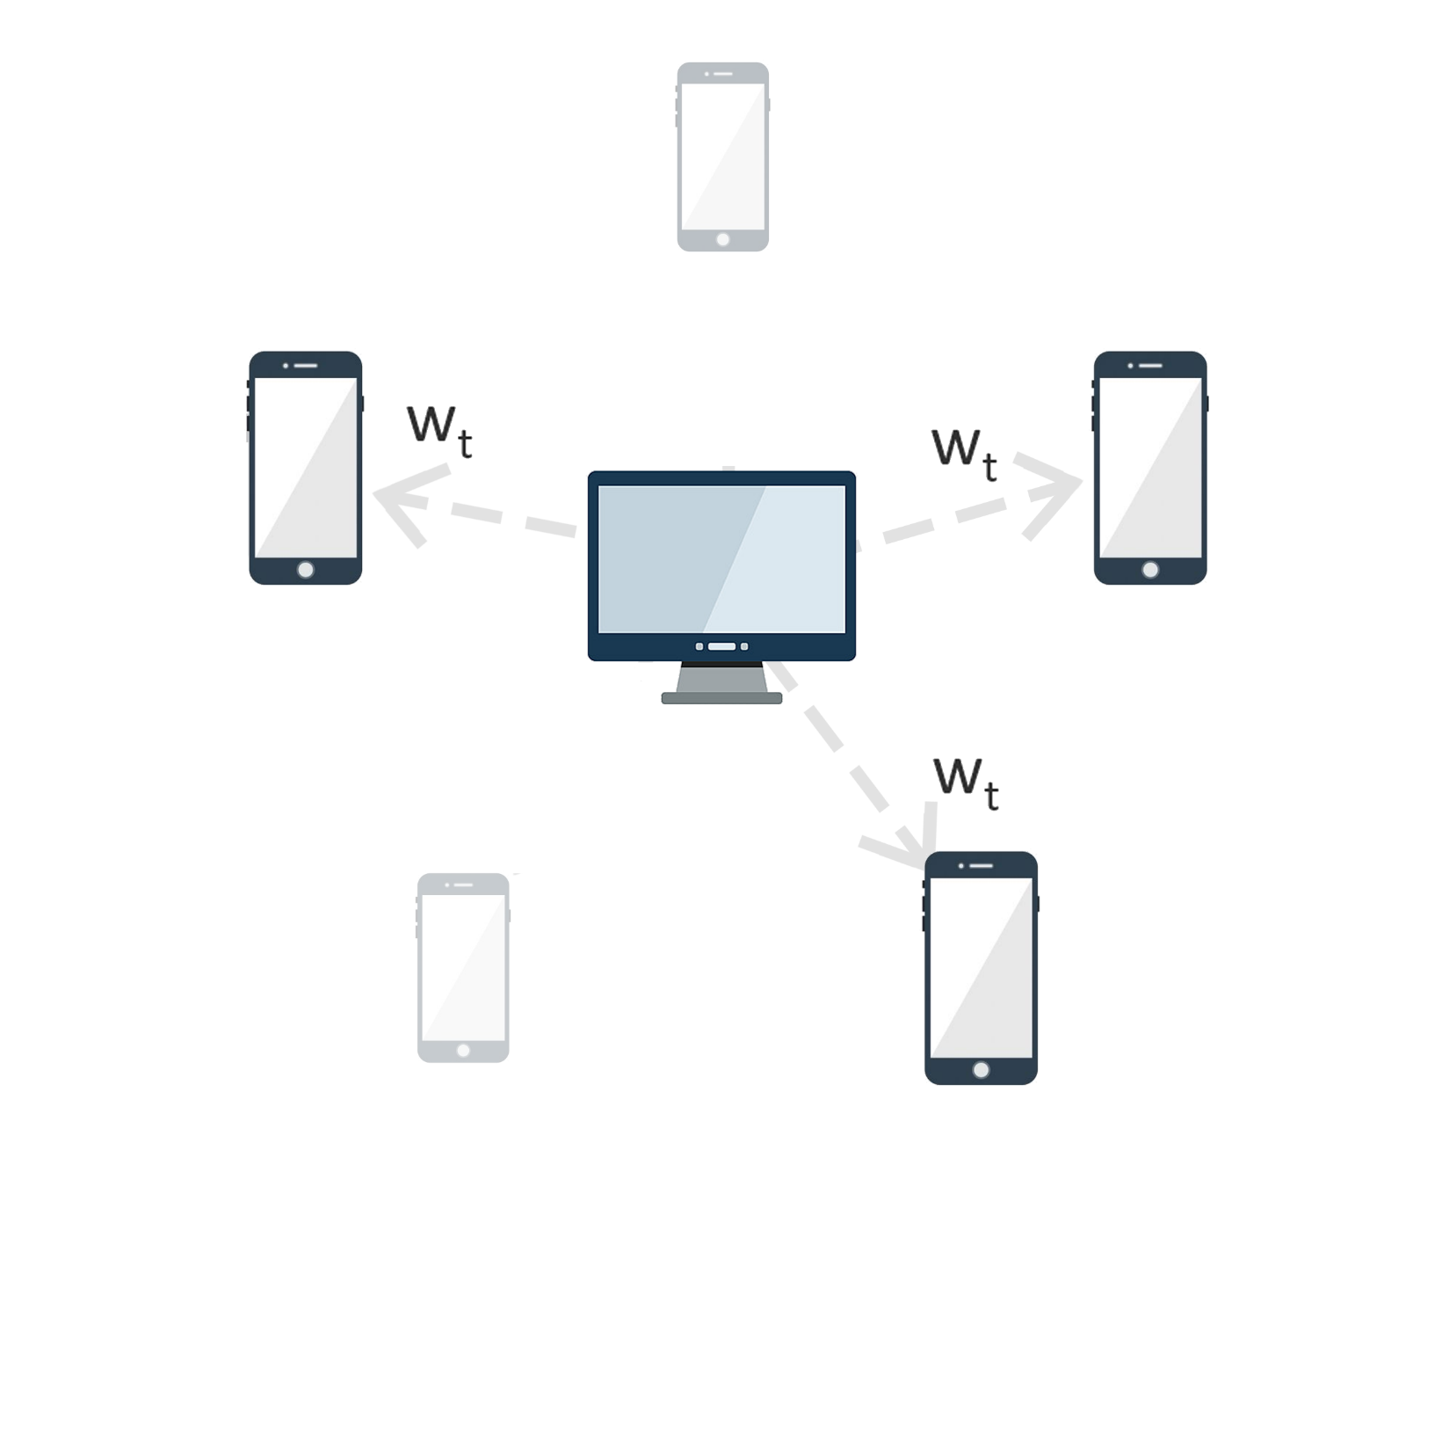
Notes:
8

Slide 9
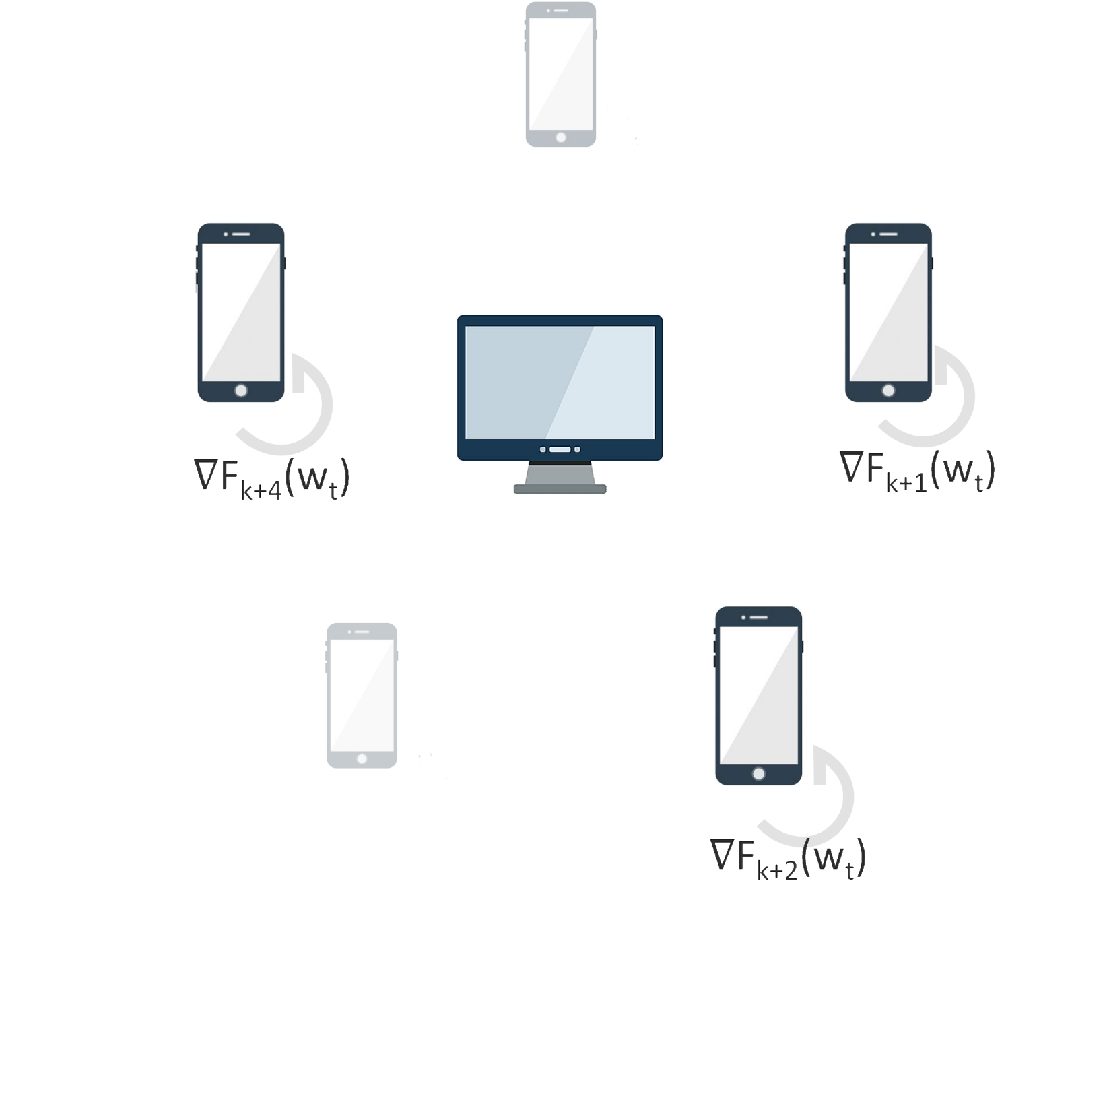
Notes:
9

Slide 10
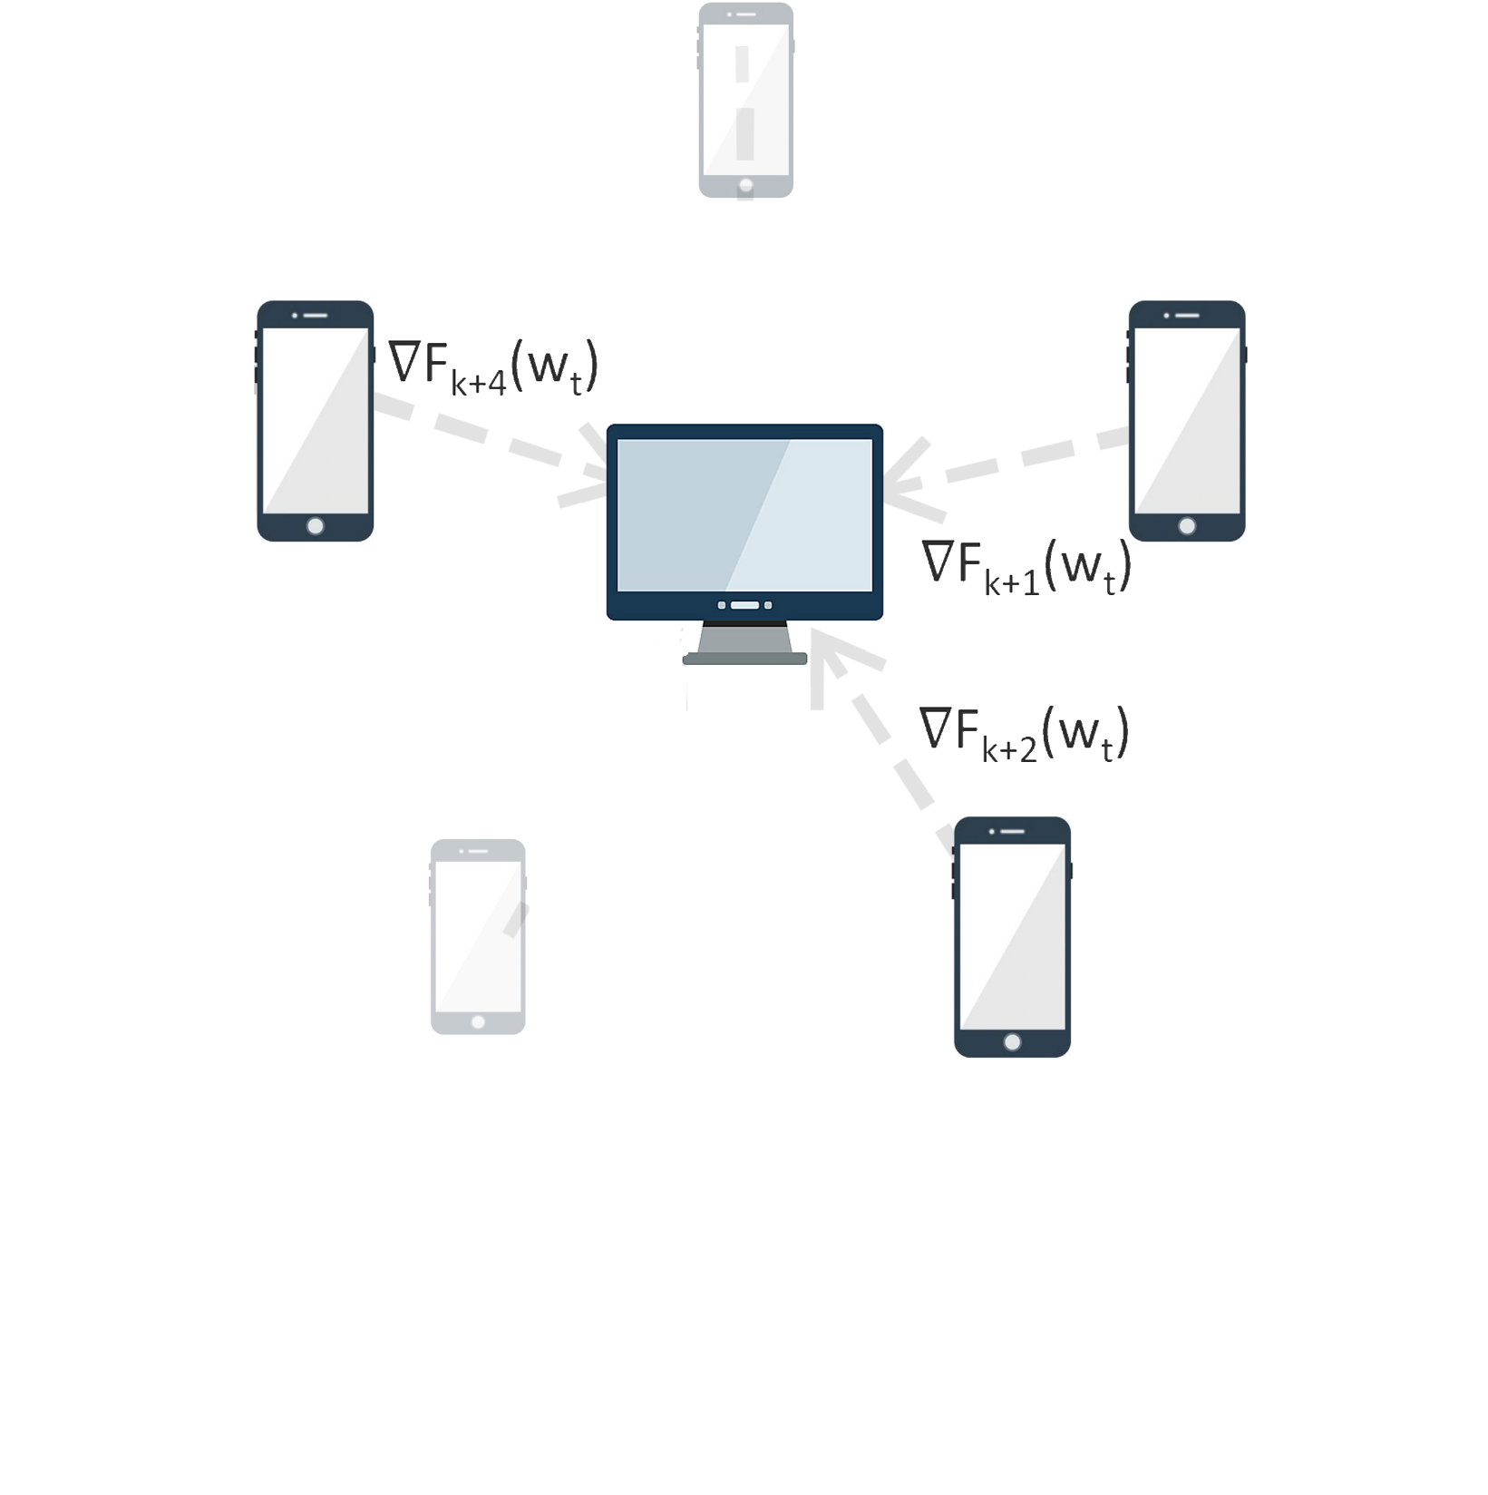
Notes:
10

Slide 11
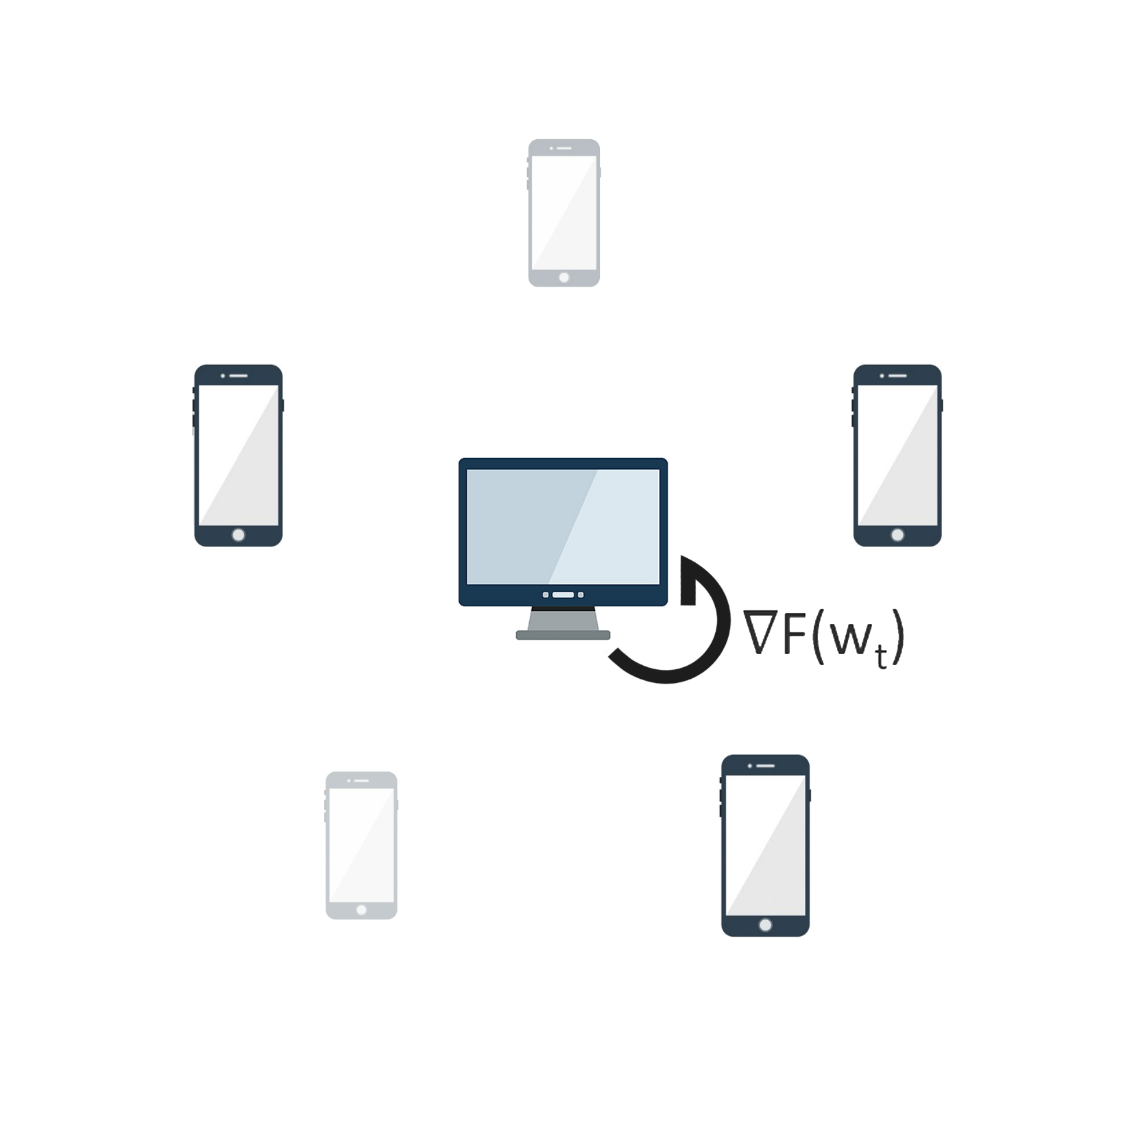
Notes:
11

Slide 12
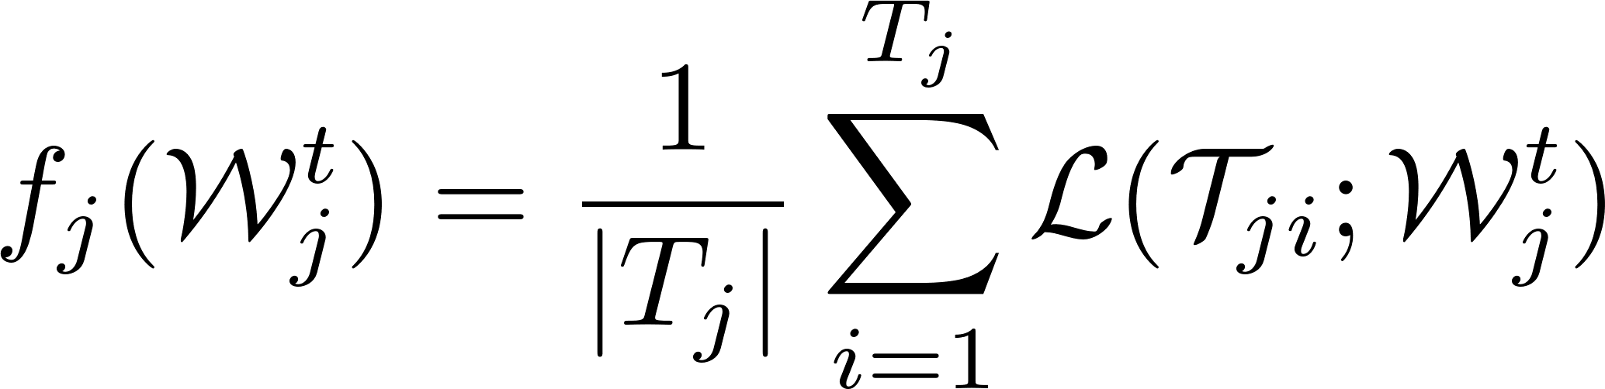
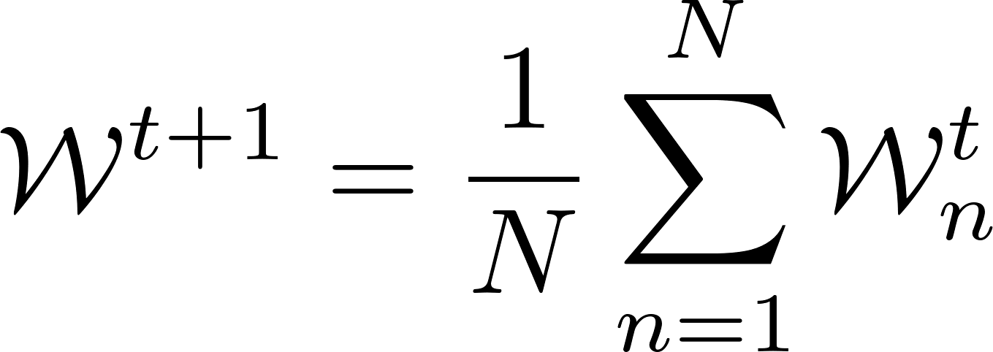
Methods: Federated Learning

Slide 13
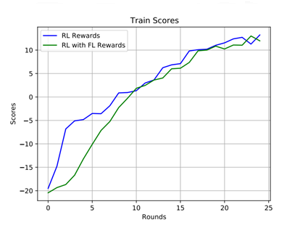
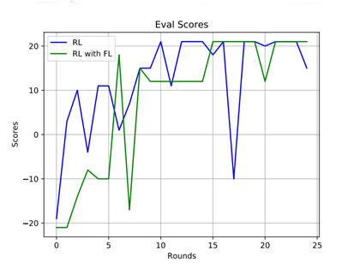
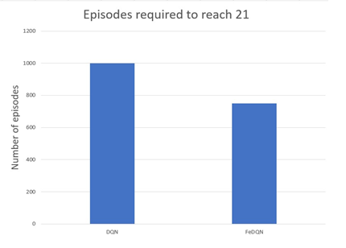
Experiments & Results

Slide 14


Demo
RL w/o FL RL w/ FL

Slide 15
Conclusions
We presented training an RL agent with federation pipeline.
We showed that clients can share their knowledge without actually sharing their datasets and environments.
FeDQN strategy outperformed DQN strategy in both;
being trained using less episodes
less training time

