Slide 1
COMP 4901F Data Visualization Lab 6 D3 Interaction
Yuanzhe Chen (Aaron)
Dept CSE, HKUST

Slide 2
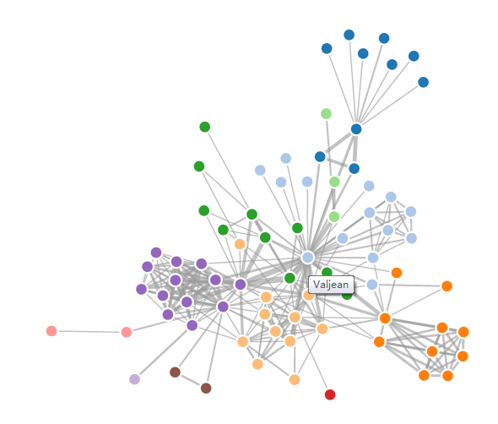
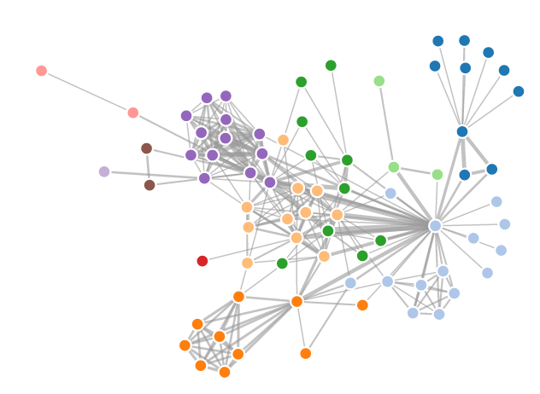
Interaction
Interaction allows users perform analysis with the visualization interactively.
Exp:

Slide 3
Interaction
selection.on ~listen to the mouse event
Possible mouse event:
– mousedown – mouseup – click – dblclick – mouseover – mouseout – mouseenter – mouseleave

Slide 4
Interaction
Exp:
1 2 3 4 5 6 7 8 9 10 11 12 13 14 15 16 17 18 19 20 21 22 23 | var svg = d3.select("body").append("svg"); var square = svg.append("rect") .attr("height", 100) .attr("width", 100) .attr("x", 10) .attr("y", 10) .attr("fill", "green") .on("mousedown", mouseDown) .on("mouseup", mouseUp) .on("click", mouseClick); function mouseDown() { console.log("mouseDown"); } function mouseUp() { console.log("mouseUp"); } function mouseClick() { console.log("mouseClick"); }

Slide 5
Notes
Define click & dblclick event on simple svg elements
Using title instead of mouseover event:
node.append("title").text(function(d) { return d.name; });
Using this
var squares.append('rect')
.attr('x', function (d) { return d.x })
.attr('y', function (d) { return d.y })
.attr('height', function (d) { return d.height })
.attr('width', function (d) { return d.width })
.on('mouseover',function() {
d3.select(this)
.transition()
.duration(500)
.attr('stroke-width',3)
})

Slide 6
Notes
setInterval() and clearInterval
setInterval(function() { svg.datum(randomize).call(chart.duration(1000)); }, 2000);
var refreshIntervalId = setInterval(fname, 10000); /* later */ clearInterval(refreshIntervalId);

Slide 7
Your task
1. Download the skeleton code (static box plots)
2. Add the following interactions:
-when mouse hovers over one box, highlighting the selected box.
(Hint: change the opacity of all other boxes.)
-when double clicking on one box, the clicked box will stop/start randomly changed.
(Hint: define the setInterval and clearInterval function inside the mouse event.)

