Slide 1
COMP 4901F Data Visualization Lab 4 D3 Basics
Yuanzhe Chen (Aaron)
Dept CSE, HKUST

Slide 2
D3
D3 is a JavaScript library for data visualization
Official website (D3js.org) includes:
-Tons of examples
-A comprehensive API reference
It is an “example-based” library

Slide 3
D3 Selection
var canvas = document.getElementById('canvas');
->
d3.select('canvas'); d3.selectAll('canvas');
svg.selectAll('circle');

Slide 4
D3 basic shape
var tempSVG = document.createElementNS(NS, 'rect'); tempSVG.setAttribute('x', startP.x); tempSVG.setAttribute('y', startP.y); tempSVG.setAttribute('width', width); tempSVG.setAttribute('height', height); tempSVG.style.fill = fill;
var rectangle = svgContainer.append("rect") .attr("x", 10) .attr("y", 10) .attr("width", 50) .attr("height", 100);

Slide 5
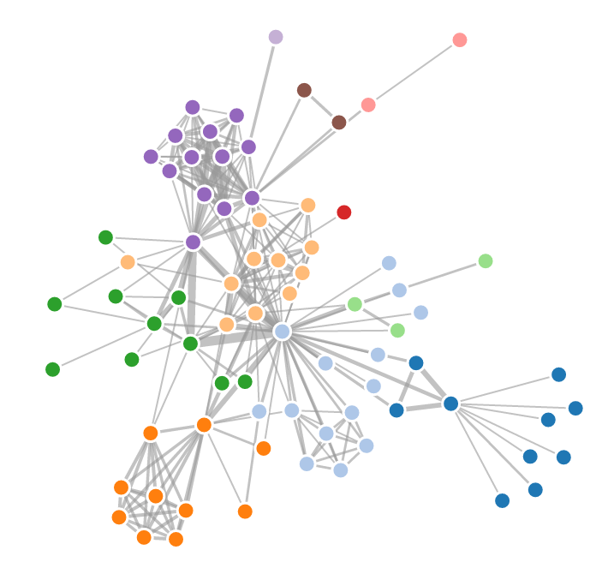
Force-directed Graph
There is a spring force between each pair of nodes.
The layout is determined by all the forces.
var force = d3.layout.force() .nodes(nodes) .links(links) .size([w, h]) .linkStrength(0.1) .friction(0.9) .linkDistance(20) .charge(-30) .gravity(0.1) .theta(0.8) .alpha(0.1) .start();

Slide 6
Using real data
Data can be stored in:
-database: Mysql, MongoDB
-local file: json, csv
You always need to build a server first!
To build a server:
-Python
-Javascript library: node.js, meteor.js...

Slide 7
Using real data
d3.json("miserables.json", function(error, graph){ //data = graph });
//graph is only locally valid in the function.

Slide 8
Note
Include the library:
<script src="http://d3js.org/d3.v3.min.js"></script>
2. D3 is based on basic javascript. You can still use svg and canvas mixed with D3.

Slide 9
Your task
1. Download the skeleton code
2. General task: finish the code to draw a force-directed graph
3. Play with different parameter settings. Check the function of each parameter.

