Slide 1
COMP 4901F Data Visualization Lab 3 Canvas
Yuanzhe Chen (Aaron)
Dept CSE, HKUST

Slide 2
Canvas
“canvas” is an HTML element used to draw graphics on web page.
Similar functionality with SVG
Canvas Vs SVG
Canvas is faster
SVG is more convenient for moving and deleting elements

Slide 3
Canvas example
<body>
<div id="svg" style="width:600px; height:400px">
<canvas id="canvas" width="600" height="400" style="position:absolute"></canvas>
</div>
<button type="button" onclick="display()">Display SVG</button>
</body>

Slide 4
Get the control point of canvas
var canvas = document.getElementById('canvas'); var ctx = canvas.getContext('2d');

Slide 5
Elements in canvas
ctx.fillStyle = "#FF0000"; ctx.fillRect(0,0,150,75);
Line
Circle
Text
Curve

Slide 6
Ctx.moveto()
ctx.moveTo(0,0); ctx.lineTo(200,100); ctx.stroke();

Slide 7
Ctx.moveto()
ctx.beginPath();
ctx.moveTo(0,0); ctx.lineTo(200,100);
ctx.lineTo(100,100);
ctx.arc(95,50,40,0,2*Math.PI); ctx.stroke();
//multiple paths are allowed

Slide 8
Note
1. console.log
2. The coordinate system is the same as the SVG coordinate system
3. ctx.clearRect(0, 0, canvas.width,canvas.height);

Slide 9
Your task
1. Download the skeleton code
2. General task: draw a simple line chart overlaid on the bar chart generated by SVG.
3. Finish the functions: drawBlue() and drawRed().

Slide 10
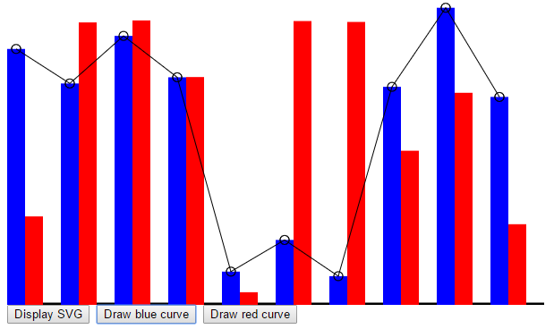
Your task

